Slide 1

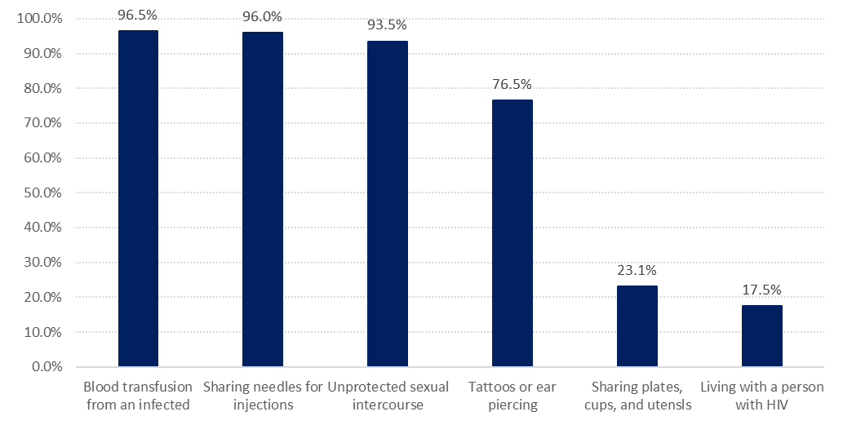
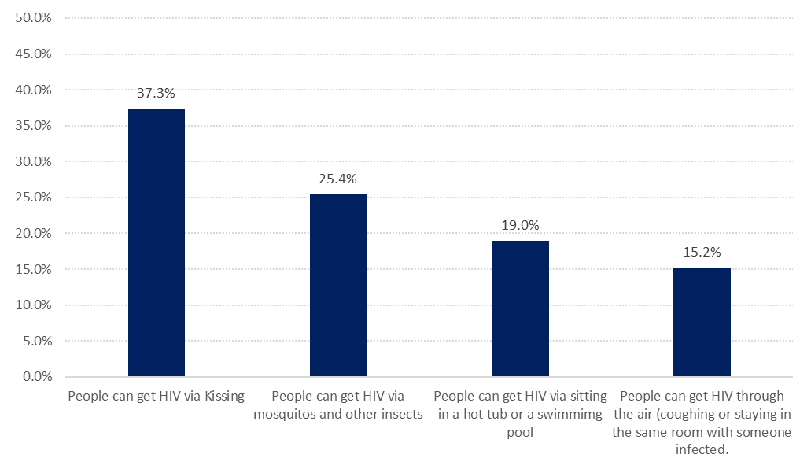
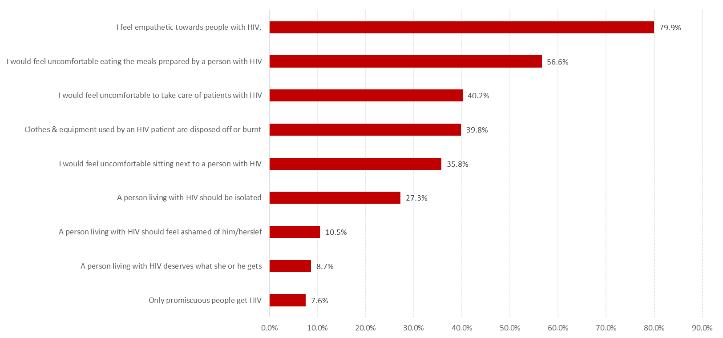
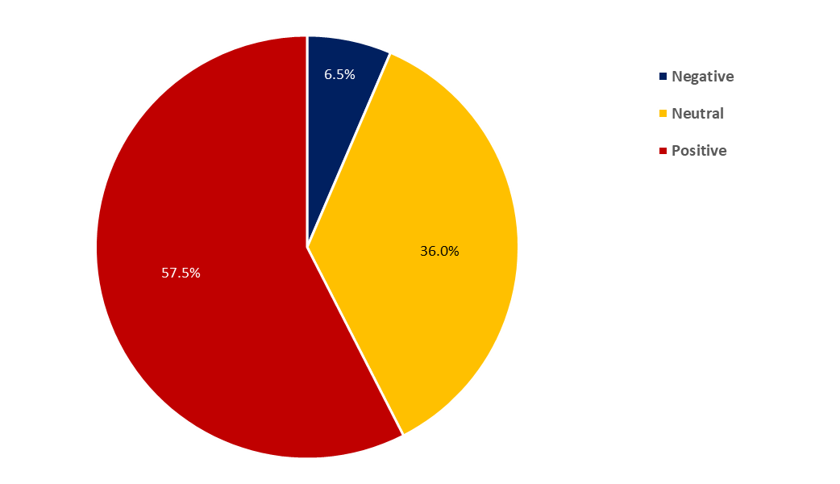

Knowledge, Attitude & Practice of Health Care Workers Toward HIV Patients at Primary Health Care Centers ( PHCCs)
Hasan M. Alzahrani, Rawan A. Hadi , Mona H. Alkhayri, Amal Y. Moshebah, Abdulaziz H. Alqarni, Fahad H. AlTameem, Faisal E. Al-Salateen, Abdulrahman A. Alqahtani, Ahmad A. Mahfouz
Background:
The human immunodeficiency virus (HIV) infects cells of the immune system, destroying or impairing their function. HIV can be transmitted through unprotected sexual intercourse, and oral sex; transfusion of contaminated blood; and contaminated needles, syringes, surgical equipment or other sharp instruments. It may also be transmitted between a mother and her infant. According to recent WHO statics, there were approximately 36.7 million people living with HIV at the end of 2016 (1).
A study performed in 2015 in Jeddah, Saudi Arabia, among illegal residents showed that more than 40% think that HIV positive people should be isolated but less than 20% would support a marriage with an HIV positive person.(2)Another study among paramedical students in Saudi Arabia showed lack of knowledge regarding HIV/AIDS transmission and means for prevention in addition to unfavorable attitudes towards HIV/AIDS individuals.(3)
It has been shown that health education has a positive impact on knowledge and attitudes of the students towards accepting discussion of AIDS topics with others, acceptance of home care for HIV infected family member and acceptance of HIV-infected individual's right at work.(4)Another study in 2012, among male dental students in King Khalid University, Saudi Arabia, revealed deficiencies with respect to knowledge and information received on HIV and AIDS related topics.(5).
Aims & Objectives:
Recent data regarding knowledge, attitude and practices of primary healthcare workers in Saudi Arabia in general and in the Aseer region in particular are scarce and even lacking.
The aim of the present work is to study knowledge, attitude and practices (KAP) of primary healthcare workers towards HIV in Abha and Khamis Mushait, of Aseer region, Saudi Arabia.
Methods:
The present work is a cross sectional study conducted in primary health care centers in Abha and Khamis Mushait cities of Aseer region, southwestern Saudi Arabia in 2017. All male and female health care workers(physicians, nurses, lab technicians and dentists) were invited to participate in the study. Administrative personnel not in direct contact with patients’ care were not included.
Data were collected through self-administered questionnaire. A validated structured questionnaire was used. The questionnaire covered the following four major areas; demographic data including age, sex, and nationality, professional data including type of profession, how long have they been working, have they provided care towards HIV patients. The questionnaire included 14 closed-ended question about knowledge of HIV infection and transmission. The questionnaire also attitudes regarding treating HIV patients, the right of health personnel to practice and willingness to treat.
Data were verified, coded and analyzed using the statistical package for social sciences (SPSS). Frequencies and percentages were used to present the results.
All the necessary official permission was fully obtained before data collection. Verbal consents were taken from the participants. Collected data were kept strictly confidential and used only for the research purposes.
Results:
  Description of the Study Sample
The present study included 372 health care workers (HCWs). Almost half of the study sample were from Abha city (199, 53.5%) and the rest were from Khamis Mushait city. The majority of HCWs were females (61.3%) and Saudis (85.5%). The highest frequent age group was 20-30 years (48.7%). Dentists represented 47.6% followed by physicians (25.5%) and nurses (21.0%). The highest frequent period of work was 5-10 years 22.8% of the HCWs mentioned that they provided care to HIV patients.
  Knowledge of the well known modes of HIV transmission
The HCW involved in our study although correctly mentioned all the highest well known modes of transmission but that comes in an incorrect order by choosing blood transfusion as the most frequent way of transmission, graph-1.
  Incorrect Knowledge of modes of HIV transmission
the HCW in our study had shown a poor knowledge about HIV transmission as some of them believe that just kissing or living with an infected person might put others in the risk of harboring HIV infection graph-2
  Attitudes towards HIV Patients
Compared to national and international data our study did show a negative attitude among HCW towards HIV patients, graph-3 & graph-4
  Preventive activities during the practice
Regarding preventive activities during the practice, one-third of HCWs (38.2%) mentioned that spills of blood or body fluids are decontaminated by 0.5% Na CL solution. Two-thirds mentioned that the work provides protective equipment for HCWs to prevent the spread of HIV and identified the use of liquid detergent and running for hand washing to prevent the spread of HIV (65.3%).
Conclusion / Recommendations
The knowledge about HIV/AIDS among this profession was good , but practice and attitude was poor. According to these findings, efficacious education programs should be prepared.
Acknowledgment :
To the Aseer General Health Directorate, KSA.
Conflict of interest
There was no conflict of interst.
References:
Affiliation of principal author:
Dr. Hasan M. Alzahrani
Consultant Emergency Physician. KKU-Abha
Graph (1): Methods of HIV transmission as recorded by HCW.
Graph (2): Believes regarding other methods of HIV transmission as recorded by HCW
Graph (3): Attitude of HCW towards HIV patients and their care givers.
Graph (4): Overall attitude of sampled HCW regarding HIV patients and their care giver.

