Slide 1


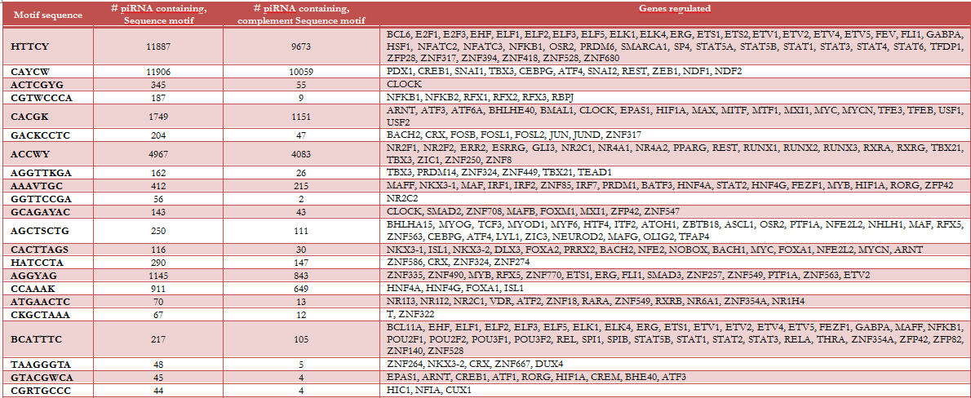
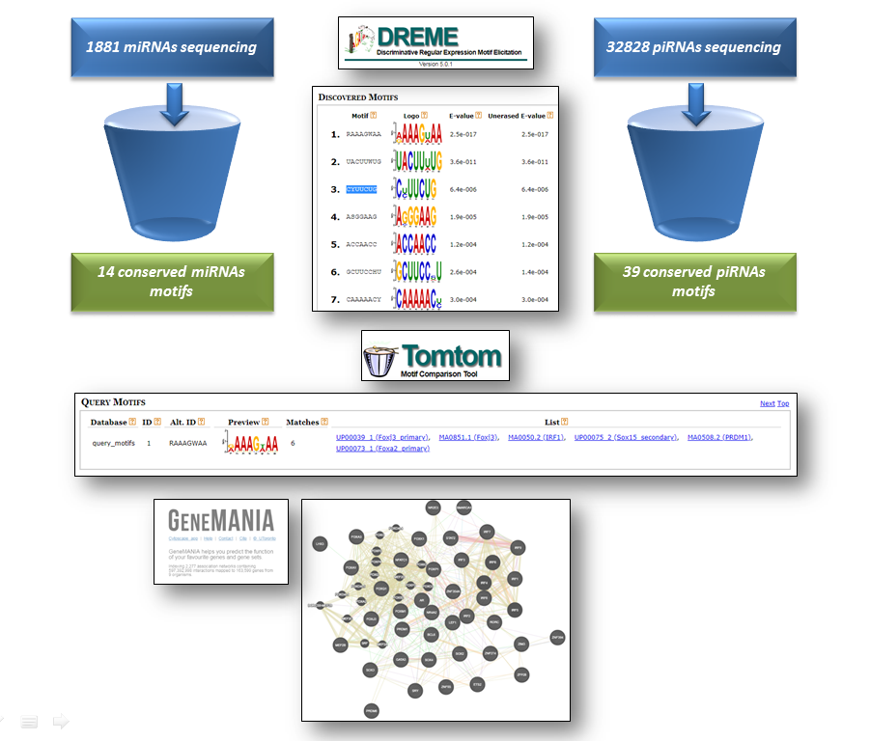
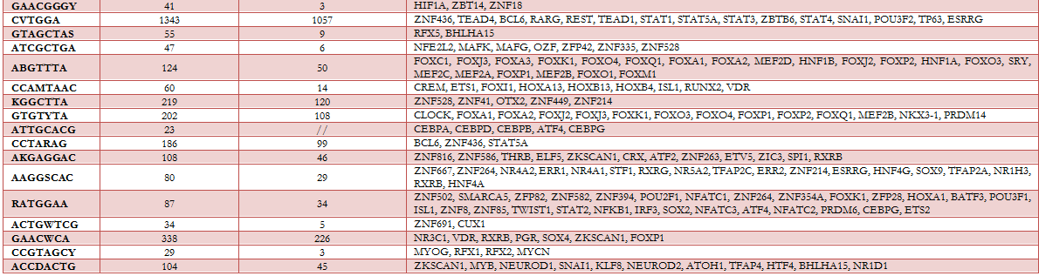
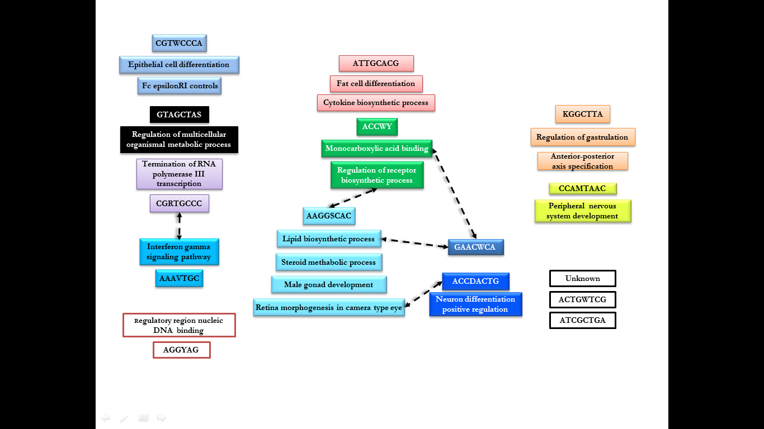
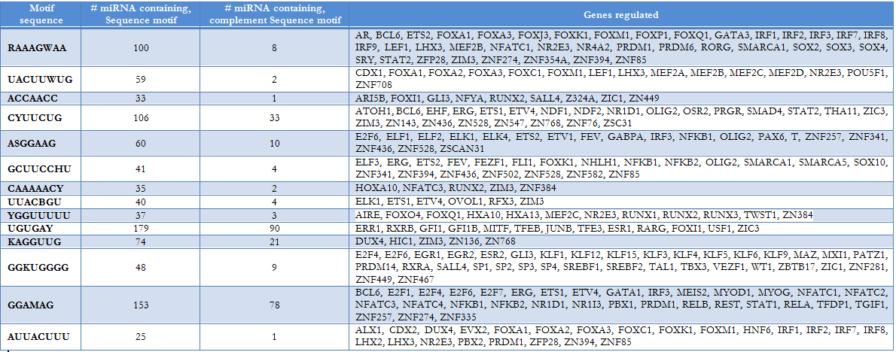
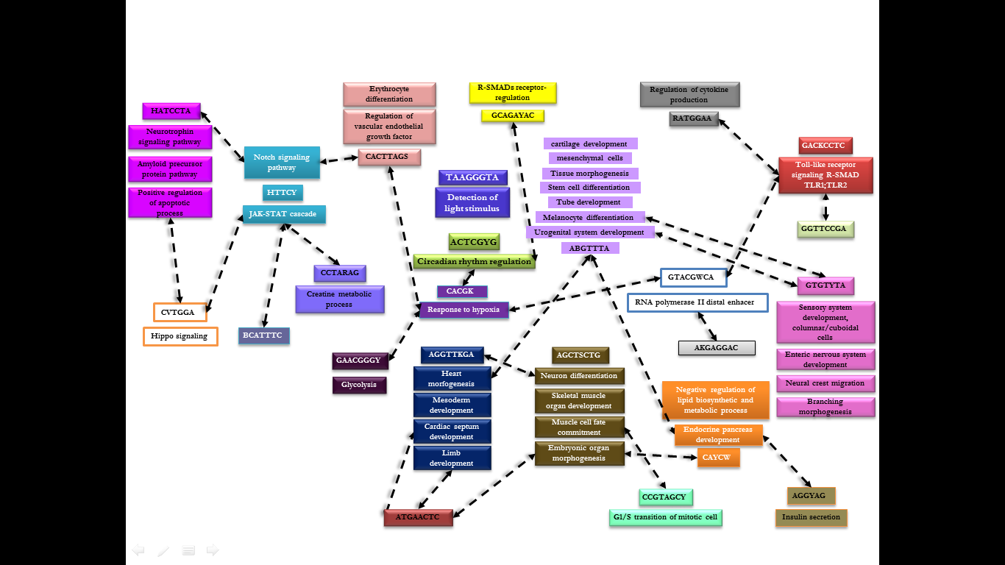
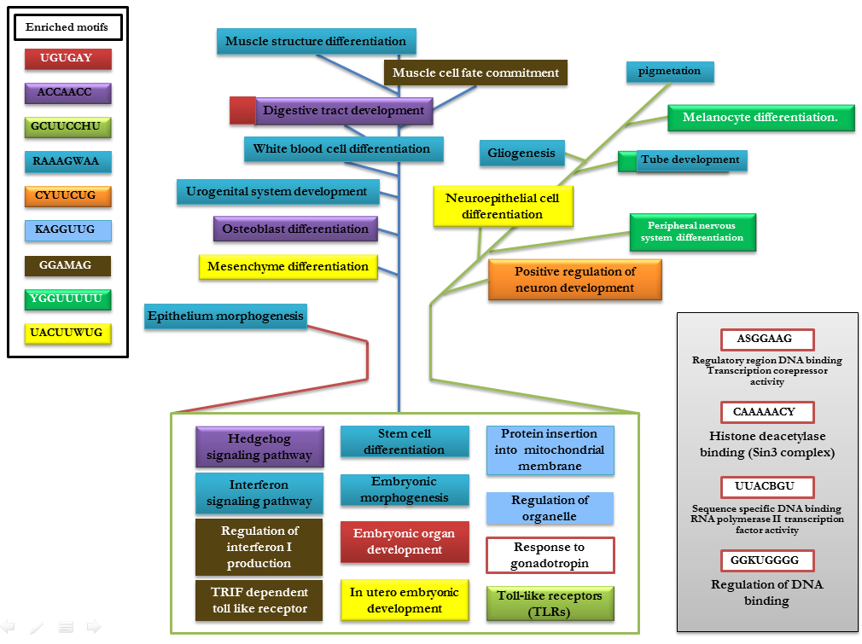
Spatial and temporal distribution of small no coding RNAs
(miRNAs and piRNAs) into the cell
Massimiliano Chetta, Laboratory of Human genetics, ospedale Antonio Cardarelli , Via Antonio Cardarelli, 9, 80131 Napoli NA,Italy
Alessandra Rosati, Department of Medicine, Surgery and Dentistry, University of Salerno, Via S. Allende, Baronissi (SA), Italy
ABSTRACT
In recent papers is clear the race to massive sequencing and how these new technologies are changing the vision of our understanding of the intricate cellular network. The growing use of high-throughput sequencing (HTS) methodologies, highlights the power of these new skills to characterize and photograph the intricate cell networks in specific cell life moment. We analyzed the distribution of complete subclasses of small no coding RNA into the cell (miRNA and piRNA) analyzing the occurrence of conserved motifs onto genome-scale regulatory networks. The analysis revealed a spatial and temporal distribution of miRNAs and piRNAs and the possible involvement in the regulation of specific events during development.
INTRODUCTION
The diffusion of new technologies of high throughput sequencing has resulted in a large amount of sequencing data set that gave us the opportunity to shine the spotlight on different aspects of the intricate cellular networks. The 90% of the genome is transcribed following distinct regulatory pathways, tissue-specific rhythms in specific time-points. The complex regulatory networks control is realized through different types of trans-regulators TFs (transcription factors), different classes of small noncoding RNAs and steps in their maturation. All these evidences have changed the view of cellular networks regulation. However, the advances in methods that analyze RNA populations allowed a quantitative, and rapid characterization of small RNAs in cells and/or tissues producing a picture under a precise condition. All these data are quickly stored in specialized databases that become a source of information, and by a simply changing of the initial question, it can provide surprising results. We performed an analysis of complete subset sequences of small non-coding RNA (miRNA and piRNA) stored in the main data base to identify occurrence of conserved motifs and possible interplay between transcription factors and small non-coding RNAs in genome-scale regulatory networks. In particular, we analyzed the entire subgroup of Homo sapiens mature miRNA (1881 mature miRNAs sequences from http://www.mirbase.org/ftp.shtml) and piRNA (32826 piRNAs sequences from http://regulatoryrna.org/database/piRNA/download.html).
MATERIALS AND METHODS
Table 2: Motifs conserved in piRNAs and the genes subject to possible regulation
Analysis pipeline was performed using different bioinformatics tools available on line and consists of three main steps as reported in the figure 1. In the first step were categorized all reliable conserved motifs using DREME (Discriminative Regular Expression Motif Elicitation available on http://meme-suite.org/tools/dreme). In the Second step all the motifs are ranked in the database producing an alignment for each significant match searching one or more query motifs against one or more databases of target motifs (Tomtom). The list of genes was loaded in GeneMANIA, another software tool to identify the most related correlation between query gene set using a guilt-by-association approach. The bioinformatics tool uses a large database of functional interaction networks from multiple organisms and each related gene is traceable to the source network used to make the prediction.
Fig.1
Fig.3
RESULTS
From the analysis it was possible to identify the presence of conserved motifs in 66.7% of mature miRNAs while they are identified in about 94% of the piRNAs. Furthermore in the same piRNA there are more than one conserved motif. The analysis was performed considering also the complementary sequences.
Table 1: Motifs conserved in miRNAs and the genes subject to possible regulation
Fig.2
Fig.3: Spatial and temporal distribution of piRNAs motifs in various tissue districts.
CONCLUSIONS
This exploratory study, that took into account the whole subclasses of miRNA and piRNA, allowed to highlight the possible presence of new functional relationships between genes and these two class of small no coding RNA corroborating, as expected, the redundancy of action by the spatiotemporal distribution of cellular stimuli. We observed that not only miRNAs and piRNAs from the same family are predicted to share targets, and it has been shown that the same subgroups have regulatory functions in different tissues. We also provide a brief discussion of the requirement to combine spatiotemporal gene expression information, and functional networks, such as development signaling into dynamic network models that describe gene expression tissue development, homeostasis, regulation, and dysfunction. Consequently, the functional information derived from these experiments is mostly of the subcellular location of proteins, and for participation in embryonic developmental pathways. A differential expression analysis of these motifs could be extremely useful as markers of specific tissue, organs or pathway dysfunction.
Fig.2: Spatial and temporal distribution of miRNAs motifs in various tissue districts
REFERENCES
Timothy L. Bailey, "DREME: Motif discovery in transcription factor ChIP-seq data", Bioinformatics, 27(12):1653-1659, 2011.
Shobhit Gupta, JA Stamatoyannopolous, Timothy Bailey and William Stafford Noble, "Quantifying similarity between motifs", Genome Biology, 8(2):R24, 2007.
Khan, A. et al. JASPAR 2018: update of the open-access database of transcription factor binding profiles and its web framework. Nucleic Acids Res. 2018; 46:D260–D266, doi: 10.1093/nar/gkx1126
Martinez NJ, Walhout AJ."The interplay between transcription factors and microRNAs in genome-scale regulatory networks." Bioessays. 2009 Apr;31(4):435-45. doi: 10.1002/bies.200800212. Review.

