Slide 1


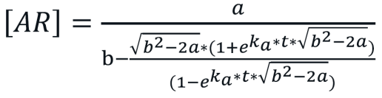
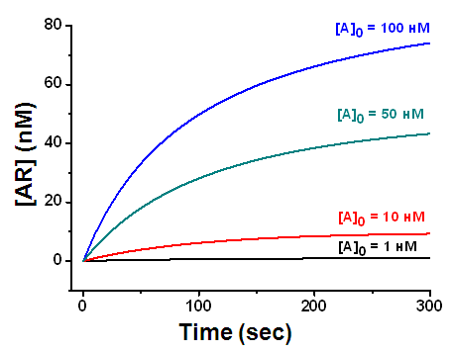
A quantitative description of the kinetic and concentration regularities of bioanalytical techniques
Sotnikov D.V., Zherdev A.V., Dzantiev B.B.
A.N. Bach Institute of Biochemistry, Research Center of Biotechnology of the Russian Academy of Sciences, Moscow, Russia
Introduction
Results & Discussion
Graphs
The high affinity and specificity of biological receptors create both the demand and the intensive development of analytical systems based on their use. Therefore, the development of theoretical concepts of such systems’ functioning, studies of quantitative regularities for the reactions occurring within them, and the interrelations between the parameters of bioreceptor reactions and analysis with their use, have become key fundamental tasks of bioanalytical chemistry. Although several proposed mathematical models have described various bioassays and biosensors, most of those models consider bioreceptor interactions in the approximation of equilibrium conditions. Due to this limitation, various effects that arise under nonequilibrium conditions remain outside existing studies.
An analytical solution of the differential equation of the complexation rate gives the function, which is presented in Figure a. The presented equation is suitable for describing the elementary stages of bioanalytical techniques. This equation provides both the kinetic dependence (if the interaction time (t) is the variable parameter) (Figure b.) and the calibration dependence (if the initial concentration of the analyte [A]0 varies). In a multistage analysis, an analytical description of the processes requires more parameters and additional simplifications for efficient operation. As a rule, when the kinetics of the formation of affine complexes are described, two main approximations are adopted: equilibrium conditions of interaction and the irreversibility of the binding reaction. For rapid bioassays in which reagents are incubated for several minutes, approximation of equilibrium conditions is very rough, although it is used in practice. When characterizing kinetic systems, the approximation of an irreversible reaction is better justified. We have shown that, within a high-affinity interaction (kd < 0.0001), the approximation of an irreversible binding is adequate for describing the analytical system (Figure c.).
a
b
Materials & Methods
c
Any bioanalytical technique is based on the affine recognition reaction (A + R ↔ AR), which obeys the laws of the reversible kinetics of a bimolecular reaction. The quantitative description of chemical transformations in assay systems not limited by diffusion is based on the main postulate of chemical kinetics: the law of mass action. For the analyte–receptor reaction in the simplest case of monovalent binding, the law of mass action provides the differential equation for the rates of change of the concentrations of reagents and the complex: [AR])/∂t=ka [A][R]-kd [AR], where ka and kd are the kinetic association constant and the kinetic dissociation constant of the analyte–receptor complex, respectively.
Conclusion
The proposed approaches will be useful for developers of bioanalytical methods as instruments for assessing the influence of various factors on the parameters of analysis and their targeted optimization.
a: The equation for calculating the concentration of an affine complex in bioanalytical systems: a = 2[A]0[R]0 and b = [A]0 + [R]0 + kd/ka. [A]0 and [R]0 are the initial concentrations of the analyte and the receptor,
b: kinetics of analyte-receptor interaction,
c: Kinetics of affine complex dissociation

