Slide 1

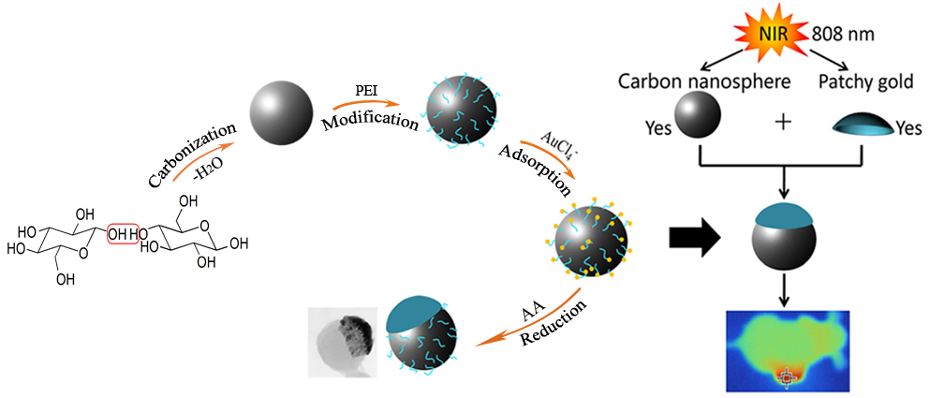
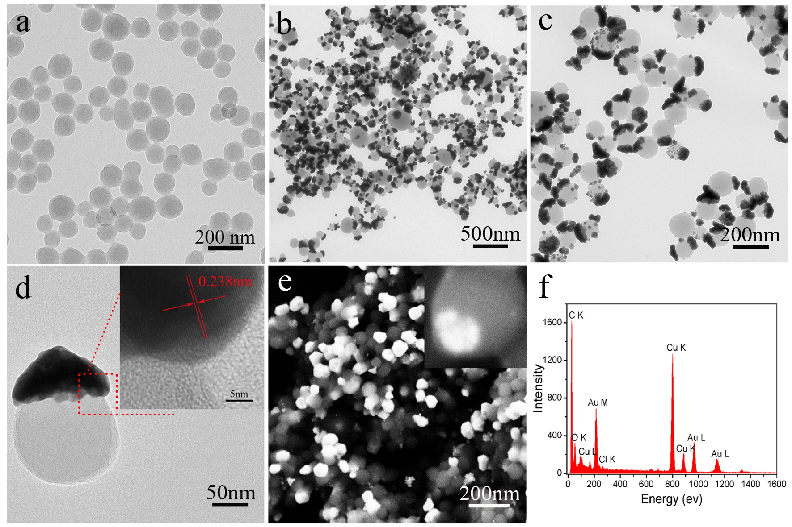
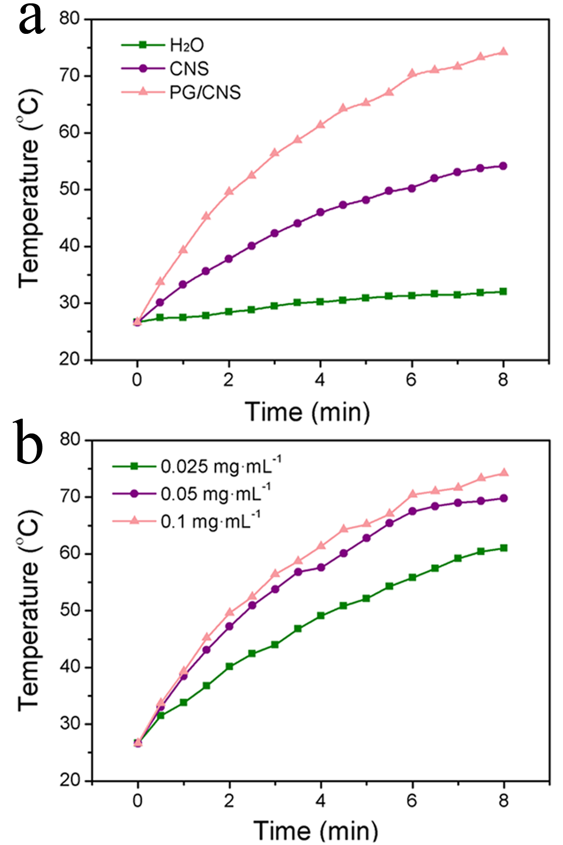
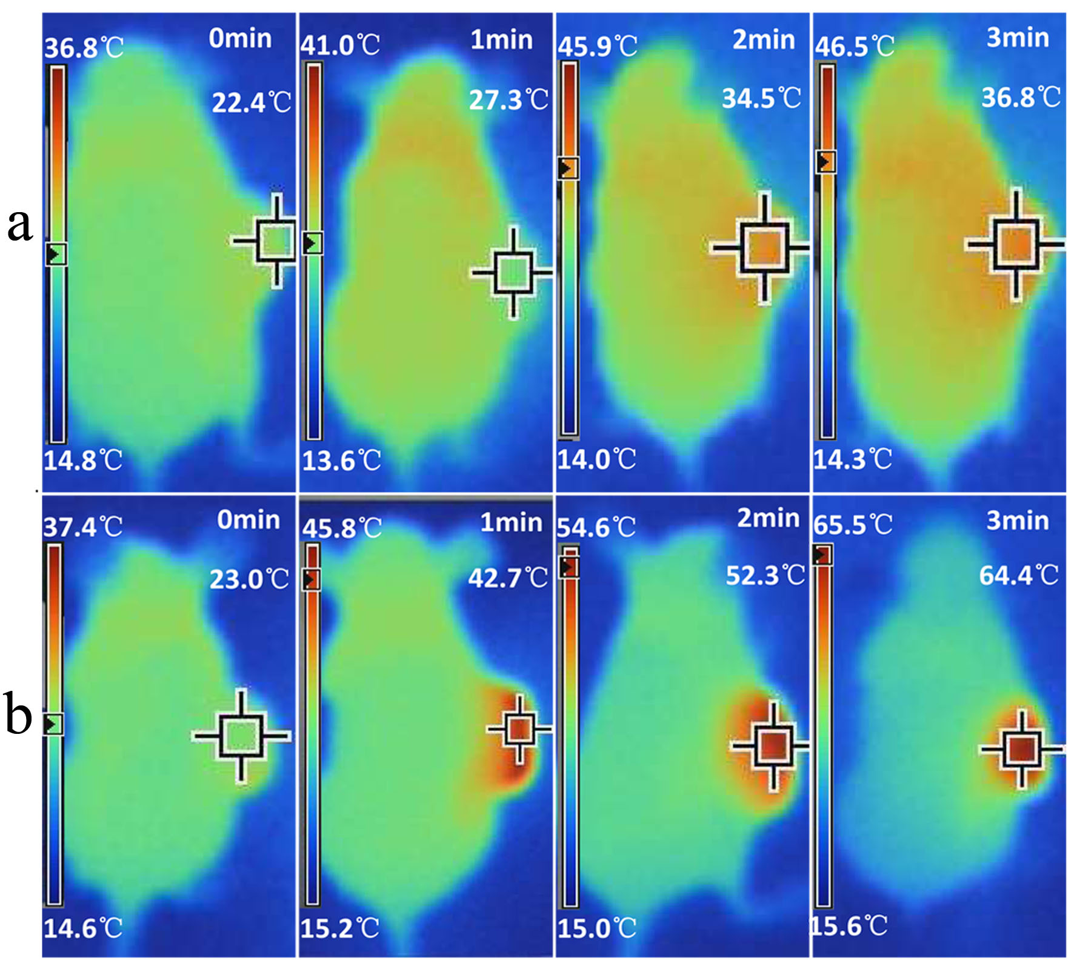
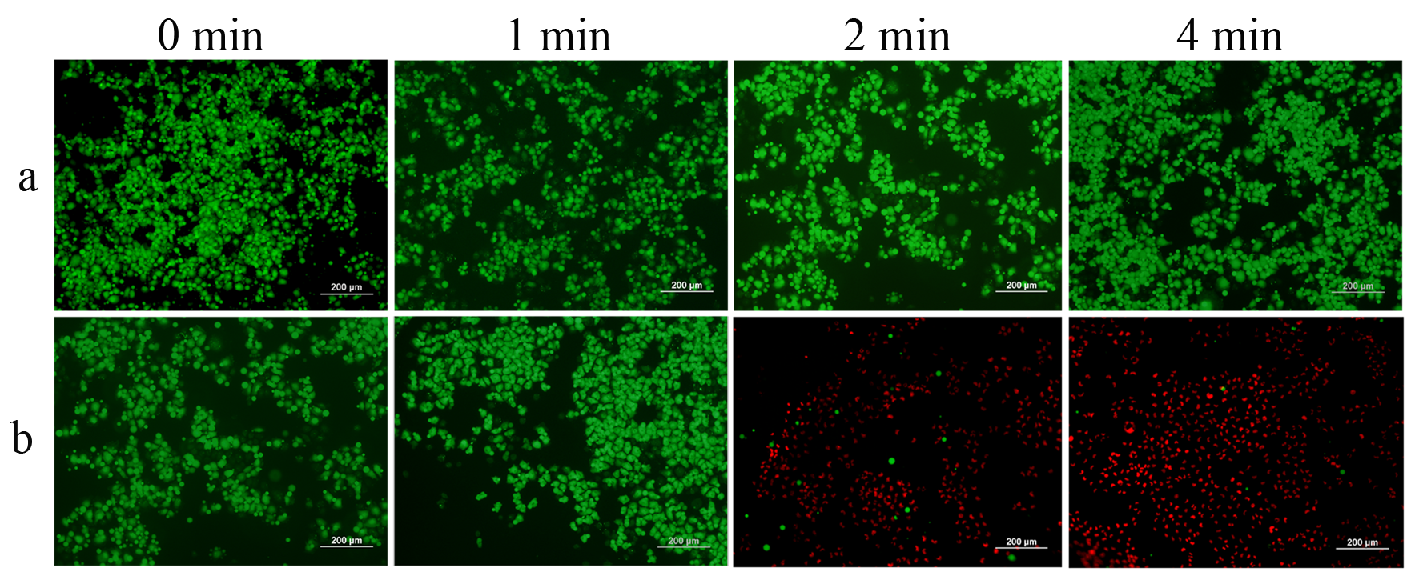
Coating Carbon Nanosphere with Patchy Gold for Production of Highly Efficient Photothermal Agent
Xiaoxiao Wang, Zhifei Wang*
School of Chemistry and Chemical Engineering, Southeast University, China, Email：zfwang@seu.edu.cn
（1）INTRODUCTION：
In this work, we design and construct a novel PTT agent by coating carbon nanosphere with patchy gold. The results show that the obtained nanocomposites not only have higher photothermal conversion efficiency but also perform more thermally stable. On the basis of these outstanding photothermal effects, the in vitro and in vivo photothermal performances in a MCF-7 cells and mice were investigated separately.
（2）RESULTS AND DISCUSSION：
Figure 2. Temperature elevation of the various samples as a function of irradiation time
Figure 1. TEM images of CNS (a) and patchy gold-on CNS (PG/CNS) (b, c); HR-TEM image of PG/CNS (d); SEM image of PG/CNS (e); EDX pattern of PG/CNS deposited on a carbon–coated copper grid (f).
Figure 3. Fluorescence images of calcein-AM/propidium iodide co-stained MCF-7 cells after the same PTT treatment: (a) Negative control; (b) incubation with PG/CNSs-PEG for 24 h.
Figure 4. Photothermal images of tumor site in Laser group (injected with saline) and Laser + PG/CNSs-PEG group (injected with PG/CNSs-PEG) during 3 min irradiation of 2.5 W/ cm² NIR.
Acknowledgements: This study was financially supported by the State key Basic Research Program of the PRC (2014CB744501) and the NSF of China (81771976).

