Slide 1



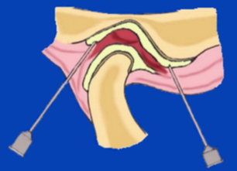
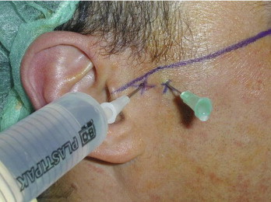
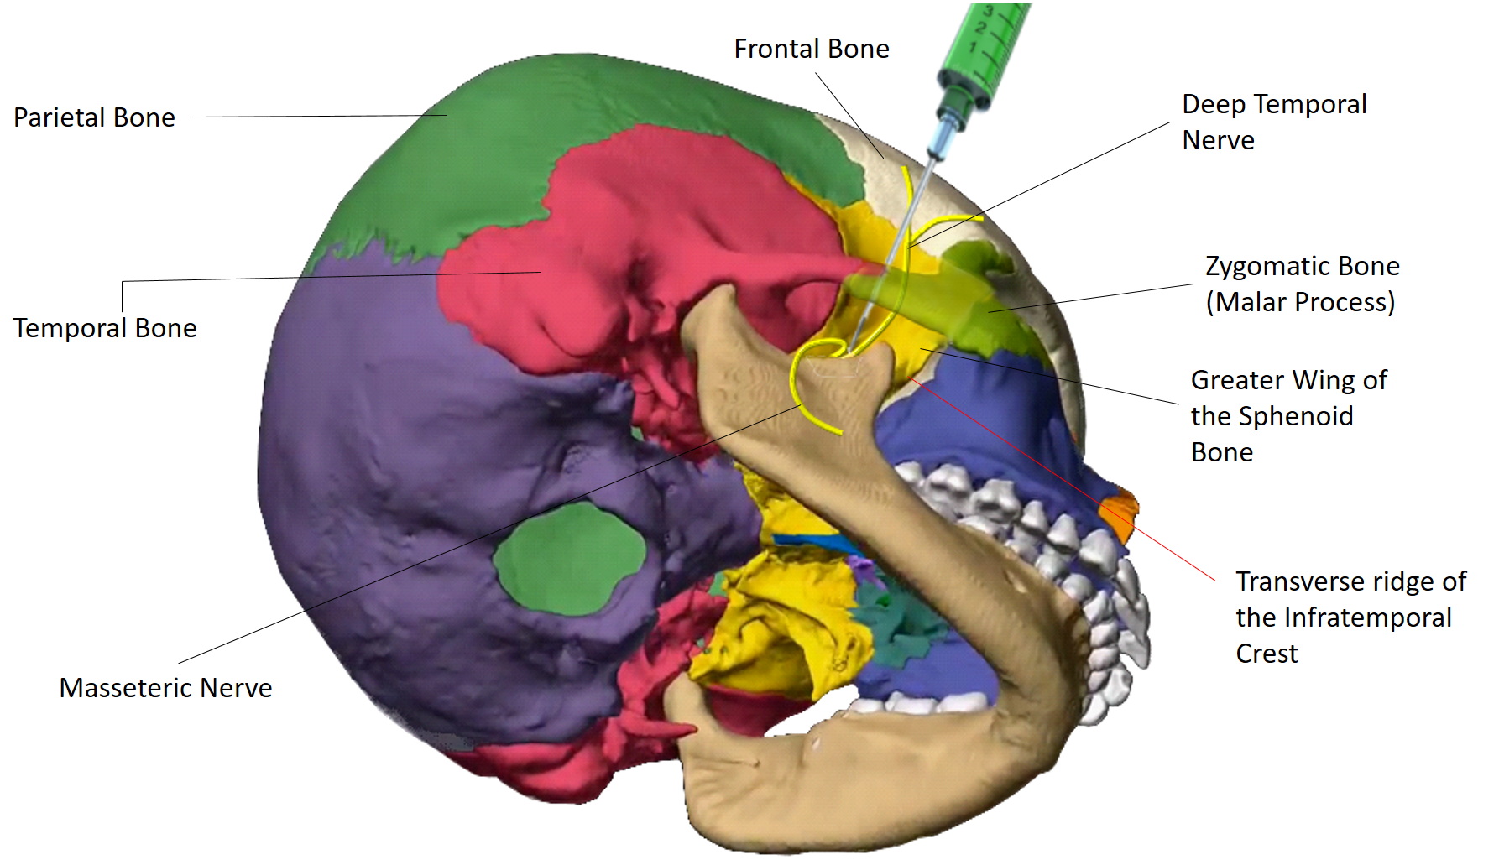
Case report: Efficacy Of Twin Block Injection Technique In
Management Of TMJ Arthralgia
Hafsa Affendi, BDS* and Samuel Y. P. Quek, DMD, MPH^
*Resident, Center for Temporomandibular Disorders and Orofacial Pain, ^ Faculty, Department of Diagnostic Sciences
Rutgers School of Dental Medicine, Newark NJ
Introduction
Examination
Treatment
A 35 y.o female with a c/c of pain on the right side of face reports to the OFP clinic, Unit-1 for further evaluation following Arthrocentesis of the right TMJ
Reports that the pain began 7 months ago and progressed in frequency and intensity
Reports feeling popping of the right joint on opening the jaw
Reports that Arthrocentesis of the right TMJ helped for 5 weeks after which the pain returned with similar frequency and intensity
A subjective scale of '0 to 3' was used to assess the pain intensity:
0=No pain, 1= Mild pain, 2=Moderate pain, 3=Severe pain.
Findings
Pain on TMJ palpation:
Right TMJ Capsule: 2++/3
Right TMJ Posterior Ligament: 2++/3
Right Deep Masseter: 2/3
AROM: 41 mm
PROM: 45 mm
Subluxation of the TMJ was noticed
Twin block injection was administered on the right side
This extra oral injection blocks both the masseteric and deep temporal nerves, to manage the muscle pain
After the Twin Block the patient surprised us, reporting that the pain or discomfort in the joint had improved
VAS: 1/10
Discussion
TMJ Arthralgia
In a previous case series sustained efficacy of the twin block has been demonstrated in the management of Chronic masticatory myofascial pain
However, this case report suggests that the twin block may also have a role in the management of some arthrogenous TMJ pain
It is hypothesized that by blocking both the sensory and motor fibers to the masseter and temporalis muscles with the Twin Block, pain sensation and muscle function is reduced increasing the relaxation of the jaw
TMJ Arthralgia is a term used to describe pain in the TMJ
Pain around the TMJ may sometimes be perceived as 'Ear ache'
The pain is reproduced by palpation of the TMJ capsule and Posterior ligaments
Often results in discomfort during opening, closing, protrusion and masticatory movements of the jaw
May result in reduced mouth opening due to conscious 'Muscle guarding' of the affected joint
The pictures above depict Arthrocentesis of the TMJ
Objective Findings
Conclusions
Onset: 7 months ago
Location: Right TMJ
Duration: Constant
Frequency: increases with jaw movement
Intensity: VAS 9/10
Quality: sharp, aching
Aggravating factors: chewing, applying pressure on the joint
Alleviating factors: NSAIDs alleviate symptoms mildly
This case report suggests that Twin block may be an effective adjunctive modality for the management of TMJ arthralgia as well
Future studies determining the 'true mechanism of action' of Twin block in management of TMJ Arthralgia will have to be performed
Arthrocentesis
References
TMJ arthrocentesis represents a form of minimally invasive surgical treatment for TMJ disorders
It consists of washing the joint with a sterile fluid and a possibility of depositing a drug or other therapeutic substance
Resolution of symptoms is due to the removal of chemical inflammatory mediators and changes in intra-articular pressure
It is not unusual for the patient to have moderate to severe pain for a few days following the procedure
Florencio Monje-Cil, Dorrit Nitzan and Raul Gonzalez-Garcia. Temporomandibular joint arthrocentesis. Med Oral Patol Oral Cir Buccal. 2012 Jul; 17(4): e575-e581.
Veena Kanti, Sowmya Ananthan, Gayathri Subramanian, Samuel Y.P. Quek. Efficacy of the twin block, a peripheral nerve block for the management of chronic masticatory myofascial pain: A case series. Quintessence Int2017;48:829-833;doi: 10.3290/j.qi.a39094
Twin block injection technique
Assessment
TMJ Arthralgia
Myalgia of the right deep masseter muscle
Hypermobility and Subluxation

