Slide 1

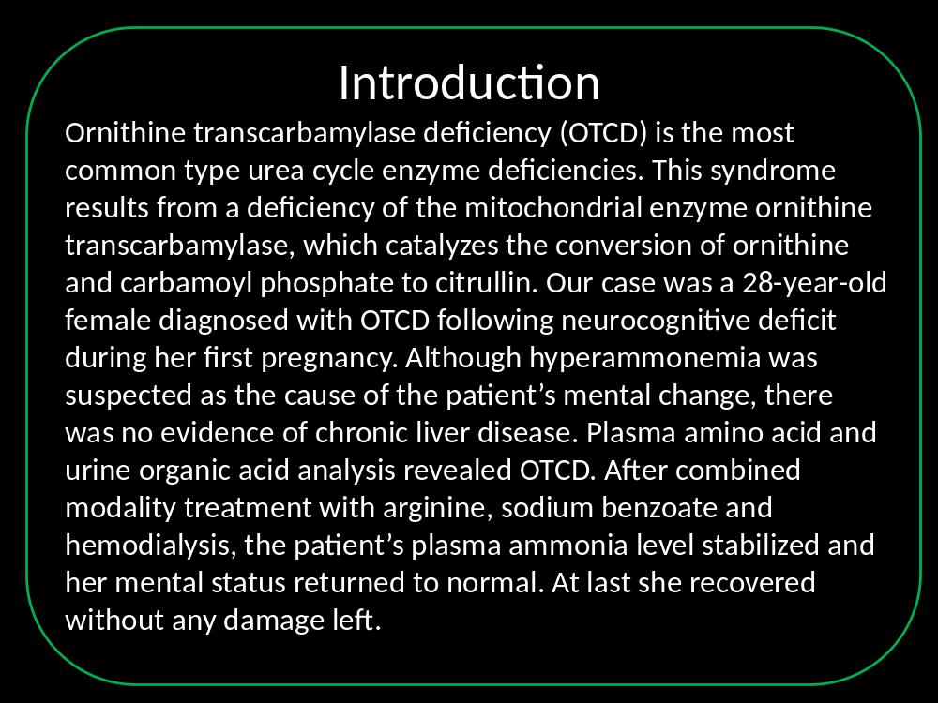
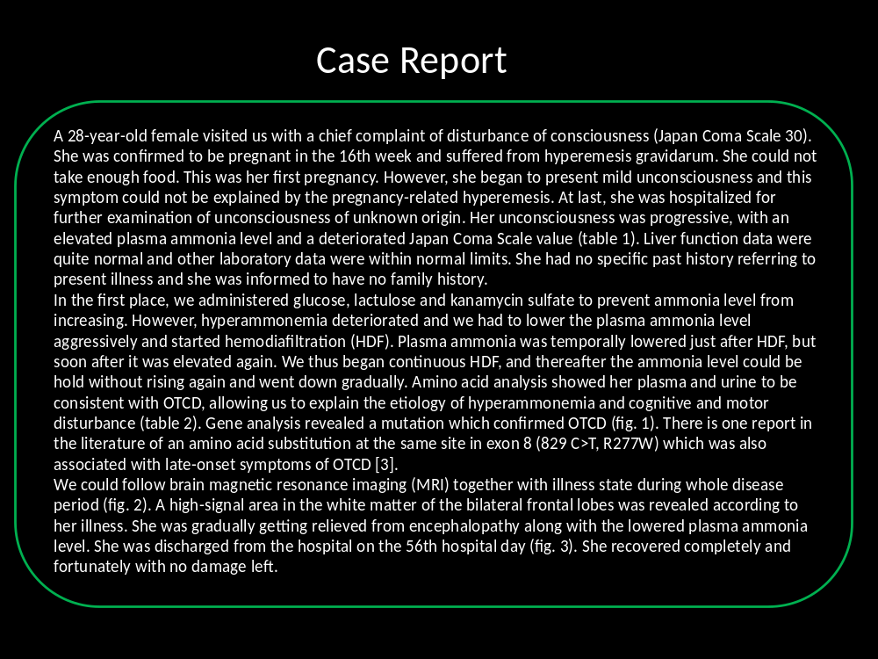
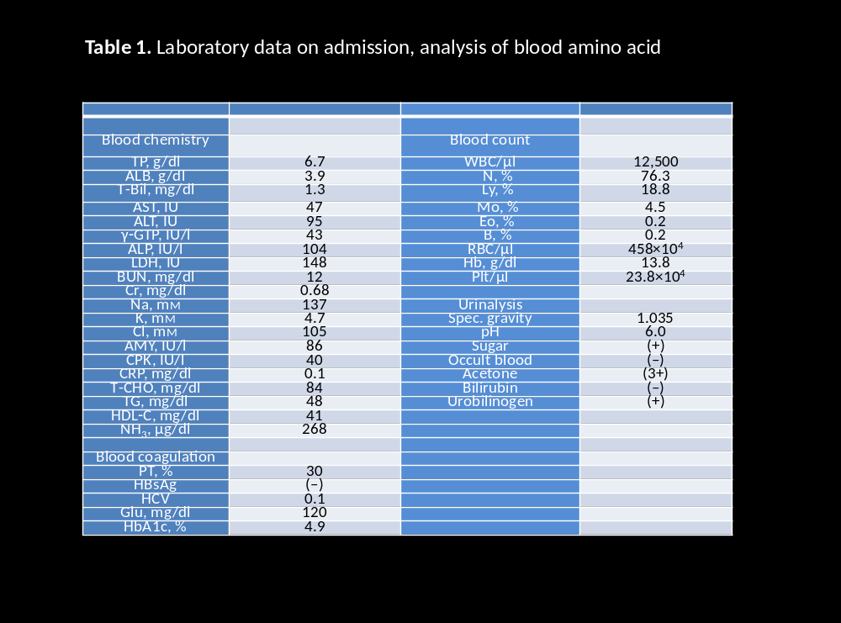
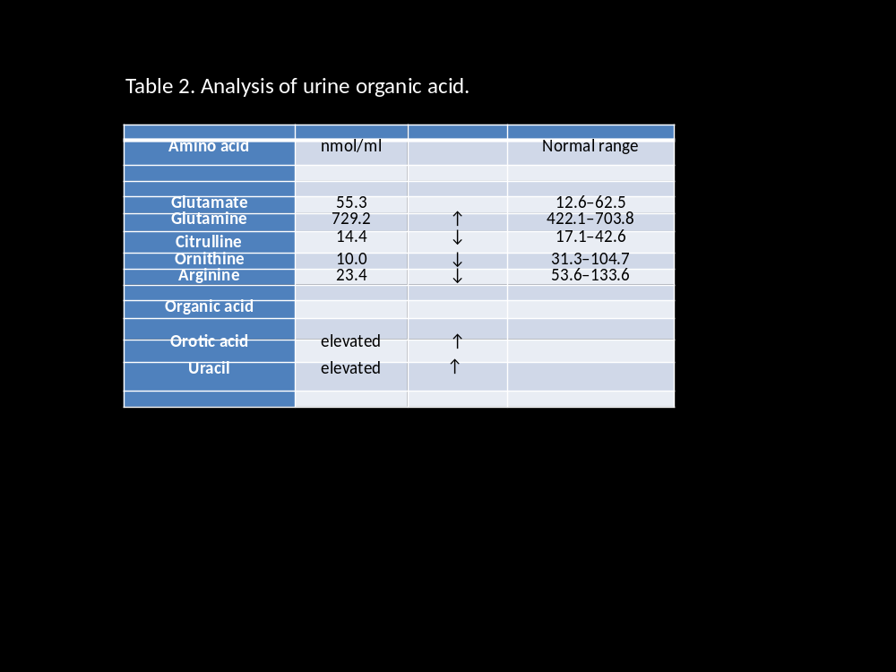
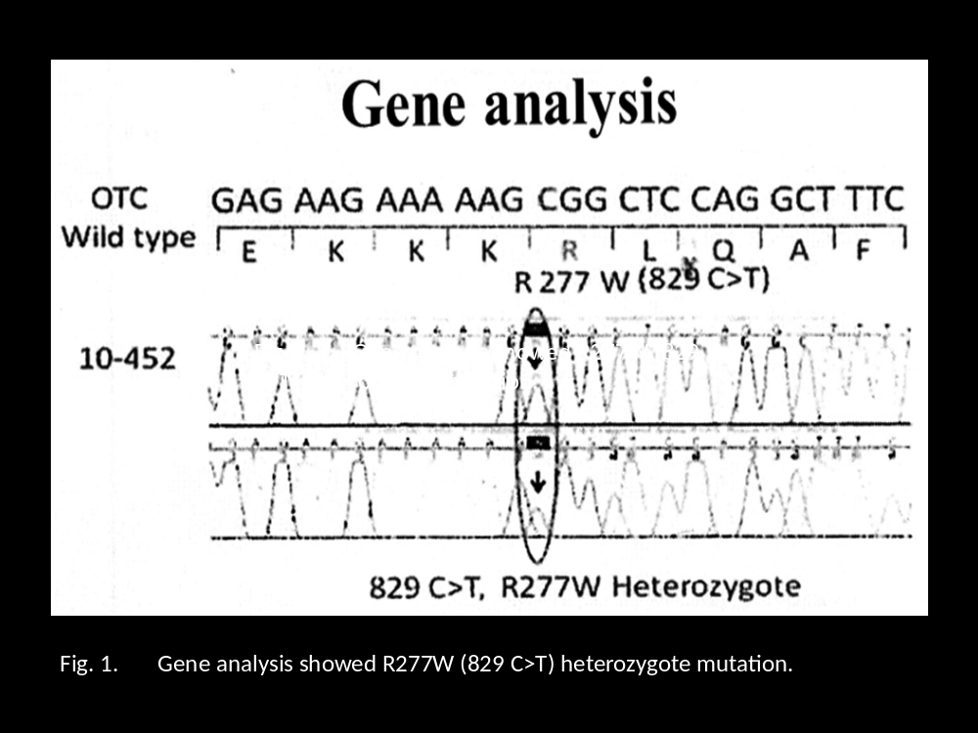
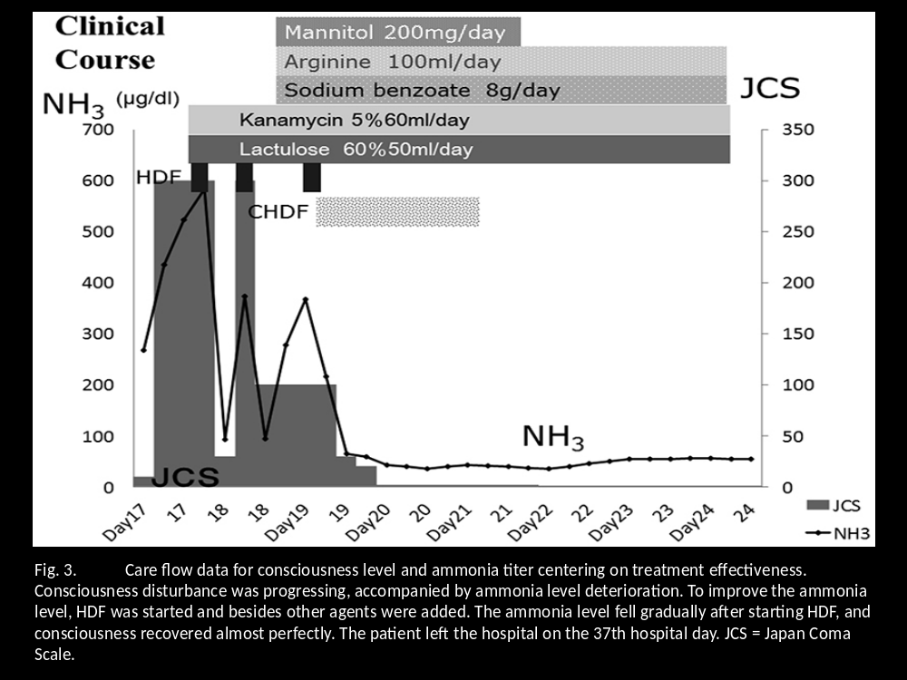
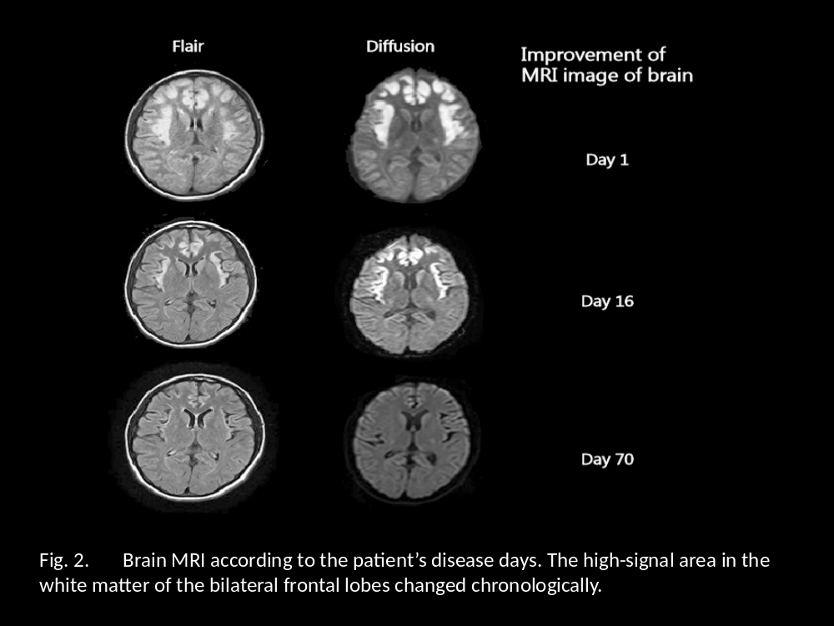
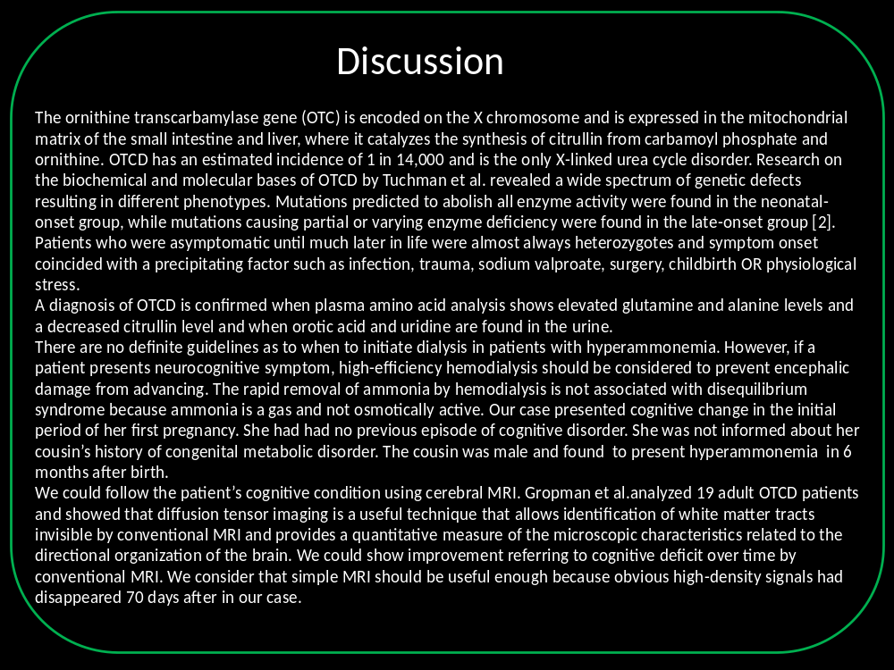
Antepartum Ornithine Transcarbamylase Deficiency ; Case report.
Hitoshi Nakajima, Naoyasu Kashima, Fumiya Komatsu, Ikutaka Takemoto, Syo Kijima, Tadashi Maeda, Toshiyasu Watanabe, Yoshihisa Urita
Department of General Medicine & Emergency Care, Toho University, Tokyo, Japan

