Slide 1

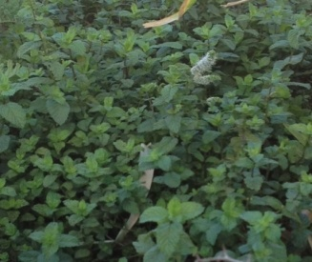
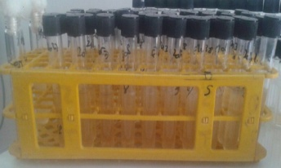
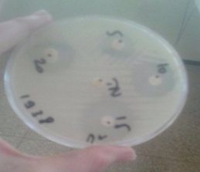
Essential oil and hydrosol of Moroccan spearmint as possible antimicrobial products
Nadia Zekri^{(1,2)}, Mohammed Alaoui El Belghiti⁽¹⁾, Touria Zair⁽²⁾
⁽¹⁾University of Sciences, Rabat, Morocco; ⁽²⁾ University of Sciences, Meknes, Morocco
M. Spicata L.
Introduction: The interest has increased, in recent decades, in the search for natural products and active compounds that could be an alternative to the use of antibiotics. Many works focused on the antimicrobial properties of plant extracts. The most essential oils (Eos) studied for their antibacterial properties belong to the Lamiaceae family. Many EOs from Mentha have proved their antimicrobial activity against pathogenic microorganisms in different parts of the world. The effectiveness Antimicrobial Mentha EO was found correlated often with their chemical composition. As for the hydrosols ((HYD), it did not benefit from the same interest. Some researches focused on the assessment of antibacterial hydrosols of some plants but on that of mints are still rare.
Aim: To examine the in vitro antimicrobial activity of EO and HYD of the leaves and flowers of Moroccan native M. spicata L. This plant is the most used mint by Moroccan people in the traditional medicine, for flavoring tea and for pharmaceutical and industrial purposes.
Method: The EO and HYD of spearmint were obtained by hydro-distillation using Clevenger apparatus then analyzed by CG-MS and CG-FID. Both extracts were tested by using agar disc diffusion and dilution broth methods. We used the Mueller Hinton Agar (MHA) culture medium prepared from 40 g of powder in 1000 ml of distilled water; Heated and stirred to obtain a medium completely dissolved. After sterilization in an autoclave at 121°C. for 15 minutes, we have allowed to cool then poured into Petri dishes made of sterile plastics. The bacterial suspension (10⁸ CFU/ml) inoculated onto the surface of the culture medium (MHA) in a petri dish with a cotton swab. The paper filter discs (6 mm diameter) loaded with 5 μl, 10 μl, 15 μl and 20 μl of the pure EO and HYD are placed in the Petri dishes inoculated and antibiotic disc (gentamicin 10 meg) is deposited as positive control. A disc containing saline is used as a negative control. Incubation is carried out for 24 hours at 37°C. Zones of inhibition around disks were measured using a transparent ruler (mm). The macrodilution method in a liquid medium was used to determine the minimal inhibitory concentrations (MIC) and minimum bactericidal concentrations (MBC) of EO and HYD. For the DMSO solution, we added a quantity of EO 60/40 (DMSO / EO: v /v) to obtain a stock solution homogeneous. From the stock solution, we selected specific volumes to have final concentrations about 0,15; 0,30; 0,60; 1,20; 2,40; 4,80; 9,60; 19,20; 38,40; 76,80 (μl/ml) that were aseptically added to a series of test tubes containing a Sterile Mueller-Hinton volume in ml. Each tube of the set, containing 3.96 ml of the test solution (broth + EO), was inoculated with 40 μl of standard inoculum (10⁸ CFU/ml). For the HYD, we proceeded in the same way but without adding DMSO. The concentrations applied are: 2; 4; 8; 16; 32; 64; 128; 256 and 512 μl/ ml. This inoculum was obtained in the form of a suspension in sterile saline solution (0.9% NaCl). The final volume of the solution in each tube is equal to 4 ml. After incubation for 18 to 24 hours at 37°C, the MIC values ​​of the EO are determined.
Fig 1. Antibacterial tests for determination
MIC and MIB concentrations
Conclusion: The results of analyses of EO and Hydr spearmint and antibacterials tests led concluding:
1.The chemical profiles were different: the main components of EO were carvone (71,56%) and limonene (10,50%) while the Hyd was dominated by 1,8 cineol (22,58%) and camphor (3,53%).
2.The antimicrobial activity of M. Spicata has been proven. The high concentration of
carvone can be used as an explanation for the traditional uses of this plant for the treatment
of microbial diseases. So, the use of mint EO as antibiotics or alternatives to synthetic
molecules can be suggested.
3.The results of the HYD evaluation led deducing that this natural product exhibits an
antibacterial activity with respect to certain microorganisms. It can also be a source for the
isolation of high value compounds like carvone used in aromatherapy, cosmetic industry
and other therapeutic virtues. Further studies are recommended to verify the effectiveness
of this HYD against various microbial strains.
Table 1: Main components of EO and Hyd spontaneous spearmint
Compound | Calculated IK | M. spicata L.
 |  | EO | Hyd
α-Pinene | 939 | 0,37 | 5,88
α-Fenchene | 945 | ---- | 2,59
β-Pinene | 979 | 0,58 | 2,25
1,8-Cineol | 1028 | ---- | 22,85
Limonene | 1029 | 10,50 | ----
Camphor | 1140 | ---- | 13,53
Borneol | 1169 | 0,78 | 3,14
Dihydrocarveol neo | 1194 | ---- | 1,23
Trans-4-caranone | 1195 | 2,75 | ----
Pulegone | 1237 | 0,16 | ----
Carvone | 1242 | 71,56 | 0,24
Bornyl acetate | 1284 | ---- | 0,40
Carvacrol | 1299 | ---- | 3,56
Iso-dihydrocarveol acetate | 1329 | 2,07 | ----
β-Bourbonene | 1387 | 1,07 | ----
β-Caryophyllene | 1419 | 0,76 | 0,47
Germacrene D | 1479 | 0,61 | ----
Total % |  | 96,07 | 58,28
Table 2. Zone of inhibition (IZ) of tested germs by spearmint EO
Bacteria | Spearmint EO | Gentamycin
E. coli BLSE | 10 | 12
Ps. putida | - | 10
E. coli | 18 | 19
P. mirabilis | 12,2 | 13
Ps. aeruginosa | - | -
S. aureus | 34 | 22
Table 3: MIC and MIB values of spearmint EO against tested germs
Bacteria | Concentration (µl/ml)
 | M. spicata L. EO
 | CMI | CMB
E. coli BLSE | 1,20 | 76,80
E. coli | 0,30 | 38,40
P. mirabilis | 0,60 | 76,80
S. aureus | 0,30 | 19,20
Table 4: IZ and MIC of tested germs by hydrosol spearmint
Bacteria | Hydrosol IZ (mm) MIC(µl/ml)
E. coli BLSE | ---
Ps. putida | ---
E. coli | ---
P. mirabilis | ---
Ps. aeruginosa | ---
S. aureus | 30/ 256
Fig 2: Inhibition zone (mm) of bacteria strains by EO spearmint

