Slide 1



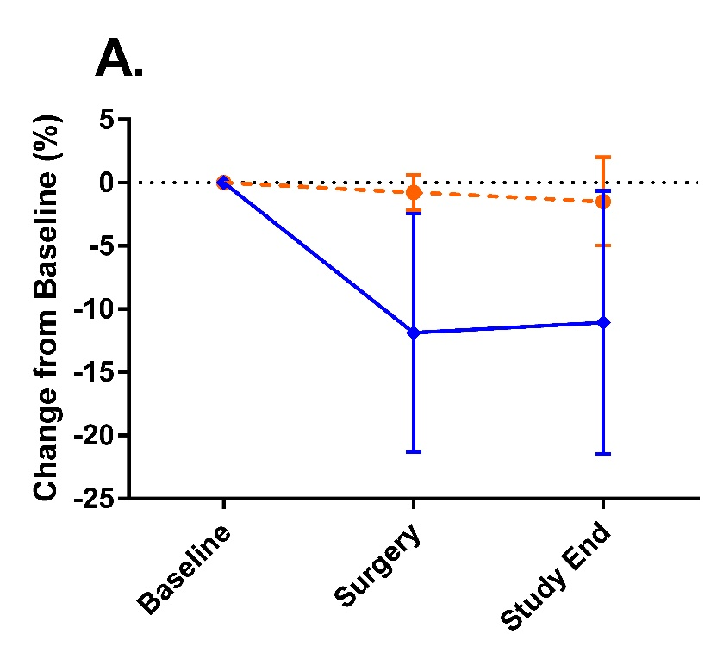
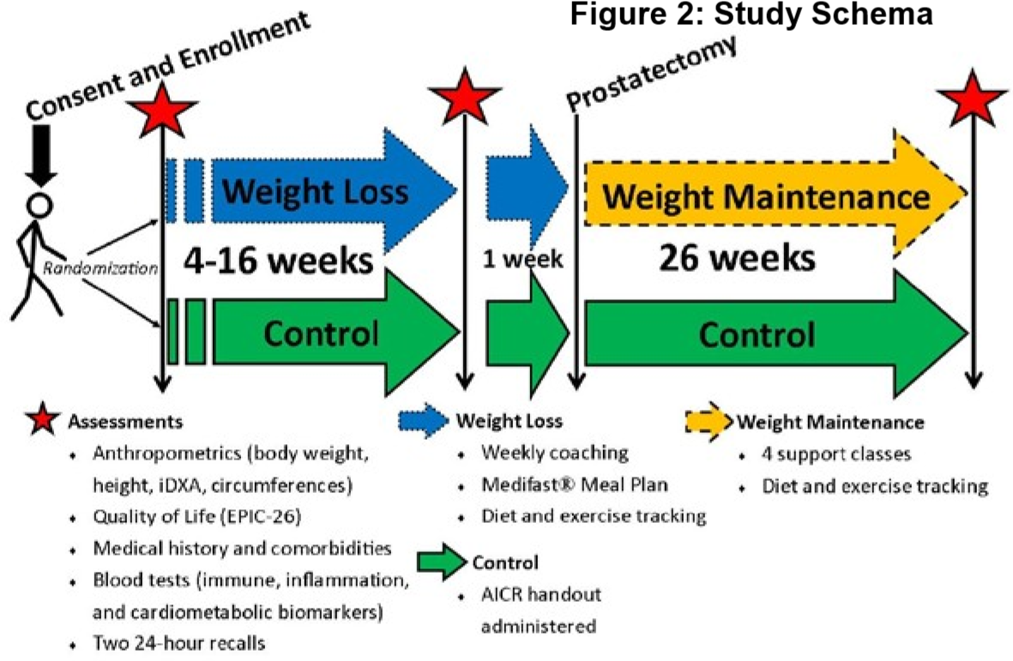
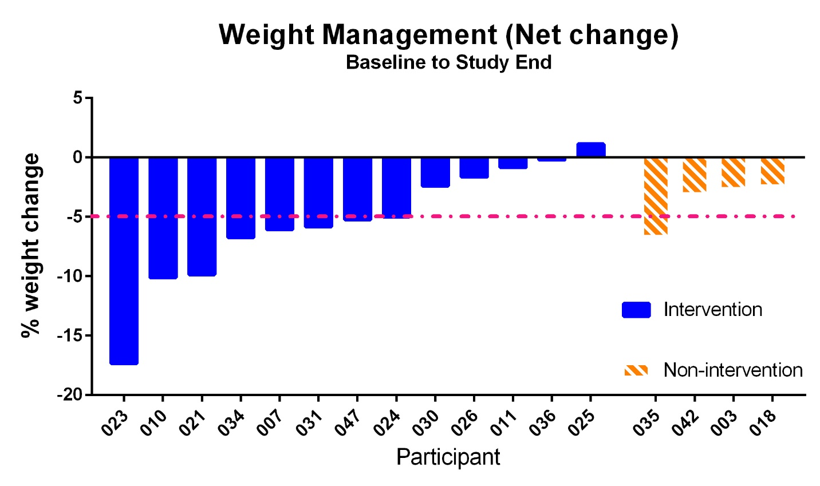
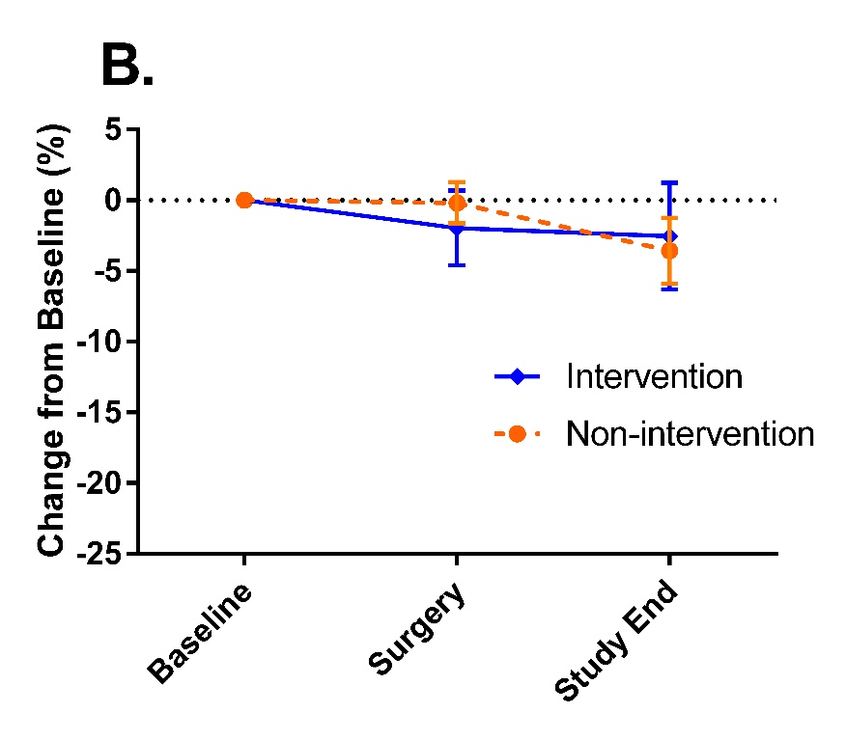
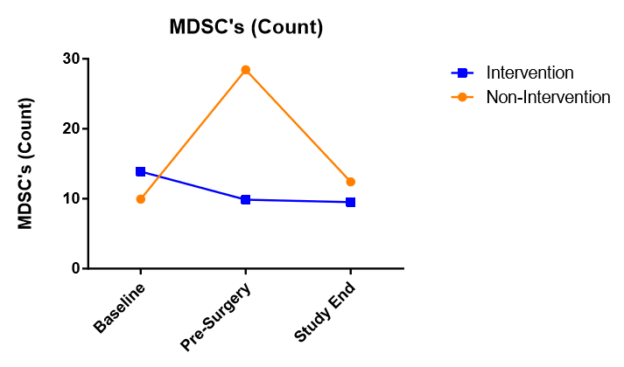
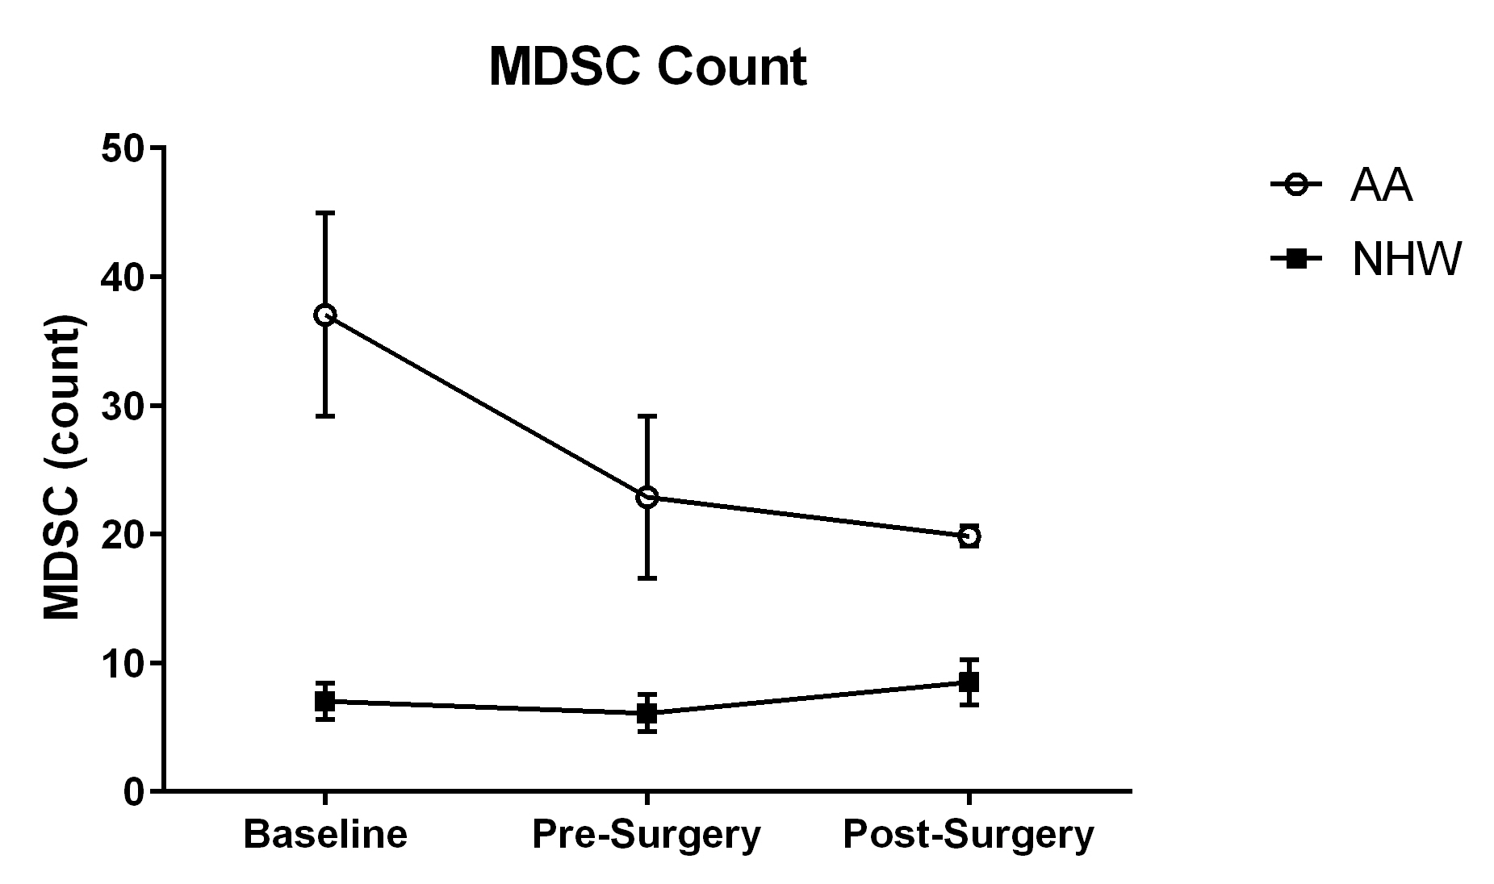
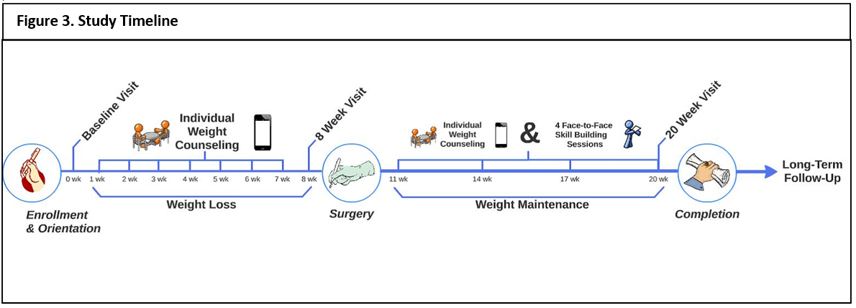



Weight Management’s Effectiveness of Reducing Myeloid-derived Suppressor Cell in Prostate Cancer Patients
Ifeoma Agali⁶, Lauren K. Hand¹, Misty D. Bechtel¹, Cole R. Chana¹, Abigail C. Stanley¹, Prabhakar Chalise³, Nick Mahan¹, Moben Mirza², Eugene K. Lee², Debra K. Sullivan¹,Jennifer Klemp⁴, Christie A. Befort⁵, J. Brantley Thrasher², Jill M. Hamilton-Reeves^{1,2}
¹Department of Dietetics & Nutrition,; ²Department of Urology, University of Kansas Medical Center, ³Department of Biostatistics, University of Kansas Medical Center; , ⁴Breast Cancer Prevention Center, ⁵Department of Preventive Medicine and Public Health,⁶ACE Program
Introduction
Results
Conclusions
In the United States, prostate cancer is the second most common cancer in men, with 29,340 deaths per year (1) and 70% of these men are obese or overweight (2). There is a direct correlation between excessive fat, myeloid-derived suppressor cells (MDSCs), CXCL12, and the aggressiveness of cancer.
Tumor cells create a proinflammatory environment by release cytokines and chemokines such as CXL12 that attract immune cells to the tumor microenvironment, but excess fat cells exacerbate this proinflammatory state (3,4). Due to abnormal adipose cell growth in obese people, it becomes difficult for the body to provide oxygenated blood to those cells. Adipose cell death from hypoxia attracts macrophages (5). Continuity of theses macrophages within the adipose tissue causes chronic inflammation that triggers the increase production of proinflammatory factors CXCL12, and MDSCs. CXCL12 is a chemokine that is functional in inflammation response, tumor growth, and metastasis (5,6).
MDSCs are partially differentiated myeloid cells that accumulate in the blood and are attracted to the tumor site disrupting the ability of the immune system to rid the body of tumor cells. MDSCs also promote the spread of cancer (3). MDSCs create a barrier to tumor surveillance (protect the tumor from the immune system editing out cancerous cells). The more MDSCs in the tumor environment the more aggressive the cancer (3). The focus of this trial was to determine the effectiveness of fat loss in decreasing MDSC count. Weight loss, specifically fat loss, may decrease MDSC count. Lower MDSC counts would improve prostate cancer patients’ outcomes, by reducing the risk of the cancer cells escaping outside of the prostate and reducing the risk of cancer recurrence.
Baseline Characteristics
Body Composition: Fat Loss
Men in the intervention group lost more weight than in the non-intervention group.
Muscle mass in the intervention group decreased slightly in the intervention group, but decreased by 5% in the non-intervention group after their prostatectomy.
Major decreases in fat mass in the intervention group.
MDSC counts were decreased in the intervention group and stayed lower during the weight loss maintenance phase (post prostatectomy).
Baseline Characteristics | Intervention (n=15) | Non-Intervention (n=5)
Mean age, (SD) | 61 ± 6 | 59 ± 3.4
Body Weight, kg (SD) | 99 ± 11 | 90 ± 12
BMI, kg/m² (SD) | 30 ± 3 | 29 ± 2
Race Number
White | 12 | 4
African American | 3 | 1
Future Studies
Based on these data, a larger randomized study is being led by Dr. Hamilton-Reeves. Weight Management Aimed to Reduce Risk and Improve Outcomes for Radical Prostatectomy (WARRIOR), will include 40 men and focus on prostate cancer survivorship along with weight management.
Figure 2: Outline of WARRIOR timeline and procedure
African American population in the study was low (only 26%). In this study, MDSCs counts were 4x higher in the African American men than the Caucasian man at baseline. Higher .This was interesting because Prostate Cancer mortality is 60% higher in African Americans than Caucasians (7). It could be possible that race is a factor for higher MDSC counts.
Dr. Hamilton-Reeves and Mr. Broderick Crawford are working on a grant proposal, through the Prime Health Foundation, for community-based program in prostate cancer. The proposal is geared towards the African American population. The goal of the program would be to build a partnership between KU and the African American community.
Body Composition: Lean Mass
Methods
A pre-post study with a prospective control was conducted with n= 20 men. Participation requirements were: recently diagnosed prostate cancer (stage T1 -T2), aged 50-72 years, scheduled prostatectomy within 4-16 weeks, BMI between 25-45 kg/m², and access to internet. Exclusions from the study included: high risk medical conditions, evidence of biochemical recurrence, evidence of metastasis, undergoing salvage therapy, castration-resistant prostate cancer, active cancer treatment, a history of radiation therapy for cancer treatment, and a history of 5 alpha reductase inhibitors three months prior. Participants could choose either the Intervention group or Non-Intervention group.
Within the Intervention group, pre-prostatectomy interventions included:
Individual weight coaching,
Diet changes with Meal Plans,
Home-based physical activity, and
Daily tracking/monitoring through m.Care app (LifeScience Technologies).
Post-prostatectomy Intervention strategies included:
Individual weight coaching, and
In-person skill building sessions at the CRC Demo Kitchen.
Weight, height, Dual Energy X-Ray Absorptiometry, and approximately 3 tablespoons of blood. were collected at baseline and 1 week prior to surgery. Blood samples were processed through Ficoll density gradient centrifugation to isolate peripheral blood mononuclear cells (PBMCs). Using the PBMCs, flow cytometry was performed to assess levels of MDSCs. Antibodies used to detect MDSCs were: HLA-DR, CD11b, CD33, CD15, CD14, CD66b.
Body weight changes, body composition, and immune cell counts changes between the groups were assessed using the two-sample t-test. Changes from baseline in outcomes were assessed using the Wilcoxon sign rank test.
References
1.The American Cancer Society medical and editorial content team. (2016, February 16). Key Statistics for Prostate Cancer | Prostate Cancer Facts. Retrieved June 14, 2018, from https://www.cancer.org/cancer/prostate-cancer/about/key-statistics.html
2.National Institute of Diabetes and Digestive and Kidney Diseases. (2017, August 01). Overweight & Obesity Statistics. Retrieved June 14, 2018, from https://www.niddk.nih.gov/health-information/health-statistics/overweight-obesity
3.Parker, K. H., Beury, D. W., & Ostrand-Rosenberg, S. (2015). Myeloid-Derived Suppressor Cells: Critical Cells Driving Immune Suppression in the Tumor Microenvironment. Advances in Cancer Research, 128, 95–139. http://doi.org/10.1016/bs.acr.2015.04.002
4.Umansky, V., Blattner, C., Gebhardt, C., & Utikal, J. (2016). The Role of Myeloid-Derived Suppressor Cells (MDSC) in Cancer Progression. Vaccines (Basel), 4(4). doi:10.3390/vaccines4040036
5. Castro, A. M., Macedo-de la Concha, L. E., & Pantoja-Meléndez, C. A. (2016, August 11). Low-grade inflammation and its relation to obesity and chronic degenerative diseases. Retrieved July 8, 2018, from https://www.sciencedirect.com/science/article/pii/S0185106316300737
6. NCBI. (2018, July 1). CXCL12 C-X-C motif chemokine ligand 12 [Homo sapiens (human)] - Gene - NCBI. Retrieved July 8, 2018, from https://www.ncbi.nlm.nih.gov/gene?Db=gene&Cmd=DetailsSearch &Term=6387
7.Shenoy, D., Packianathan, S., Chen, A. M., & Vijayakumar, S. (2016). Do African-American men need separate prostate cancer screening guidelines? BMC Urology, 16, 19. http://doi.org/10.1186/s12894-016-0137-7
MDSC count of African American Men vs Non-White Hispanic Men
Additional
Sponsors:

