Slide 1
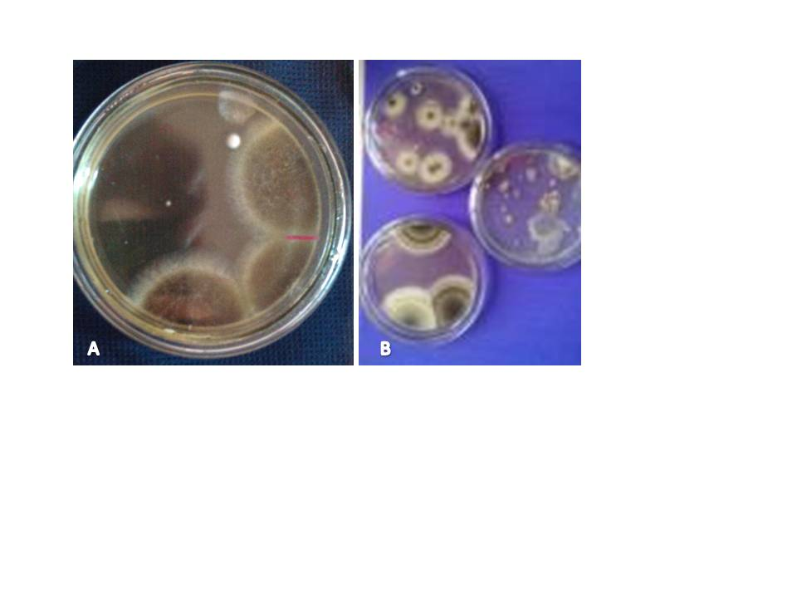
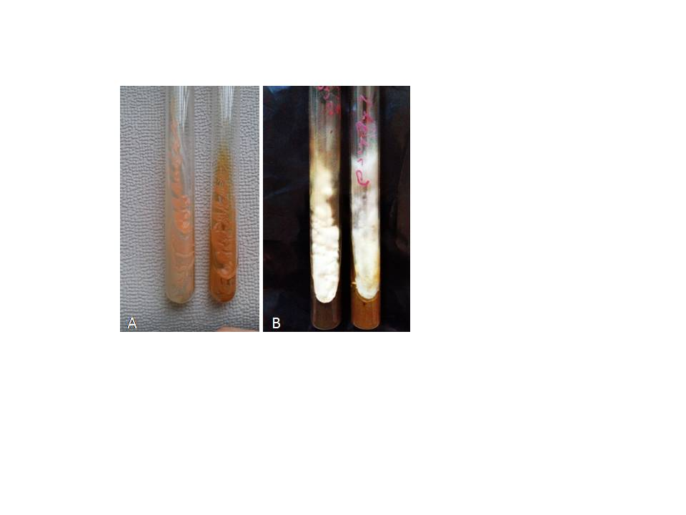
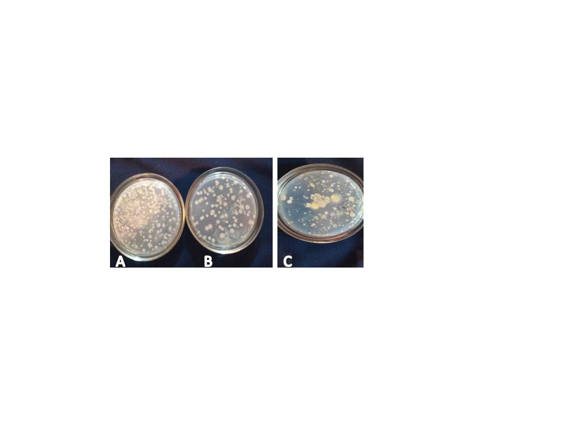
The 12th World Congress of Biotechnology and Microbiology
June 28th-29th, 2018 Amsterdam, Netherlands
The Effect of Biological Preparate “Biocatena” and Fungicide” Ridomil Gold” on Fungal Diseases of Tomato Root and Rhizosphere
Guliko Dvali, Leila Zviadazde, Naili Lomtadze, Maia Kobakhidze, Karlo Kikoria
Georgian Technical University, Biotechnology Centre, Tbilisi, 0175, Georgia
Introduction
An important part of maintaining a positively healthy ecological environment is the protection of agricultural crops from a variety of diseases, including pathogenic fungi which are widely treated using fungicides. However, the issue is that the fungicides have a negative impact on the growth of the plant. Thus, to protect the agricultural environment the biological preparate “Biocatena” is used to inhibit the growth of pathogenic fungi, whilst reducing the negative impact of chemical treatments (fungicides), resulting in the production of ecologically-healthy agricultural produce. (2004)
The research aim was to study the influence of the biological preparate “Biocatena” and the fungicide “Ridomil Gold” on pathogens that cause fungal diseases of the root and rhizosphere of the tomato variety “Slivka”.
Material and Methods
The Seedling’s root systems were treated with the biological preparate -2% “Biocatena” before planting,during vegetative phase with four 15-20day intervals. The soil was fertilized with "Organica"before planting. Fora valid comparison 2.5 kg/ha fungicide “Ridomil Gold” was used. The working solution was 300-500l/ha with 7-10 day intervals.
The Microbiological analysis was carried out using the I.M. Vozniakovskayamethod. Formicrobe cultivation, artificial and natural solid nutrients were used: chapeck, suslo and potato in different concentrationsof 10⁻², 10⁻³, 10⁻⁴, 10⁻⁵.The total number of microbial colonies in the root and rhizosphere were estimated as thousands per gram of dry soil. The pure cultures of pathogenic fungi were isolated from the rhizosphere and root of the tomato and it was evident that the fungal diseases were caused by the fungus species: Phytophthora Infestans and Fusarium oxysporum.
It was revealed that total number of microbes in the uncultivated soil was 500 thousand fungi, 180 thousand bacteria and 210 thousand actinomycetes. However, in the dry soil there were 400 thousand pathogenic fungi per gram of soil.
Table 1. The total number of microbeswithin the uncultivated soiland the cultivated soiltreated with the biological preparate “Biocatena” and fungicide “Ridomil Gold” (1000/1gr. Absol. Dry soil)
Figure 1. Result of the influence of the biological preparate “Biocatena” and fungicide “Ridomil Gold” on the soil; A-uncultivated soil, B-cultivated using “Biocatena",C-cultivated using fungicide” Ridomil Gold”
Table 2. The Effect of the biological preparate “Biocatena” and fungicide “Ridomil Gold” on the number of pathogenic fungi during the flowering phase (The total number of microbes1000/1g of Absol. Dry soil)
Figure 2. Fungal diseases of the“Slivka” tomato root (A) and rhizosphere (B)
Figure 3. Pathogenic fungi from tomato root and rhizosphere; A- Fusarium oxysporum; B -Phitophtora Infestans
Result
The Number of pathogen fungi on the plants root system (25 thousand) and rhizosphere (28 thousand) during the flowering phase decreased when treated with “Biocatena “. In contrast, the number of pathogenic fungi decreased to 30 thousand on the root and 36 thousand on the rhizosphere when treated with the fungicide “Ridomil Gold”.The pure cultures of pathogenic fungi were isolated from the rhizosphere and root of the tomato and it was concluded that the fungal diseases were caused by Phytophthora Infestans and Fusarium oxysporum.
Conclusion
Therefore, the biological preparate "Biocatena" produced in Georgia had a positive effect. It should be noted that the development of the total number of microbes was inhibited using the fungicide “Ridomil Gold”, but the development of useful microorganisms using “Biocatena” was not inhibited, which helps to maintain a healthy environment for the active development of the plant during the flowering phase
Literature
1.Kotlyarov V. V.Sedinina N. V.Donchenko D. Y.Kotlyarov D. V. Systematicuse of drugs based on bacteria and fungi in plants protection and improvement of the microbiological composition of soil. (2015). Polythematic , Scientific Journal of Kuban State Agrarian University
2. M.V. Shtershins, F.C. –U. Jalilov, I.V. Andreeva, O. G. Tomilova. Biological Protection of Plants. Moscow, “Kolocc”, 2004, pp.264
Conditions | The total number of microbes
uncultivated soil | 1.180 000
cultivated using “Biocatena" | 580 000
cultivatedusing fungicide” Ridomil Gold” | 825 000
Conditions | uncultivated soil | cultivated using"Biocatena" | cultivated using fungicide” Ridomil Gold”
root | 35 000 | 25 000 | 30 000
rhizosphere | 45 000 | 28 000 | 36 000

