Slide 1
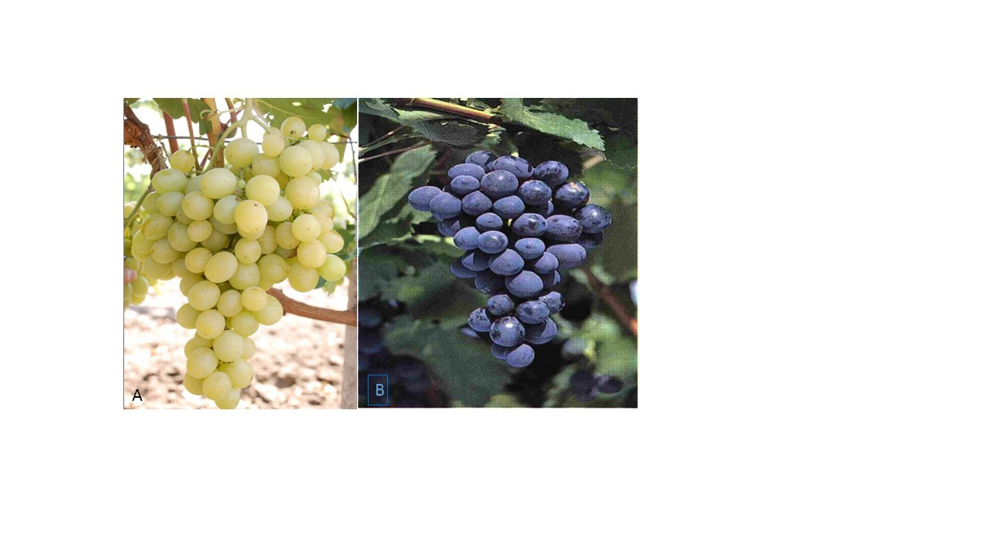
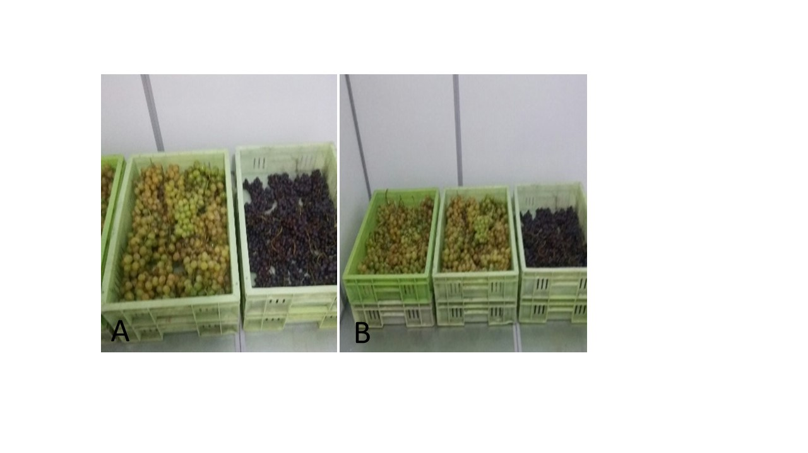
12th World Congress on Biotechnology and Microbiology
June 28-29, Amsterdam, Netherlands
Effect of Eucalyptus Extract and Calcium Chloride on Grape Storage Ability
Tamar Shamatava, Maia Kukhaleishvili, Merab Jgenti, Sopio Japarashvili, Iveta Megrelishvili, Ekaterine Bulauri, Tamar Chipashvili
Georgian Technical University, Biotechnology Center, 0175 Tbilisi, Georgia.
E-mail: tamarasha_12@yahoo.com
Introduction
As it is known, during the storage of grape, periodically applied to the treatment of sulfur anhydride or converse the grapes together with potassium metabisulphite [1]. During storage in both cases, the loss of grapes is minimal, which increases its storage ability. However, the grapes stored in such conditions cannot be considered as ecologically clean products [2].
Methods
In this study the effect of eucalyptus extract and calcium chlorid (CaCl₂) on grape storage ability was investigated. The treatment include control(Sulfur dioxide (SO₂) 20-30 minutes exposure, once a month) and two combinations: I. 1% CaCl₂ +0.5% eucalyptus extract; II. 2% CaCl₂ + 1% eucalyptus extract. Two grape varieties: ,,Italia” and ,,Alphonse Levallée” were selected for the study, which are the most popular cultivars among consumers in Georgia.(Figure 1).
Figure 1. Selected grapevine varieties: A- “ Italia”, B- “Alphonse Levallée”
After the treatments grape were stored at 0-10 ⁰C, relative humidity of 85-90%. Evolution of qualitative features such as percentage of decay caused by microbiological and physiological diseases was done in the middle of the storage (60 days) and at the end of the storage (120 days).
Result
Results showed that the loss caused by microbiological and physiological diseases in the middle stage of the storage (60 days) on two species grape was unimportant- Control- 0.9%; with the 1% CaCl₂ +0.5% eucalyptus extract-1.5% and 2% CaCl₂ +1% eucalyptus extract -1% (Table 1).Therefore at the end of the storage (120 days) control loss was 6.1%; on condition 1% CaCl₂ +0.5% eucalyptus extract-11.4% and 2% CaCl₂ + 1% eucalyptus extract -7.3% (Table 2; Figure 2.).
Table 1. Loss caused by microbiological and physiological diseases in the middle stage of the storage (60 days) according grape varieties
Table 2. Loss caused by microbiological and physiological diseases at the end of the storage (120 days) according grape varieties
Figure 1. Results of grape storage, A-Grape before storage, B- Grape at the and of storage
Conclusions
Thus, 2% CaCl₂ + 1% eucalyptus extract solution showed the best result from the combined compounds, loss after storage was 7.3%. Sulfur dioxide (SO₂) condition loss was less but it is noteworthy that the solution of 2% CaCl₂ + 1% eucalyptus extract is an ecologically pure mix and the stored grapevines are ecologically pure products, which is a key factor in choosing a storage facility.
Literature
1. Adzhiev A.M., Adzhieva N.A.(2002). Ecological and adaptive viticulture. Scientific bases and applied aspects, Makhachkala, 256pp.
2. Serpuhovitina K.A. Modern trends in the development of viticulture(2005).Wine-making and viticulture, N 1, 10-11pp.
Grapevine cultivars | Type of Combined compoun combination
 | control (Sulfur dioxide (SO₂) 20-30 minutes exposure, once a month |  | 2% CaCl₂+ 1% eucalyptus extract | 1% CaCl₂+2% eucalyptus extract
Italia | Loss After 60 days of storage
Alphonse Levallée | 0,9 % | 1.5% |  | 1%
Grapevine cultivars | Type of Combined compoun combination
 | control (Sulfur dioxide (SO₂) 20-30 minutes exposure, once a month | 2% CaCl₂+ 1% eucalyptus extract | 1% CaCl₂+2% eucalyptus extract
Italia
Alphonse Levallée | Loss After 120 days of storage
 | 6.1% | 11.4% | 7.3%

