Slide 1
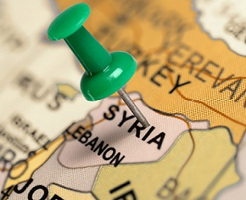
ANESTHESIA IN SYRIAN CRISIS
Osama Yanes M.D Anesthesia

Slide 2
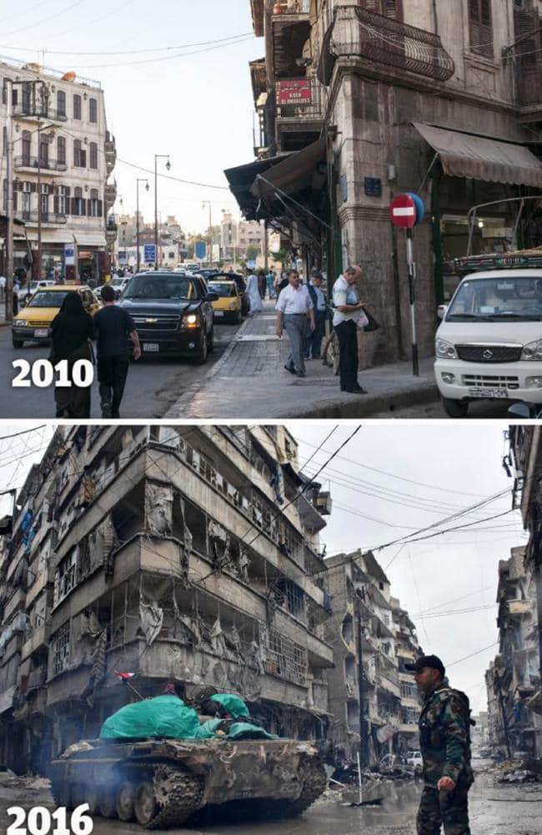
Syria Before and after

Slide 3
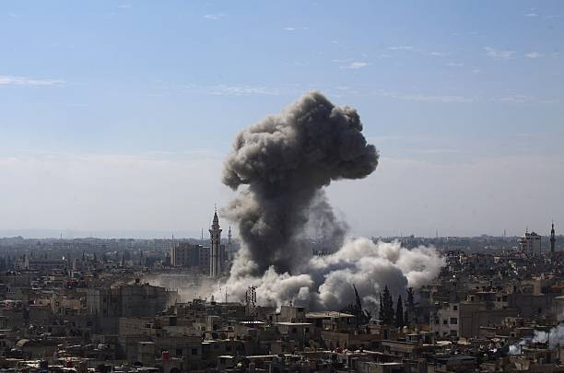
war

Slide 4
Abstract
As described by U.N.H.C.R the Syrian armed conflict is the worst humanitarian tragedy in this century .Syria is experiencing a protracted political and socioeconomic crisis that result in severe deterioration of living conditions which has also significantly eroded the health system. The armed conflict crisis in Syria is characterized by high number of trauma cases still other surgical health require care and varies between government and none government areas in general .
A descriptive study with direct examining of the recrds in a of ministry of health hospital IBN –ALNAFES Hospital which is located at the north site of Damascus . Where it serves all cases Anesthesia challenging difficulties of crisis ( frequent shelling attacks and bombing , terrorist act ).

Slide 5
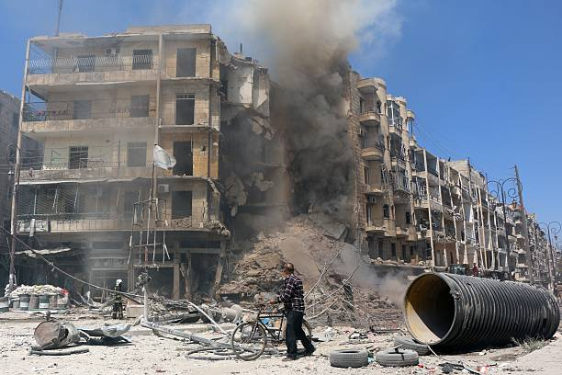
It is the war

Slide 6
Abstract Cont.,
Anesthesia care was assured through strict adherence of a minimum of sanitation availability of essential disposals , adequate infrastructure , adequate water , drugs and equipment for anesthesia procedures , and capability for blood transfusion .(7)
During the study period (Jan-Sept 2015) , 700 anesthesia were performed 65% males , median age was 25 years , violent trauma was the most common surgical indication also selected regular operation .
Local ,regional , general anesthesia and combinations were performed with or without intubation .

Slide 7
Abstract cont.,
AS an overall view comparing to none-government hospitals or health centers areas 1-hospital quality and the outcome results of anesthesia and surgery were within the good standards with low mortality and complications 2-regional anesthesia were frequently used 3-ketamine used for its advantages with or without midazolam . 4-availability of adequate anesthesia staff and equipped hospital facilitate serving both military and civil cases .
Different medical reports show that the none-government areas have different level of service depending on many separate or combined factors .

Slide 8
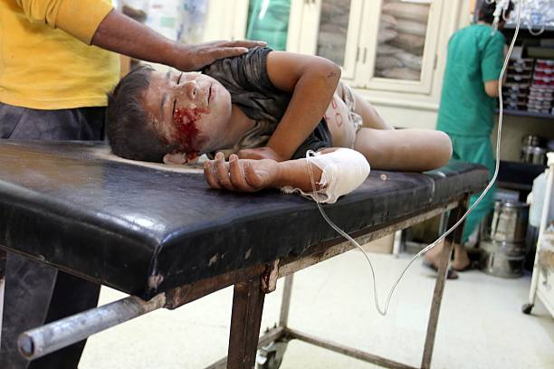
It is the war

Slide 9
Introduction
It is been more than seven years since the Crises in Syria started. AS described by U.N.H.C.R the Syrian armed conflict is the worst humanitarian tragedy in this century .While VALERIE AMOS U.N Chief for Humanitarian affairs says (7 ) …. EVERY TIME we use a new figure in relation to the Syrian crisis we say that it is unprecedented. We have run out of wards to fully explain the brutality of violence and callous disregard for human's life which is hall mark As a sequences of the crisis heath care deteriorated, which varies in different areas. Anesthesia as an important specialty also affected. A report details Syria health collapse where metal knockout instead of anesthesia has been used (5).

Slide 10
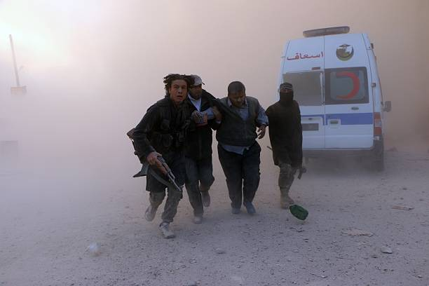
It is war

Slide 11
Introduction cont.,
Also the Anesthesia in Syria is being done by lower infrastructure workers pursuing instruction (6). In this article we study the effect of crisis on Anesthesia as a part of health care in the
At the government side as an example Ibn Al-nafees Hospital while in the non-government we depend on different reports from different agencies or organizations or journals . , Damascus city which Is the capital of Syria where Ibn Alnafees Hospital located at the northern site is characterized and Famous as trade center through all periods of history till now and it is not a problem to provide hospitals with the necessary materials or equipment

Slide 12
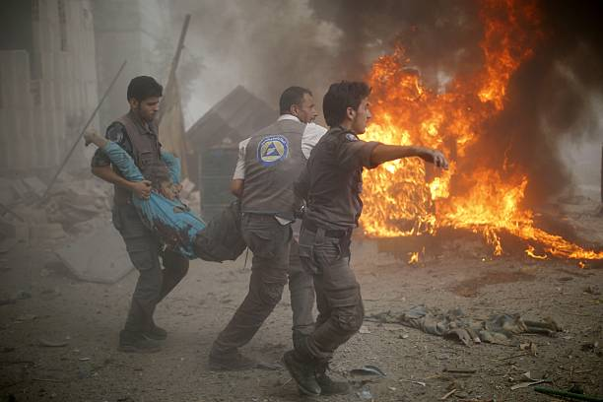
war

Slide 13
Introduction Cont.
Both military and civil regular cases are accepted which put additional pressure and effort on all hospital facilities …But still the challenging difficulties of crises is present because of the frequent chilling attacks and bombings also the many terrorist acts and attacks and acts which lead to affect so many civilians in the city even children, women, and elders . So it is clear that we have in the crises in Syria a situation of disaster because of armed conflict which is characterized by (11)
1-high of trauma
2-scarcity of human resources
3-damaged infrastructure
4-destruction of facilities
5-transportation and the availability to reach the hospital .
6- technique which fit in disaster type techniques.

Slide 14
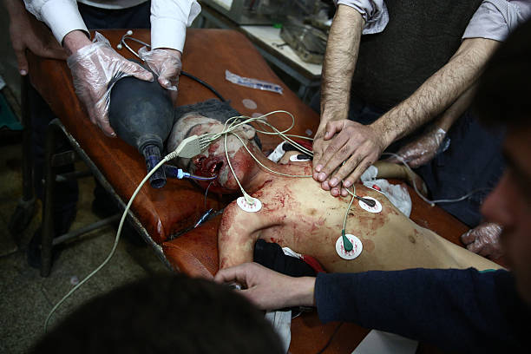
war

Slide 15
Introduction Cont
In allover Syria we can consider 2 major areas the first under the government control while the second is out of the government control ( which controlled by different variety of armed groups ) . Medical services and health care are managed and supported by the government in its side while on the other side:
1-W.H.O sworld health organization
2-M.S.F Doctors without Borders .
3-S.A.M.S Syrian American Medical Society .
4. G.H.E.F
5-Syrian British Medical Society
6-S.I.C.H Syrian international coalition for health.
The quality and health care at the government areas proved to be much better ( 1,2,7,9,10)
Recent findings by doctors without borders (M.S.F) has proven that even in precaution situation, safe administration of anesthesia is possible and , do not harm principle , can and must be Upheld. Anesthesia providers need to recognize the difficulties linked to these contexts.
Resource requirements and the aid response (6,7)

Slide 16
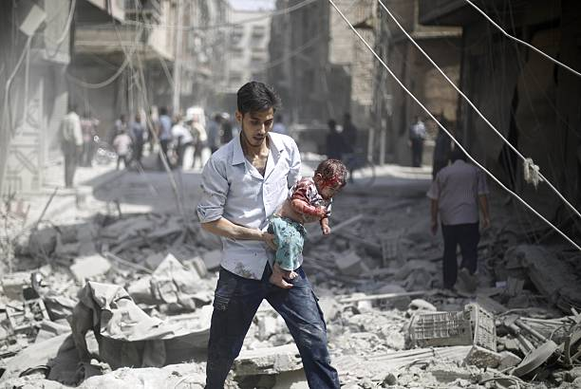
war

Slide 17
Introduction Cont
In developing countries qualified surgical and anesthesia providers are typically rare to none existent and this storage is also introduced in a lack of minimal infrastructure an supplies to perform surgical activities in general if availability of anesthesia provider is far more difficult, in turn restricting the possibilities of surgical care and in some conditions even making it dangerous . this is a common reality in resource –poor setting, through recent reports suggest an improvement of condition for the provision of anesthesia in some developing counties such Syria but this is basically in the capital Damascus not all parts of the country. (6,7,9).

Slide 18
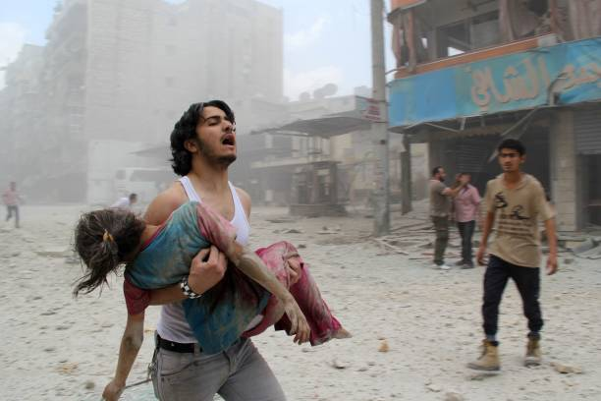
war

Slide 19
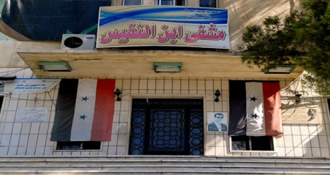
Methods
A descriptive study of 700 cases had different types of anesthesia ,-at IBN-AL NAFEES
IBN –AL Nafees Hospitl is a government hospital which managed , directed and belongs to the ministry of health (M.O.H) of Syria. It is 200 beds hospital which serves 1-All general abdominal surgeries including laparoscopic surgeries . 2-Orthopedic surgeries 3-E.N.T Surgeries 3- Neurosurgeries 4-Maxilofacial Surgeries 5-thorcic surgery 6- surgical intensive care 7-vascular surgery .(13)

Slide 20
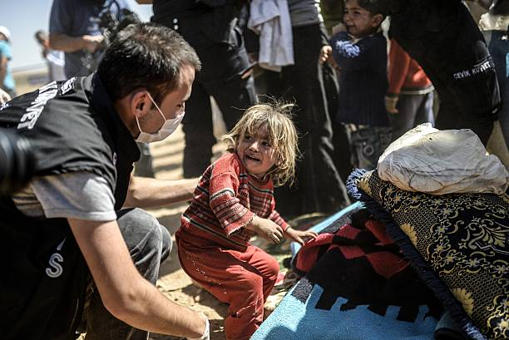
war

Slide 21
Methods cont.,
During the period from Jan 2015 - Sept 2015 different surgeries were done and anesthesia was performed in different possible ways .(13)
67% males 33% females, average age was 25 years.
During this period cases were mostly violent trauma , abdominal surgery both upper and lower ( violent and none violent) of the violent orthopedic were the major cases while of the none violent abdominal were the highest number of cases other cases such head injuries face injuries and neurosurgical cases still available with different numbers depend on the cause and place and nature of the armed offence vascular surgery can accompany any injury .

Slide 22
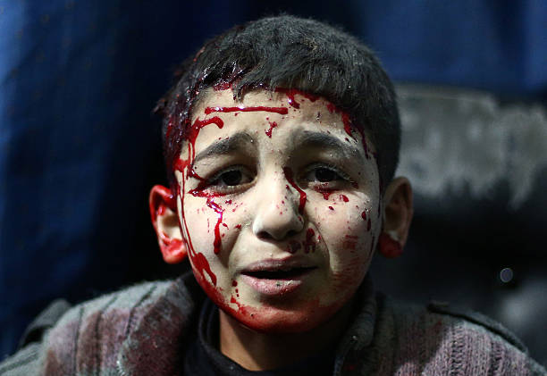
war

Slide 23
Methods cont, table 1
Table 1 Sex
n% | variable
700 cases 100% 33% 67% | Total SEX Female Male

Slide 24
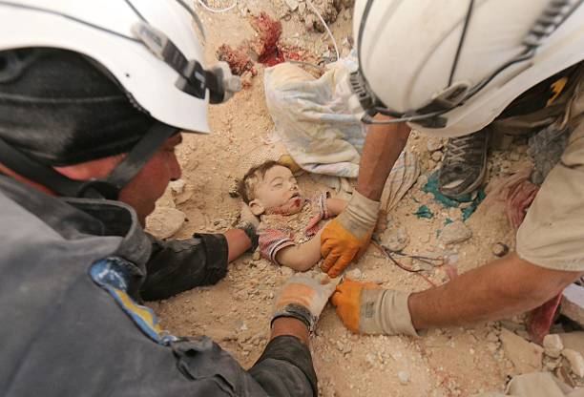
war

Slide 25
Table 2
Table 2 age
n% | Age
63 cases 9 % 399 cases 57 % 175 cases 25% 63 cases 9 % | 0-14 15-29 30-44 >45
 | Median 25 ( 15 – 29 )

Slide 26
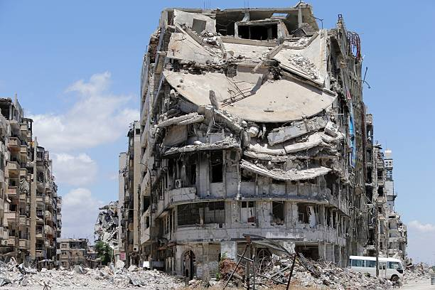
It is the war

Slide 27
Table 3
Table 3 violent and none violent trauma
n% | Variable
434 cases 62% 266 cases 38% | Violent None violent

Slide 28
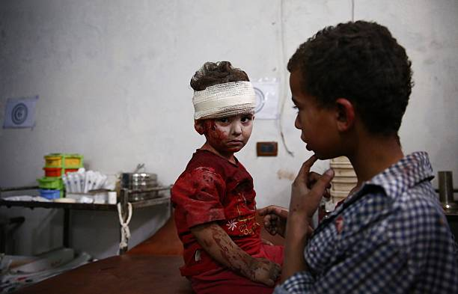
war

Slide 29
Table 4
Table 4 Violent cases
n% | variable
434cases 100% | Total cases
137cases31% 180cases41% 50cases 11% 39cases 9% 28cases 6% | Abdominal injuries (laboratory) Fractures Vascular injuries Neural injuries others

Slide 30
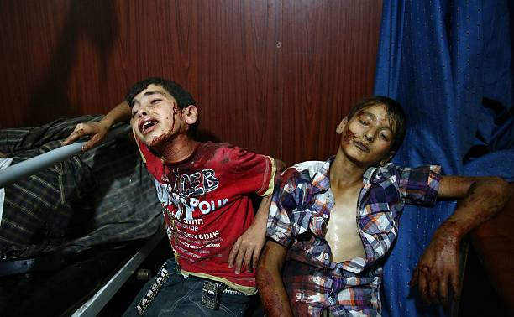
war

Slide 31
Table 5
Table 5 None violent cases
n% | variable
266 cases 100% | Total
112 cases 42% 63 cases 23% 27 cases 10% 35 cases 13% 29 cases 10% | Cholecystectomy Hiatus hernia Lower limb fractures Upper limb fractures Others
Notes:
OTHERS include all different types of surgeries such maxillofacial surgeries 8 cases , diagnostic laboratory 10 cases brain tumor 2 cases , vertebrae fixation 6 cases and vascular surgery 3 cases

Slide 32
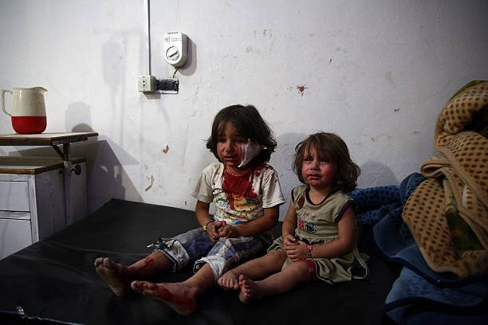
It is war

Slide 33
Methods cont.,
The hospital was well maintained with medical supplies such drugs ,disposals and all other instruments and machines , since it is one of the main hospitals in Damascus and Syria .(13)
Drugs mainly used are Hypnotics , muscle relaxants , narcotics , neostigmine , midazolam , antiemetic's beside all the emergency drugs necessary for cardiovascular resuscitation and to treat any side effects during and after anesthesia .
Operation room well maintained sterilized with optimal capacity all the times for any emergencies .
Well trained anesthesia nurse and technicians available all the times adequately .(13)

Slide 34
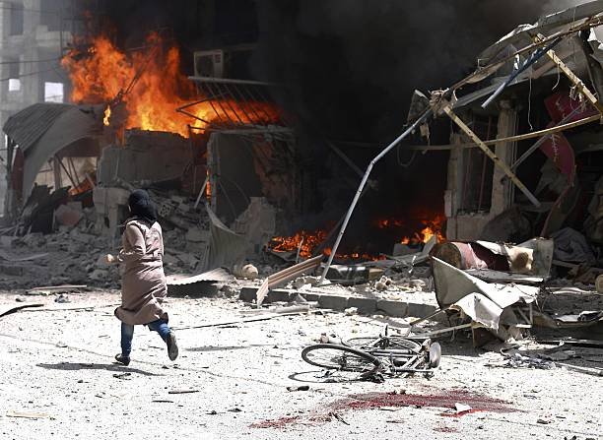
war

Slide 35
Methods cont.,
Local anesthetics drugs and materials also available .
Inhaled anesthetics such Sevoflorane ,Isoflorane, Halothane were all available and used for different inhalational anesthesia techniques . (3,4,8)
Infrastructure personal were adequate and well trained and equipped.
Anesthesia techniques were used varied between general anesthesia with or without intubation to a regional anesthesia spinal to even epidural, pier block.
I.C.U unit was ready and equipped with drugs and instruments, machines and personal. And will discuss the results and characteristics later. (13)

Slide 36
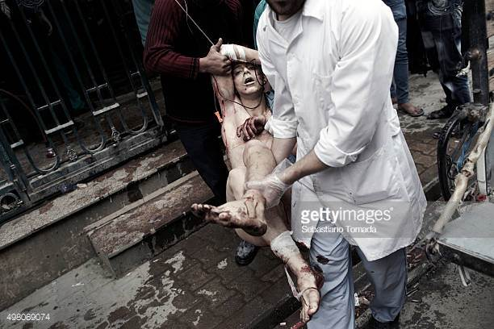
war

Slide 37
Table 6
n% | variable
700cases100% 383cases55% 317cases45% | Total General Anesthesia Local and Regional Anesthesia

Slide 38
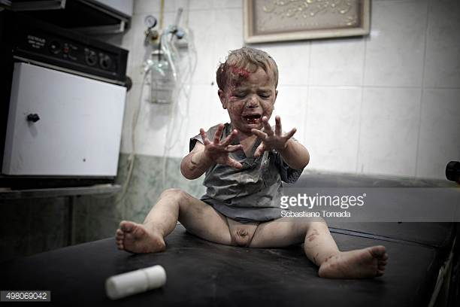
WAR

Slide 39
Table 7
n% | Variable (RegionalAnesthesia Technique)
383cases100% 180cases47% 80cases20% 46cases11% 23cases6% 54cases14% | Total Spinal Epidural Bier block Brachial plexus block local

Slide 40
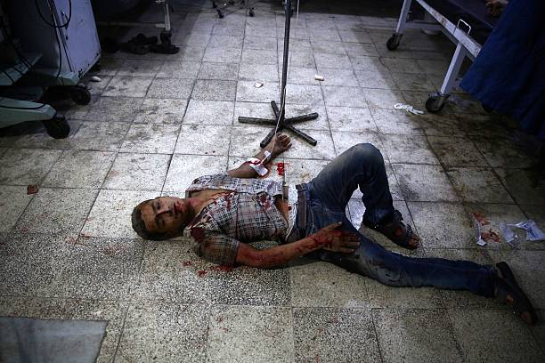
war

Slide 41
Methods cont.,
Local anesthetics were used are lidocaine 2%, Marcaine 0.5% with or without Adrenaline
Ketamine use even was important it was limited to General anesthesia without intubation and short period with or without the use of Midazolam .(9)
Balanced anesthesia for all general anesthesia were used depending on A.S.A score and overall evaluation of individual case .(8)
Sevoflorane as inhalational anesthetic were used.(13)

Slide 42
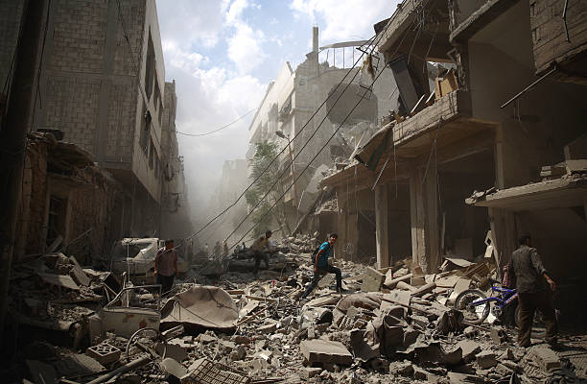
war

Slide 43
American Society of Anesthesiologist (A.S.A) Score.
 | A.S.A
Patient in apparent good health status | class 1
Patient with mild systemic disease | class 2
Patient with severe limiting systemic disease but not incapacitating. | class 3
Patient with severe incapacitating disease that is a constant threat to life. | class 4
Morbid patient not expected to survive 24 h with or without surgery | class 5
A declared Brain dead patient whose organs being removed for donor purposes . | class 6

Slide 44
war

Slide 45
RESULTS & DISCUSSION
Anesthesia Techniques
In precarious contexts, some anesthesia techniques may not be appropriate. The guiding principles are that they should take into consideration two main features: as much as possible, cardio-respiratory depression and muscular relaxation should be avoided, and limited dependence on oxygen and biomedical monitoring should be maintained [3,4,8)
The following techniques were used and appear to be widely accepted:
Local anesthesia: It is considered a good technique for many indications as it is safe and effective. As some risks are present (e.g. cardiac toxicity after accidental intra-venous injection), it should be performed in defined areas (e.g. emergency or operating departments) where material and equipment for resuscitation maneuvers are present.(8)

Slide 46
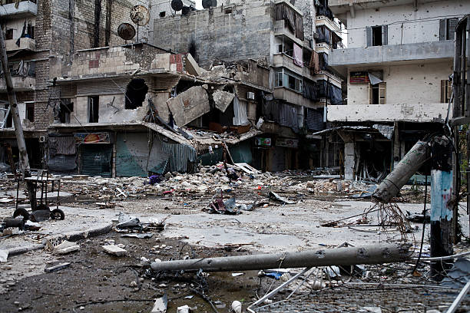
war

Slide 47
Results&Discssion cont.,
Spinal anesthesia: This technique, if correctly performed, is also safe and effective, and oxygen availability is not an absolute requirement. It is recommended in surgical interventions under the umbilicus: lower limb surgery, , and surgery in the pelvis and inguinal area. Nevertheless, as any anesthesia, means should be available for timely resuscitation and to overcome possible adverse effects (e.g. hypotension).*(*8)

Slide 48
war

Slide 49
Results &Discussion cont.,
General intravenous anesthesia: (3.4)This technique can be performed with and without muscular relaxation. In precarious situations, the decision of neuromuscular relaxation should be taken with care, in function of the availability of mechanical ventilation. In some cases it will be necessary to keep patients in spontaneous ventilation during long periods of the intervention, as manual ventilation limits the activities of the anesthesia provider [8].

Slide 50
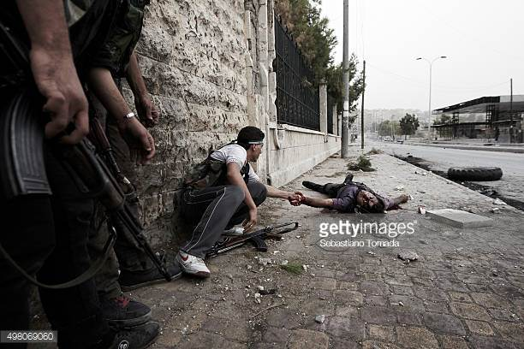
war

Slide 51
Results&Discussion cont.,
Ketamine (9,4,3) remains one of the preferred options for intravenous anesthesia in precarious situations [3,4]: it has analgesic and narcosis effects that avoid the use of opioids during the surgical intervention; it can be used for almost all types of surgery; and as laryngeal reflexes are not totally suppressed, it allows performing some interventions without intubation (e.g. where anesthesia providers are not highly skilled, general intravenous anesthesia with Ketamine and without intubation is used for Cesarean sections). It should be acknowledged that the main concern in disasters and armed conflicts is hemorrhagic shock (from trauma, obstetrical or visceral origin), and the effects of Ketamine in the cardiovascular and respiratory systems can only be positive when dealing with this particular killer.

Slide 52
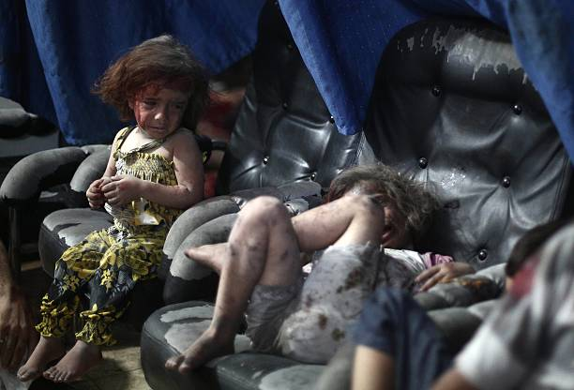
war

Slide 53
Results&Discussion cont.,
Some anesthesia techniques have been reported by some emergency teams in precarious settings, though implementation is debatable(3)
Inhalational anesthesia: (3,4) This type of technique might not be possible to implement as serious concerns might be present: lack of anesthesia circuits, difficulties in supply of halogenated anesthetics, challenges to properly evacuate these anesthetic agents from improvised operating rooms. Its implementation will also demand the availability of narcotic drugs for analgesia [3]. Good solutions for replacing mechanical devices are available, where draw-over manual anesthesia circuits can be a good option: they can be transported by the anesthesia provider itself

Slide 54
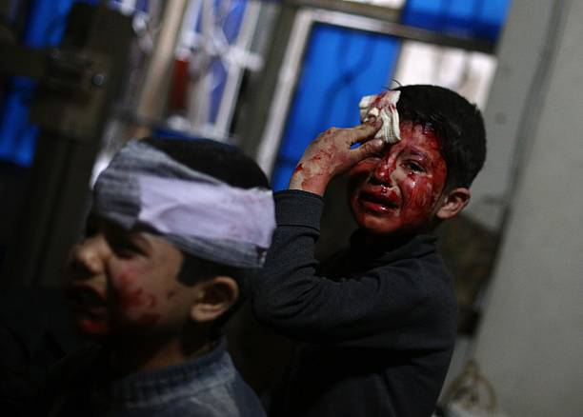
war

Slide 55
Results&Discussion cont.,
Regional anesthesia(8) This is a technique that unfortunately is underused in many settings, despite its positive characteristics in surgical management of limb trauma. It is safe and efficient, and does not rely on the availability of oxygen. Its implementation is more linked to the knowledge and skills of the anesthesia provider, and to a timely availability of not only specific needles and anesthetics, but also of specific devices such as nerve stimulators or ultrasound. Several reports propose more use of this technique in precarious settings, and emergency teams should think on how improve its provision [3,4,8].

Slide 56
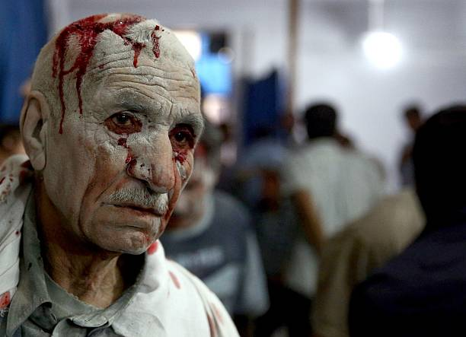
war

Slide 57
Results&Discussion cont.,
Epidural anesthesia(8.4.3) In precarious settings,(8) the implementation of this technique might be difficult and may not be recommended. The possible complications outweigh its possible benefits, as in these settings it is always possible to use spinal technique. Long lasting analgesia with the help of epidural catheters can be difficult to achieve and complications such as hematomas or headaches can be a burden for anesthesia providers that are already overloaded of work. However, in more controlled settings with better resources, this technique could be implemented [8,3].
It has been documented that the use of standard operative procedures provides coherence and good understanding to

Slide 58
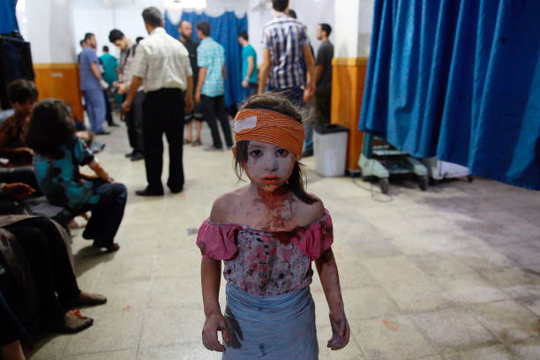
war

Slide 59
Results &Discussion cont.,
the management and treatment of patients, and certainly improves the quality of the provided healthcare. The standardization of care given by different anesthesia providers eases the work of the pharmacy and supply, and avoids confusion among the healthcare staff. The implementation of standard operative procedures should be one of the first activities to be performed in difficult settings; the most important components are: antibiotic prophylaxis and treatment, post-operative pain management , thromboprophylaxis (8) , blood transfusion, and monitoring of surgical site infections.(3,4,8)

Slide 60
Results&Methods cont.,
Also , though not less important, surgical procedures must only be performed if there an informed consent has been granted by the patient, or if incapable, by her/his representative. This is highly recommended by the WHO, in order to preserve the patient’s autonomy and her/his right to even refuse the surgical intervention. In precarious contexts when life-threatening situations need urgent care, the surgical team can be confronted with the impossibility of obtaining the informed consent from the patient. In such situations, the case must be exhaustively documented and medically justified for the patient’s best interest.(1,2,7,10.6).

Slide 61
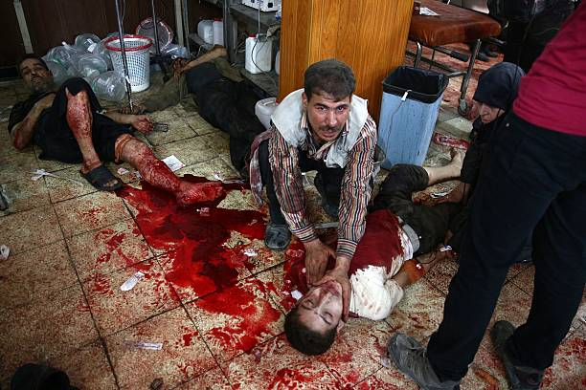
war

Slide 62
Resulrs&Discussion cont.,
Local, spinal and general intravenous are the recommended techniques in precarious situations. Ketamine, as an intravenous agent, remains the drug of choice in such contexts due to its pharmacological characteristics,(8) though issues with importation and exportation need to be taken into consideration. Inhalational anesthesia might not be possible to implement, while regional anesthesia is an underused technique that should be encouraged in the future. Epidural anesthesia is not recommended in these settings as it is possible to perform spinal anesthesia and avoid potential complications.(3,4,8)

Slide 63
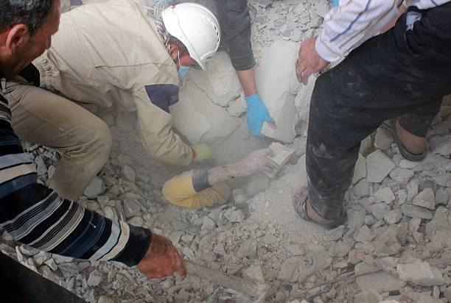
war

Slide 64
Results&Discussion cont.,
Quality anesthesia provision in disasters and(3) armed conflicts remains a challenge, due to among others impaired healthcare systems, security concerns, challenges in ensuring supply lines, the need for a satisfactory infrastructure, basic means (disposables, drugs, biomedical devices), competent human resources, standard operative procedures, and adapted anesthesia techniques. The provision of safe anesthesia should be tailored to a specific context, aiming for the best possible quality that can be offered. The “do no harm” principle must be upheld at all times and surgical care should not be provided at any cost, compromising safety and quality.10,4)

Slide 65
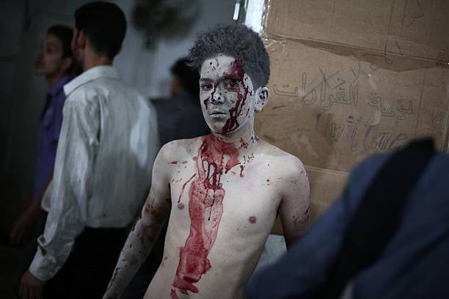
war

Slide 66
Results&Discussion cont.,
Clear standard operative procedures should be implemented in these contexts to ease the provision of care and improve its quality. At the same time, clear policies regarding informed consent form should be in place as it is a right of the patient to know what kind of procedure is going to be performed and what the possible risks are, and to be able to refuse the proposed surgical care. and lack of adequate human resources and material. However, following the experience of several surgical care teams, it is possible to perform safe anesthesia in such contexts, by carefully considering (11,12,3,4)

Slide 67
war

Slide 68
Results&Discussion cont.,
There are few reports regarding anesthesia management in disasters and armed conflicts, mainly written by relief teams that worked for a short period in these contexts. It is important to encourage local anesthesia teams and researches to report their invaluable experience working in precarious situations. Sharing experience will help other anesthesia providers working in similar situations and international / national aid organizations to deliver safe and quality anesthesia in ongoing and future situations of disaster and armed conflicts. (11,12)

Slide 69
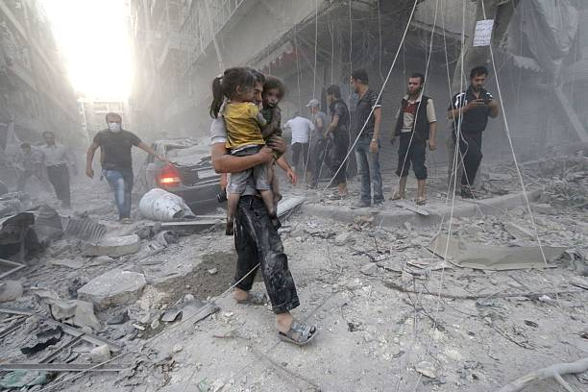
war

Slide 70
conclusion
The Syrian crisis is a War which have own characteristics between a Civil War and regional and international War .
Historic background (11)
When most people think of such War surgery they envision a poor soldier being forcibly held down while his arm or leg is amputated without the benefit of anesthesia. Almost invariably, they picture him “biting the bullet” to help relieve the pain. This Hollywood concept of Civil War surgery is far from accurate.
Anesthesia was used in High percentage in Syrian Crisis War surgeries.as well it was used in all civil wars anywhere..
Sulfuric ether had been discovered in Europe in the 1830’s and was first used as an anesthetic by William Morton in 1846. After a successful public demonstration it became widely used in surgery. Chloroform, which had been discovered in 1832, was soon in common use as well.

Slide 71
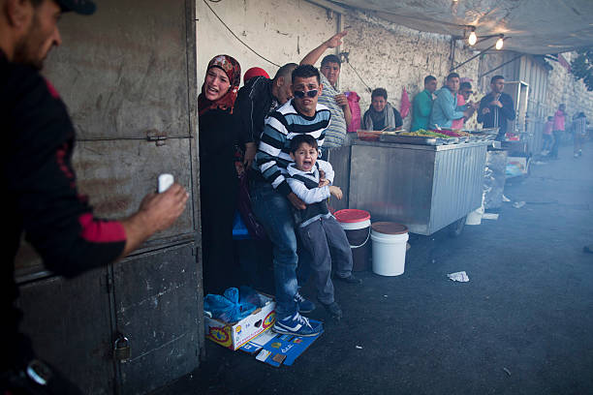
war

Slide 72
Conclusion cont.,
In the past Civil War in Europe, the anesthetic qualities of chloroform and ether were well known and widely used. Chloroform was the preferred anesthetic since a smaller quantity was needed and its effect was rapid.(11)
Administering Anesthesia Chloroform was administered by placing the anesthetic on a sponge at the top of a cone and putting the open end over the patient’s nose and mouth. It was administered gradually to avoid shock. Once the patient was affected the cone was removed. The average time needed for the administration of chloroform was nine minutes. (11)

Slide 73
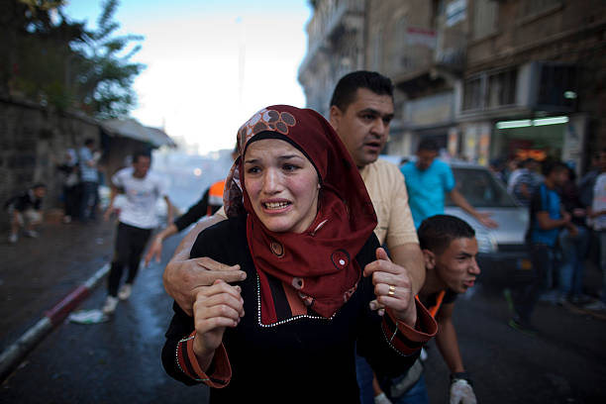
war

Slide 74
Conclusion cont.,
Ether was used less frequently since more of the substance was needed to produce the desired effect and it took an average of seventeen minutes to work. The best method of administration was to use a folded towel or bell-shaped sponge which was large enough to cover the nose and mouth. This was then soaked with the anesthetic. Another drawback for using ether was that it was flammable, a dangerous matter in an era of gas and candle lighting.
Both ether and chloroform were manufactured in large medical laboratories run by the armies on both sides. Some private laboratories, like Squibb’s, contracted with the Union Army to produce drugs and developed an improved way to distill ether.(11)

Slide 75
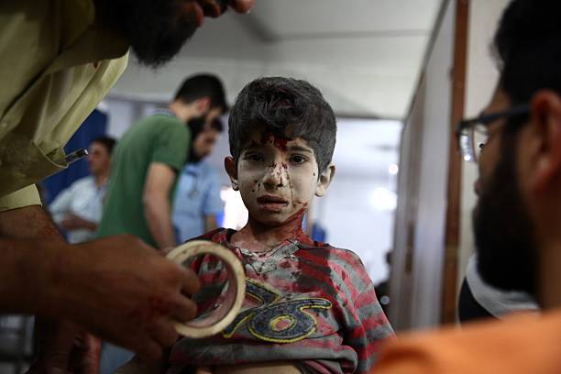
war

Slide 76
Conclusion cont.,
Now , with the modern technology available supply of anesthesia more easy than it was in the past, and in case of Damascus city which was and still a main trade center in the area it was not a problem to keep supplies and even storage of supplies through the government of Syria, but unfortunately areas which are under difficult circumstances with lack of transportation or difficult to get supplies will be shortage in every things , one report shows that anesthesia has been done by infrastructure and , even knockdown be used for anesthesia but in our case we are talking about a central city hospital supported and supplied by ministry of health of government .(10)
Notes:
anesthesia

Slide 77
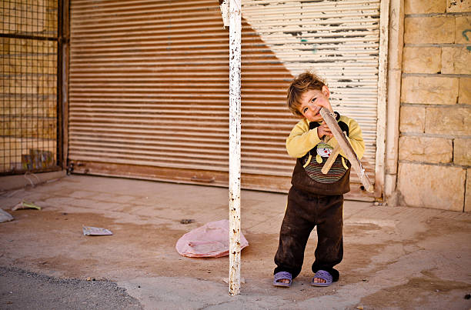
war

Slide 78
Conclusion cont.,
biting the bullet, especially during surgery. The surgical manuals do not advocate placing anything in the patient’s mouth. Placing a bullet between the teeth of a prone man who is likely to scream in pain is not the smartest thing to do , also knock down the patient by knock the patient down in the head been done Syria all these methods are not advisable and not recommended (5)
Notes:
,

Slide 79
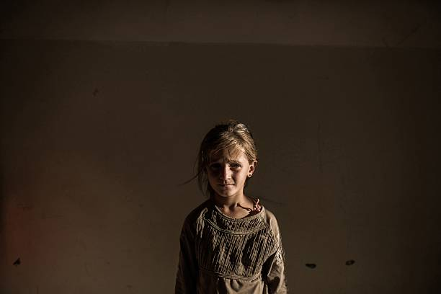
war

Slide 80
Conclusion cont.,
Quality anesthesia provision in Syrian crisis is armed conflict similar to an armed conflicts and disaster which still remains a challenge, due to among others impaired healthcare systems, security concerns, challenges in ensuring supply lines, and lack of adequate human resources and material. However, following the experience of several surgical care teams, it is possible to perform safe anesthesia in such contexts, by carefully considering the need for a satisfactory infrastructure, basic means (disposables, drugs, biomedical devices), competent human resources, standard operative procedures, and adapted anesthesia .(12)

Slide 81
It is the war

Slide 82
Conclusion cont.,
The provision of safe anesthesia should be tailored to a specific context, aiming for the best possible quality that can be offered.
The “do no harm” principle must be upheld at all times and surgical care should not be provided at any cost, compromising safety and quality(12)

Slide 83
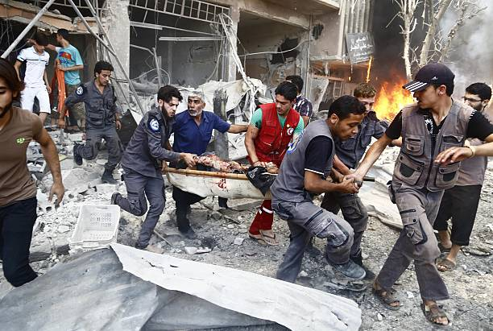
war

Slide 84
Conclusion cont.,
Local, spinal and general intravenous are the recommended techniques in precarious situations. Ketamine, as an intravenous agent, remains the drug of choice in such contexts due to its pharmacological characteristics, though issues with importation and exportation need to be taken into consideration. Inhalational anesthesia might not be possible to implement, while regional anesthesia is an underused technique that should be encouraged in the future. Epidural anesthesia is as needed and as indicated even it is possible to perform spinal anesthesia and avoid potential Complications and we should keep training for it ..(12)

Slide 85
It is the war

Slide 86
Conclusion cont.,
Clear standard operative procedures should be implemented in these contexts to ease the provision of care and improve its quality. At the same time,
clear policies regarding informed consent form should be in place as it is a right of the patient to know what kind of procedure is going to be performed and what the possible risks are, and to be able to refuse the proposed surgical care.

Slide 87
war

Slide 88
Conclusion cont.,
It is important to encourage local anesthesia teams and researches to report their invaluable experience working in precarious situations. Sharing experience will help other anesthesia providers working in similar situations and international / national aid organizations to deliver safe and quality anesthesia in ongoing and future situations of crisis and War conflicts.

Slide 89
It is war

Slide 90
References
References:
1- AVSI foundation (Association of Volunteers in International Service), The Health crisis in Syria what is happening in ten points
.2- AVICINA JOURNAL OF MEDICINE 2012 July- Sept 51-53 Health care in Syria before and during Syrian crisis
3- Millers Anesthesia 8th edition 2010 chapter 81 p 2819 anesthesia for trauma p2823anesthesia in war and austere conditions
4- Morgan's & Mikhail's Anesthesiology 5th edition 2013 chapter 9 p197-99 ketamine.
5- RT news March 10 – 2014 Metal knockout instead of anesthesia – report details Syria health care collapse

Slide 91
war

Slide 92
References Cont.,
6- MAGNA (medical aid) . March 4 -- 2016. The anesthesia in Syria being done by lower sanitary workers pursuing instructions
7- Syrian American Medical Society annual report 2015.
8- Manual of Regional Anesthesia Carlo D Franco M.D 3rd edition 2008 chapter 3 p37-neuroaxial block,p47
9- W.F.S.A November 16 2015 Ketamine use in war zone in Syria.
10- International Journal Of Public Health January 2015 60 pp63-72 Syria : Health in country under Tragidic transition .

Slide 93
References
11--- Anesthesia in the civil war …January 22 2017 national museum of civil war medicine.
12 --- Anesthesia provision in disasters and armed conflicts .global health anesthesia 16 February 2017.
13- ibn al nafees hospital records

Slide 94
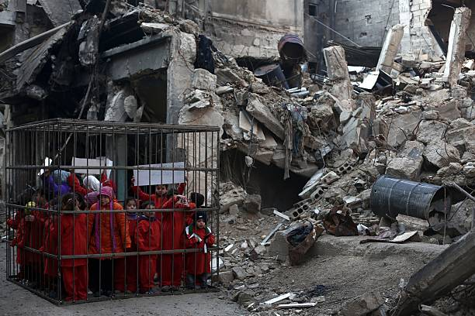
war

Slide 95
Thank you

