Slide 1

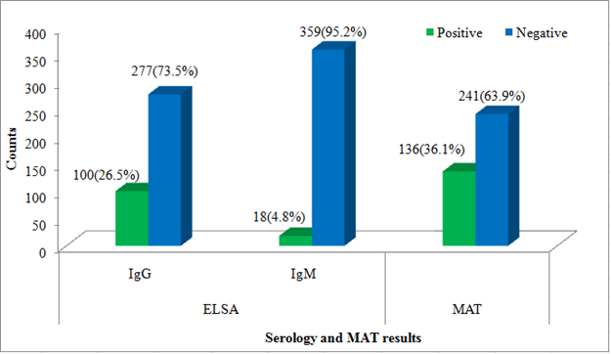
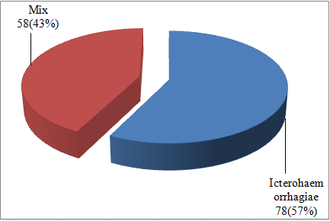
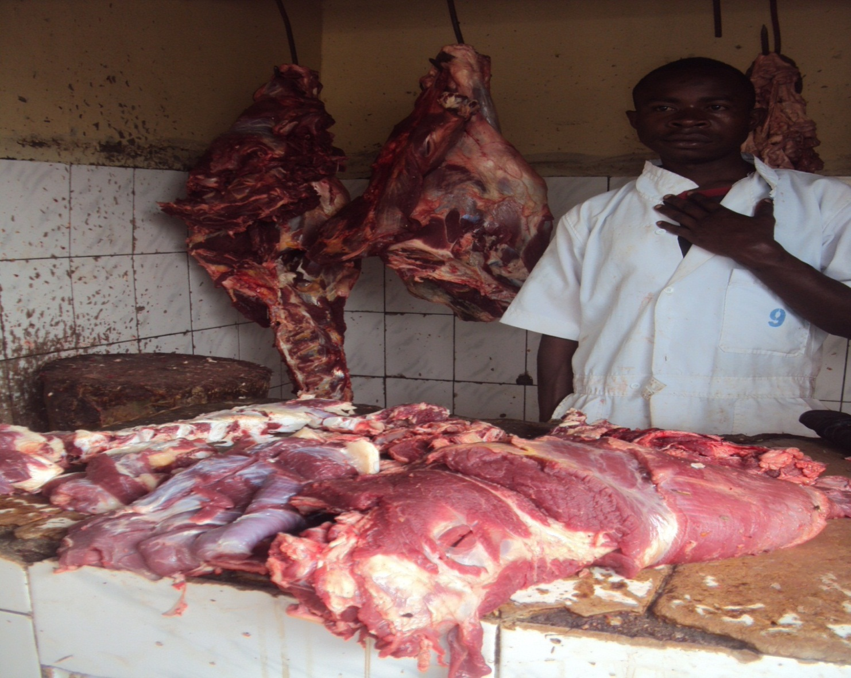
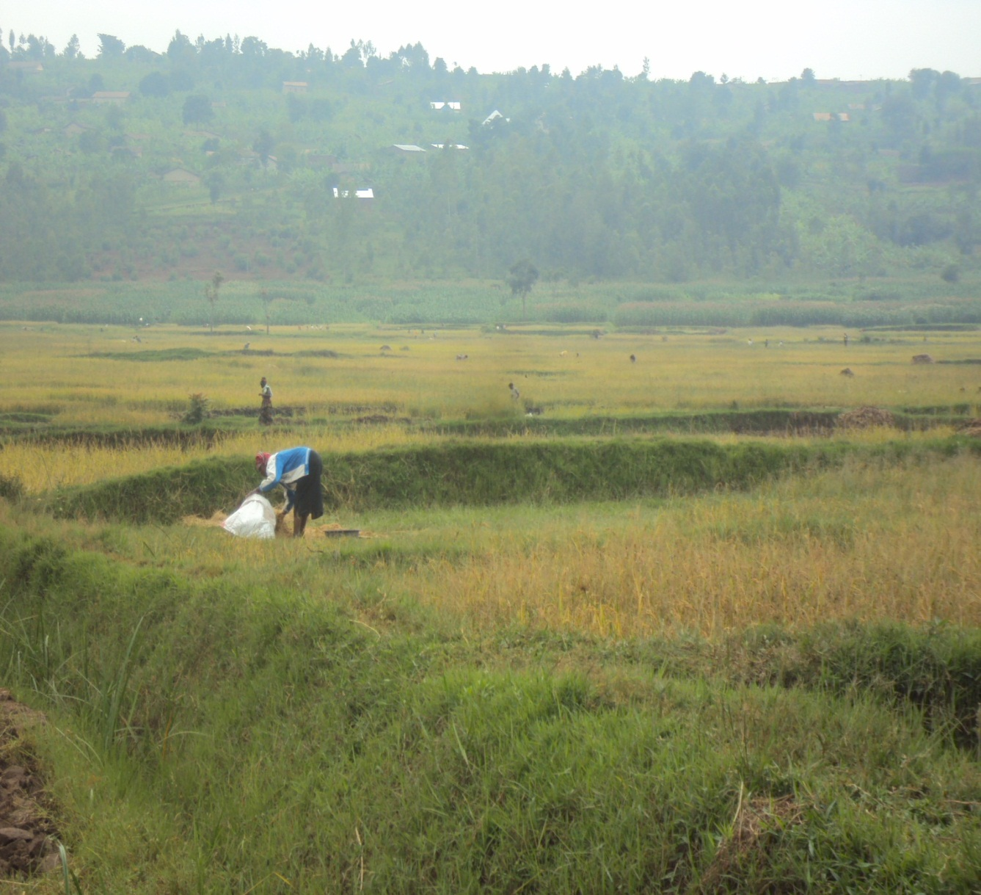



Prevalence of Leptospirosis and Associated Risk Factors in Rural RWANDA
E. Ntabanganyimana¹, H. C. Devon², R. Giraneza³, P. Cameron⁴, J. A. Dixson³; ¹University of Rwanda, Internal medicine, Kigali, RW/RW, ²University of Utah School of Medicine, Infectious Diseases, Utah/US, ³University Teaching Hospital, Butare, Internal Medicine, Butare/RW, ⁴Visiting HRH, Internal Medicine, Brooklyn/US
Background:
Leptospirosis is a zoonotic spirochete that is transmitted thought the urine of wild and domestic animals (4). It causes a non-specific febrile illness that is often mistaken for malaria in endemic regions, and under-treatment due to lack of recognition of the disease leads to almost 50,000 deaths each year (5). In East Africa prevalence varies greatly, from as low as 7% in Kenya to 37% in Somalia (3). Transmission epidemiology also varies around the world, with research in Nicaragua showing that rodents are the most clinically important vector, while studies in Egypt and Chile suggest that dogs may play a more important role (1,2). There are no published studies of Leptospirosis in Rwanda.
Aims:
To evaluate the prevalence of Leptospirosis exposure and recent acute infection among asymptomatic adults in two districts of Southern Province.
To identify a particularly high-risk population.
Methods:
We performed a cross-sectional study to assess prevalence of Leptospirosis in Rwanda. 377 Asymptomatic subjects were recruited from five occupational categories: 74 cattle farmers, 69 fish farmers, 98 crop farmers, 68 slaughterhouse workers, and 68 university students defined as low-risk controls. Serum samples were tested using both ELISA and Microscopic Agglutination Test (MAT) where OD ≥ 1.0 for Ig G and Ig M, and MAT titer ≥ 100 defined as positive Leptospirosis either acute infection when MAT titer ≥ 800 or exposure for the remaining group. Participants were interviewed in their local language to collect data on risk factors, and these were correlated with serology and MAT results.
Findings:
Overall, 40.1% (151/377) were found to be positive for Leptospirosis. Every subject that was positive for Leptospirosis exposure reported contact with rats (100%, p≤0.01, 95% CI 1.09-1.60, OR 1.251), and were also more likely to report exposure to cows (86.1% vs 78.3% for those not exposed, p=0.01, 95% CI 1.10-2.02, OR 1.194). Occupations significantly associated with Leptospirosis were crop farmers (p<0.01, 95% CI 2.0-8.1, OR: 4.024), cattle farmers (p<0.01, 95% CI 1.6-6.7, OR 3.081), and slaughterhouse workers (p=0.03, 95% CI 1.1-4.9, OR 1.596). We found 6 subjects (1.6%) meeting criteria for acute infection.
Interpretation:
This study demonstrates a very high prevalence of leptospirosis exposure among asymptomatic adults in rural Rwanda, particularly relative to neighboring countries. Exposure was particularly high among crop farmers, cattle farmers, and slaughterhouse workers. Exposure to rats was significantly associated with leptospirosis infection. The high prevalence of Leptospira exposure suggests that Leptospirosis may need to be considered among the differential for acute febrile illness in Rwanda. Vector control efforts may target rats, while farmers and slaughterhouse workers may be prioritized for infection control efforts.
References
1. Leptospira contamination in household and environmental water in rural communities in Southern Chile. Int J Environ Res Public Health. 2014 July; 11(7): 6666-6680
Felt SA, Wasfy MO, Pimental G et al. Cross-species surveillance of leptospira in domestic and peri-domestic animals in Mahalla City, Gharbeya Governorate, Egypt. Am J Trop Med Hyg. 2011 Mar; 84(3): 420-5
de Vries SG, Visser BJ, Nagel IM, Goris MG, Hartskeerl RA, Grobusch MP. Leptospirosis in Sub-Saharan Africa: a systematic review. Int J Infect Dis. 2014;28:47–64.
Organization WH, others. Human leptospirosis: guidance for diagnosis, surveillance and control. 2003. ISBN. 2010;92(4):154589.
Epidemiology, microbiology, clinical manifestations, and diagnosis of leptospirosis [Internet]. [cited 2016 Mar 17]. Available from: http://www.uptodate.com/contents/epidemiology-microbiology-clinical-manifestations-and-diagnosis-of-leptospirosis
Acknowledgements:
We thank the members of Immmuno-serology department at Butare University Teaching Hospital, Rwanda for the assistance of lepto ELISA analysis and Yale University for MAT analysis. We thank THRIVE consortium and Utah University for the study sponsorship.
BIOGRAPHY: Dr. Etienne NTABANGANYIMANA has completed his MMed in Internal Medicine department at the age of 33 years, from University of Rwanda, College of Medicine and Health Sciences. Currently he is Junior Consultant at Gihundwe District Hospital, Western Province, Rwanda and at Africa Healthcare Network, Gihundwe and Gisenyi Dialysis Centers.
Appendices

