Slide 1

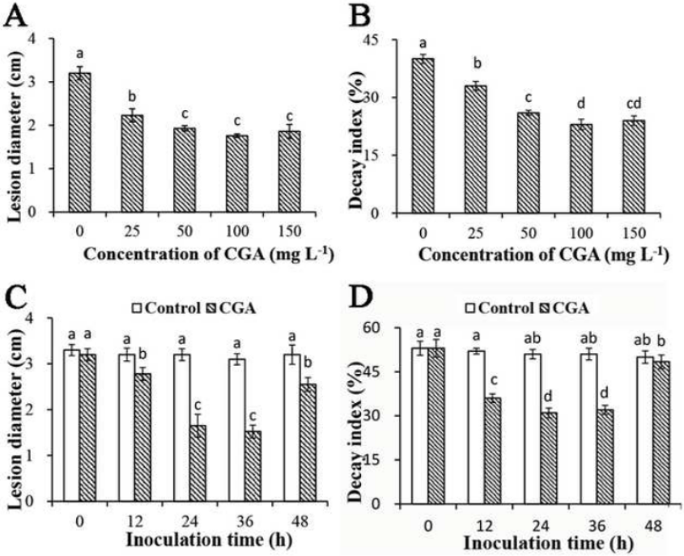
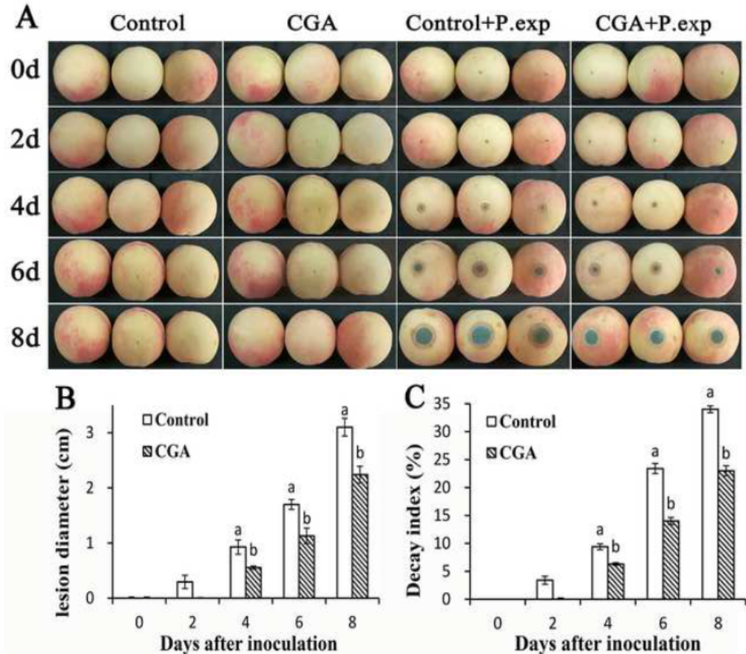
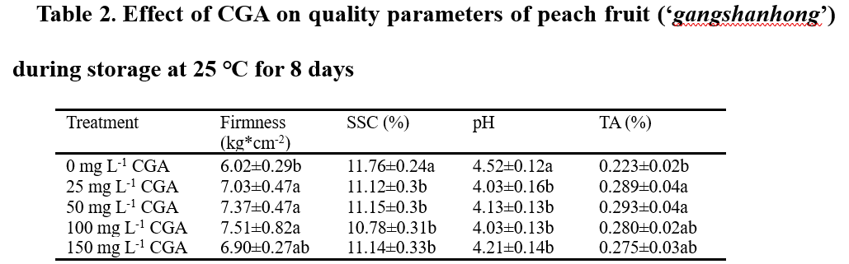
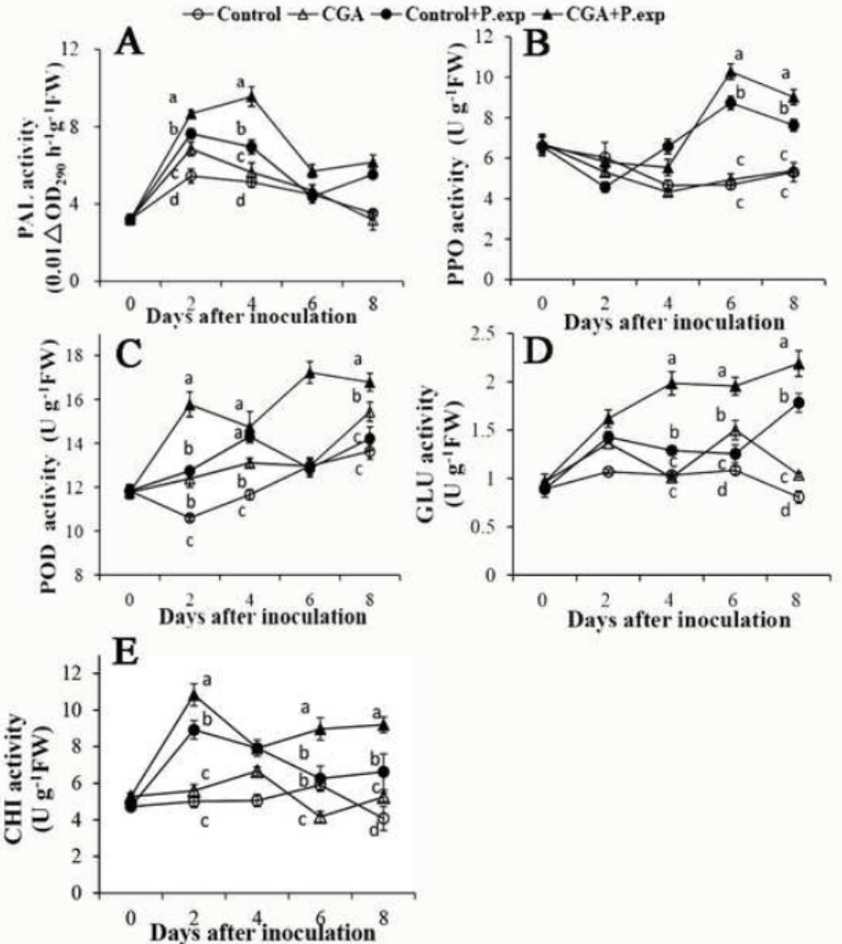
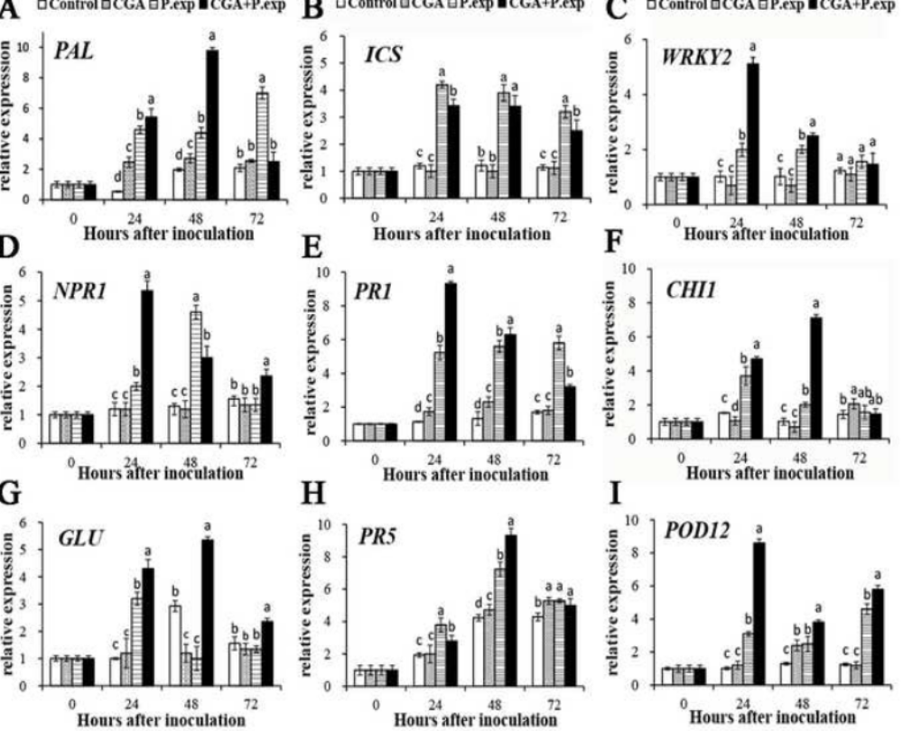
11th World Congress on Food Chemistry &
Food Microbiology
Chlorogenic acid induces resistance against Penicillium expansum in peach fruit by activating the salicylic acid signaling pathway
Wenxiao Jiao, Xiangxin Li, Xiaomei Wang, Jiankang Cao, Weibo Jiang
College of Food Science and Nutritional Engineering, China Agricultural University,
8 17 Qinghuadonglu Road, Beijing 100083, P.R. China.
Introduction
Fig.1
Fig.2
Peach (Prunus persica L.) fruit, belongs to climacteric fruit, has been one of the most popular fresh fruits in the world. However, it has only a short shelf life after harvest when stored at ambient temperature because of its high susceptibility to pathogens. Blue mold rot caused by P. expansum is one of the major postharvest diseases in fruit, and leads to considerable economic losses (Zhu, Yu, Brecht, Jiang & Zheng, 2015). Synthetic fungicides have been applied extensively in the past to control postharvest diseases in fruit and vegetables, because they are cheap and effective. Negative effects of synthetic fungicides, such as environmental pollution, health risks, and pathogen resistance, have stimulated more and more studies seeking other approaches to controlling postharvest diseases in fruit. Boosting natural disease resistance (NDR) in fruit is considered an efficient and preferred strategy for reducing disease incidence (Terry & Joyce, 2004).
Chlorogenic acid (CGA, 3-O-caffeoylquinic acid) is an important phenolic compound distributed widely in plant such as apple, Eucommia, honeysuckle, artichoke. It possesses multiple biological properties favorable for human health, including anti-inflammatory, anticarcinogenic, anti-diabetic, antihypertensive, and antimicrobial effects. Extensive studies have demonstrated that CGA plays a key role in defense responses of plants against a wide range of pathogen challenges. However, it is largely unknown thus far how exogenous CGA may influence disease resistance in plants.
Table 2
Fig.3
Fig.4
Methods
We carried out the experiment for CGA treatment and evaluation of disease severity. Therefore, the four groups in this work displayed as follows:
1) control, fruit treated only with sterile distilled water;
2) CGA, fruit treated only with CGA solution;
3) P. exp, fruit treated with sterile distilled water followed by inoculation with P. expansum;
4) CGA + P. exp fruit treated with CGA at 100 mg L⁻¹ followed by inoculation with P. expansum.
Moreover, defense-related enzyme activitiesincluding phenylalanine ammonia-lyase (PAL), peroxidase (POD), polyphenol oxidase (PPO), β-1,3-glucanase (GLU), and chitinase (CHI) were measured according to methods of previous studies. Real-time quantitative polymerase chain reaction (RT-qPCR) were well-designed to analyze expression of key genes involved in the salicylic acid (SA) signaling pathway.
Conclusion
Results from this study indicated that treatment with CGA at 25-150 mg L⁻¹ was effective at reducing lesion diameter and decay index of peach fruit after inoculation with P. expansum during storage at 25 ℃. CGA controlled the postharvest blue mold rot in peach fruit by up-regulating the activities of defense-related enzymes and activating the SA signaling pathway. This work suggests that CGA is an efficient, safe, and eco-friendly postharvest elicitor with potential for commercial application.
Results and discussion
1) As the data shown, the results indicated that application of exogenous CGA at 25-150 mg L⁻¹ effectively reduced lesion diameter and decay index of peach fruit after P. expansum infection during storage at 25 ℃ (Fig.1 and Fig.2).
2) CGA exhibited significant beneficial effects on fruit quality parameters including firmness, soluble solids contents, pH value, and titratable acidity (Table 2).
3) Activities of main defense-related enzymes and expression of key genes involved in the salicylic acid (SA) signaling pathway, such as PAL, ICS, WRKY, NPR1, PR1, CHI, GLU, PR5, and POD, were enhanced by CGA treatment (Fig.3 and Fig. 4).
Literature Cited
Results from this study indicated that treatment with CGA at 25-150 mg L⁻¹ was effective at reducing lesion diameter and decay index of peach fruit after inoculation with P. expansum during storage at 25 ℃. CGA controlled the postharvest blue mold rot in peach fruit by up-regulating the activities of defense-related enzymes and activating the SA signaling pathway. This work suggests that CGA is an efficient, safe, and eco-friendly postharvest elicitor with potential for commercial application.

