Slide 1

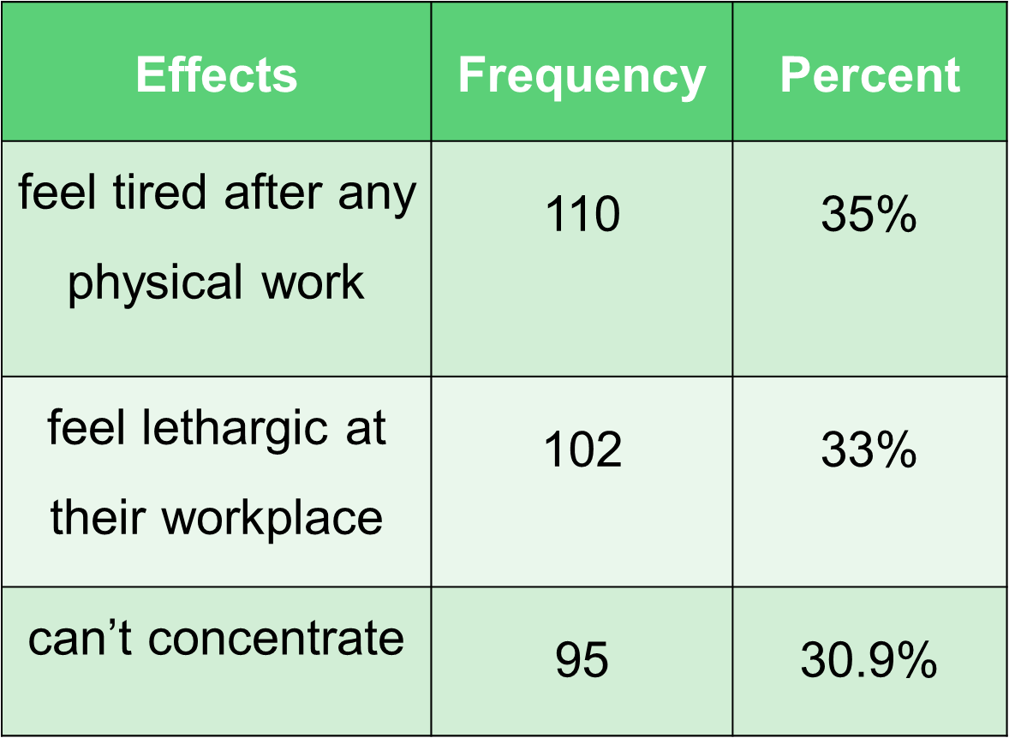


Morning Sickness among Young Adults of Karachi, Pakistan: Prevalence, Knowledge and Associated Factors
Maha Akhter¹, Maira Khalid², Fizza Arif³, Arsalan Shafique⁴ Dr. Nafisa Hassan Ali⁵
Medical Students¹⁻⁴, Department of Clinical Laboratory Sciences⁵, Dow University of Health Sciences, Karachi
INTRODUCTION
RESULTS
RESULT CONT..
Morning sickness is the uncomfortable feeling of nausea and malaise (sometimes may accompanied with vomiting), one encounters upon rising up.
Being considered to be associated with pregnancy only, there is a lack of study which evaluates Morning Sickness besides pregnancy.
This study presents the prevalence of Morning sickness among young adults, determining their knowledge about it and its consequences on one’s lifestyle.
Presence of one or more symptoms such as Nausea, Vomiting, Dizziness etc. upon rising up was labelled as occurrence of Morning sickness.
Out of 450 participants, prevalence rate of Morning Sickness was 71% (n=316). Awareness about Morning Sickness was 48% (n=215) and it was statistically related with Field of study (p=0.01).
Many participants reported that symptoms get worsen if they go in a poorly-ventilated area (49.1% n=221).
There was found a tendency of Morning Sickness being common in families (52% n=233).
Table 1: Effects of Improper breakfast intake
PURPOSE
To evaluate the prevalence of Morning Sickness among Young Adults, and assessing its common symptoms and associated factors
MATERIALS AND METHODS
A cross-sectional, descriptive study
From: June-August 2016
At: Dow University of Health Sciences (Ojha campus), and University of Karachi, Pakistan
Non-probability convenience sampling.
Data collected using: Self-administered questionnaires
Statistical analysis: SPSS v16 (p<0.05 as significant level)
DISCUSSION
At present, there has been no such study that had assessed Morning sickness beside pregnancy, hence we found no data for comparison. Nonetheless, the exact cause of Hyperemesis Gravidarum is not known¹, however, many studies demonstrated that Nausea and Vomiting of Pregnancy or its severe form Hyperemesis Gravidarum² is mainly associated with release of HCG (human chorionic gonadotropin) ^{3,} hormone. On the similar pattern, in non-pregnant females and males the surge of certain hormones, mainly Serotonin^{4,} causes morning sickness symptoms and among those, nausea being the commonest.
n= 500
Inclusion criteria:
n= 450
Young male and Non-pregnant females (18-35 years),with at least 16 years of education
Exclusion Criteria:
n= 50
Females either pregnant, or with history of pregnancy, individuals with known medical issues
n=237
Healthcare professionals/ students
n=214
non-health related fields
Morning Sickness is associated
Significantly to
Food intolerance to dairy product, egg and wheat
(p=0.001).
Insignificantly to
Age (p=0.07) and Gender (p=0.7)
Associations:
CONCLUSION
Prevalence of Morning sickness is quite high among the young adults. This issue should not be ignored and awareness campaign should be run to educate masses about healthy diet regimen.
REFERENCES
Munch S. Chicken or the egg? The biological-psychological controversy surrounding hyperemesis gravidarum. Soc Sci Med. 2002 Oct;55(7):1267-78. Review. PubMed PMID: 12365536
Nelson-Piercy C. Treatment of nausea and vomiting in pregnancy. When should it be treated and what can be safely taken? Drug Saf. 1998 Aug;19(2):155-64. Review.
Bolin, M., Åkerud, H., Cnattingius, S., Stephansson, O., & Wikström, A. (2013). Hyperemesis gravidarum and risks of placental dysfunction disorders: a population-based cohort study. Bjog, 120(5), 541–547.
Cubeddu, L. X., Hoffmann, I. S., Fuenmayor, N. T., & Malave, J. J. (1992). Changes in serotonin metabolism in cancer patients: its relationship to nausea and vomiting induced by chemotherapeutic drugs. British Journal of Cancer, 66(1), 198–203.
51.4% (n=213) participants either skip their breakfast or could only take up to few bites due to these symptoms.

Slide 2

Introduction
Morning sickness is the uncomfortable feeling of nausea and malaise (sometimes may accompanied with vomiting), one encounters upon rising up.
Being considered to be associated with pregnancy only, there is a lack of study which evaluates Morning Sickness besides pregnancy.
This study presents the prevalence of Morning sickness among young adults, determining their knowledge about it and its consequences on one’s lifestyle.
Result
Presence of one or more symptoms such as Nausea, Vomiting, Dizziness etc. upon rising up was labelled as occurrence of Morning sickness.
Out of 450 participants, prevalence rate of Morning Sickness was 71% (n=316). Awareness about Morning Sickness was 48% (n=215) and it was statistically related with Field of study (p=0.01).
Association:
Purpose
To evaluate the prevalence of Morning Sickness among Young Adults, and assessing its common symptoms and associated factors
Materials and methods
A cross-sectional, descriptive study
From: June-August 2016
At: Dow University of Health Sciences (Ojha campus), and University of Karachi, Pakistan
Non-probability convenience sampling.
Data collected using: Self-administered questionnaires
Statistical analysis: SPSS v16 (p<0.05 as significant level)
n= 500
Inclusion criteria:
n= 450
Young male and Non-pregnant females (18-35 years),with at least 16 years of education
Exclusion Criteria:
n= 50
Females either pregnant, or with history of pregnancy, individuals with known medical issues
n=237
Healthcare professionals/ students
n=214
non-health related fields

