Slide 1

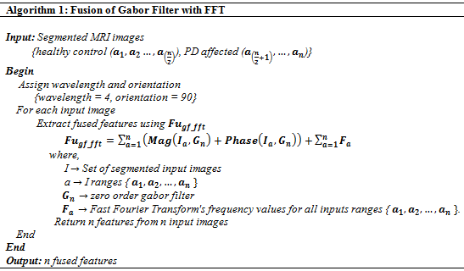
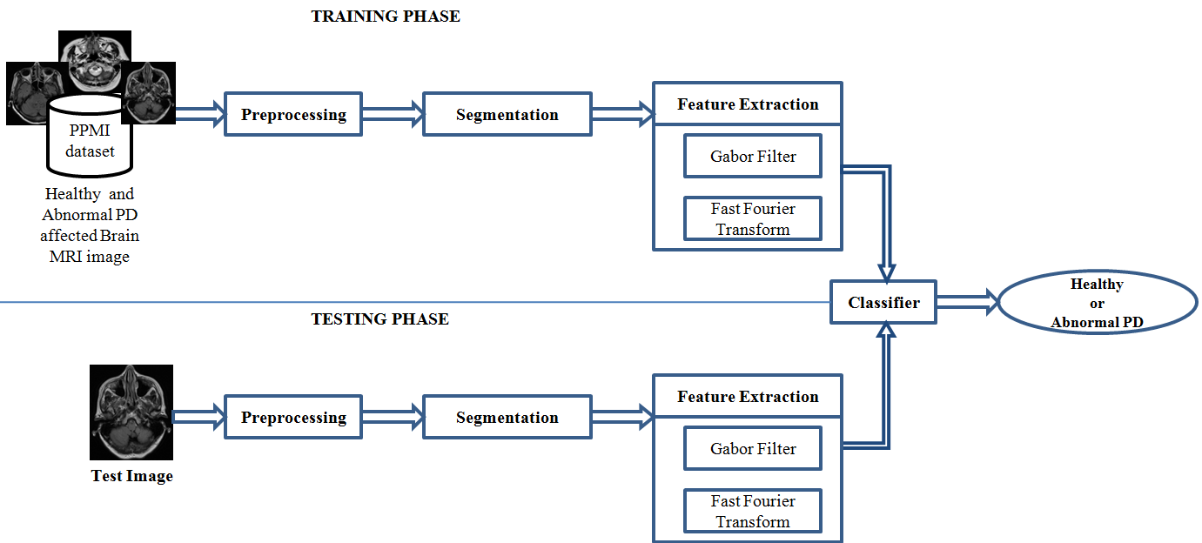
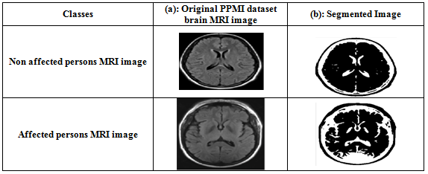
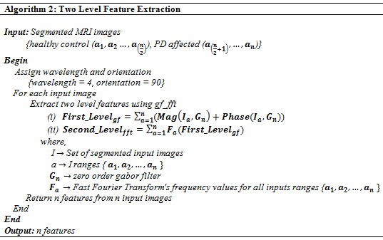
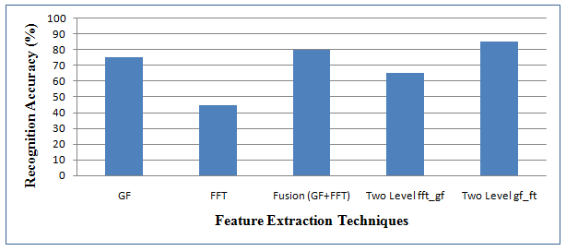


DETECTION OF PARKINSON DISEASE IN HOMO SAPIENS USING SUPERVISED APPROACH
CONTACT
B.Anusha¹, P.Geetha²
¹Research Scholar, ²Assistant Professor, Department of Information Science and Technology,
College of Engineering Guindy, Anna University, Chennai, Tamil Nadu, India.
Name : B.Anusha
Mail :bsanusharaj@gmail.com
Ph.no : 9489890950
Problems
PD LABELING SYSTEM FRAMEWORK
RESULTS
Identification of the exact feature extraction technique.
Developing an automatic early stage Parkinson Disorder (PD) identification system.
Objective
To propose a supervised approach based automatic PD labelling system for the detection of Parkinson disease in Homo sapiens.
Techniques
Segmentation
  OSTU thresholding and Morphological operations
Feature Extraction
  Gabor Filter (GF)
  Fast Fourier Transform (FFT)
  Fused GF with FFT
  Two level GF_FFT
  Two Level FFT_GF
Classification
  Support Vector Machine (SVM)
Two Level FFT_GF
  Table 1:Pre-processed segmented output for healthy control versus PD affected. It describes that the input image firstly processed and segmented through OSTU thresholding based segmentation and after performing morphological operations.
METHODOLOGY
Gabor filter (GF)
Fast Fourier Transform (FFT)
Fourier transform maps signal into Fourier frequencies, which produces result in O(N log N) time.
Data Set
Parkinson's Progression Markers Initiative (PPMI) dataset offered by USC University of Southern California
  Training: 160 persons
  Testing: 20 persons
CONCLUSION
Figure 1: Parkinson detection system's Recognition accuracy, which attained the maximum of 85% when we use two level GF_FFT feature extraction for the detection of Parkinson disease affected person.
An automated well-organized PD detection system obtained 5% more accuracy for two level GF_FFT than fused GF-FFT feature.
This could be improved on varied size of dataset.
Future work contributes towards the recognition capability in other neuro degenerative genetic disorder identification.
References
Marvin M Goldenberg. "Medical management of Parkinson’s disease." Pharmacy and Therapeutics 33.10 (2008): 590.
Tao Wu, and Mark Hallett. "A functional MRI study of automatic movements in patients with Parkinson's disease." Brain 128.10 (2005): 2250-2259.
S.Sridhar. "Digital Image Processing". Oxford University Press, ISBN 10: 0199459355 ISBN 13: 9780199459353, 2011.
Software
The licenced version of MATLAB 2017a simulink tool

