Slide 1
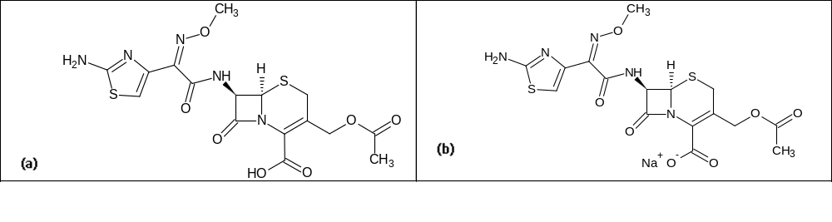
Nano-Mixed Micelles: An Approach to Enhance the Oral Bioavailability of BCS Class III Drug
Mosab Arafat¹, Cathrin Kirchhoefer², Momir Mikov³
¹College of Pharmacy, Al Ain University of Science and Technology, Abu Dhabi, UAE.
²Department of Chemistry, The University of Warwick, UK.
³Department of Pharmacology, Toxicology and Clinical Pharmacology, Medical Faculty, University of Novi Sad, Serbia.
Interactive!
Click on any of these bubbles to jump to each section
Abstract
Aim
The main purpose for this study was to investigate the ability of mixed micelles formulation (MMs) made of phosphatidylcholine (PPC) and BS (sodium cholate) loaded with Cefotaxime sodium (CEF) and 3α,7α-dihydroxy-12-keto-5β-cholanate (MKC) complex to enhance the oral bioavailability of CEF in rats.
Methods: thin-film hydration method was used to prepare CEF loaded MMs using different BS concentrations. MMs were characterized and the oral bioavailability of CEF in MMs formulation was assessed and the pharmacokinetic (PK) of CEF-loaded MMs in comparison with CEF-BS complex and CEF aqueous solution were evaluated using 24 male Wistar rats. Blood samples were collected for up to 24 h and CEF analyzed using a validated HPLC assay.
Results: PK data showed that the oral bioavailability of CEF in MMs was found to be (4.21 %) higher compared to the CEF in aqueous solution (1.30%). Cmax of CEF in MMs formulation was higher (1.06 ± 0.1 µg/ml) compared to CEF-MKC complex (0.59 ± 0.1 µg/ml) and CEF in aqueous solution (0.52 ± 0.1 µg/ml). Similarly, the mean values for AUC0-t of CEF in MMs formulation was higher (3.75 ± 0.8h.µg/ml) compared to CEF-MKC complex (1.52 ± 0.2 h.µg/ml) and CEF in aqueous solution (1.03 ± 0.4 h.µg/ml, respectively).
Conclusions the mixed micelles formulation composed of PPC and BS was able to increase the intestinal epithelial cell efflux of drug and eventually enhance the oral bioavailability of BCS Class III Drug CEF up to 4-fold
Its low oral bioavailability can not only be related to rapid degradation undergoing hydrolysis at high acidity found in the stomach, but also the zwitterionic character as a peptidomimetric drug restricts the permeation of the intestinal mucosal membrane. Its pharmacokinetics (PK) have been investigated in various species after single injection such as rats, sheep, goats, calves, cats, dogs, and humans..
Overall, studies agree about an approximate serum half-life of 1.1-1.3 h after injection. Bearing in mind the obvious downsides of drug delivery by injection and potential side effects of high oral dosages, CEF is an ideal drug candidate to improve oral bioavailability. However, only a few studies can be found in literature resulting in a 2.7-fold increase using liposomes plus an additional 1.2-1.8-fold increase using folic acid-coupled liposomes, a 9-fold increase using 3α,7α-dihydroxy-12-keto-5β-cholanate (MKC) microvesicles and a 4-fold in vitro increase using BS. In the current study, we selected CEF as Class III model drug and sodium cholate (NaC) as a model BS to investigate the influence of mixed micelles made of phosphatidylcholine (PPC) and NaDC (MMs) on the oral bioavailability of CEF in rats, by evaluating the PK of CEF in MMs and CEF-MKC complex in comparison with CEF aqueous solution.
Background
Several drug formulation based on MMs can be found in literature, such as taxol, silybin , streptomycin and gentamycin, tetrazepam and further benzodiazepine drugs. The drug model chosen for this investigation was cefotaxime sodium (CEF), a third-generation cephalosporin with a broad spectrum of antibacterial activity. CEF is a semisynthetic, 2-aminothiazolyl beta-lactam antibiotic that is highly hydrophilic, but its low permeability classifies it as a class III drug according to the Biopharmaceutical Classification System (BCS).
Fig. 1 Chemical structures of (a) cefotaxime (CTX) and (b) cefotaxime sodium (NaCTX)
INTRODUCTION

Slide 2

Nano-Mixed Micelles: An Approach to Enhance the Oral Bioavailability of BCS Class III Drug
Mosab Arafat¹, Cathrin Kirchhoefer², Momir Mikov³
¹College of Pharmacy, Al Ain University of Science and Technology, Abu Dhabi, UAE.
²Department of Chemistry, The University of Warwick, UK.
³Department of Pharmacology, Toxicology and Clinical Pharmacology, Medical Faculty, University of Novi Sad, Serbia.
Interactive!
Click on any of these bubbles to jump to each section
Materials
Cefotaxime sodium (CEF) and sodium deoxycholate (NaDC) was purchased from Sigma Aldrich (St. Louis, USA) and phosphatidylcholine (PPC) was obtained from Lipoid GmbH (Ludwigshafen, Germany). HPLC grade of acetonitrile, chloroform, tetrahydrofuran (THF) and methanol were obtained from Merck (Darmstadt, Germany). MKC was synthesized and purified in the Department of Pharmacy, University of Novi Sad, (Novi Sad, Serbia). Glacial acetic acid was obtained from BDH Laboratory Supplies (Poole, England).
Sample Preparation
Prior to analysis, CEF was extracted from plasma samples using previously published method [38]. Briefly: an aliquot of plasma (100 µl) was transferred into Eppendorf micro-centrifuge tubes and deproteinized by adding 15 µl aliquots of 30% (w/w) perchloric acid. After vortex-mixing for 30 s (Stuart Scientific, UK),70 µl of 0.55M aqueous disodium hydrogen orthophosphate buffer was added and the mixture was immediately vortexed again for further 15 s. Afterwards, samples were centrifuged (Eppendorf, Hamburg, Germany) at 15,000 rpm for 10 min and 60 µl of the supernatant was injected into the HPLC system. .
Assay Validation
A complete Shimadzu's HPLC system (Shimadzu Corporation, Japan) was used consisting of a LC-10A vp Intelligent HPLC pumpand a SPD-10A vp detector set at an operation wavelength of 254 nm and a Rheodyne 7725i injector fitted with a 50 µl sample loop (Rheodyne, USA). This HPLC system was typically used to analyze all the CEF plasma samples and all obtained data were collected and processed by Shimadzu Class VP version 7.4 software. A Phenomenex SB-C18 reversed phase analytical column (150 x 4.6 mm, 5µm) (Torrance, CA, USA) fitted with Refillable Phenomenex guard column (10 x 2 mm, 5 µm) packed with Perisorb RP-18 (Upchurch Scientific, Oak Harbour, WA, USA) was used with mobile phase of 0.04 mol aqueous ammonium acetate : acetonitrile : THF (90 : 7:3, v/v) adjusted to pH 5.7 using glacial acetic acid. Data manipulation and processing was carried out using EZC from Elite software. The flow rate was 0.9 ml/min and the samples were quantified using peak area
Statistical analysis
PK parameters such as maximum concentration (Cmax) and the time to reach maximum concentration (Tmax) were derived directly from the CEF serum concentration-time profiles. Half-life (t1/2) was calculated from the elimination rate constant (determined using the terminal three points). Area under the plasma concentration-time curve (AUC0- t) was calculated by the trapezoidal method and extrapolated to infinity to give AUC0-∞. The mean residence time (MRT) was calculated from the AUC0-t. The oral bioavailability (F) was calculated using equation below All data were expressed as mean ± SD
Preparation of CEF-loaded Mixed Micelles (CMMs)
CMMs were prepared by thin-film hydration method with some modifications as described previously. Briefly, a lipid mixture containing PCC:NaC (13:2) was dissolved in chloroform and evaporated under reduced pressure at 50ºC for 25 min to form a lipid film using a rotary evaporator (R-144Buchi, Switzerland). The flask was then flushed with nitrogen to remove residual solvent. 10 ml of Phosphate buffered saline (pH 7.4) containing CEF-MKC complex made of 50 mg/ml CEF (100 mmol) and MKC (12 mmol) was added to the flask together with glass beads. CMMs were achieved after lipid film hydration with CEF-MKC complex solution followed by swirling the flask gently for 10 min at 37ºC. Triplicate batches were prepared each being subjected to 5 cycles of filtrations through 0.22 µm pore size filters using cellulose syringe filters and kept frozen at -20 ºC. Samples were used within 12 h of preparation..
Rat treatment
The experiment was carried out by randomly divided rats into 4 groups (n= 6, per group) to receive followings: 1- a single i.v. dose of CEF (20 mg/kg) in sterilized normal saline solution for injection, 2- a single oral dose of CMMs containing (80 mg/kg of CEF) in PBS administered by oral gavage, 3- a single oral dose of CEF-MKS complex containing (80 mg/kg of CEF) in PBS administered by oral gavage or 4- a single oral dose of free CEF (80 mg/kg) in PBS administered by oral gavage.
For i.v. study, 100 µl blood samples were collected into heparinized tubes from the tip of the tail pre-dose and after the dose at 5, 10, 20, 30, 45, 60, 90, 120, 180, 240, 360, 720 minutes and 24 hours after the dose . Similarly, blood samples for the oral study were taken from the tip of the tail pre-dose but at different timing of 15, 30, 60, 90, 120, 150, 180, 240, 300, 420, 540, 720 minutes and 24 h after the dose. Each blood sample was replaced by an equal volume of saline and heparinised tubes were used. Each animal was housed in individual metabolic cages during blood sampling. Animals were kept warm and cages were covered to provide protection and security and minimise isolation stress.
METHODS

Slide 3
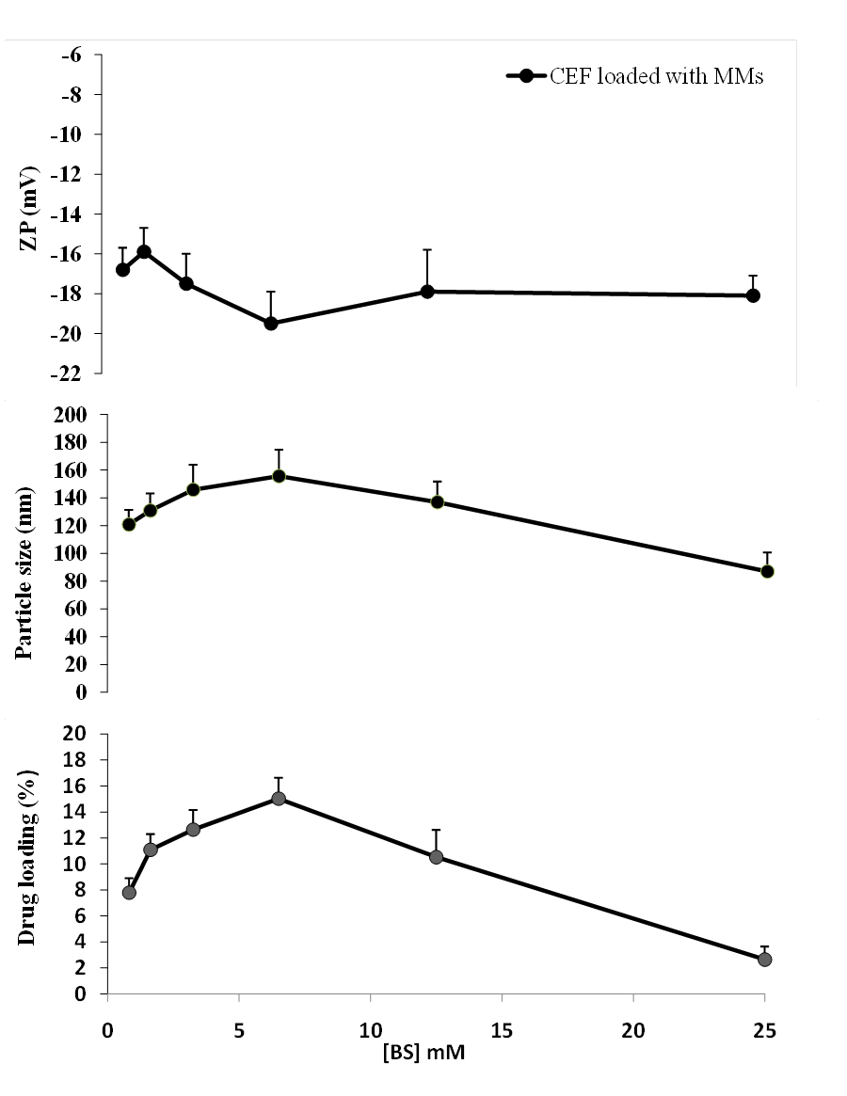
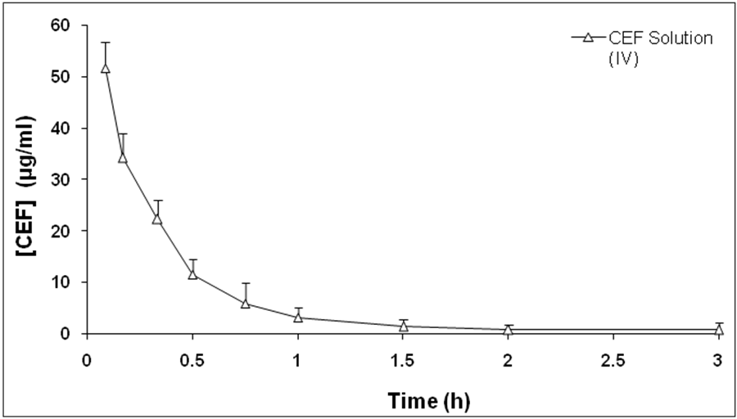
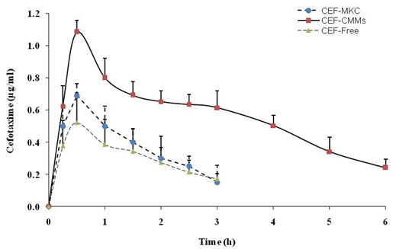
Nano-Mixed Micelles: An Approach to Enhance the Oral Bioavailability of BCS Class III Drug
Mosab Arafat¹, Cathrin Kirchhoefer², Momir Mikov³
¹College of Pharmacy, Al Ain University of Science and Technology, Abu Dhabi, UAE.
²Department of Chemistry, The University of Warwick, UK.
³Department of Pharmacology, Toxicology and Clinical Pharmacology, Medical Faculty, University of Novi Sad, Serbia.
Interactive!
Click on any of these bubbles to jump to each section
Figure 3 Plasma concentration-time profiles of CEF after i.v. administration (20 mg/kg) of CEF aqueous solution to rats (data are mean ± S.D., n = 6).
Figure 2 Drug loading (DL), zeta potential (ZP) and particle size of CEF loaded MMs versus different concentrations of BS (0.8 – 25 mM) (data are mean ± S.D., n = 3).
Figure 4 Plasma concentration-time profiles of CEF after oral administration of CEF (80 mg/kg) as free CEF in solution, CEF-MKC complex and CEF-loaded with MMs to rats (data are mean ± S.D., n = 6).
RESULTS

Slide 4
Nano-Mixed Micelles: An Approach to Enhance the Oral Bioavailability of BCS Class III Drug
Mosab Arafat¹, Cathrin Kirchhoefer², Momir Mikov³
¹College of Pharmacy, Al Ain University of Science and Technology, Abu Dhabi, UAE.
²Department of Chemistry, The University of Warwick, UK.
³Department of Pharmacology, Toxicology and Clinical Pharmacology, Medical Faculty, University of Novi Sad, Serbia.
Interactive!
Click on any of these bubbles to jump to each section
According to PK studies, the MRT of CEF loaded MMs was longer than free CEF solution and the CEF-MKC complex, which resulted in a higher AUC. This can be ascribed to existence of an interaction between CEF and the mixed micelles keeping in mind that the concentration of MMs is above the CMC at the time of administration. These intermolecular forces would initially extend the rate of CEF release until the MMs concentration becomes below the CMC due to blood dilution, where the remaining entrapped drug could be release completely [1, 2]. On the other hand, a significant increase in the Cmax of CEF loaded MMs as compared to others is an evident indication of not only better drug absorption, but it could also be related to the protection of CEF inside the micelles from the stomach acidity.
Introducing BS into mixed micelles improves the oral bioavailability of class III drug molecules. However, the enhancement by loading CEF into MMs could be due to a number of factors. It was shown that oral administration of CEF as CEF-MKC complex can greatly enhance the MRT and AUC of the drug [3]. Another study highlighted that the presence of BS in drug-loaded micelles can increase drug permeability through the mucosal membrane [4]. Furthermore, BS was also expected to enhance the penetration of CEF in the paracellular route by exerting a mucolytic effect and binding calcium ions causing the opening of the tight junctions [5]. Finally, several studies confirmed that BS can enhance the affinity for transporters like H+/peptide symporter (PEPTl) and increase beta-lactam antibiotic trans-epithelial flux and availability [6 –8]. Besides enhancing intestinal permeability, the poor stability at low pH is a major concern with the oral bioavailability of class III drugs. Even not being the main focus of this study, the MMs formulation seemed to protect the drug from degradation in the acidic environment of the stomach up to a certain degree. Therefore, the increased oral bioavailability might also be related to the protection inside the micellular core.
Conclusions
On the basis of the results obtained, it can be concluded that the MMs formulation composed of CEF-MKC complex, NaC and PPC was able to increase the oral bioavailability of the class III drug up to 4-fold. As mentioned before, the overall mechanism might involve multiple factors such as: 1) the direct absorption enhancement properties of BS through the mucosal membrane of the small intestine, 2) the formulation in MMs increasing intestinal uptake by endocytosis via both Payer's patches and intestinal enterocytes, 3) the increased drug stability encapsulated in the mixed micelles. However, the increase in the oral bioavailability of CEF is still limited mainly due to drug hydrolysis caused by the stomach acidity. Thus, further studies are required to focus on the additional protection of the drug molecule from the harsh acidic environment in the stomach.
Acknowledgments
The authors are grateful and thankful to Al Ain University of Science and Technology for the given time and travel expenses for accomplishing this study
References
  Poelma F, Tukker JJ, Crommelin DJA. The role of bile salts in the intestinal absorption of drugs Acta Pharmaceutica Technologica. 1990; 36 (2): 43-52.
  Dongowski G, Fritzsch B, Giessler J, Härtl A, Kuhlmann O, Neubert RH. The influence of bile salts and mixed micelles on the pharmacokinetics of quinine in rabbits. Eur J Pharm Biopharm. 2005; 60 (1): 147-151.
  Yanyu X, Yunmei S, Zhipeng C, Qineng P. The preparation of silybin–phospholipid complex and the study on its pharmacokinetics in rats. Int. J. Pharm. 2006; 307(1): 77-82.
  Mikov M, Fawcett JP. 2006. Bile acids. Eur J Drug Metab Pharmacokinet. 2006; 31 (3):133-4.
  Alberts B, Bray D, Lewis J, Raff M, et al. Molecular Biology of the Cell. 3rd ed. Garland Science; 1994.
  Bretschneider B, Brandsch, M, Neubert R. Intestinal transport of β-lactam antibiotics: analysis of the affinity at the H+/peptide symporter (PEPT1), the uptake into Caco-2 cell monolayers and the transepithelial flux. Pharm. Res. 1999; 16 (1): 55-61.
  Mikov M, Raskovic A, Jakovljevic E, Dudvarski D, Fawcett JP. Influence of the bile salt sodium 3α,7α dihydroxy-12-oxo-5 β-cholanate on ampicillin pharmacokinetics in rats. Asian J Drug Metab Pharmacokinet. 2005; 5(3): 197-200.
  Bambeke F, Michot JM, Tulkens PM. Antibiotic efflux pumps in eukaryotic cells: occurrence and impact on antibiotic cellular pharmacokinetics, pharmacodynamics and toxicodynamics. J Antimicrob Chemother. 2003; 51 (5): 1067-77.
DISCUSSION

