Slide 1


Monitoring of metastatic bone tumor using by near infrared fluorometric imaging system on mouse xenograft model
2017. 12
Department of Premedical Science, College of Medicine, Chosun University, Dong-Gu, Gwangju, Korea
Lab. of Orthopaedic Surgery, Chosun University Hospital, Dong-Gu, Gwangju, Korea
Wonbong Lim. PhD.

Slide 2
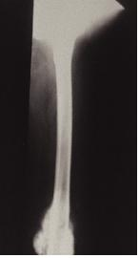
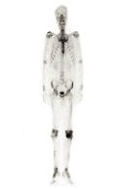
Introduction
Prostate cancer is the most common cancer among men.
The mortality from this disease results mostly from the metastasis of tumor cells to secondary sites, particularly bone. Prostate cancer metastasizes to the bone with high frequency, causing significant morbidity and mortality.
Jacobs reported that 80% of men with prostate cancer had bone metastases at autopsy. A more recent rapid autopsy study also reported that 80% of patients who die from prostate cancer have metastases in bone, further confirming the prevalence of bone metastasis in prostate cancer. Delineating the biological basis of the proclivity of prostate cancer cells for bone may lead to strategies to prevent or treat prostate cancer metastasis.
Notes:
As u know the prostate cancer is the most common cancer in male, and it is metastasizes to the bone with high frequency
And delineating the biological basis of the proclivity of prostate cancer cell for bone may lead to strategies to prevent metastasis

Slide 3
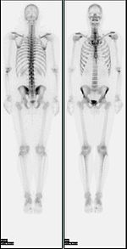
Introduction
A bone scan or bone scintigraphy is a nuclear medicine imaging technique of the bone. It can help diagnose a number of bone conditions, including; cancer of the bone or metastasis, location of bone inflammation and fractures (that may not be visible in traditional X-ray images), and bone infection.
However, it would be fail to find cancer which has spread to the bones and it takes harder time detecting metastases that are purely osteolytic tumor.

Slide 4
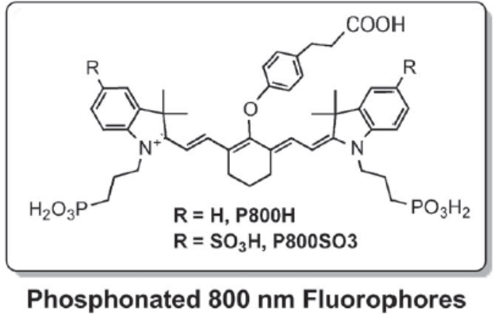
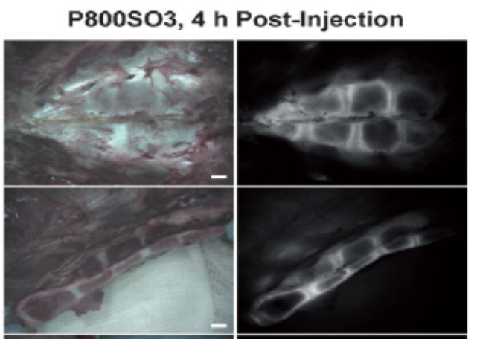
Introduction
In response to this unmet clinical need, optical imaging provides real-time visualization of the surgical field especially when combined with near-infrared (NIR) fluorophores, allowing intraoperative image-guided surgery.
Especially, bone-tissue targeting NIR fluorophore which was introduced in 2001, required the covalent conjugation of a bisphosphonate or other bone-targeting ligand to an NIR fluorophore, creating a bifunctional molecule for biomedical imaging
Hyun, H. et al. Angew Chem Int Ed Engl 53 (2014).

Slide 5
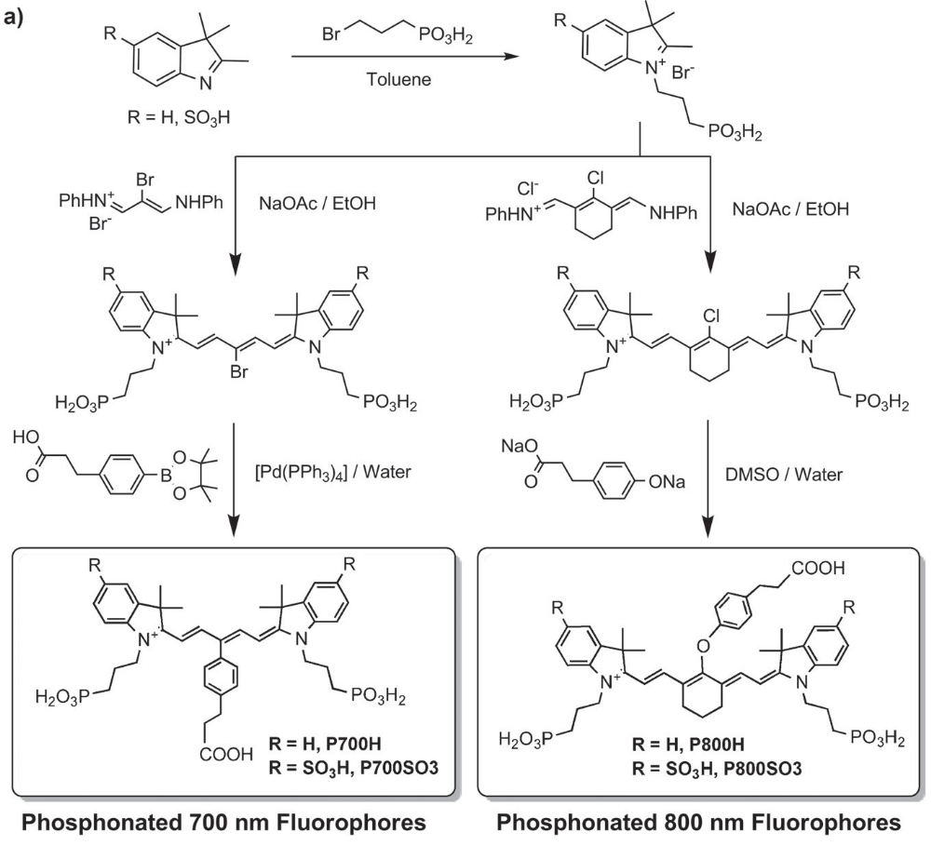
Introduction
Hyun, H. et al. Angew Chem Int Ed Engl 53 (2014).

Slide 6
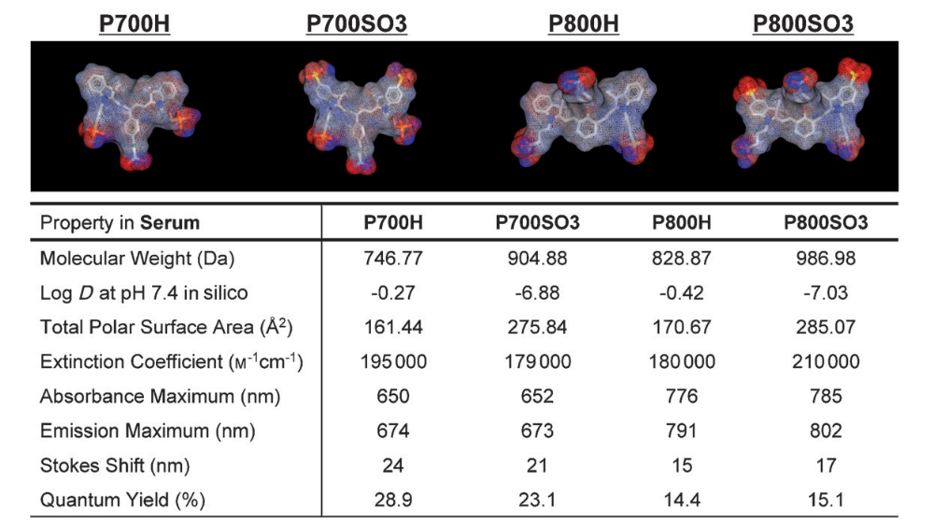
Introduction
Hyun, H. et al. Angew Chem Int Ed Engl 53 (2014).

Slide 7
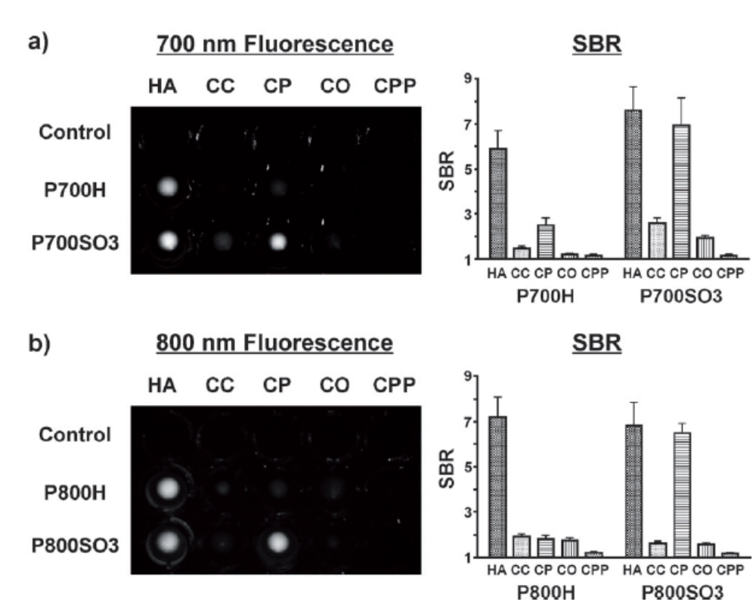
Figure . a, b) Calcium-salt binding properties of the P700 (a) and P800 (b) NIR fluorophores. SBR was calculated by dividing the fluorescence intensity of each fluorophore sample by the signal intensity of each control sample. All of the NIR fluorescence images have identical exposure and normalizations. Images are representative of n=3 independent experiments. CC=calcium carbonate, CO=calcium oxalate, CP=calcium phosphate, CPP=calcium pyrophosphate, HA=hydroxyapatite.

Slide 8
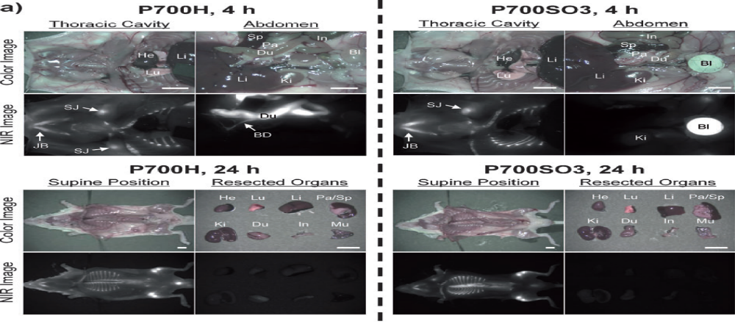
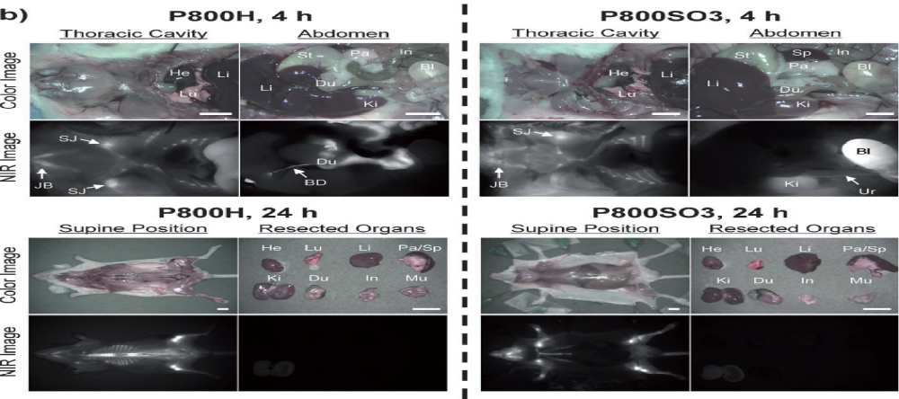
Fig. In vivo biodistribution and bone tissue imaging using the P700 and P800 NIR phosphonates in mice. Each NIR fluorophore was intravenously injected into 20 g CD-1 or athymic nude mice (10 nmol; 0.4 mgkg1) 4 and 24 hours prior to imaging. Scale bars=1 cm. Images are representative of n=3 independent experiments. BD=bile duct, Bl=bladder, Du=duodenum, He=heart, In=intestine, JB=jaw bone, Ki=kidneys, Li=liver, Lu=lungs, Mu=muscle, a=pancreas, SJ=shoulder joint, Sp=spleen, St=stomach, Ur=ureter.

Slide 9
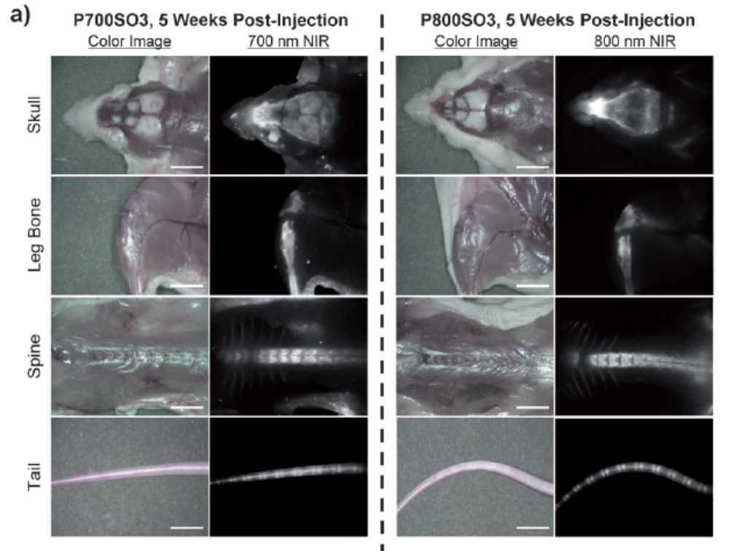
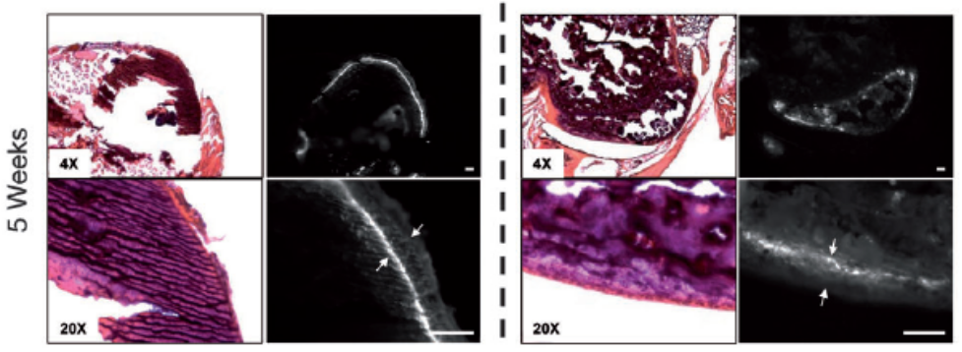
Fig. Stable incorporation of phosphonated NIR fluorophores into bone matrix. a) P700SO3 and P800SO3 were injected intravenously into 20 g athymic nude mice (10 nmol, 0.4 mgkg1) five weeks prior to imaging. Scale bars=1 cm. b) H&E and NIR imaging of resected bone tissues at one day and five weeks post-injection of P700SO3 and P800SO3. Scale bars=100 mm.

Slide 10
Purpose of present study
In present study, we investigate that the selective fluorometric detection of bone tumor could provide diagnostic intervention in progression of metastasis.
The goal of this study was to assess bone metastasis at each type/stage according to in vitro and in vivo study.
In addition, it was monitored the pathophysiological outcomes in real-time by using bone-targeted NIR fluorophore, so that it could be alternative tool for diagnosis of bone tumor instead of bone scan, finally.

Slide 11
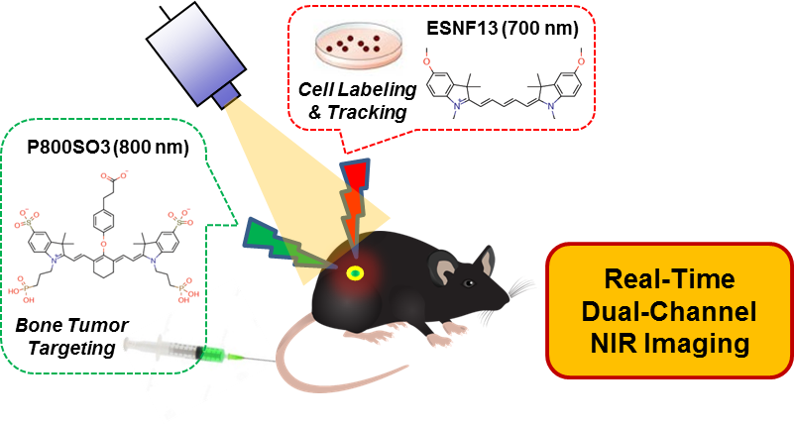
Study Design

Slide 12
Study Design
NIR fluorophores
ESNF13 and P800SO3
Osteoblasts differentiation
50 mg/ml of ascorbic acid and 10 mM of β-glycerophosphate to MC3T3
Osteoclasts Differentiation
30 ng/mL M-CSF and 37.5ng/mL of RANKL to Bone marrow derived Macrophages of Mouse
Bone metastasis of Cancer Cell
– PC-3 and MDA-MB-231
– Intratibial xenograft model
– Intracardiac xenograft model of bone metastasis
Chosun University
Notes:
HT29 colon cancer cells) were used as a source of CD133.

Slide 13
Analysis
In vitro cell assay
- The NIR imaging on a 4 filter set Nikon Eclipse Ti-U inverted microscope system
- Alizarin Red S staining
- Tartrate-resistant phosphatase (TRAP) staining.
In vivo NIR fluorescence imaging
- the Mini-FLARE® imaging system
- H&E Staining
- TRAP staining
Chosun University

Slide 14
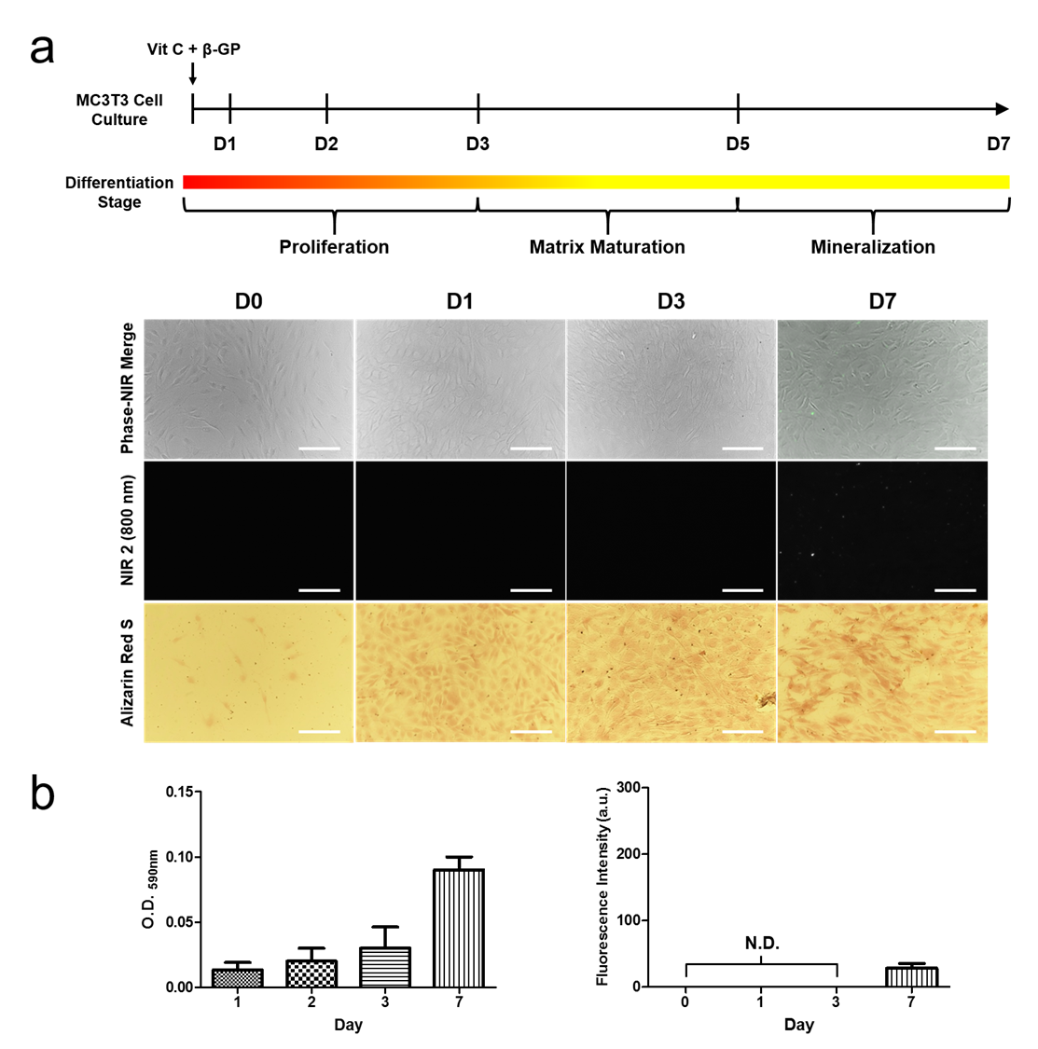
Results (1)
Fig. 1. MC3T3 cells were differentiated by treatment of vitamin C and β-glycophosphate and NIR fluorophore was monitored at each stage.

Slide 15
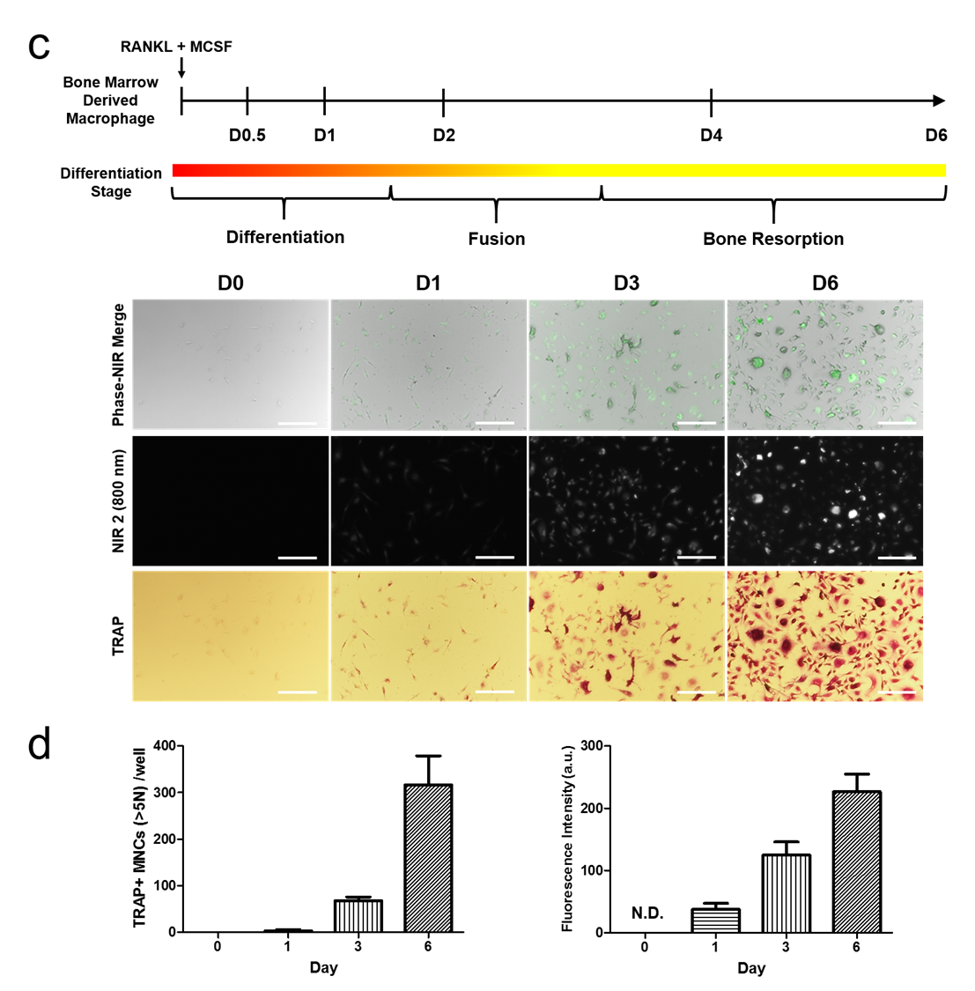
Results (2)
Fig.2 NIR 2 fluorophore were monitored during osteoclast differentiation of bone marrow derived macrophage cells by RANKL and M-CSF treatment

Slide 16
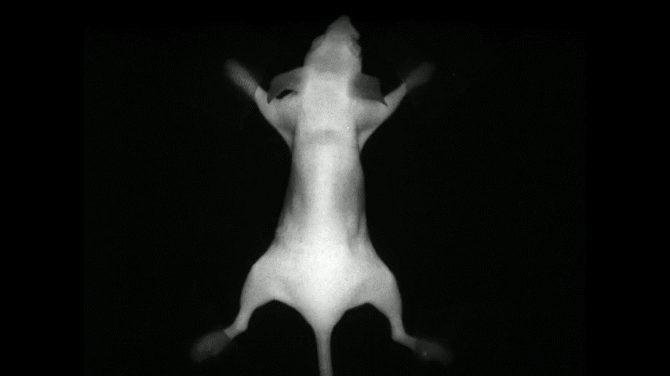

Slide 17
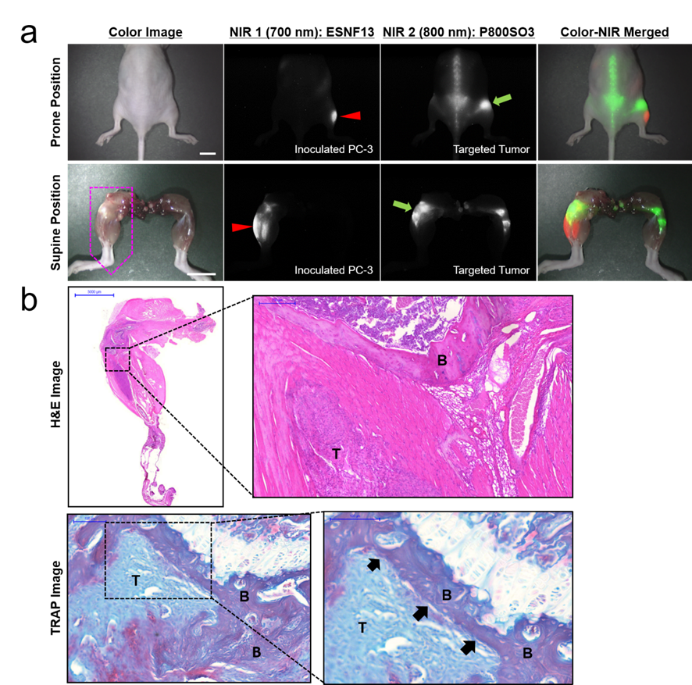
Results (3)
Fig. Real-time dual-channel intraoperative imaging of intratibial inoculated PC-3 cells and metastatic bone tumor in mice.

Slide 18
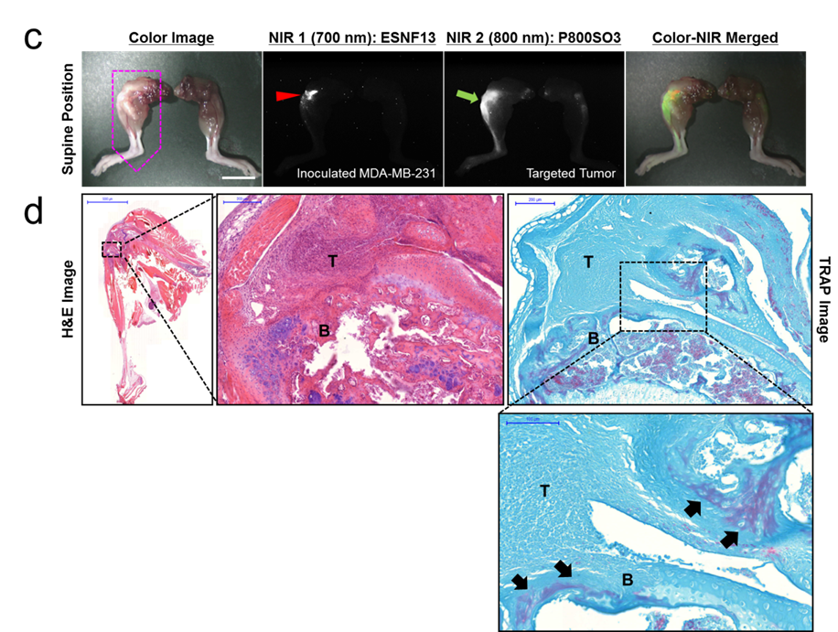
Results (4)
Fig. Real-time dual-channel intraoperative imaging of intratibial inoculated MDA-MB-231 cells and metastatic bone tumor in mice.

Slide 19
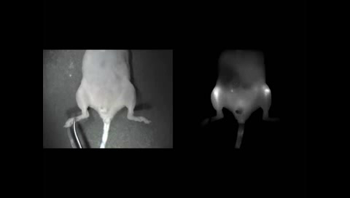

Slide 20
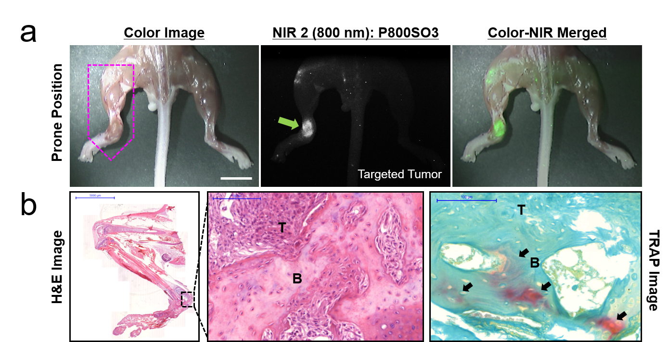
Results (5)
Fig. Real-time intraoperative imaging of intracardiac inoculated PC-3 cells and metastatic bone tumor in mice.

Slide 21
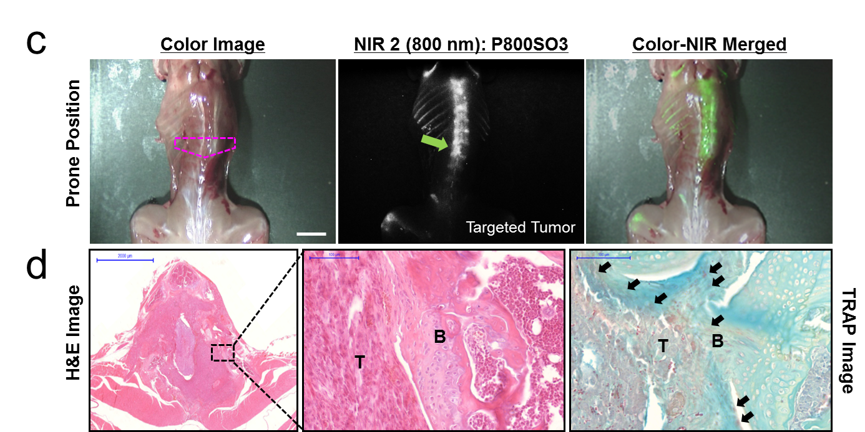
Results (6)
Fig. Real-time intraoperative imaging of intracardiac inoculated MDA-MB-231 cells and metastatic bone tumor in mice.

Slide 22
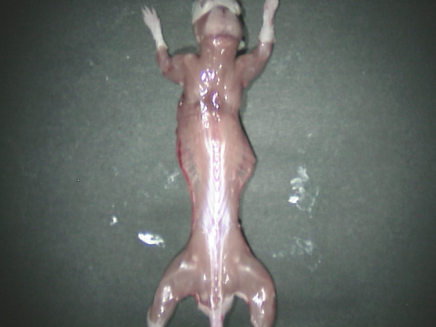
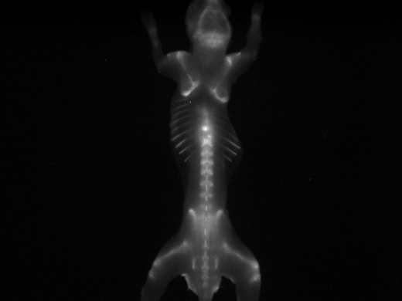

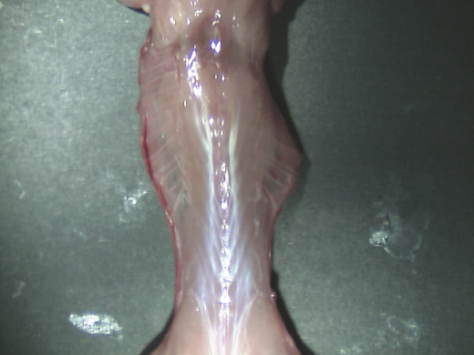
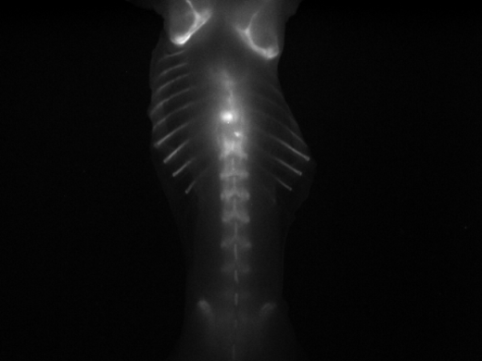
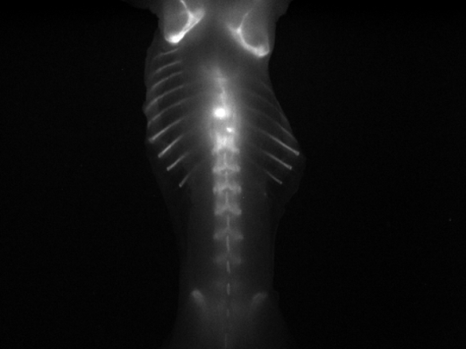
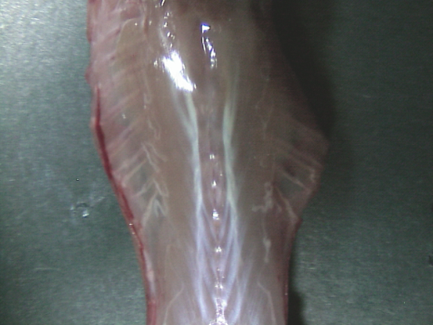
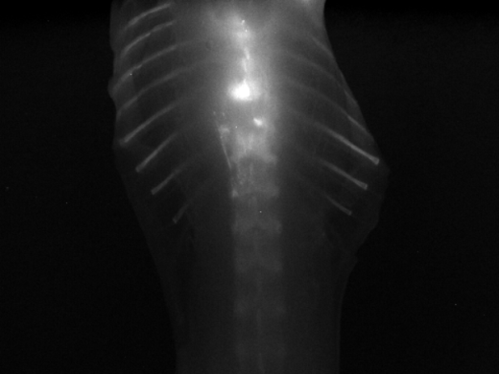
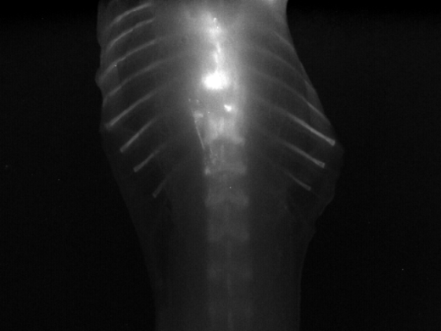
LNCaP Bone Meta (WT)
Color Image
NIR 2 (800 nm Fluorescence)

Slide 23
Conclusion
By using the targeted NIR fluorophore, metastatic bone tumor-specific images were clearly monitored under the NIR fluorescence imaging system in real-time, which allowed the diagnosis of bone metastasis in vivo by providing the location of the metastatic bone tumor.
The future of imaging bone metastasis by using the targeted NIR fluorophore will likely involve the development of an array of new tracers which will be tumor specific and greatly increase diagnostic accuracy.
The NIR fluorescence imaging technique accompanied by the targeted NIR contrast agents could provide potential tool for early diagnosis of bone tumor.

Slide 24

ACKNOWLEGMENT
Department of Orthopaedic Surgery,
Chosun University Hospital
Lab of Orthopaedic Research,
Medical School of Chosun University
Prof. Lim, Wonbong
Post Doc. Ko, YoungJong
PhD course Park, Mineon
PhD course Kim, Bora
Ms Course Joo, Jin Woong
Thanks to
Prof. Hoon Hyun
Department of Biomedical Sciences, Chonnam National University Medical School

