Slide 1





December 4-5, 2017 | Madrid, Spain
Clinical experience in 12 patients implanted with a contralateral prophylactic medical device in case of first low-energy hip fracture due to osteoporosis
Pr SZPALSKI Marek^{a*}, Pr LE HUEC Jean-Charles^{b},
Dr JAYANKURA Mark^{c}, Dr REYNDERS Pieter^{d} ªHôpitaux Iris Sud, Department of Orthopedic and Trauma Surgery, Brussels, Belgium
^{b}Pellegrin Hospital, University Hospital of Bordeaux , Bordeaux, France
^{c}Erasme Hospital , Brussels, Belgium
^{d}University Hospital of Brugmann, Brussels, Belgium,

Slide 2
Conflict of interests
Pr Marek Szpalski : Inventor and shareholder
Pr Jean-Charles Le Huec : Shareholder

Slide 3
The problem to be solved
Today :
840 000 hip fractures in Europe
350 000 in the US

Slide 4
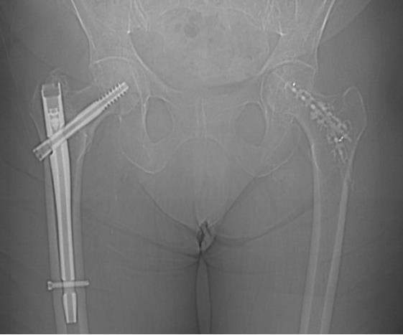
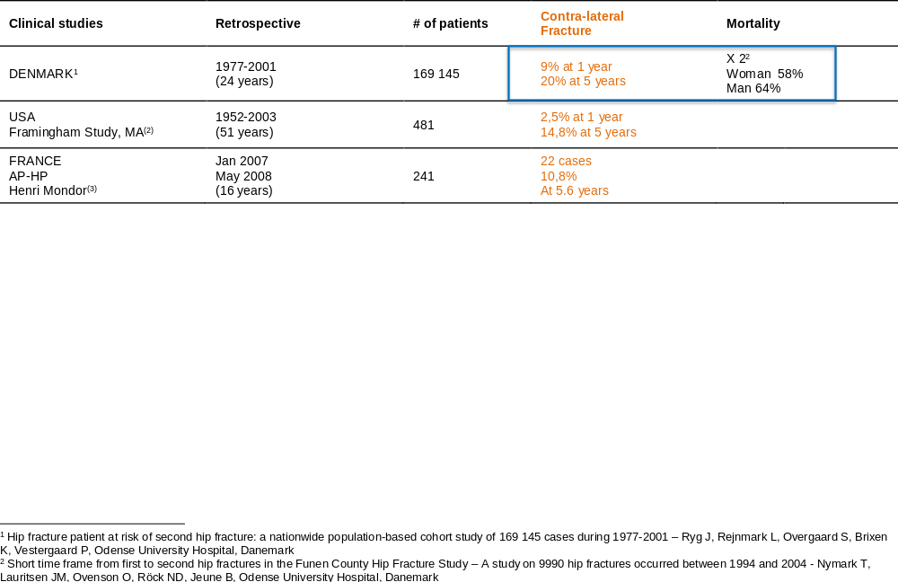
The problem to be solved
Contralateral hip fracture ➔

Slide 5
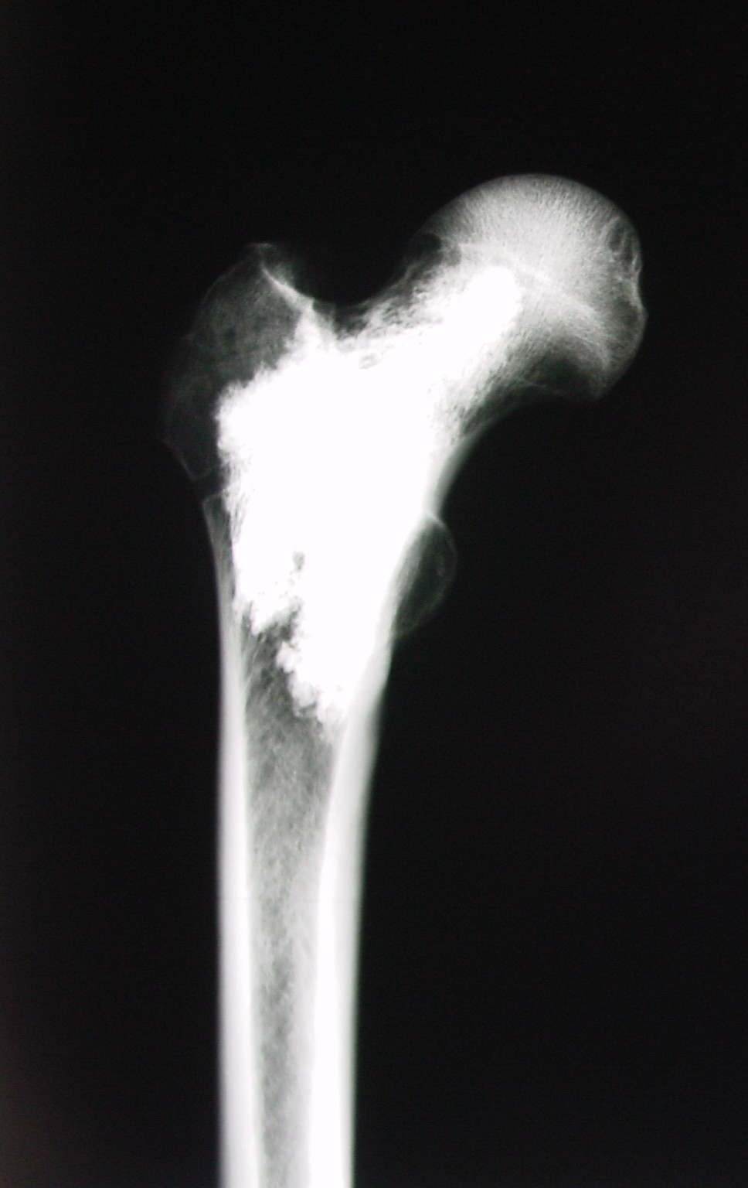
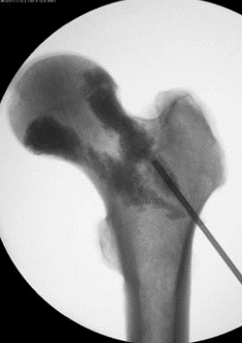
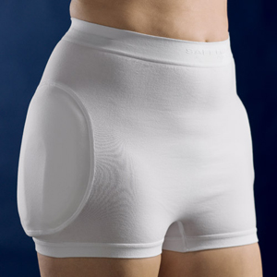

Existing techniques for hip fracture prevention
Femoroplasty^{(5,6)} (biomechanical testing)
Medication⁽⁷⁾
Hip protector⁽⁸⁾
Risk of subtrochanteric fracture
Risk of fracture during drilling
Major difficulty in case of possible later surgery
Poor compliance
Slow protection
Side effects
Poor compliance

Slide 6
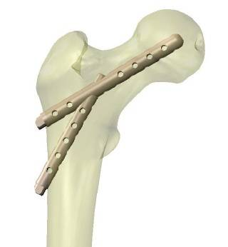
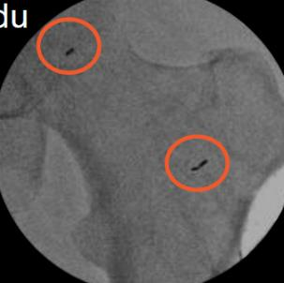
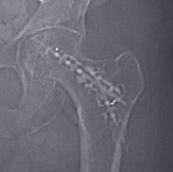



The device
2 implants made of polymer PEEK Optima ® biocompatible (sterile)
Radiotransparent (visualizing tantalum markers radio-opaque)
Combined in situ with PMMA bone cement
The device combined with cement allows to reinforce the proximal femur in case of bone fragility⁽⁹⁾
implant (Hyprevention)
Patented
Bone cement
1250
Notes:
The implant create a stress distribution from the diaphysis to the head allowing to improve the femoral head performance

Slide 7
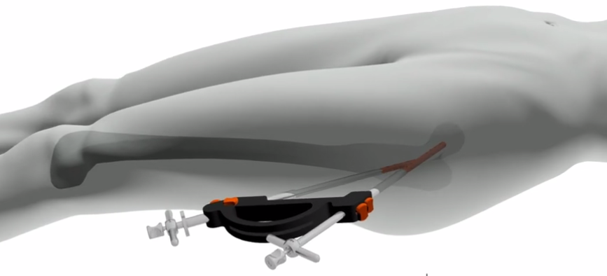
Minimal invasive surgical technique

Slide 8
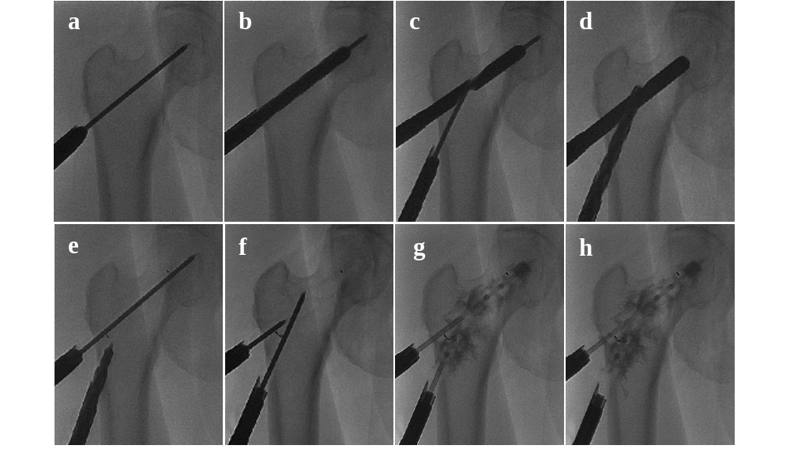
Minimal invasive surgical technique

Slide 9
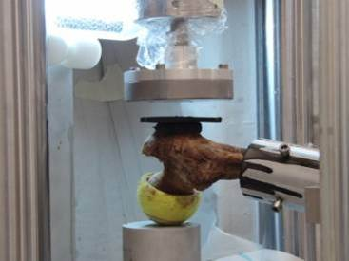
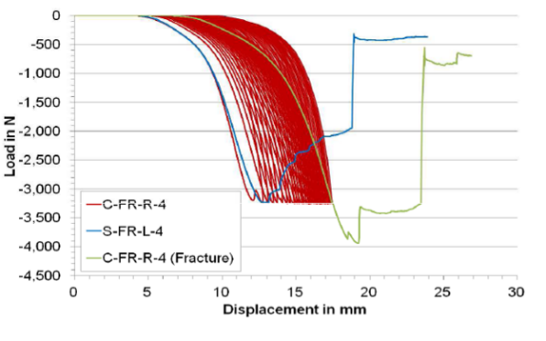
BIOMECHANICAL EVALUATION
Fracture load (+ 655N or +18%)
Keaveny 2010: loss 60N/year post-menopausis
+655N = +10 years
Energy ro fracture (+ 6.2J or +32%).
No change in fracture type
      Multiple falls resistance
PUBLICATION
A new approach to prevent contralateral hip fracture: Evaluation of the effectiveness of a fracture preventing implant. Szpalski M, Gunzburg R, Aebi M, Delimoge C, Graf N, Eberle S, Vienney C. Clin Biomech. August 2015, Vol. 30(7), pp. 713-9.

Slide 10
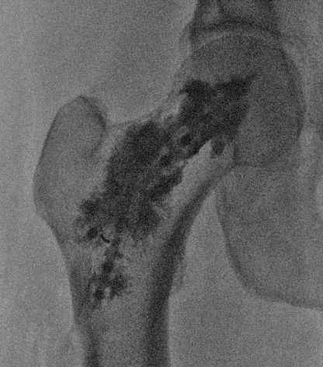
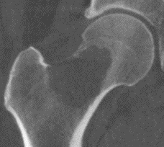
One device for 2 clinical indications
TRAUMATOLOGY | ONCOLOGY
Elderly presenting osteoporosis | Patient with cancer
Contralateral hip fracture prevention | Reinforcement of bone with metastasis
One anaesthesia, one hospitalisation | No stop chemotherapy, short hospitalisation (day-surgery), post-op radiotherapy

Slide 11
CLINICAL EXPERIENCE
STUDY | INDICATION | OBJECTIVE | NB PATIENTS | STATUS
PRE-CE
HIP#0 | Trauma | Pilot Feasibility Tolerance | 12/15 | Inclusion ends Dec 2017 5years follow-up Publication
HIPPON | Onco | Pilot Feasibility Safety Efficacy | 10/10 | Complete Publication
POST-CE (CE mark August 2015)
HIPPON100 | Onco | Observational Efficacy | 27/100 | Product sold, 2years follow-up 10 clinical centres, IP
HIP50 | Trauma | Observational Efficacy | 50 | To start in Q4-2017, 2years follow-up Product sold, more than 10 centres selected
HIP#1 | Trauma | Comparative Efficacy | 100 + 100 | Protocol under writing

Slide 12
CLINICAL EXPERIENCE
  Cornelis et al., Percutaneous internal fixation with Y-STRUT® device to prevent both osteoporotic and pathological hip fractures: a pilot study, Journal of Orthopaedic Surgery and Research 2016
  Cornelis et al., Clinical experience from a 10-patient cohort implanted with new prophylactic device to prevent impending pathologic hip fractures, CVIR 2017
  Szpalski M. et al., Contralateral Prophylactic Reinforcement in Case of First Low-Energy Hip Fracture: First-in-Man Clinical Data of a New Percutaneous Internal Fixation Device, J Osteopor Phys Act 2017
  Cornelis and Deschamps, Augmented osteoplasty for proximal femur consolidation in cancer patients: Biomechanical considerations and techniques, DII 2017

Slide 13
HIP#0 multicentre prospective pilot study in traumatology
Main inclusion criteria
  Low energy per trochanteric fracture on the first side
  At risk for new fracture evaluated by:
    Risk of falling depending on the life style
    And/or FRAX index
    And/or T-score or Bone Mineral Density (BMD) or any other validated score available to evaluate the bone quality in the proximal femur
  Patient ≥ 60 years old
Main exclusion criteria
  Uncontrolled diabetes
  Fibromyalgia and chronic fatigue
  Active systemic infection
  Paget’s disease
  Coxarthrosis or suspicion
Notes:
There is also the FRAX indix that can be an indicator to identify patient at risk of new fracture.

Slide 14
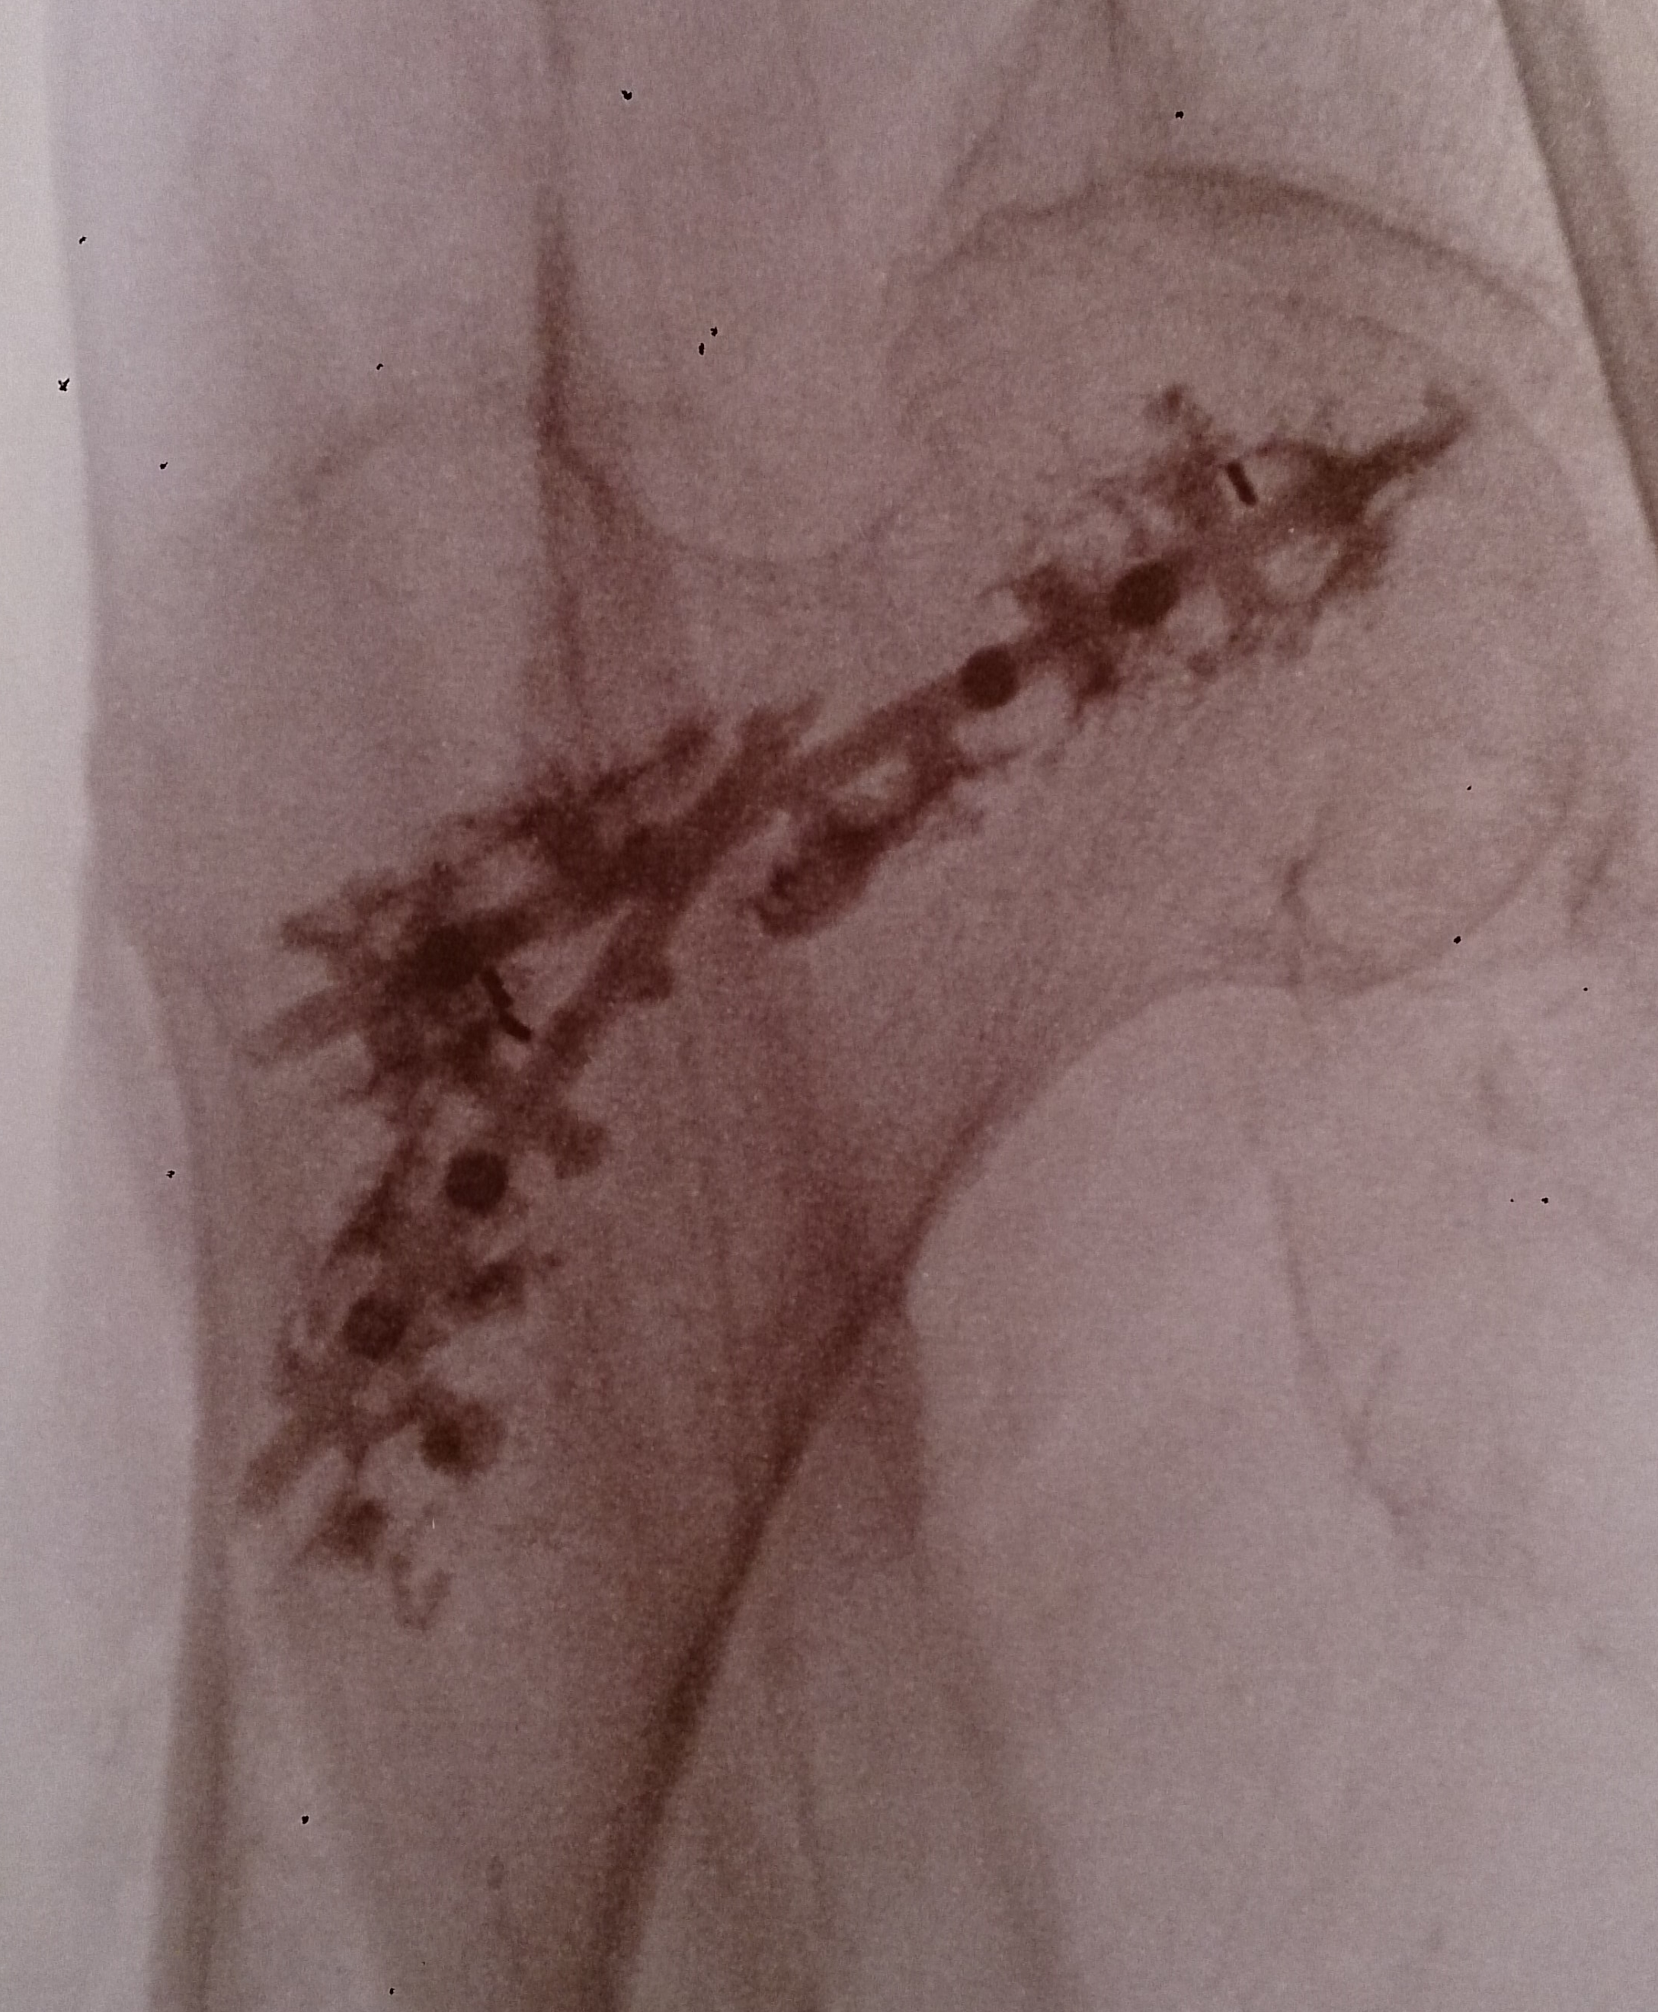
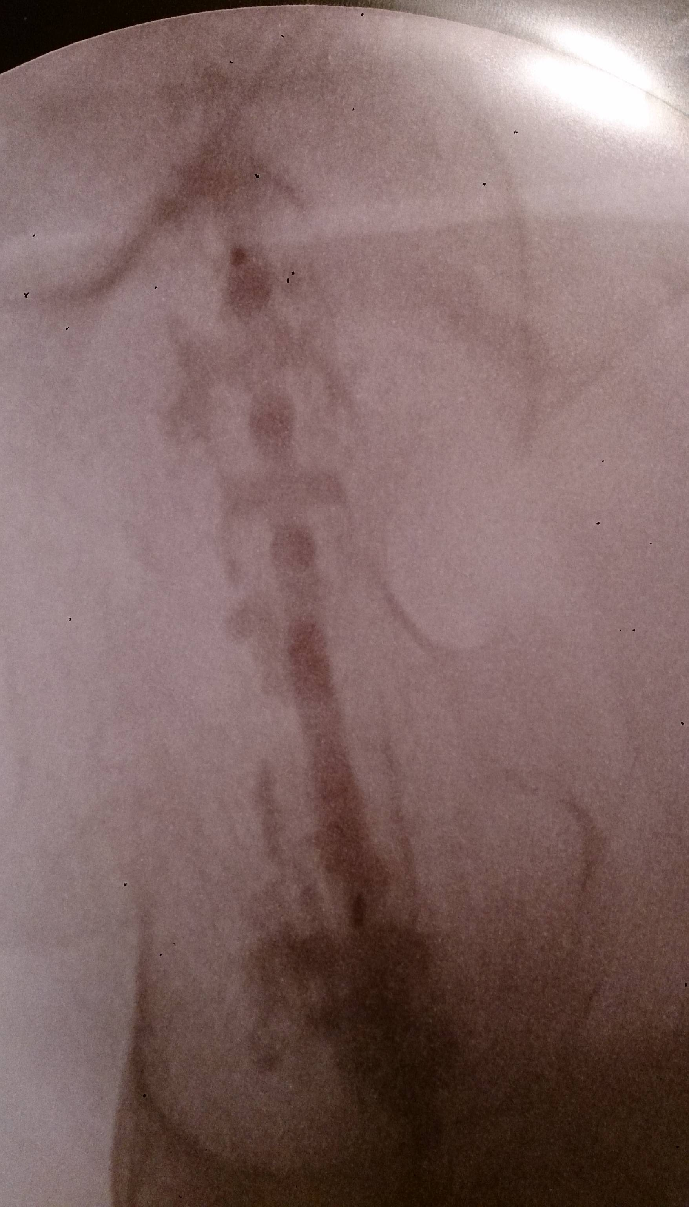
CLINICAL CASE
Female, 82yo, pertroch
GA,10cc cement

Slide 15
RESULTS – traumatology
12 patients implanted
First per-trochanteric fracture (N=12)
Mean age: 82±7yo (N=12)
T-score: -3.3±0.43 (N=4)
10 ♀ / 2 ♂
Mid-term tolerance and safety
  Criteria : walking recovery, pain, radiographic control, adverse events
Clinical efficacy
Criterion: occurrence of fractures
Follow-up: 3 to 56 months
Notes:
First 12 patients implanted between February 2013 and December 2016

Slide 16
RESULTS – traumatology
75% AG (N=12)
Operative time: 53min (30-90) (N=9)
Cement: 10cc (6-22) (N=9)
Hospitalisation duration: 12 days (5-29) (N=11)
Follow-up : 614 days (86-1707) (N=12)
Pain at 3 weeks: VAS 0.9 (0-4) (N=11)
Pain at 3 months: VAS 2.4 (0-4) (N=5)
Walking recovery OK
1 serious adverse events linked to the device: cement extrusion causing pain, surgical intervention needed to remove it
No post-operative fracture
NEXT PUBLICATION 12 patients with a 6-month follow-up (in 2018)

Slide 17

GENERAL CONCLUSIONS
  No post-op fracture when the surgical technique is adequately followed
  Immediate weight bearing and all patients resume walking
  Short hospitalisation (day-surgery case)
  Post-op pain decrease in oncology and improved quality of life
  No post-op pain in traumatology
What’s next ?
Multicentre, prospective observational study
50 patients in France
2 years follow-up
Further evaluation of the clinical efficacy

Slide 18
REFERENCES
(1) Ryg et al. Hip fracture patient at risk of second hip fracture: a nationwide population-based cohort study of 169 145 cases during 1977-2001. J Bone Miner Res. 2009
(2) Kanis et al. A systematic review of hip fracture incidence and probability worldwide. Osteoporos Int. 2012
(3) Berry et al. Second Hip Fracture in Older Men and Women: the Framingham Study. Arch Intern Med. 2007
(4) Gaumetou et al. Non-simultaneous bilateral hip fracture: Epidemiologic study of 241 hip fractures. Orthop Traumatol Surg Res. 2011
(5) Sutter et al. The Effect of Cement Placement on Augmentation of the Osteoporotic
Proximal Femur. Geriatr Orthop Surg Rehabil. 2010
(6) Fliri et al. Limited V-shaped cement augmentation of the proximal femur to prevent
secondary hip fractures. J Biomater Appl. 2013
(7) Rabenda et al. Adherence to bisphosphonates therapy and hip fracture risk in osteoporotic women. Osteoporos. Int. 2008
(8) Kannus et al. Prevention of hip fracture with hip protectors. Age Ageing. 2006
(9) Szpalski et al. A new approach to prevent contralateral hip fracture: Evaluation of the effectiveness of a fracture preventing implant. Clin Biomech. 2015
Notes:
18

