Slide 1
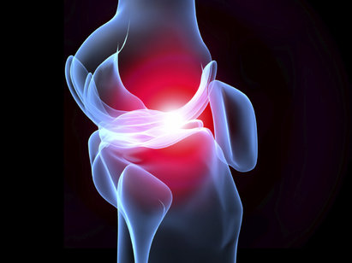
Ankle cartilage is more resilient to cytokine-induced catabolism than knee cartilage: A potential target for prevention of knee arthritis?
Ali Abdullah
Final year medical student
Cardiff University, UK

Slide 2
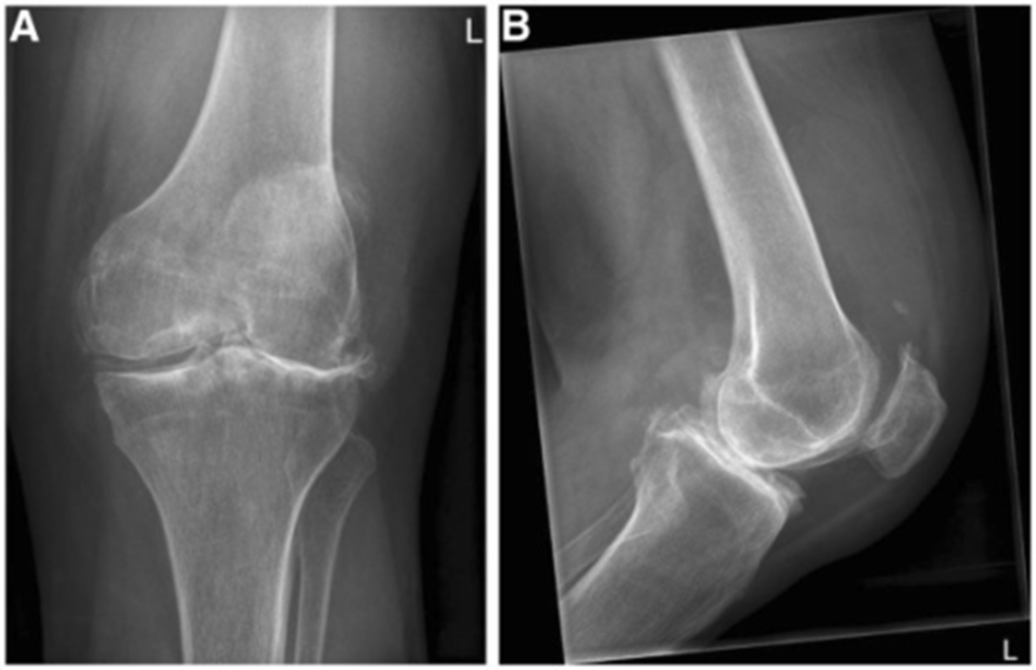
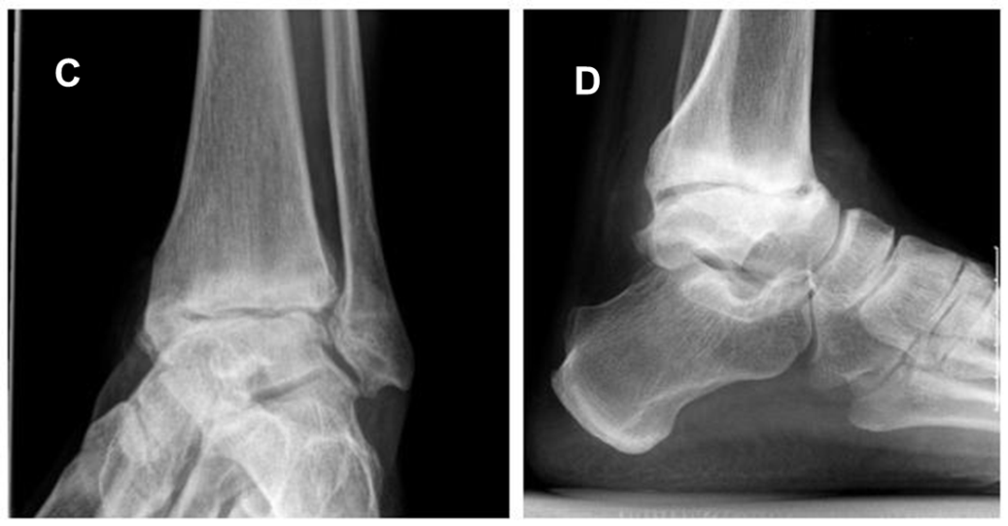
Background
Prevalence of symptomatic osteoarthritis (OA)
  Knee
    11-19%
    Primary OA
  Ankle
    3.4 – 4.4%
    70% Post Traumatic
  Why is the ankle spared from primary OA?
  Can the reasons be applied clinically to halt osteoarthritic progression?

Slide 3
Knee vs Ankle
Previous studies

Slide 4
Aims and Methods
Compare human knee and ankle responses to cytokines (IL-1α, oncostatin M [OSM], TNF-α)
Explants from human talar domes (n=12) and femoral condyles (n=7)
Explants cultured in the presence or absence of either
  high concentration cytokines (100ng/ml TNFα, 10ng/ml OSM, 5ng/ml IL-1α)
  low concentration cytokines (2ng/ml TNFα, 0.2ng/ml OSM, 0.1ng/ml IL-1α).
Media was analysed up to 28 days for markers of cartilage degradation (proteoglycan loss) and inflammation (NO, PGE₂)
Assessing differential gene expression by Next Generation Sequencing of mRNA

Slide 5
Results: Proteoglycan loss
* p<0.05

Slide 6
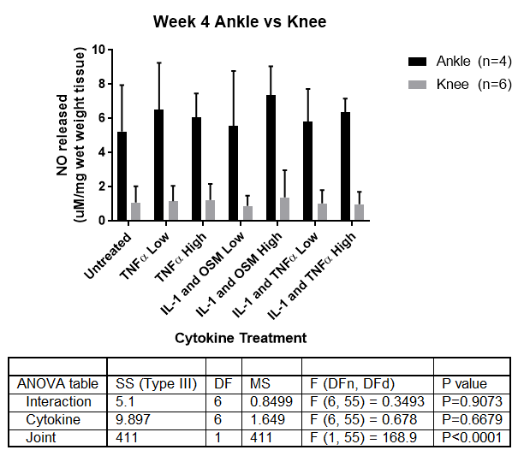
Results: Nitric Oxide (NO) release

Slide 7
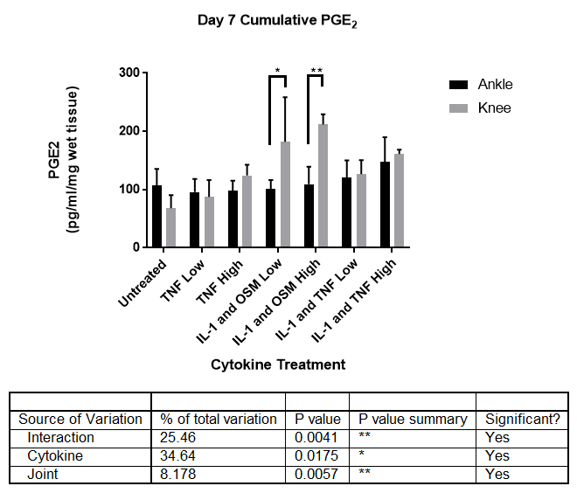
Results: Prostaglandin E2 (PGE2) release
* p<0.05
** p<0.01

Slide 8
ANOVA Statistical Analysis
Prostaglandin E2 release

Slide 9
ANOVA Statistical Analysis
Nitric oxide release

Slide 10
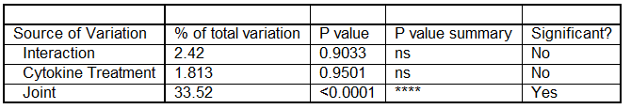
ANOVA Statistical Analysis
Proteoglycan loss
Is this truly representative?
Responders and non-responders (each patient is unique!)
Some of the methodology could be improved

Slide 11
Proteoglycan loss and NO release non-significance
To improve the methodology
  Match most joints
  Obtain knee AND ankles from diabetic patients
Display the data individually
  To highlight responders and non-responders
n=4 at the moment (3 matched, 1 unmatched)

Slide 12
Results so far
2 matched pairs and 1 unmatched pair reacted as previously

Slide 13
Results so far: 1 unresponsive matched pair

Slide 14
Results: Next Generation Sequencing
Do the chondrocytes express different genes?
>800 Differential genes expressed adj p<0.05
Ankle expresses 3 times LESS glutamate receptor subunits
  Play a role in the inflammatory process particularly following exposure to IL-1

Slide 15
Conclusions
Ankle cartilage is less responsive with regards to:
  Proteoglycan loss
  Prostaglandin E₂ release
No significant differences with regards to:
  Nitric oxide release
There is differential gene expression
Could be a reason for reduced osteoarthritic incidence

Slide 16
How can this research lead to a therapy?
1. Identifying signalling pathways to research further
Fewer cytokine receptors?
More cytokine inhibitors?
Different receptor isoforms?
Different pathways altogether?

Slide 17
How can this research lead to a therapy?
2. Identifying targets for gene-based therapies
"We found that first-generation adenovirus can be implanted into rabbit cartilage… and that the matrix formed is completely natural, native to the host and a fundamental platform on which healing and repair is based.”
Gene Therapy (2004) 11, 133–141
Nature Publishing Group

Slide 18
Limitations
Sourcing for first set of culture results
Cartilage not loaded
Sample size still small at this point – difficult to obtain

Slide 19
Thank you. Questions?

