Slide 1
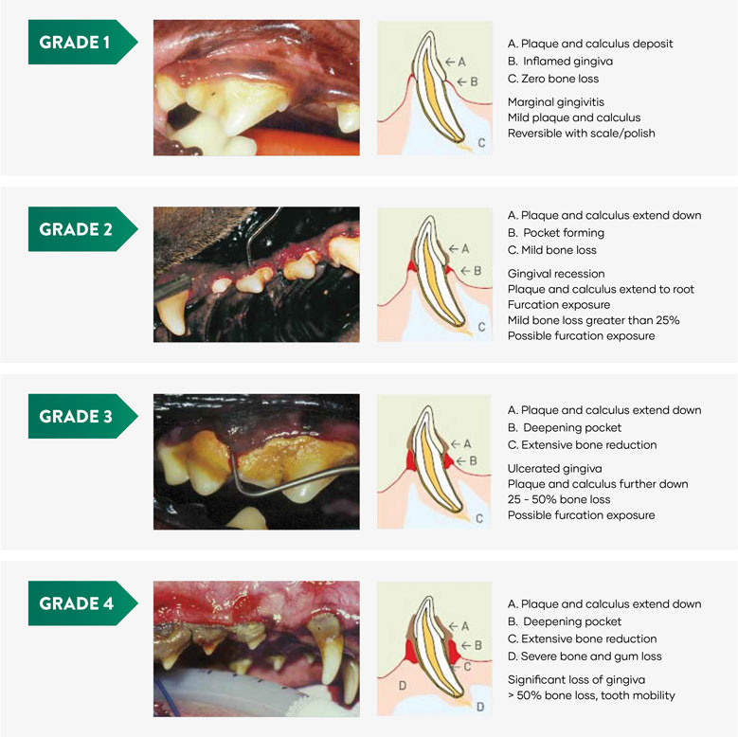
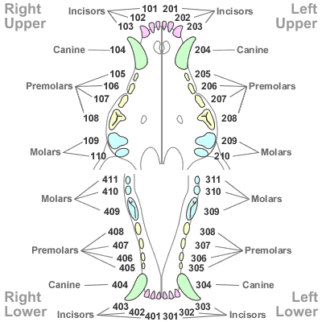
VV Veterinary dentistry Keyana Beamon, LVT
Abstract
Animals, both large and small that do not receive routine dental care are at risk for developing dental disease, if presenting problems are not corrected by a veterinary dentist. Dental disease can lead to secondary problems to the heart and other systems of the body. Veterinary professionals have developed research that indicated a scaling system based on how advanced the periodontal disease is. The higher the periodontal disease the likelihood that numerous teeth may need to be extracted. The purpose of this study is to understand the importance of oral health being maintained for a wide variety of animals. Veterinary dentists use dental charting and radiographing to determine what may need to be addressed in the oral cavity. Although each breed of species has unique oral anatomy, these tools utilize aid in the determination of what stage of periodontal disease is occurring. Understanding the anatomy and needs of each species' oral health is how periodontal disease can be either maintained or prevented altogether.
Goal:
The goal of this study is to bring awareness to dental disease is various species and how dental disease can affect other parts of the body. Dental disease can be treated and/or maintained with various tools used by veterinarian professionals.
Modified Triadan System
The Modified Triadan System provides a consistent method of numbering teeth system across different species of animals. This helps keep track of any abnormalities that may be noted during the dental cleaning process.
The effects of dental disease
Bad breath (halitosis)
Cardiac disease
Decreased appetite
Oral pain
Weight loss
Nasal discharge
Bleeding gums
Contact info: Keyanabeamon777.kb@gmail.com

