Slide 1

Conference Brochure
Global Recycling Summit
July 22-23, 2019 |Rome, Italy
Theme: Recycling the Wastes into an Efficient
https://recycling.pulsusconference.com//

Slide 2

Invitation
PULSUS brings a new spin on conferences by presenting the latest scientific improvements in your field. Listen to motivating keynotes from thought leaders or rub elbows with pioneers across the globe. Rome is all set for an amazing event as PULSUS proudly presents the “Global Recycling Summit” slated on July 22-23, 2019 at Rome.
PULSUS cordially welcome researchers, academicians, students and business professionals in the field of Recycling Wastes and challenges from around the world to participate in the upcoming Recycling 2019. The meeting for this year will revolve around the theme “Recycling the Wastes into an Efficient” thus relaying the most cutting-edge findings in the current issues of materials Science and to make a better world.
Welcome to share your views
Sessions and Topics
Waste Management Techniques
Reduce Reuse and Recycle
Solid Waste Management
Sustainable Energy policy
Paper Recycling
Waste Water Recycling
Plastic Recycling
Rubber recycling
Metal Recycling
Textile Recycling
Food waste recycling
E-Wastes Recycling
Industrial Waste Recycling
Chemical Waste Recycling
Agriculture Waste Recycling
Organic Waste Recycling
Waste Treatment Technologies
Waste to Energy
Recycling Market
Circulatory Economy
Who can attend…??
Researchers working on Environmental chemistry, Professors in Chemistry, Post-doctoral and Researchers in Chemistry, Heads of Chemical Departments, Industry Professionals, Directors/ Managers/CEO’s, Presidents & Vice Presidents, Brand Manufacturers/ Marketers of Consumer Products.
Important Dates
Quick Links
Abstract submission opens: 18-02-2019
Registration opens: 20-02-2019
Early bird registration: 30-03-2019
On spot registration: 22-07-2019
Brochure Download
Abstract Submission
Registrations
Cancellation Policy

Slide 3

Materials in Global Market
“Recycling 2019: Rome, Italy” is the integration of recent technologies within the field of usage & waste-management to assist business professionals harness the complete potential of their follow. It involves the employment of tools and technologies that helps to attain a particular degree of content and broaden the reach of the follow and therefore the professional person. The conference brings a rare opportunity for all people of the environmental community to upgrade their ability of the most recent technologies.
Market Analysis Report : Recycling 2019 has been planned with twofold objectives in mind. The theme of the conference is "Recycling the Wastes into an Efficient” which covers a wide range of critically important sessions. This Conference aims to bring the advancement in the field of Recycling, Waste Treatment, Cost benefit analysis, Environmental Impact of Reuse and Recycling: Cause of Pollution Control and also lays a special importance at educating and informing environmental researcher, industry professionals with the latest knowledge of technologies that can be applied to counter the economic under-evaluation ecologist may face in their practice.
Major Recycling and Waste Management Associations across the Globe:
· Air & Waste Management Association
· Alabama Recycling Coalition
· Aluminum Association, Inc. (DC)
· American Forest and Paper Association
· American Iron & Steel Institute (DC)
· Arizona Recycling Coalition
· Arkansas Recycling Coalition
· Solid Waste Association of North America (SWANA)
Sponsorship Opportunities
Diamond Sponsor $10000
Gold Sponsor $7500
Silver Sponsor $5000
Bronze Sponsor $3500
Exhibition $2500

Slide 4






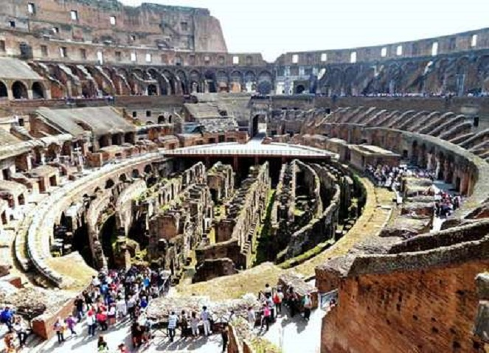

Tourism in Rome

