Slide 1

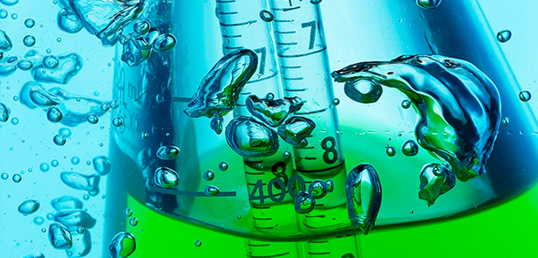
Green Chemistry
and
Sustainability Summit
July
22-23, 2019
Rome, Italy
Hosting Organization: Pulsus
40 Bloomsbury Way | Lower Ground Floor
London, United Kingdom | WC1A 2SE | Tel: +1-408-429-2646
greenchemistry.pulsus@gmail.com

Slide 2
Invitation
PULSUS brings in a new spin on conferences by presenting the latest scientific improvements in your field. Listen to motivating keynotes from thought leaders or rub elbows with pioneers across the globe. Rome is all set for an amazing event as PULSUS proudly presents the “Green Chemistry and Sustainability Summit” slated on July 22-23, 2019 at Rome, Italy.
PULSUS cordially welcome researchers, academicians, students and business professionals in the field of Chemistry and Environmental challenges from around the world to participate in the upcoming Green chemistry 2019. The meeting for this year will revolve around the theme “Deterrent World for Green and Healthy Environment” thus relaying the most cutting-edge findings in the current issues of environmental challenges and to make a better world.
Conference Highlights:
  Atmospheric Chemistry
  Short-lived Climate pollutants
  Catalysis
  Agricultural Energy
  Nanotechnology in Green Chemistry
  Land Degradation
  Waste disposal
  Acidification
  Green Chemistry Principles
  Environmental Issues
  Future Trends on Green Chemistry

Slide 3
Conference Tentative Agenda:
July 22, 2019
Time Session
08:30-09:30 Registrations
09:30-11:30 Keynote Forum
Group Photo
11:30-11:45 Network & Refreshments Break*
11:45-13:00 Tracks: Ground work on Green Chemistry | Atmospheric chemistry
13:00-13:45 Lunch Break**
13:45-16:00 Tracks: Short-lived Climate pollutant | Catalysis
16:00-16:15 Network & Refreshments Break*
16:15-18:00 Tracks: Agricultural Energy | Nanotechnology
Day Concludes
July 23, 2019
08:30-09:30 Registrations
09:30-10:30 Keynote Forum
10:30-11:30 Tracks: Land Degradation | Waste disposal
11:30-11:45 Network & Refreshments Break*
11:45-13:00 Tracks: Acidification | Green chemistry Principles
13:00-13:45 Lunch Break**
13:45-16:00 Tracks: Environmental Issues | Future trends on Green chemistry
16:00-16:15 Network & Refreshments Break*
16:15-18:00 Poster Presentations
Day Concludes
Award Ceremony
Conference Concludes
Note: Agenda can be subjected to change at any moment of time until July

Slide 4
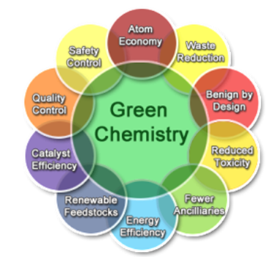
Market Analysis
Green Chemistry is the new philosophical idea processed for a sustainable environment from non-polluting materials. The future trends on green chemistry is for safer products which does not affect the environment and the success is depends on the new chemists and chemical industry. Environmental Protection agency by US and American chemical society are the major associations supporting research area and creating awareness for preventing pollution and toxic content and analyzed the use of green chemical products are making clean environment and economically balancing the social environment. According to the government survey the production and distribution of the chemical products are focused on value, consumption, market share and growth of the company. They design their business policy for improving global competitiveness and securing jobs it causes lack of environmental care and global warming.
Basically, the plastic materials are formed from polymers, or molecules containing repeated chemical unit. The polymers used for producing polymers are from bulk petrochemicals. These products can also be derived from renewable biomass. The new market renewable products for sustainable environment includes bioplastics, building materials, flame retardants, healthcare and personal care. Chemical companies are less dependent on single group of raw materials for producing their products, where the transition of raw material to renewable material creates new and helping nature leads the chemical industry more sustainable. There are few regions such as North America, Europe, Southeast Asia, India and Africa, based on the product the market value, sales and revenue the addiction of chemicals is increased in healthcare industries, food industry, construction industry and automobile industry which leads to the unstainable environment and damage.

Slide 5
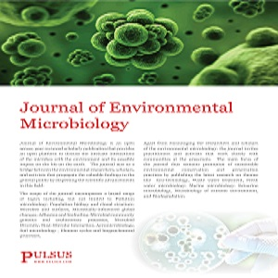
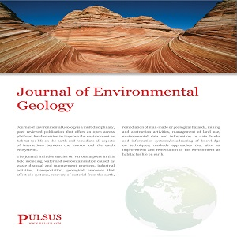
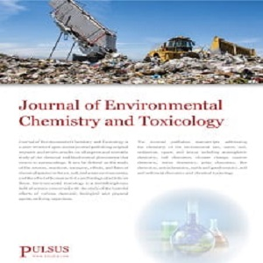
Supporting Journals
Journal of Environmental Microbiology
https://www.pulsus.com/journal-environmental-microbiology.html
Journal of Environmental Geology
https://www.pulsus.com/journal-environmental-geology.html
Journal of Environmental Chemistry and Toxicology
https://www.pulsus.com/journal-environmental-chemistry-toxicology.html

Slide 6


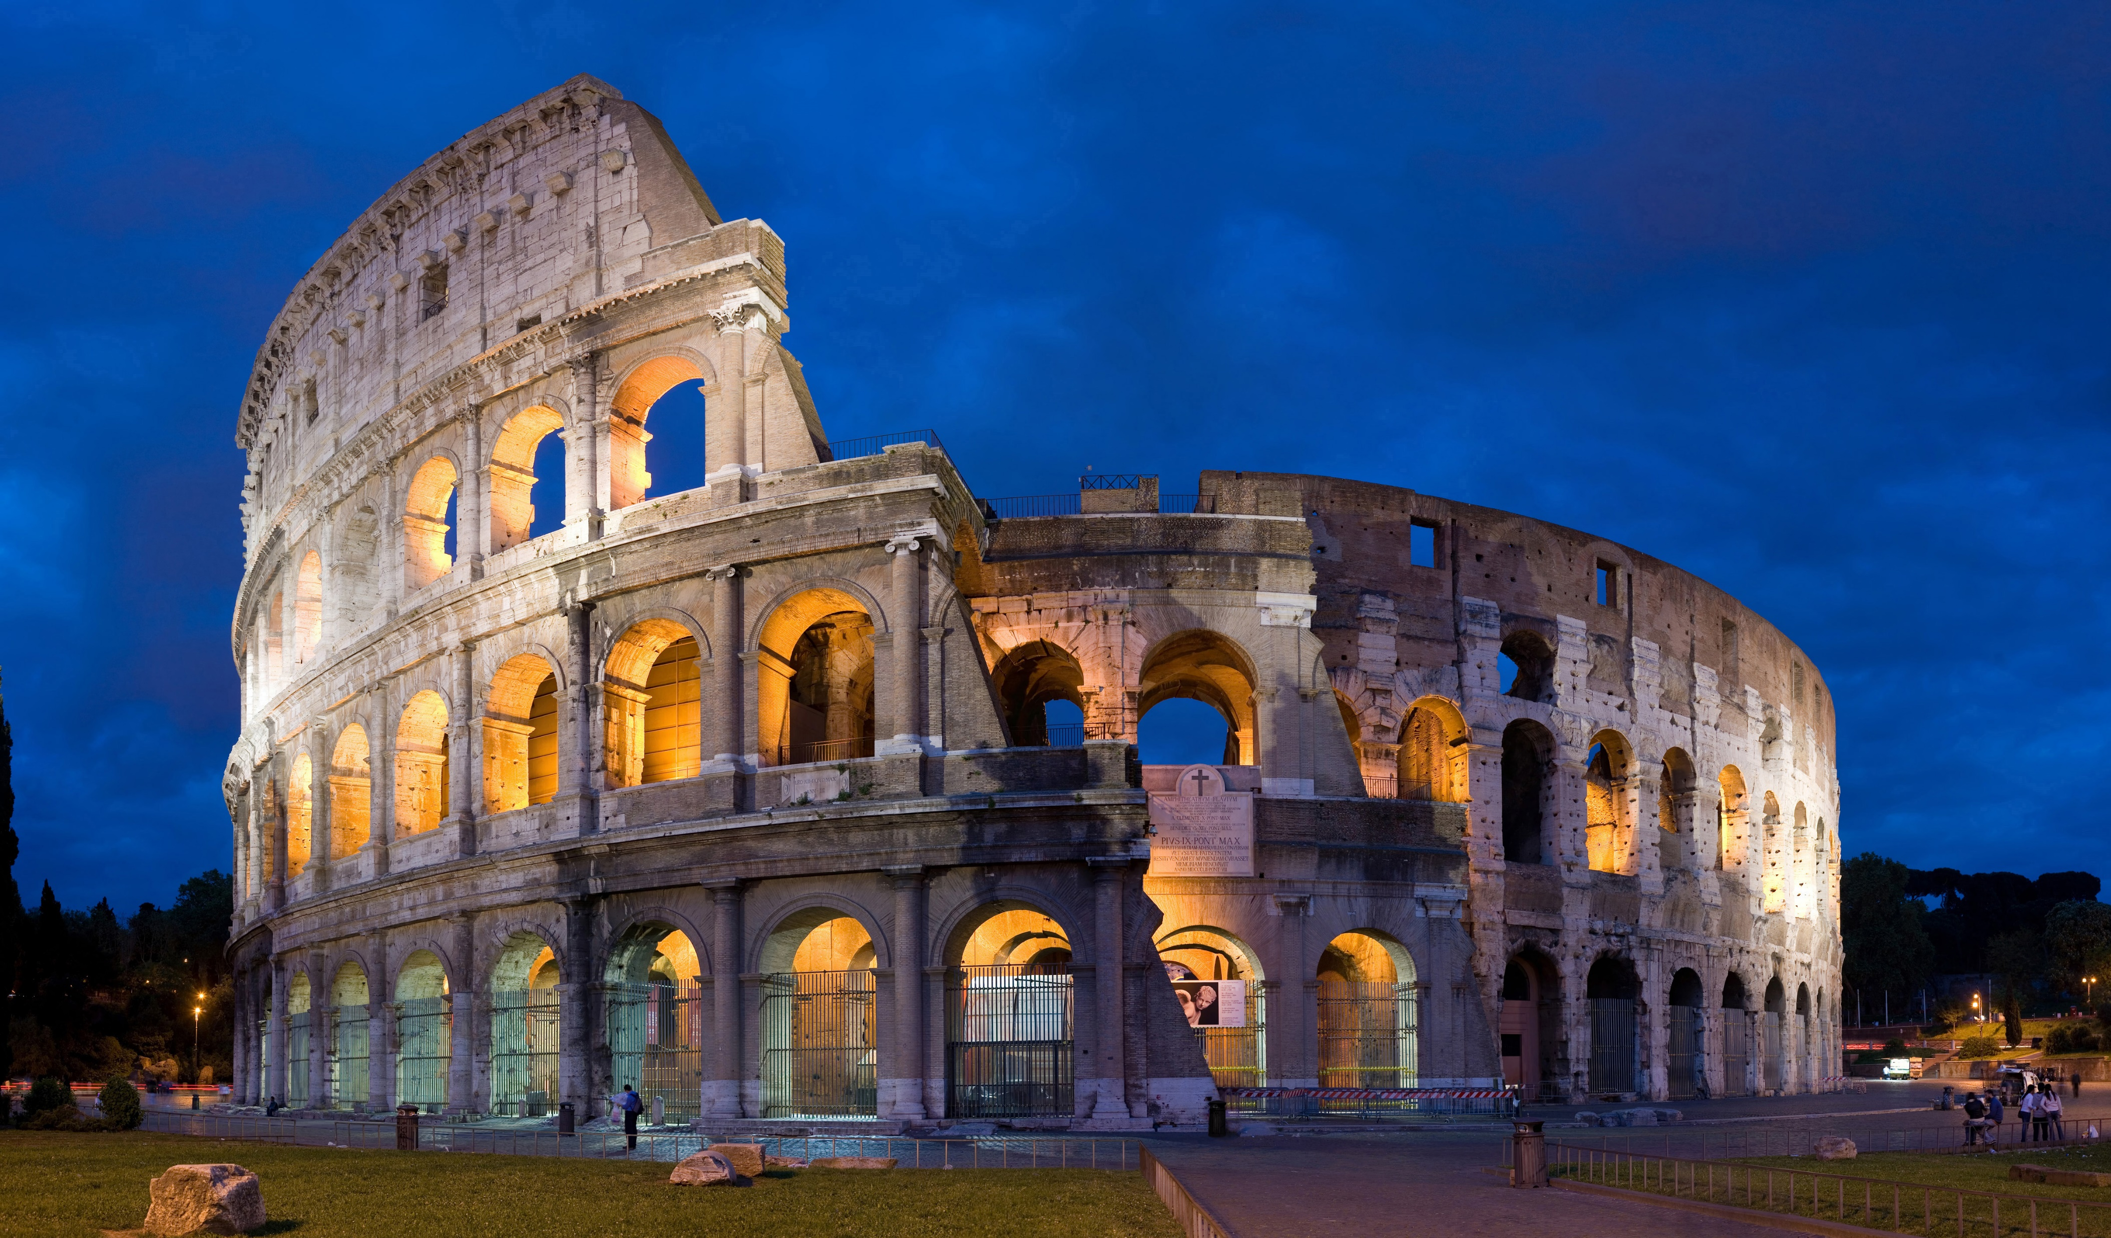
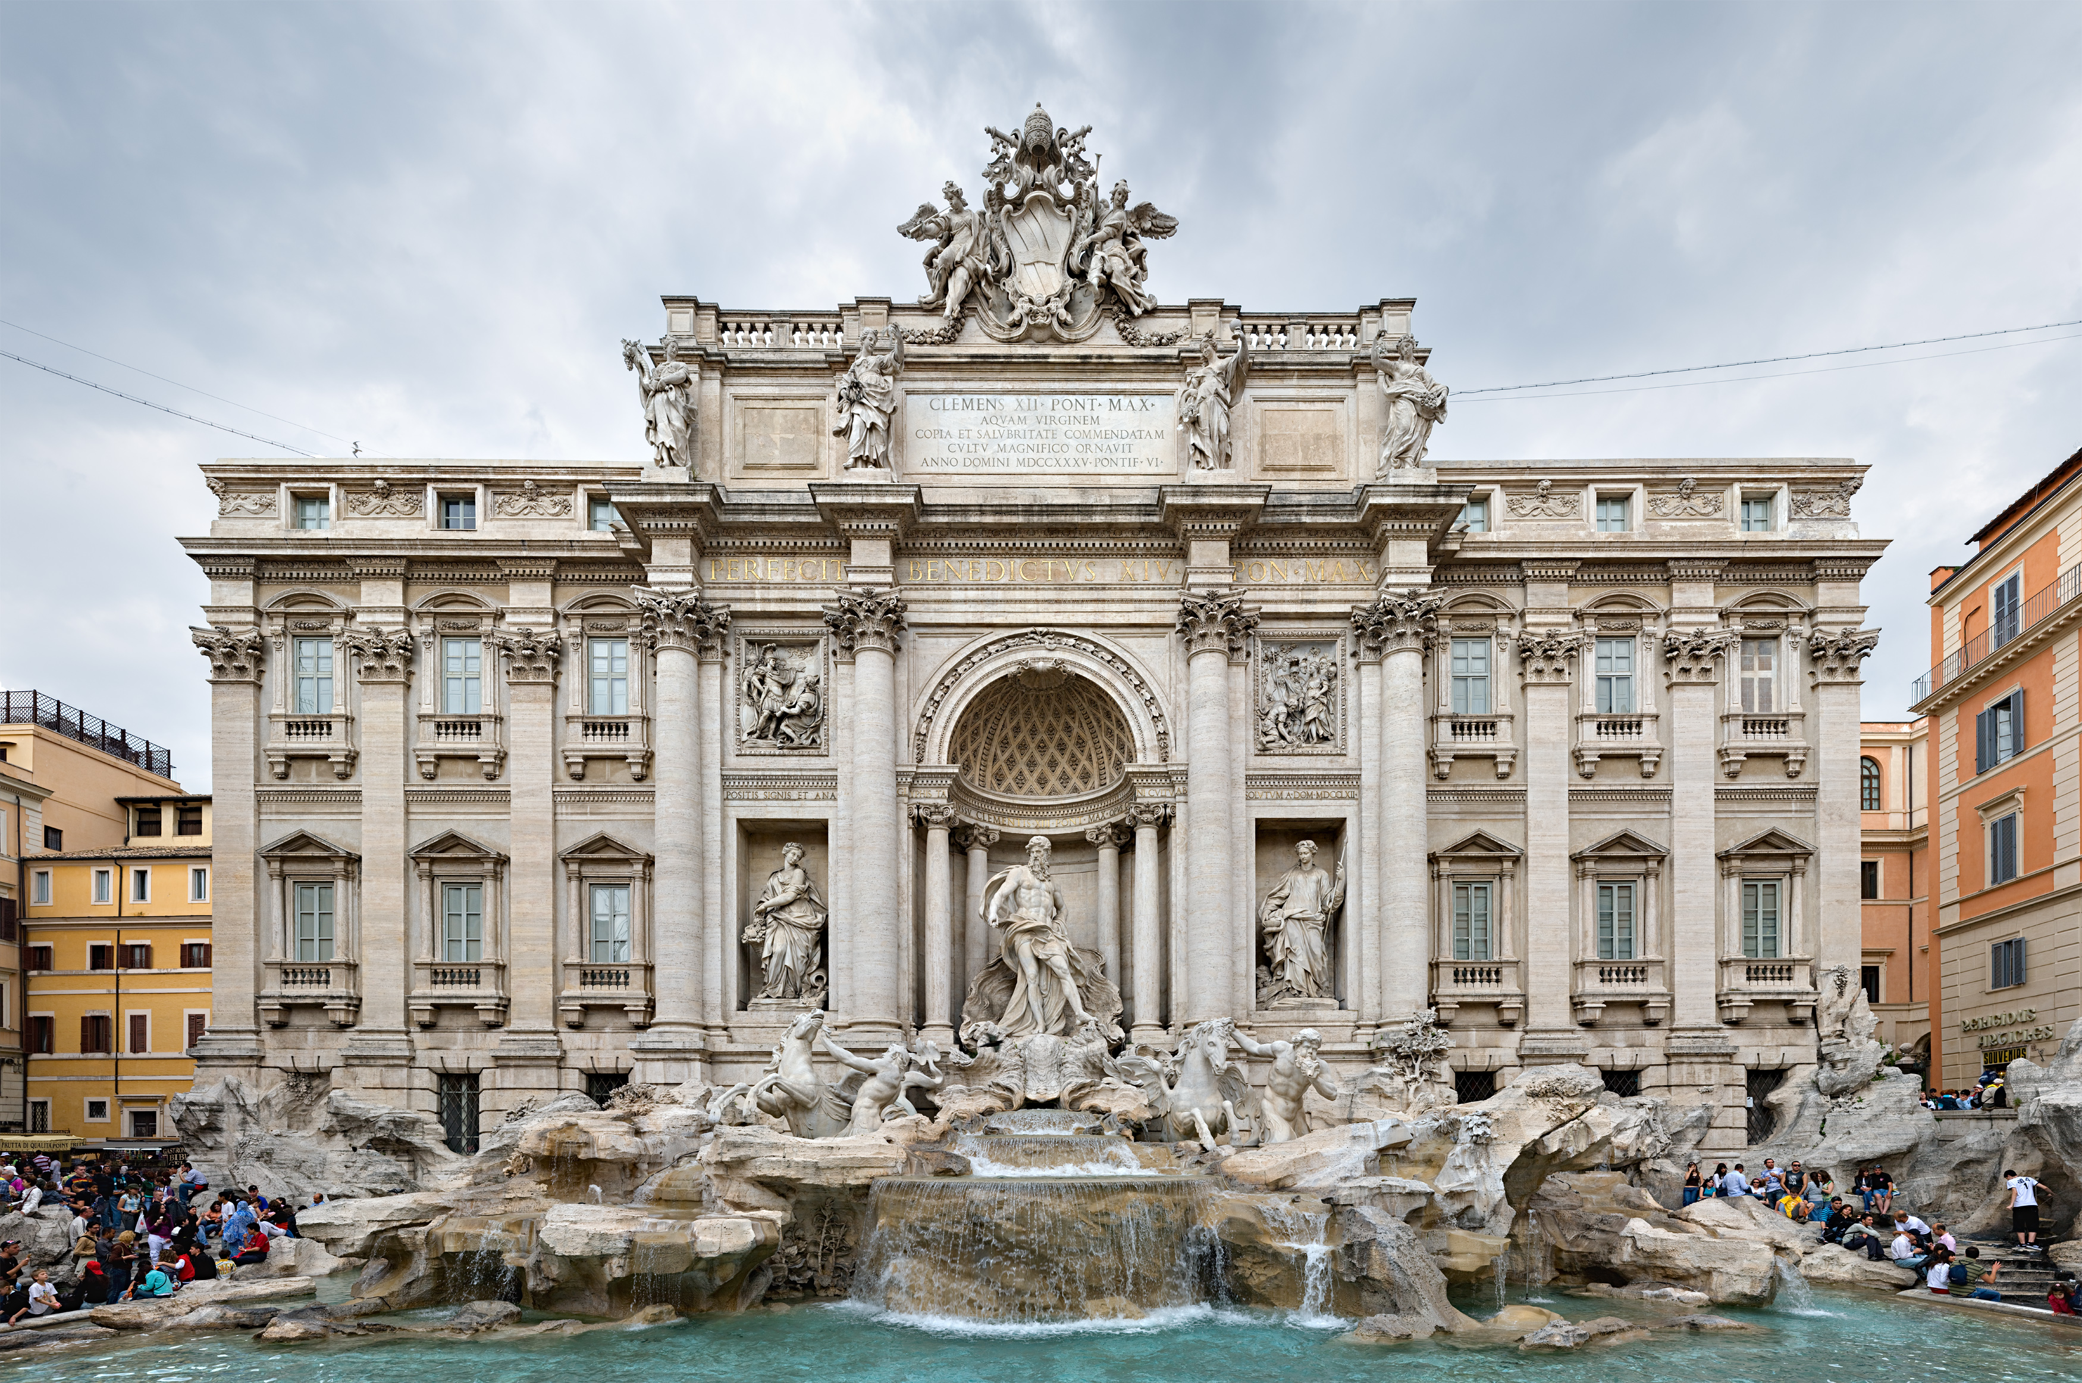
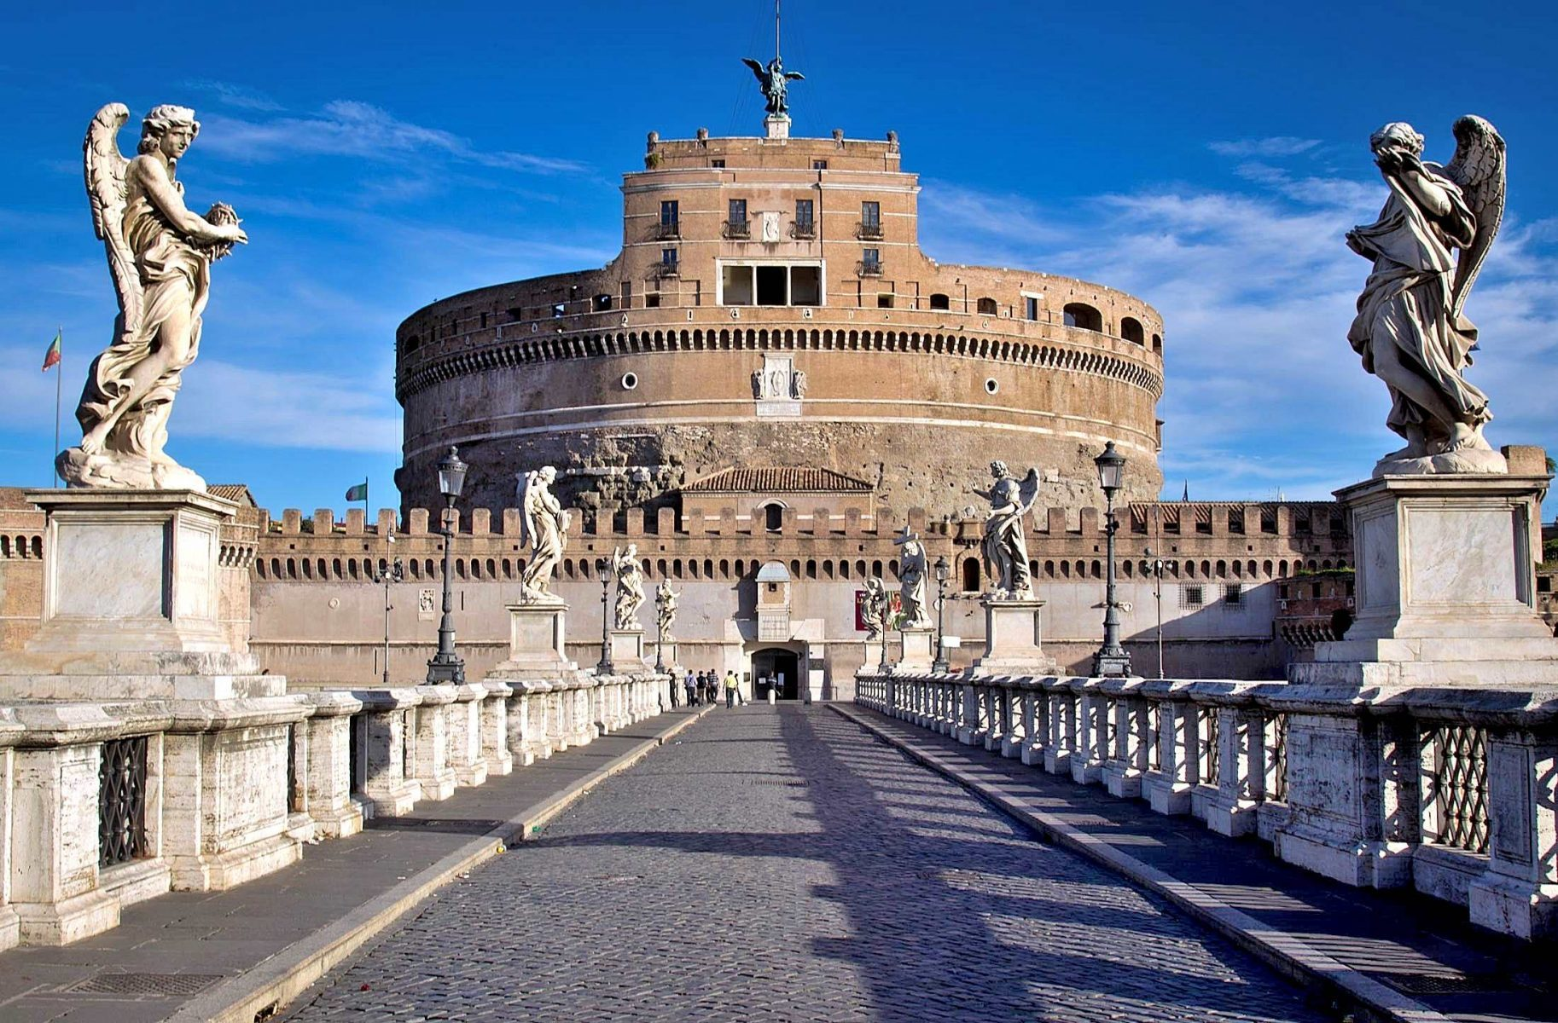
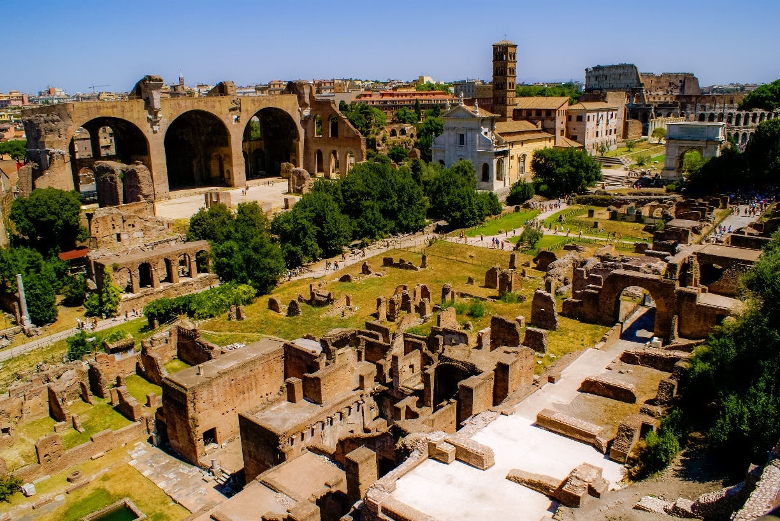

About City and Venue
Rome has a whole lot to recommend itself beautiful buildings, a warm climate, incredible food, and thousands of years of history to explore. In fact, there are so many things to occupy your time in Rome on an Italy, you may have difficulty paring down your list to the essentials. From visits to famous landmarks to iconic food experiences to strolls through art galleries.
Rome was founded in 753 BC by Romulus. Rome is 4,336 m (14,453 ft) above sea level and located inland about 27 kilometres (17 miles) from the Tyrrhenian Sea. Rome is known as the "Eternal city" and "Caput Mundi," coming from Latin and meaning capital of the world. Trajan’s Column in Rome is 128 feet high. The sculptural frieze that wraps around the column is approximately 655 feet in length. Rome became the capital city of a unified Italy in 1870 after taking the title from Florence. Concrete was a Roman invention used on many structures such as the Pantheon, the Colosseum and the Roman Forum, which are still standing today thanks to the development of Roman cement and concrete. The Romans first began building with concrete over 2,100 years ago and used it throughout the Mediterranean basin in everything from aqueducts and buildings to bridges and monuments. SPQR stands for "Senatus Populusque Romanus" and means "The Senate and the people of Rome." The symbol is still seen all over the city today.
Highlights of Rome

Slide 7
Important Dates
Abstract submission opens: February 07, 2019
Registration opens: February 07, 2019
Early bird registration: 22-04-2019
On spot registration: July 22, 2019
Abstract Submission link
https://greenchemistry.pulsusconference.com/abstract-submission
Note: All the relevant abstracts will be accepted and published in respective conference proceedings.
https://greenchemistry.pulsusconference.com/registration
Registration link
UK: PULSUS
40 Bloomsbury Way, Lower Ground Floor
London, United Kingdom
WC1A 2SE | Tel: +44-203-769-1778
Asia Pacific: PULSUS
22 Sin Ming Lane, #06-76 Midview City
Singapore 573969
Fax: +65 672 50801

