Slide 1
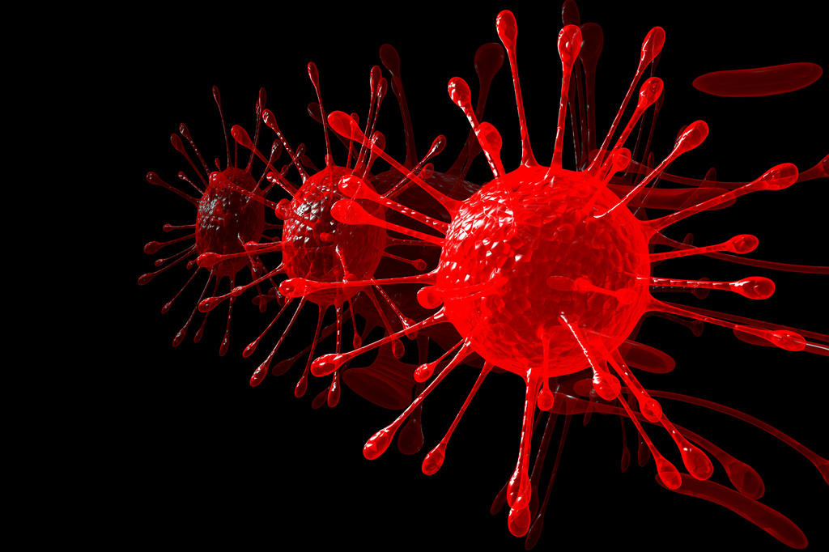
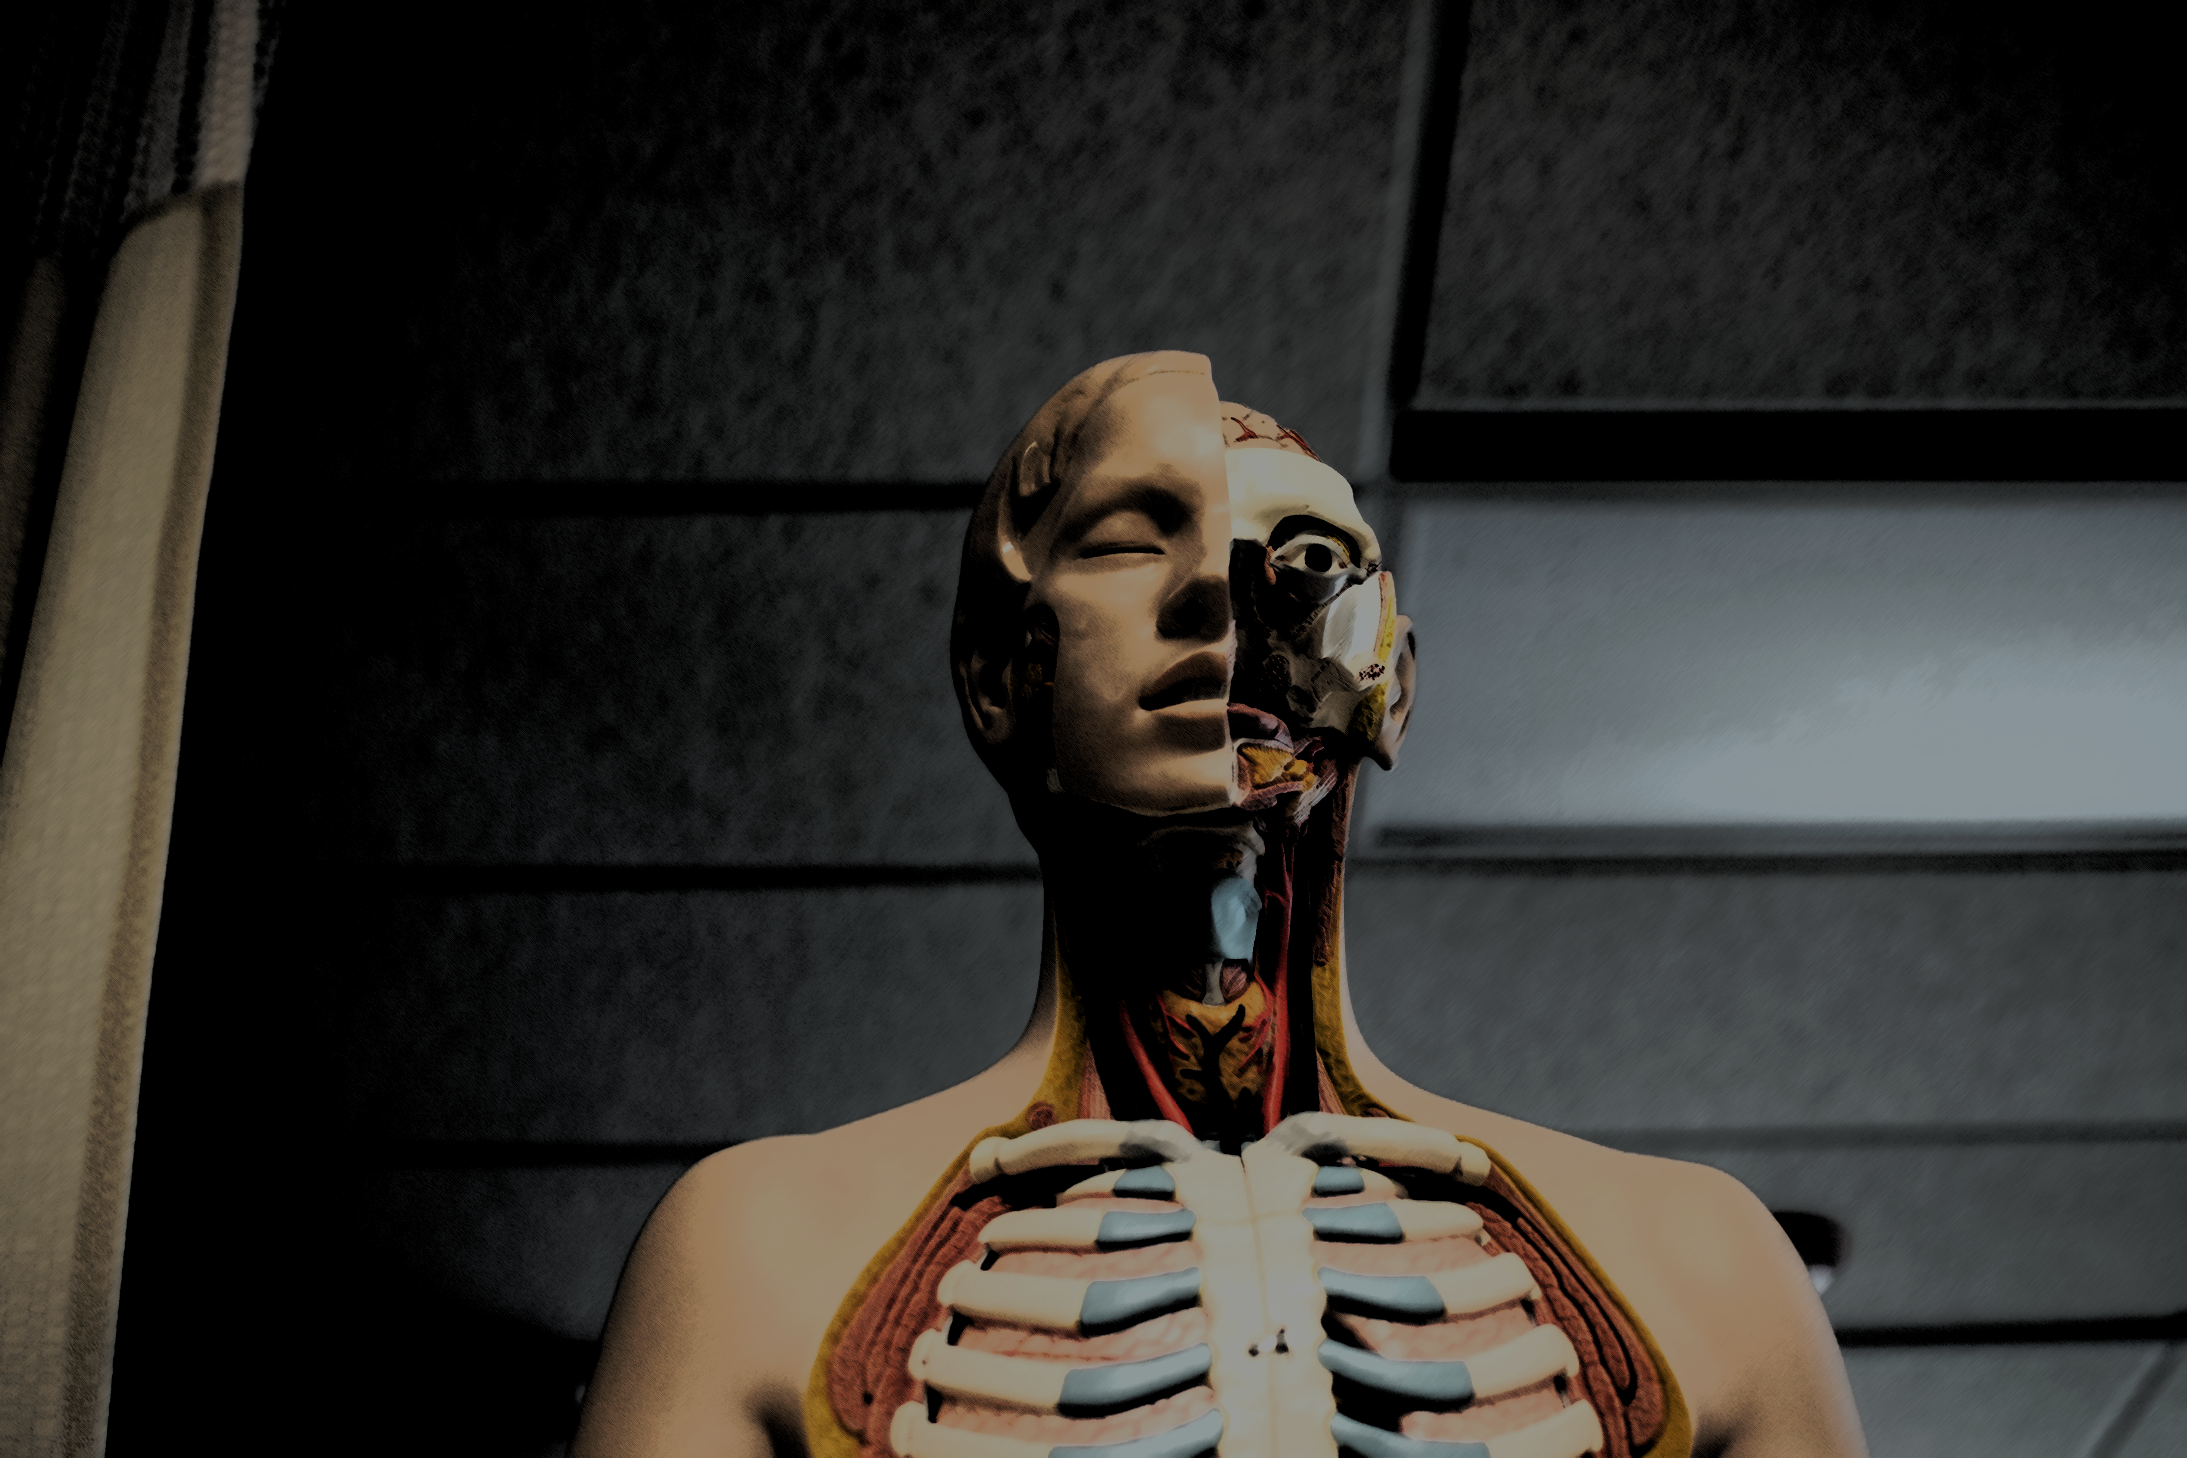

Conference Brochure
International Conference on Contagious Diseases and Anatomy
July 17 – 18, 2019, London, UK
THEME : Exploring the Recent Advancement in the Field of Contagious Diseases
https://contagiousdiseases.pulsusconference.com/

Slide 2

PULSUS brings in a new spin on conferences by presenting the latest scientific improvements in your field. Listen to motivating keynotes from thought leaders or rub elbows with pioneers across the globe. Rome is all set for an amazing event as PULSUS proudly presents the “International Conference on Contagious Diseases and Anatomy” slated on July 17-18,2019 at London, UK.
PULSUS cordially welcome researchers, academicians, students and business professionals in the field of Contagious diseases and Anatomy from around the world to participate in the upcoming Contagious Diseases - 2019. The meeting for this year will revolve around the theme “Exploring the Recent Advancement in the Field of Contagious Diseases” thus relaying the most cutting-edge findings in the current issues of environmental challenges and to make a better world. The two-day meeting is going to be an event to look forward to for its enlightening symposiums & workshops from established experts of the field, exceptional keynote sessions directed by the best in the business.
Invitation
Welcome to share your views
Sessions and Topics
Ebola virus disease and its Outbreaks
Respiratory Infection Diseases
MRSA Super bug
HIV/AIDS
Tuberculosis
Cholera
Influenza
Immunology of Contagious diseases
Contagious Diseases research
Paediatrics Contagious diseases
Genetics of Contagious Diseases
Future Contagious diseases threats
Global Contagious diseases control strategy Anatomy
Global economic consequences on Contagious Diseases
Contagious Diseases and Public health
Pharmacology of Contagious Diseases
Who can attend…??
Researchers working on Materials chemistry, Professors in Chemistry, Post-doctoral and Researchers in Chemistry, Heads of Chemical Departments, Industry Professionals, Directors/ Managers/CEO’s, Presidents & Vice Presidents, Brand Manufacturers/ Marketers of Consumer Products.
Important Dates
Quick Links
Abstract submission opens: 07-02-2019
Registration opens: 07-02-2019
Early bird registration: 22-04-2019
On spot registration: 17-07-2019
Brochure Download
Abstract Submission
Registrations
Cancellation Policy

Slide 3

Materials in Global Market
The Contagious diseases market in US is estimated to grow at a rate of 3.37% between 2014- 2019. As per the records, 25% of deaths are mainly due to Contagious diseases globally. Current market trend shows that North America has a lot of world marketplace for Contagious diseases thanks to increasing incidence of Contagious diseases and thanks to rise in aging population. Followed by North America highest global market is expected in Asia then followed by the Europe in the global Contagious diseases market. In Asia-Pacific region, China and India are expected to be the fastest growing Contagious diseases markets. The main reasons behind the highest global market of Contagious diseases market in the above countries is mainly due to large number of patients and due to increase in government funding. Some of the major companies playing a key role in the global Contagious diseases market are Merck & Co., Pfizer, Johnson & Johnson, F. Hoffmann-La Roche, GlaxoSmithKline Pharmaceutical, Inc., Auritec Pharmaceuticals, Novartis, Achillion Pharmaceuticals, Isis Pharmaceuticals and Gilead Sciences.
Market for Contagious disease molecular diagnostics tests includes hospitals, blood banks, reference laboratories. North America has the highest global market for molecular diagnostics tests followed by Europe due to the market availability of the tests and high occurrence rate of various Contagious diseases such as HPV, hepatitis and bacterial infections. Asia Pacific, Latin America and Middle East are expected to be the potential markets in the coming years. Major companies which play a key role in Contagious disease molecular diagnostics tests market are Abbott Laboratories, Affymetrix, Inc., Becton, Dickinson and Company, bioMérieux, Cepheid, Inc., Hologic, Inc., Life Technologies, Myriad Genetics, Inc., Qiagen N.V. and others.
Sponsorship Opportunities
Diamond Sponsor $10000
Gold Sponsor $7500
Silver Sponsor $5000
Bronze Sponsor $3500
Exhibition $2500

Slide 4










Tourism in
London

