Slide 1
False negative diagnoses of critical congenital heart disease with screening neonatal pulse oximetry
Julien Hoffman
Department of Pediatrics
University of California, San Francisco CA

Slide 2
Definition
Critical congenital heart disease with
  A. Oxygen saturation by pulse oximeter ≥ 95% in room air at sea level, and
  B. No abnormal physical findings

Slide 3
Causes
1. Normal oxygen saturation
2. Minimal desaturation and high cardiac output
3. Oximeter bias

Slide 4
Normal oxygen saturation
      1. Coarctation of the aorta
      May not have obstruction severe enough to change pulses and may not have murmurs. Abnormal findings may not appear for 1-2 weeks.
      2. Interrupted aortic arch
      3. Severe aortic stenosis

Slide 5
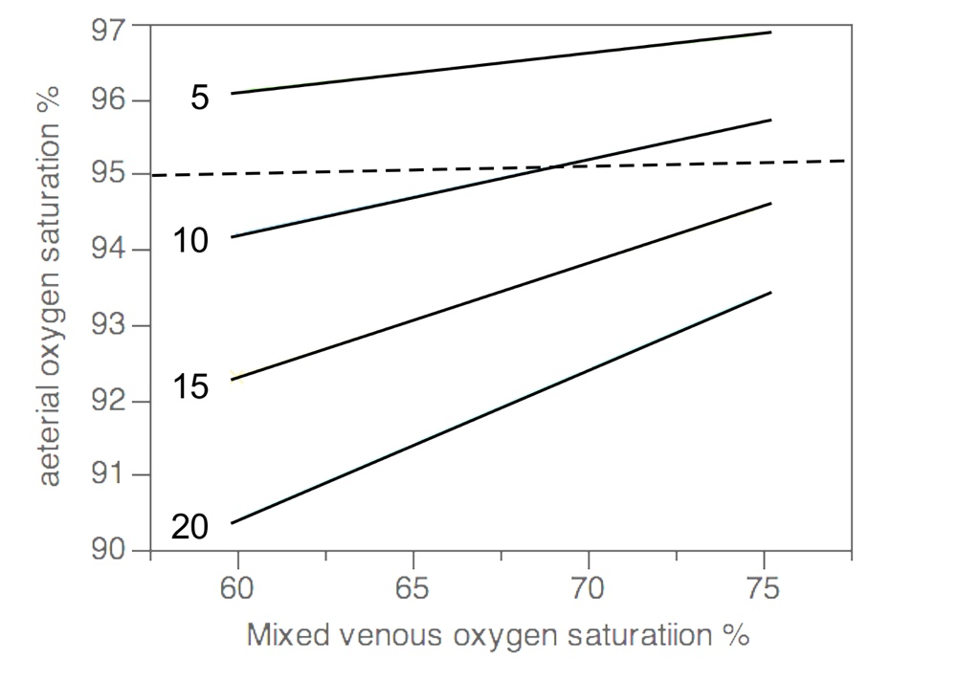
Small right to left shunt and high cardiac output
Different percentages of right-to-left shunting indicated by figures to the left of each line. Thus a small shunt and high cardiac output produce an oxygen saturation ≥95%.

Slide 6
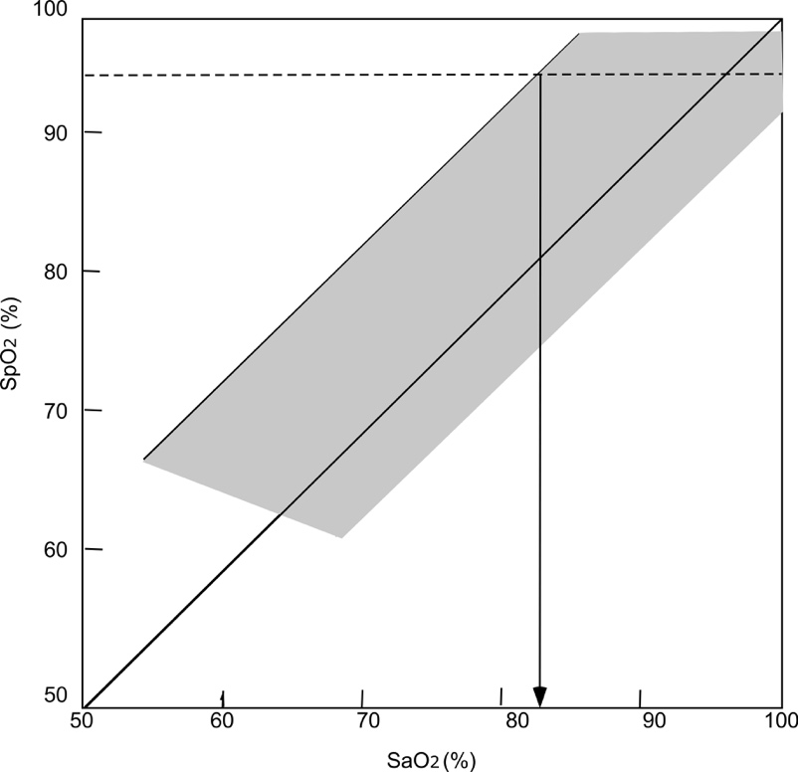
Oximeter bias (1)
The shaded area shows the approximate limits of the saturations. The dashed horizontal line is drawn at 95% pulse oximeter saturation.
Arterial blood (SaO₂) and pulse oximetry (SpO₂)
Combined results (2597 paired points) from Ross PA, Newth CJ, Khemani RG:
Accuracy of pulse oximetry in children. with critical congenital heart disease.
Neonatology 2016;109:213-218.

Slide 7
Oximeter bias (2)
The downward pointing arrow. shows that a pulse oximeter saturation of 95% can be associated with a spectrophotometric saturation ranging from 83% to 100%.

Slide 8
Other sources of error
There are reports of misinterpretation of the algorithm for detecting CCHD
Kochilas LK, Lohr JL, Bruhn E, Borman-Shoap E, Gams BL, Pylipow M,et al: Implementation of critical congenital heart disease screening in Minnesota. Pediatrics 2013;132:e587-594.
Oster ME, Kuo KW, Mahle WT: Quality improvement in screening for critical congenital heart disease. J Pediatr 2014;164:67-71 e62.

Slide 9
Conclusion (1)
False negative pulse oximetry has been described often. For example, In a Norwegian study there were 8/49,684 infants screened on the first day after birth who had saturations over 95% and had CCHD, four of which were diagnosed clinically. Ewer et al observed 6/20,555 newborn infants with CCHD and saturations >95%, but four were diagnosed clinically while in hospital.
  Estimates of false negatives are ~0.01%, but this may be too low.
Meberg A, Brugmann-Pieper S, Due R, Jr., Eskedal L, Fagerli I, Farstad T,et al: First day of life pulse oximetry screening to detect congenital heart defects. J Pediatr 2008;152:761-765.
Ewer AK, Middleton LJ, Furmston AT, Bhoyar A, Daniels JP, Thangaratinam S, et al: Pulse oximetry screening for congenital heart defects in newborn infants (PulseOx): a test accuracy study. Lancet 2011;378:785-794.

Slide 10
Conclusion (2)
The commonest cause of false negative pulse oximetry is coarctation of the aorta, but other anomalies may occasionally be the cause.
There is no substitute for careful clinical follow-up within 2 weeks of. birth if we want to reduce the number of false negative pulse oximetry results.

