Slide 1


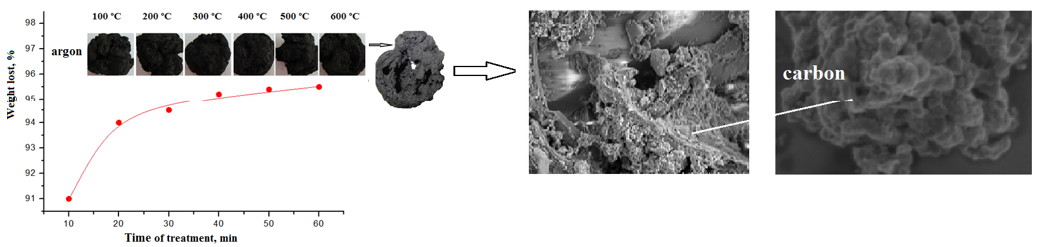
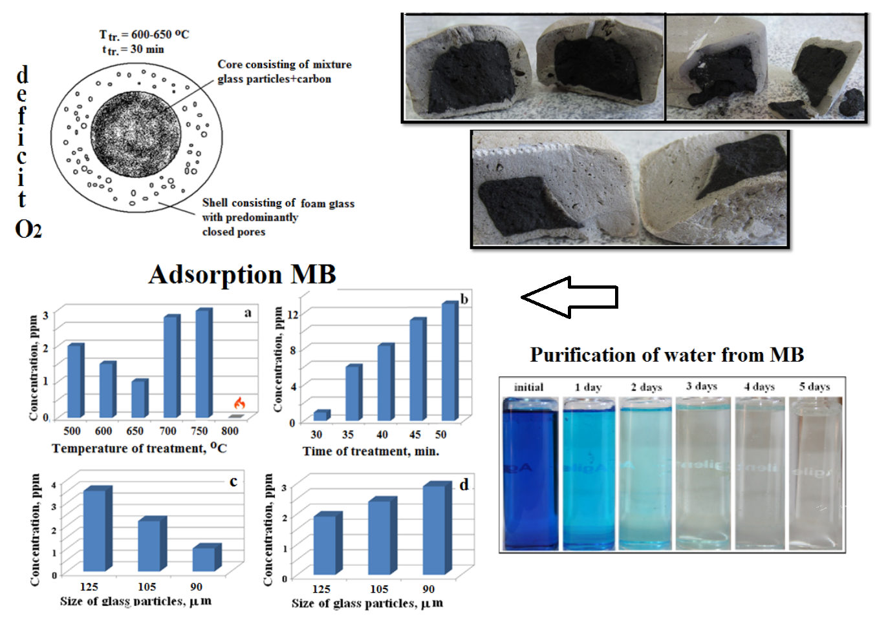
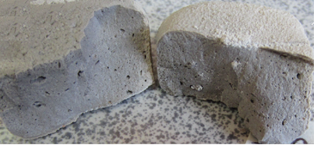

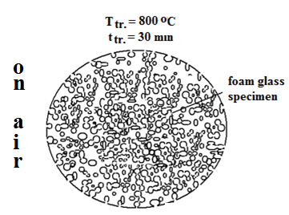
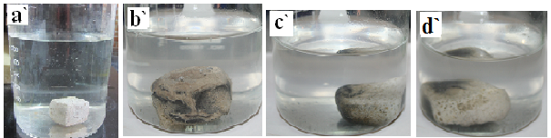

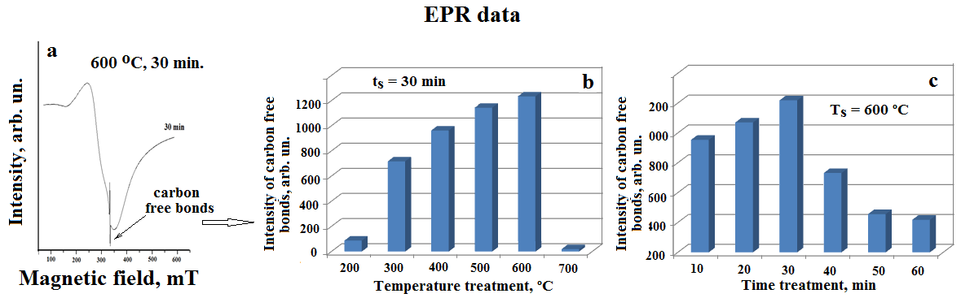
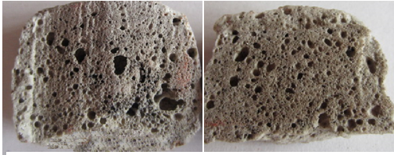
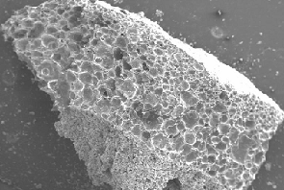
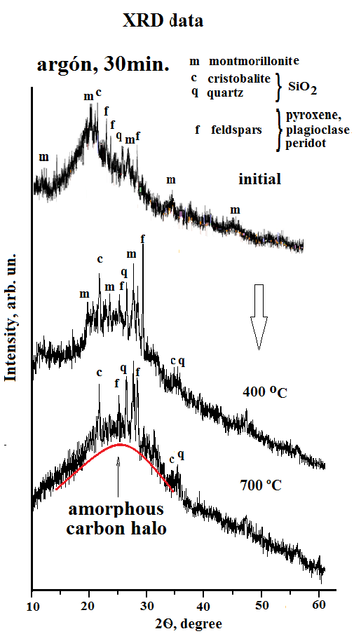

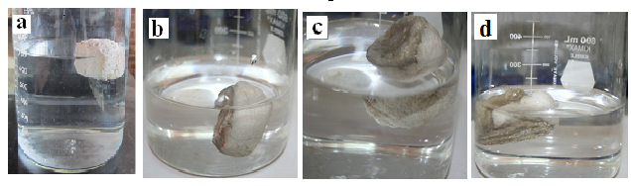
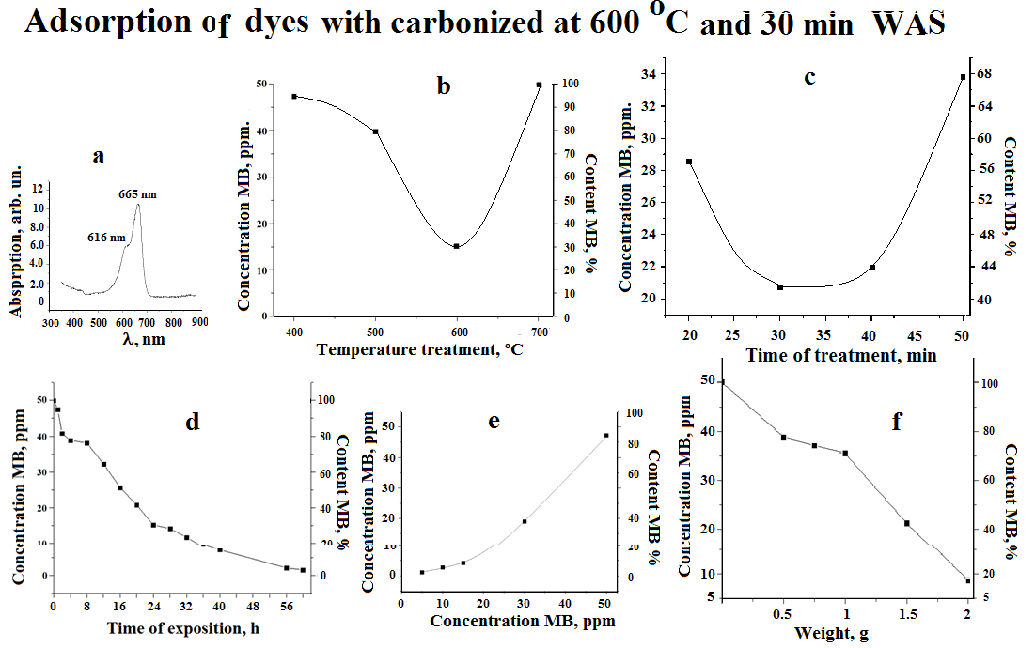

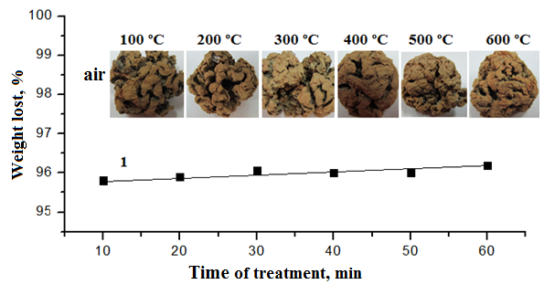
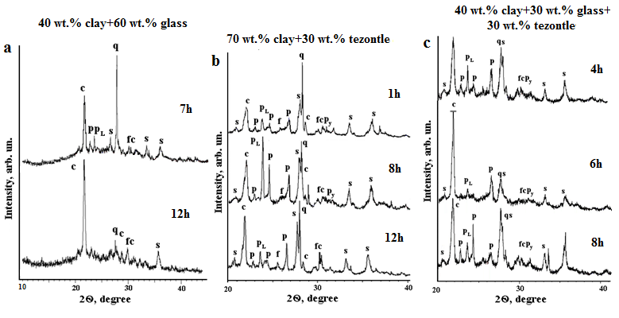
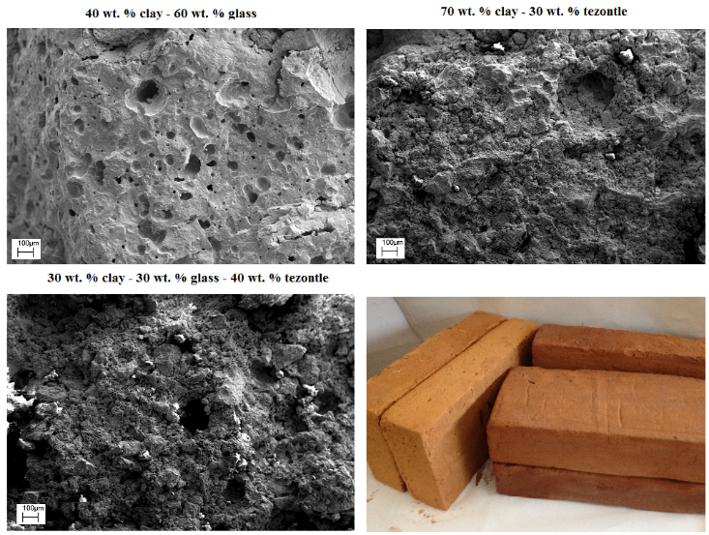
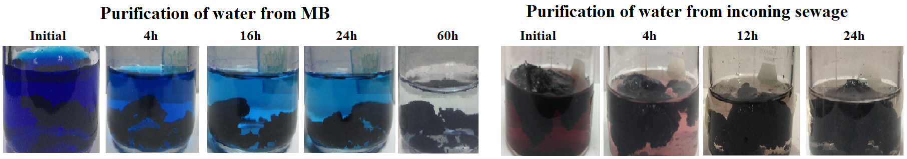
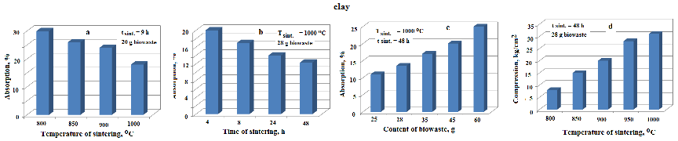
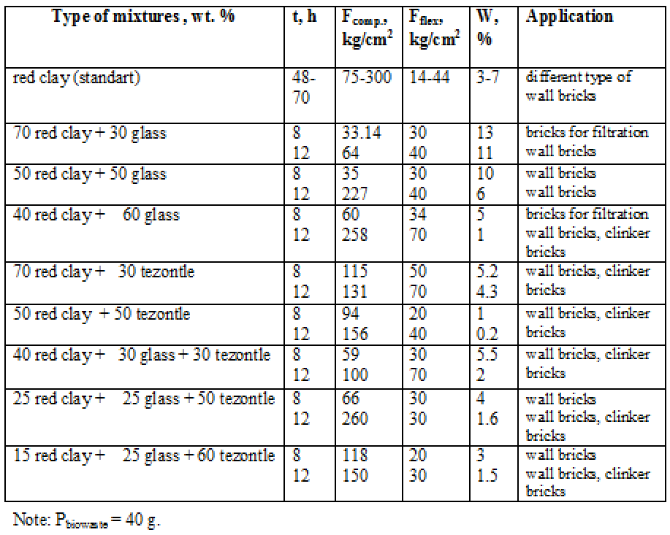
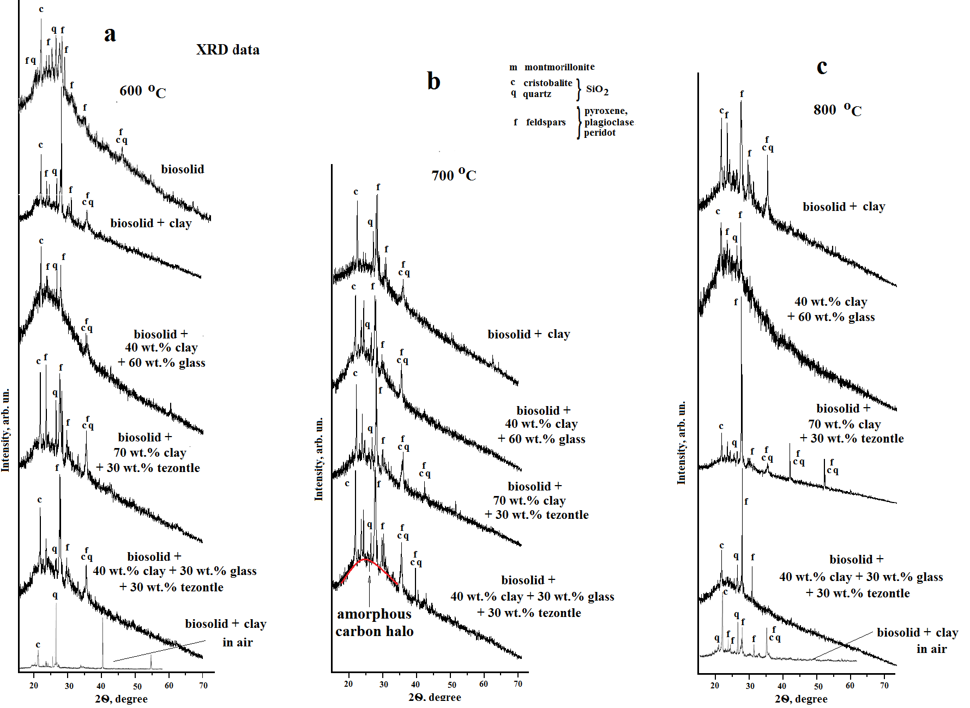
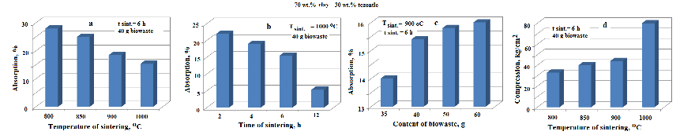
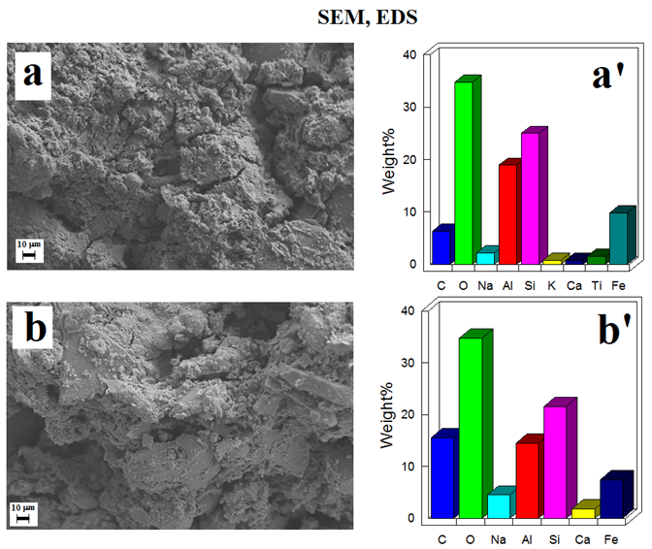
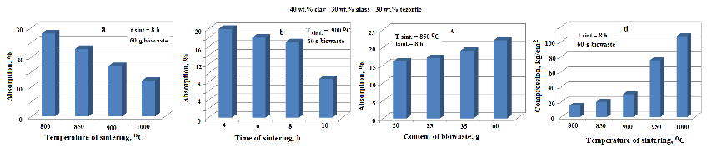
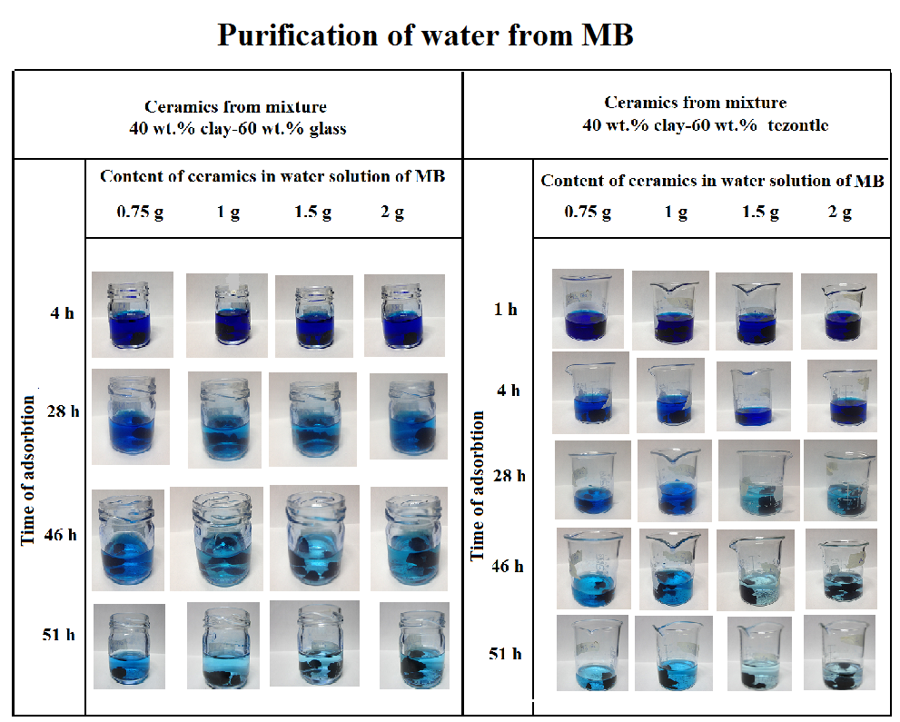
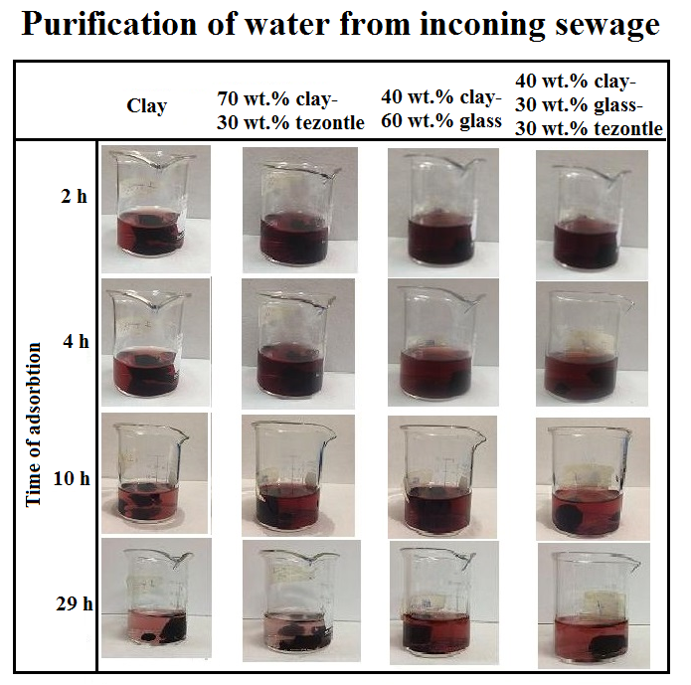
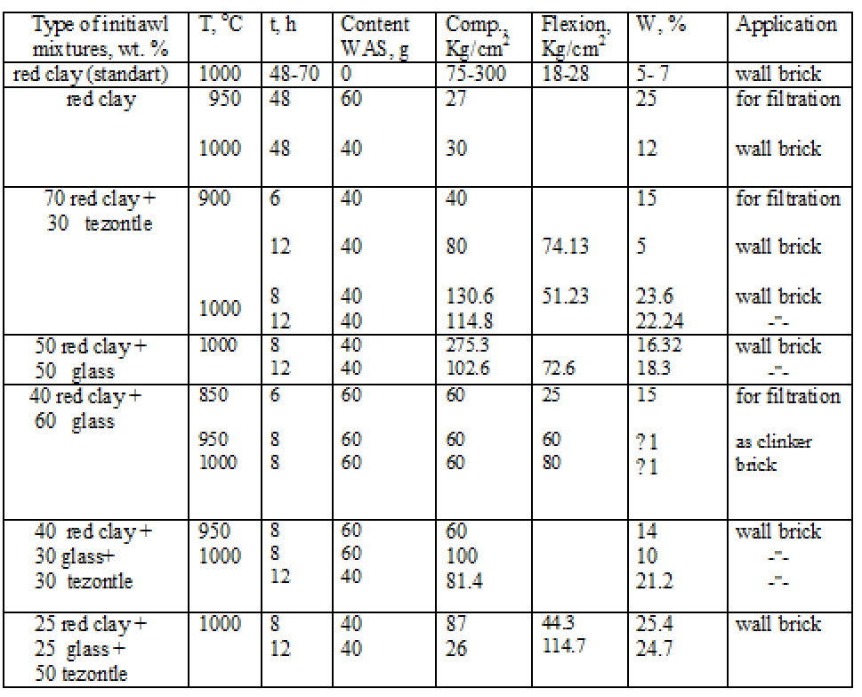
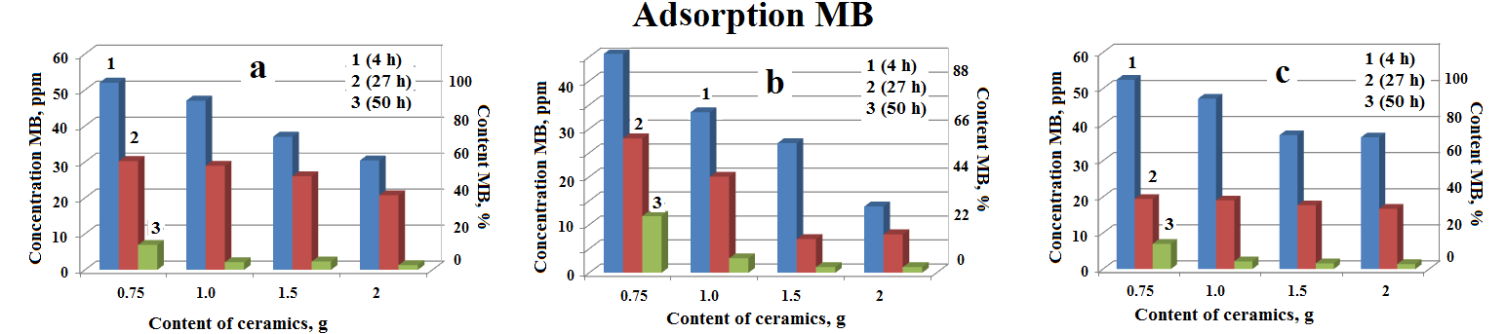
Various Ways of Waste Activated Sludge Recycling
Marina Vlasova, Dr. sci.¹; Abigail Parra Parra, MICA¹; Verónica González Molina, MICA, ¹
¹Center of Investigation in Engineering and Applied Sciences of the Autonomous University of the State of Morelos (CIICAp-UAEMor), Av. Universidad, 1001, Cuernavaca, Morelos, Mexico
Abstract
Methods and Materials
Discussion [1-6]
The recycling of waste activated sludge (WAS) formed in the process of biological purification of sewage is an urgent ecological problem. The aim of our work was development various technological schemes for the utilization of WAS for obtaining: 1) carbon adsorbent in the framework of low –temperature carbonization of WAS; 2) synthesis in the framework of low-temperature sintering of WAS-glass mixtures of composite adsorbent granules consisting from carbon and porous glass; 3) low-temperature synthesis of foam glass from mixtures WAS-a fusible comminuted glass; 4) Synthesis of porous brick products in water-saving mode when using WAS with high humidity, 5) Production of porous carbonized ceramics using WAS and firing under oxygen deficiency conditions.
To understand the physical and chemical processes occurring during the temperature treatment of components and its mixtures, methods such as X ray diffraction, Infra-Red spectroscopy, and electron microscopy with microanalysis, and electron paramagnetic resonance spectroscopy (EPR), an X-ray Fluorescence were used.
Adsorption properties were studied by the UV-Vis method with use of calibration graphs: C=f(I), where C is the dye concentration, λ is the intensity of the band with λ ~ 665 nm. The mechanical properties of the ceramic and water absorption were investigated by standard techniques.
It is known that the temperature in the anoxic environment of organic compounds leads to the gradual formation of "carbon rings" with free bonds, then to their consolidation. At the same time, the amount of free bonds decrease, and the reactivity of carbonizate decreases. Since the greatest number of free bonds is formed in the region (550-650)ºC during short-time treatment (less than 40 min.), It was just such a temperature regime that we chose to treat the wet WAS. The only effective control method in this case is EPR, which allows you to determine the required time and temperature of the synthesis of active carbonizate.
The same approach was used to produce carbonized foam glass. However, in this case it was necessary to bring together two conditions: the glass softening temperature should be close to the conditions for maintaining a sufficient number of free carbon bonds, that is, it should be a low-melting glass.
The situation is more complicated when carbonized ceramics are produced. In this case, it was necessary to prepare mixtures for which the sintering temperature would be substantially reduced by the appearance of low-melting eutectics.
To obtain foamed glass and porous bricks, a simple principle was used: removal of water vapor and burnout of the organic component. And for this it was necessary to use a wet WAS.
Results
1)Treatment WAS in argon (vacuum, oxygen deficiency) for obtaining carbon adsorbent
2) Treatment WAS + grinded glass with oxygen deficiency for obtaining carbon adsorbent in porous glass sheath
3) Treatment WAS + grinded glass in air for obtaining foam glass and porous glass
Introduction
Fig. 1. Weight loss of waste sludge depending on the treatment time at T_{tr}=600ºC in argon, and change of the color of specimens (upper part of the figure).
Mankind is now confronted with the problems of improving ecology, energy saving, and water saving, which call for their urgent solution. The greatest part of these problems arose as a result of the technogenic activity of people. For instance, the manufacture of glass for different applications and glassware is accompanied by the accumulation of considerable quantities of cullet. The use of natural stones such as basalts in ceramic production is usually connected with their grinding and accumulation of milled waste. The purification of household and industrial sewage at water treatment plants with the use of activated sludge leads to the necessity for developing methods of processing the biowaste which are dangerous for the environment. All aforementioned wastes are large-scale and require processing. Usually recycling industrial waste into new materials is an energy-consuming. It is this problem that most often prevents the development of technologies for obtaining new materials.
The aim of our work was to develop simple technologies for the processing of large-scale waste that could be introduced in large-scale production. These include the production of brick products, the production of foam glass bricks, and the production of active carbon.
Fig. 3. EPR spectra of WAS (a) and change of intensity of narrow EPR signal from carbon free bonds depending on the treatment temperature (b) and treatment time (c) in an argon atmosphere. In (b) ttr= 30 min. In (c) Ttr = 600ºC
Fig. 2. Change in the concentration of MB in solution with the sintering temperature (a) and sintering time (b) of specimens. In (a): t_{sint.} = 600ºC, d_{glass}< 90mm.
4) Sintering bricks from various mixtures prepared using WAS on air
Conclusions
In the work was established that:
1.For creation of active carbon of good adsorptive properties it is necessary realize a low temperature treatment during short time with conditions of medium argon, vacuum, deficit of oxygen (Energy Saving Technology).
2.For obtaining foam glass and carbonized foam glass it is necessary use glasses with low temperature of melting to create good conditions for formation active carbon in glass melt (Energy Saving Technology)
3.For obtaining bricks with different porosity it is possible introduce WAS with high humidity into different mixtures with clay which give possibility to decrease temperature and time sintering (Energy and Water Saving Technology).
4. In conditions of oxygen deficit it is possible obtain carbonized bricks with different porosity for specific applications.
5.All developed technologies belongs to technologies of energy saving, water saving and minimizing the release of CO2 in the atmosphere that solve an ecological problem.
Fig. 4. UV-Vis spectrum of MB (a) and contents of MB in aqueous solution depending on the treatment temperature of biowaste (b), treatment time (c), time of exposure the carbonizate (d), MB concentrations band at λ∼ 665 nm was used.
In (b): t_{tr} = 30min. Weight of specimen (P) is 0.5 f. Volume of solution (V) is 20 ml. Initial MB concentration in solution (CMB) is 50 ppm. Adsorption time is 24 h. In (c): T_{tr}=600ºC, P = 0.5g, V=20ml, C_{MB} = 50 ppm. In (d): T_{tr} = 600ºC, t_{tr}= 30 min. For solution: V =20ml, C_{MB} = 50ppm. P = 0.5g. In (e): T_{tr} = 600ºC, t_{tr} = 30 min., P = 0.5g. For aqueous solution: V=20 ml. Adsorption time is 1 h. In (f): T_{tr} = 600 ºC, t_{tr} = 30 min. For aqueous solution: V = 20 ml, C_{MB} = 50 ppm. Adsorption time is 4h.
Fig. 1. Weight loss of waste sludge depending on the treatment time at Ttr=600ºC in air, and change of the color of specimens (upper part of the figure).
Fig. 2. X-ray diffraction patterns of specimens prepared from different mixtures with the use of biowaste after treatment at 1000ºC during different sintering times. P-peridot, pL- plagioclase, f- feldspar, s- silimanite, c- cristobalite, q- quartz, py- pyroxene.
Fig. 3. Micrograph of a fracture specimen obtained from different mixtures and bricks.
Fig. 2. Fragments of X-ray diffraction patterns of sludge heat-treated in argon at T=600ºC and t=30 min.
Table I Mechanical and absorptive properties of specimens obtained at T_{sint.} = 1000 ºC, t_{sint}. = 8 h and 12 h.
5) Sintering bricks carbonized from various mixtures prepared using WAS (in argon)
Fig. 4. Absorption of water by the ceramics prepared from red clay vs. sintering temperature (a), sintering time (b), and biowaste content in the initial clay (c). In (d): dependence of the compressive strength on the sintering temperature.
Fig. 5. Dependence of the absorption of water by the ceramics obtained from the 70 wt.% red clay-30 wt.% tezontle mixture on the sintering temperature (a), sintering time (b), and content of biowaste in the initial clay (c). In (d): dependence of the compressive strength on the sintering temperature.
Fig. 2. Micrographs of fractures of specimens (a, b) and contents of elements in the registered in region (a´, b´)(a, a´) 40wt.% red clay+ 30wt.% glass + 30wt.% tezontle + WAS; (b, b´) 40wt.% red clay+60wt.% glass + WAS (1). T_{sint.} = 1000 ºC, t_{sint.} = 8 h.
  Fig. 6. Absorption of water by ceramics obtained from the 40wt.% red clay-30wt.% tezontle-30wt.% glass mixture vs. sintering temperature (a), sintering time (b), and biowaste content in the initial clay (c). In (d): dependence of the compressive strength on the sintering temperature.
Fig. 1. X-ray diffraction patterns of specimens obtained from different mixtures at different sintering temperatures in an argon atmosphere. The sintering time is 4 h.
Table II. The properties of specimens obtained with use of WAS
Fig. 3. Change in the content of MB in aqueous solutions depending on the content of ceramics obtained from: (a) 100wt.% clay, (b) 70 wt.% clay-30wt.% tezontle mixture; (c) 40wt.% clay-60wt.% glass mixture after holding in solution: (1) for 4h; (2) for 27 h; (3) for 50h. Specimens obtained at T_{sint.} = 700ºC, t_{sint.} = 1h. The volume of solution is 20ml. Initial concentration MB in solution (CMB) 50 ppm.
Future Directions
Necessary repeat this experiments in industrial conditions.
Contact Information
References
<Marina Vlasova >
<Center of Investigation in Engineering and Applied Sciences of the Autonomous University of the State of Morelos>
Email:vlasovamarina@inbox.ru
Phone:52 777 329 70 80
Vlasova, M., Parra Parra, A., Marquez Aguilar, P. A., Kakazey, M., Purification of sewage by porous materials obtained with using different types of waste, J. Applied Sciences in Environmental Sanitation, v. 6 (2), pp. 165-179, 2011 p-ISSN: 0126-2807
M. Vlasova, I. Rosales, M. Kakazey, A. Parra Parra, R. Guardian, Formation of Porous Ceramics Using Cullet and Biological Waste of Water Purification, Sci. of Sintering, v. 43, pp. 81-94, 2011 ISSN 0350-820X
C. BustosRiveraBahena‚ M. Vlasova, M. Kakazey, G. Dominguez-Patino, R. Flores, Carbonized tezontle and its adsorptive properties, Intern. J. Research Studies in Science, Engineering and Technology (IJSSET), v.2, Iss.5, pp.1-10, 2015. ISSN:2349-4751 and ISSN:2349-476X
A. Parra Parra, M. Vlasova, P. A. Márquez Aguilar, T. Tomila, Peculiarities of a Glass-Sludge Mixture Subjected to Low-Temperature Treatment, Sci. Sintering, v. 49, pp. 207-224, 2017.
V. González Molina, A. Parra Parra, M. Vlasova, A. Trujillo Estrada, P. A. Márquez Aguilar, M. Kakazey, J. Campos Alvarez, Synthesis and Properties of Carbonized Silicate Ceramics, Journal of Progressive Research in Chemistry, v.6, Iss.1, pp.255-265, 2017.
M. Vlasova, A. Parra Parra, P. A. Márquez Aguilar, A. Trujillo Estrada, V. González Molina, M. Kakazey, T. Tomila, V. Gómez-Vidales, Closed Cycle of Recycling of Waste Activated Sludge, Waste Management, v. 71, pp. 320-333, 2018. //doi.org/10.1016/j.wasman.2017.10.051

