Slide 1

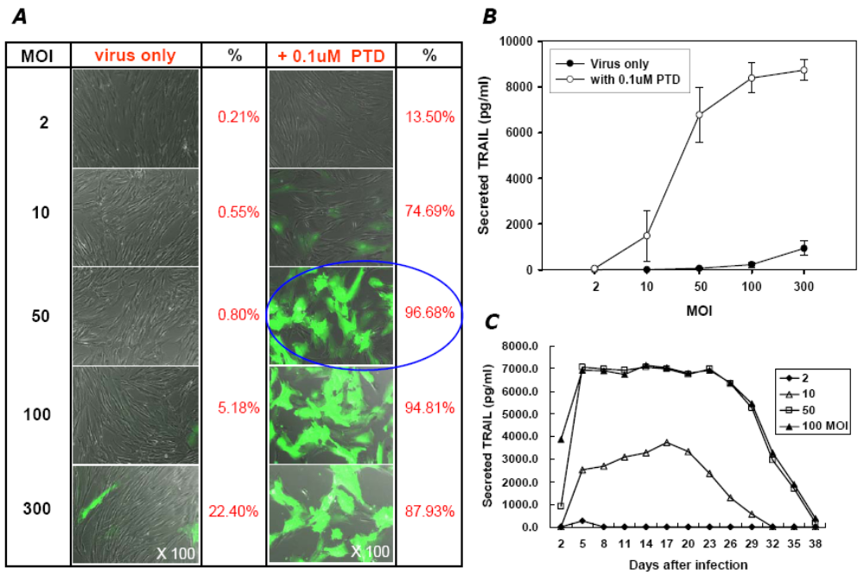
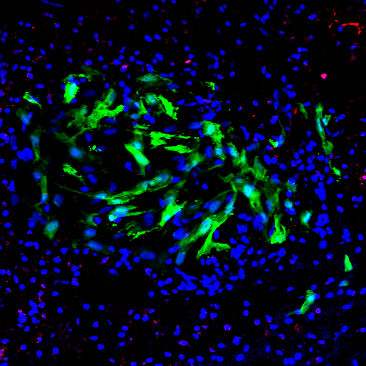
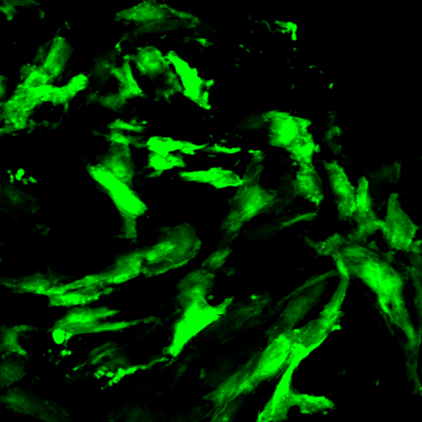

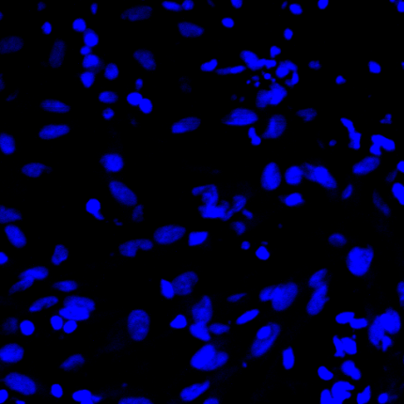
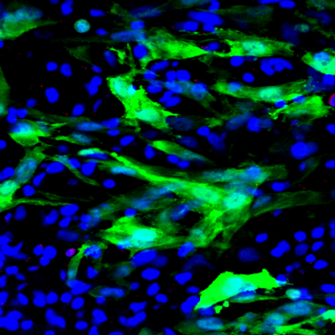
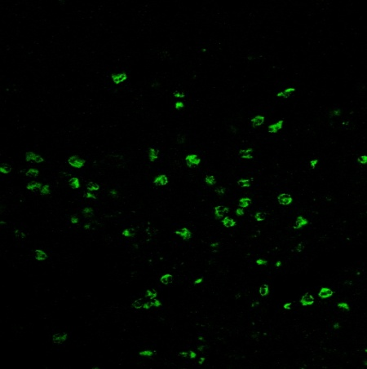

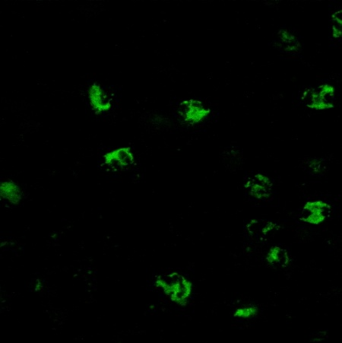
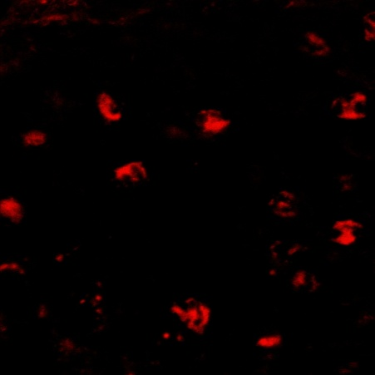
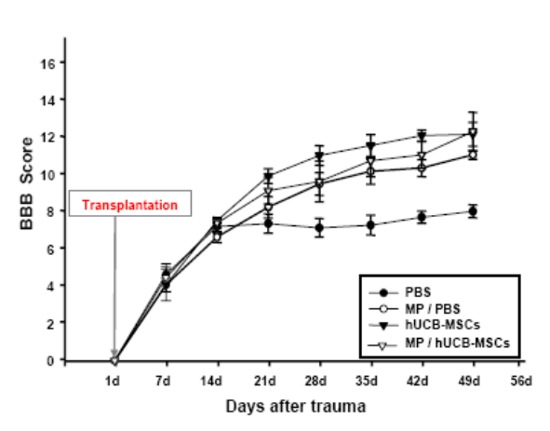
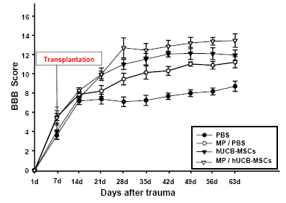
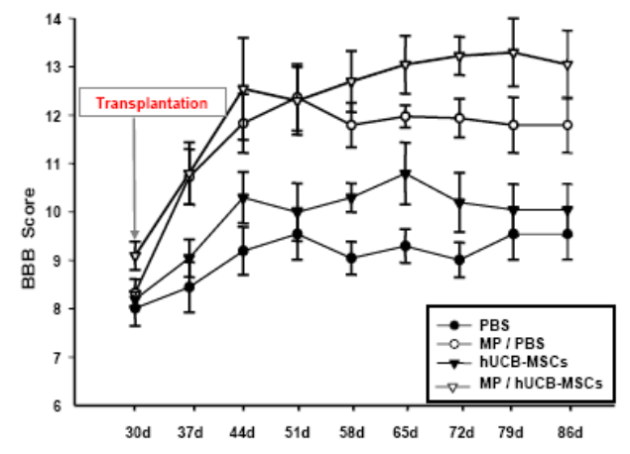
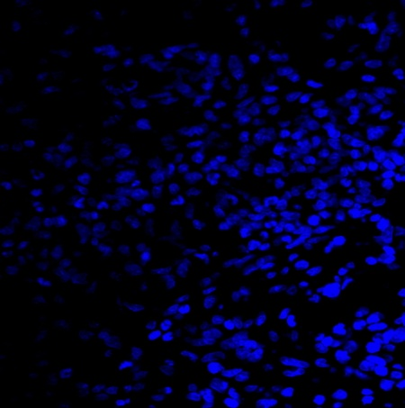
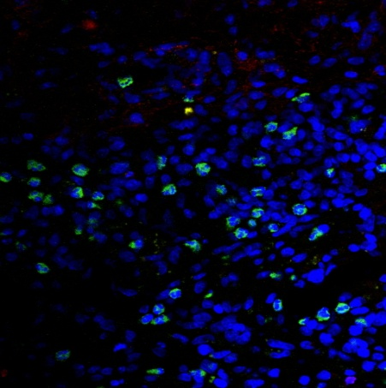
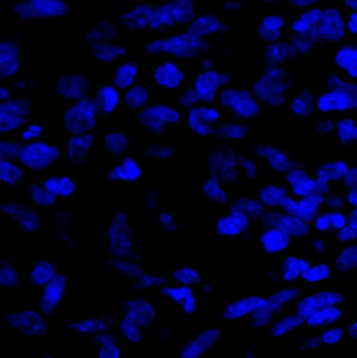
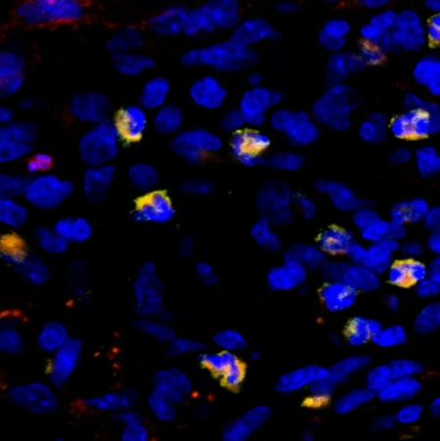
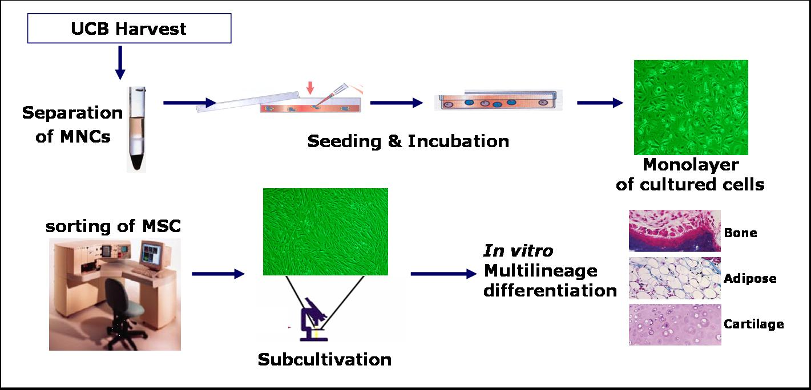
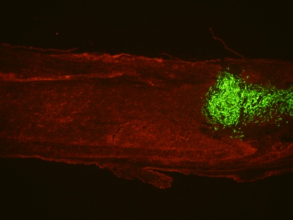
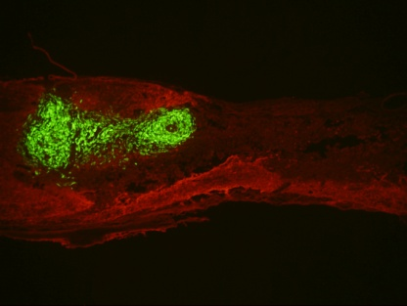
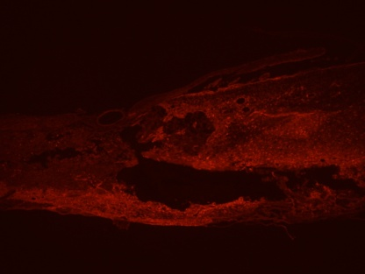
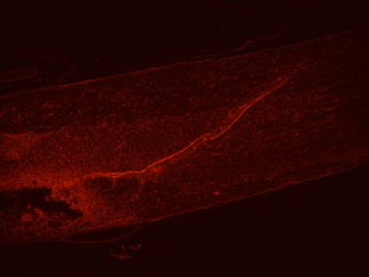
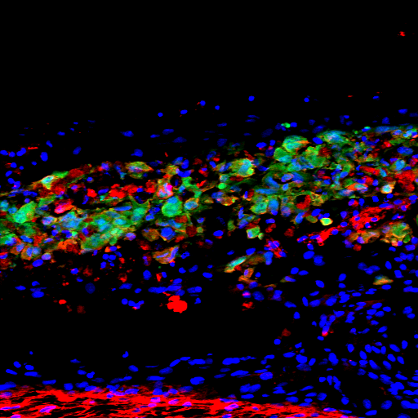
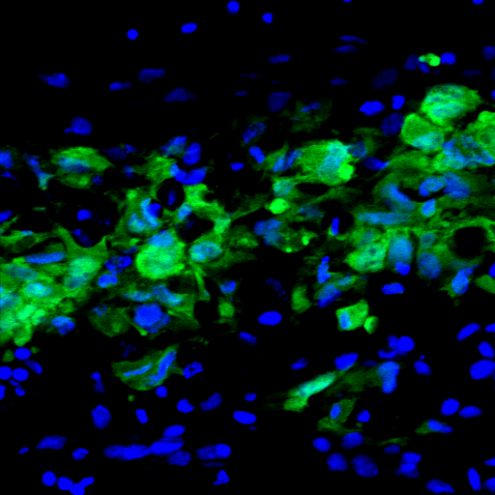
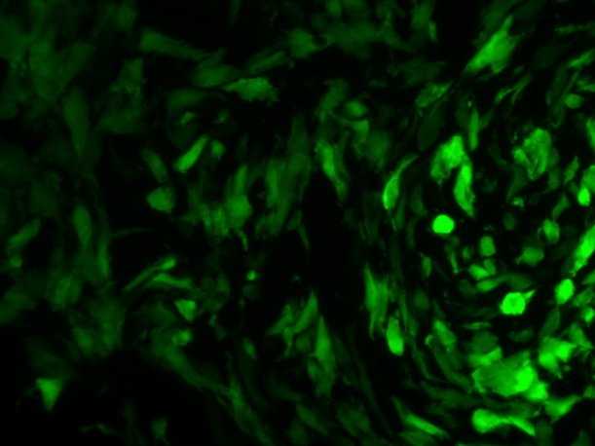
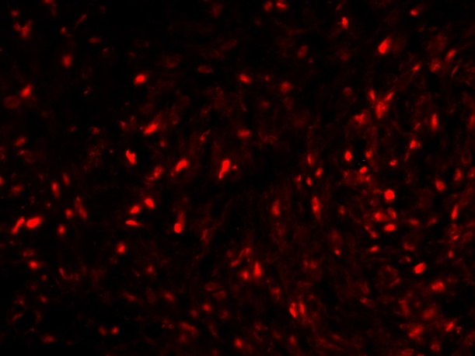
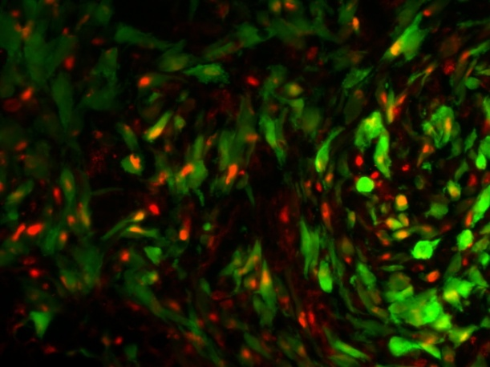
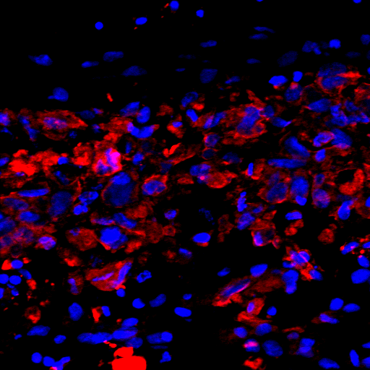
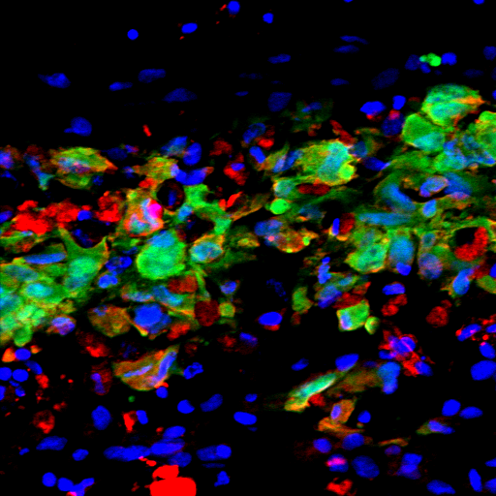
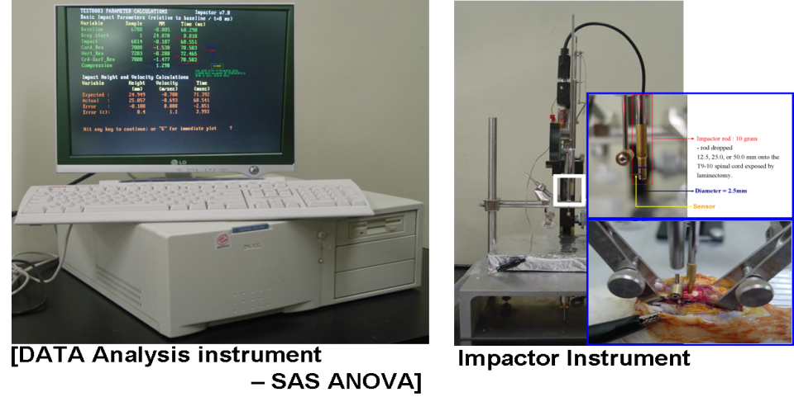
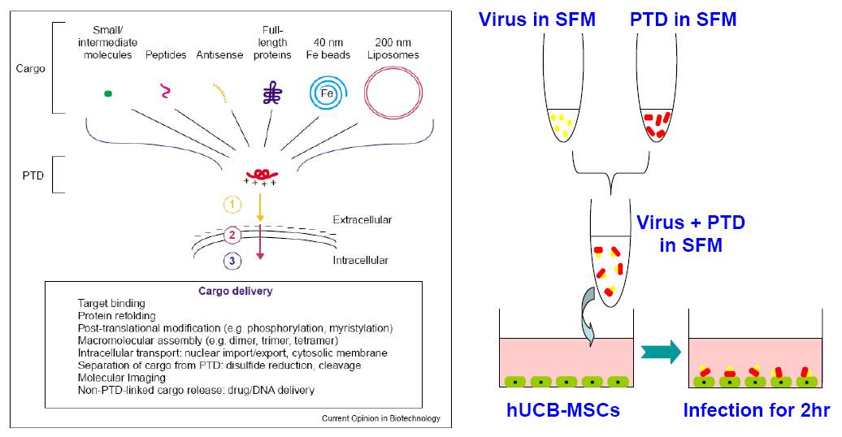
Effect of Therapeutic Time Window for Human Mesenchymal Stem Cells therapy with Methylprednisolone treatment in the contused rat spinal cord
S.I. Park, H.Y. Jung, Y.A. Chung, L.I. Maeng
Clinical Research Insitute (CRI), Incheon St. Mary’s Hospital,
College of Medicine The Catholic University of Korea, Incheon, Korea
Abstract
Results
Methylprednisolnone (MP), a glucocorticoid steroid, has an anti-inplammatory action and seems to inhibit the formation of oxygen free radicals produced during lipid peroxidation in a spinal cord injury (SCI). Currently MP is the standard therapy after acute SCI on reported neurological improvements. The combination therapeutic effect of human umbilical cord blood-derived mesenchymal stem cells (hUCB-MSCs) for transplantation time (1d, 7d, and 30d) after MP treatment on the axonal regeneration and on the behavioral improvement in SCI were studied in the rat. The spinal cord was injured by contusion using a weight-drop at the level of T9 and MP (30 mg/kg, i.m., 10 min and 4 h) was acute administered after injury. hUCB-MSCs were labeled GFP and our study was performed the efficacy for transplantation time (1d, 7d, and 30d) of hUCB-MSCs into the boundary zone of injured site. Efficacy was determined by histology and behavioral test. We found that hUCB-MSCs with MP treatment exerted a significant beneficial effect by neuroprotection and reducing cavity volume. Also the transplantation of hUCB-MSCs with MP treatment was significantly improved functional recovery. Combined transplantation at 7d after SCI provided significantly greater efficiency than combined transplantation at 1d and 30d. These results suggest that transplantation time window of the hUCB-MSCs with MP treatment give rise to an earlier neuron protection strategy and effect of cell grafting in SCI. Thus our study may be considered as a therapeutic modality for SCI.
A
GFP / TUNEL/DAPI
B
GFP
C
TUNEL
D
DAPI
GFP / TUNEL/DAPI
E
Figure 4. Survival of engrafted cell.
Tunnel staining .
(B-E) higher magnification image in white box.
Figure 1. PTD-mediated adenoviral transduction in hUCB-MSCs.
(A) FACS analysis for EGFP gene expression.
A
B
E
F
A
B
C
C
D
G
H
Figure 2. BBB scores of rats before and after cell transplantation in SCI.
(A) Behavior test of cell TP at 1d after SCI.
(B) Behavior test of cell TP at 7d cell TP after SCI.
(C) Behavior test of cell TP at 30d cell TP after SCI.
Figure 4. engrafted cell and Tunnel staining after cell transplantation in Chronic group.
(A-D) hUCB-MSCs labeled by GFP were observed around injured site .
(E-F) Some of these cell were identified positive tunnel staining.
Methods
Isolation of human umbilical cord derived mesenchymal stem cell
A
GFP/GFAP
A
B
B
GFP
C
hNA
D
hNA / GFP
C
D
Model of spinal cord injury
Fig 3. Immunohistofluorescence micrographs of injured spinal cords with grafted cells into MP+MSCs group, showing immunostaining for GFAP (red).
At 5d after transplantation into subacute group, hUCB-MSCs labeled by GFP were observed around injured site .
(B-D) GFP-MSCs were indentified human nuclei antibody of boxed area in A.
Scale bars = 1 ㎜ in A; 100 ㎛ in B-D
PTDs (Protein Transduction Domains)
Figure 5. immunostaining staining of cell transplantation with MP in subacute group.
(A-D) at 7d after transpantation, some of hUCB-MSCs labeled by GFP were
differentiated into astrocyte (red).
- spontaneous cell entry of HIV Tat, cationic peptides (<20 amino acid)
- to transduce a broad range of active agents into living cells.
Conclusions
References
Cell Transplantation group with MP was higher improved the
functional recovery than cell transplnatation in SCI model.
cell survival of MSCs with MP in subacute group was higher than other
groups.
some of MSCs were differentiated into astrocyte.
DM Basso, MS Beattie, JC Bresnahan, et al. A sensitive and reliable locomotor rating scale for open field testing in rats, J Neurotrauma., 1995
2. SE Yang, CW Ha, MH Jung, HJ Jin, MK Lee, HS Song, SJ Choi, W Oh and YS Yang. Mesenchymal stem/progenitor cells developed in cultures from UC blood, Cytotherapy., 2004
3. HS Goodwin, AR Bicknese, SN Chien, et al. Multilineage differentiation acitivity by cells isolated from umbilical cord blood: expression of bone, fat, and neural markers, Biol. Blood. Tranplant., 2001
4. ZM Zhao, HJ Li, et al. Intraspinal transplantation of CD34+ human umbilical cord blood cells after spinal cord hemisection injury improves functional recovery in adult rats. Cell Transplant., 2004
5. SI Park, JYL im, CH Jeong, SM Kim, JA Jun, SS Jeun, WI Oh. Human umbilical cord blood-derived mesenchymal stem cell therapy promotes functional recovery of contused rat spinal cord through enhancement of endogenous cell proliferation and oligogenesis. J Biomed Biotechnol., 2012
Method of transplantation
- MP injection time : within 10 min and 4h.
- Time : 1d, 7d, and 30d after injury.
- Site : 0.5 ㎜ from the midline, 1.5 ㎜ down from the dura,
and 5 ㎜ rostral from the contusion
- Cell number & rate : 3 × 105 cells/5㎕, 0.5 ㎕/min
Behavior Test
- Bass-Beatti-Bresnahan (BBB) locomotor ration scale (Basso et al., 1995).
Immunohistofluorescence & Cavity volume

