Slide 1
Vaccination Campaign
Seasonal influenza
And pneumococcal
2018-2019

Slide 2
Main causes of respiratory diseases :
VIRAL CAUSES
RSV,RHINOVIRUS, INFLUENZA VIRUS, ADENOVIRUSES, PARA INFLUENZA.

Slide 3
INFLUENZA VIRUS
Prevalence:
5-10% of adults
20-30% of children

Slide 4
Flu complications worldwide
Severe illness up to 5 Million cases each year.
Up to 500000 deaths each year.

Slide 5
95% of deaths from flu in Kuwait has risk factors

Slide 6
BACTERIAL CAUSES
STREPTOCOCCAL PNEUMONIA, Staph Aureus , Tuberculosis, HiB, Streptococcal
Pyogenes

Slide 7
PNEUMOCOCCAL INFECTIONS
GLOBALLY :
1.6 Million Deaths ANNUALLY
50 deaths Locally every year

Slide 8
Diseases caused by Pneumococcal infection:
Meningitis
pneumonia
peritonitis
Septicemia
osteomyelitis
Septic shock
Cellulitis
Sinusitis
Otitis media

Slide 9
General Campaign Policy
Lower mortality specially among high risk groups.
Lower morbidity among high risk
Achieve high vaccination coverage in population

Slide 10

مرضى زراعة الأعضاء
مرضى القلب
مرضى الصدر المزمن
كبار السن والحوامل
اختلال وظائف الكبد والكلى
الأورام السرطانية
مرضى السكري
مرضى نقص المناعة
عوامل الخطر
85% من حالات الالتهاب الرئوي بين البالغين تكون بسبب وجود أمراض تعتبر عوامل خطر
إدارة الصحة العامة
اكتوبر 2018

Slide 11





















General Policy
Priority | Nationality | Documents | Age | Vaccine
High risk | ALL | ID & Certificate | Above 6 Months | Influenza
High risk | ALL | ID & Certificate | Above 9 Years | Pneumococcal
Any referral paper or campaign card is enough |  | Not compulsary | No Cost for Vaccines

Slide 12
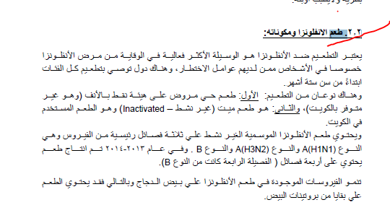

Slide 13
Flu vaccine contents
Is an inactivated (killed) vaccine –
cannot cause influenza disease.
The virus is grown in hens’ eggs, inactivated, and highly purified.
Each Vaccine Contains : 15 µg of each antigen per 0.5 ml dose of the 3-4 virus strains (usually two type A and one type
B) or (2 Type A & 2 Type B).

Slide 14





Doses needed due to previous history for up to 8 Yr
Has the child received 2
total doses of any seasonal vaccine ?
No / don't know
Yes
1 dose only
2 doses
4 week interval
Whether the two doses have been received during the same season or consecutive season

Slide 15
Dosage and methods of vaccination
Numbe of Doses
Vaccination site
Age
Dosage
6 Months
– 3 Years
IM in anterior-lateral part of upper third of the thigh
¼ Ml
1 or 2 doses
IM in the Deltoid Muscle.
Or SC injection in back of upper arm.
3 Years - 8 Years
½ Ml
1 or 2 doses.
IM in the Deltoid Muscle.
Or SC injection in back of upper arm.
More Than 8
Years
½ Ml
1 Dose.

Slide 16

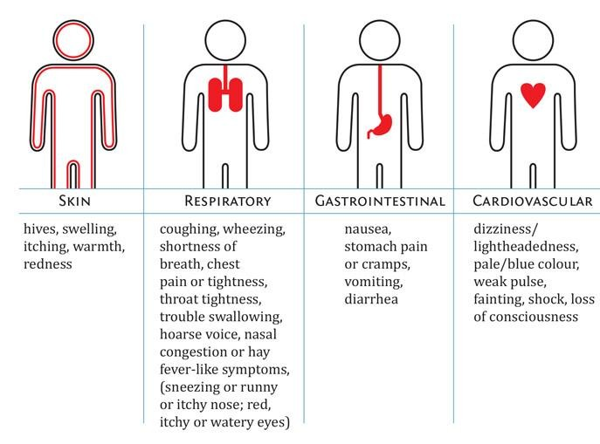

Contraindications to influenza vaccination
Anaphylaxis Symptoms
Previous history of anaphylaxis to flu vaccine
Moderate to severe illness

Slide 17
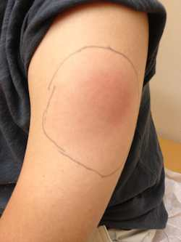
side effects from the flu shot
SIDE EFFECTS
COMMON
Soreness, redness, and/or swelling from the shot
Headache
RARE
Guillain-Barré syndrome (GBS).
Fever
Nausea
Muscle aches
1 -2 / Million Vaccinated

Slide 18
Pneumococcal Conjugate Vaccine

Slide 19
Why PCV13?
Property
T-cell-dependent immune response
Immune memory
Booster effect
Persistence of protection
Herd immunity
Reduction of carriage
PPV23
PCV13
No
Yes
Yes Yes Yes Yes
Yes
No
No
No
No
No

Slide 20
Doses and methods of vaccination
Age Group | Dosage | Number of Doses
From 9-18 Years | ½ ML I.M in deltoid Muscle | 1 Dose only
Above 18 Years | ½ ML I.M in deltoid Muscle | 1 Dose only

Slide 21
Guidelines for spacing of live and
inactivated antigens
Antigen combination | Recommended minimum Interval between doses
1. Two inactivated Vaccines | None; can be administered simultaneously or at any interval between doses
1. Inactivated and live Vaccines | None; can be administered simultaneously or at any interval between doses
1. >2 live parenteral Vaccines | 4 weeks minimum interval, if not administered simultaneously.
1. Live oral vaccines (e.g., Ty21 a typhoid vaccine, oral polio vaccine) | Can be administered simultaneously or at any interval before or after inactivated or live parenteral vaccines.
1. Inactivated Vaccine & Immunoglubulins | Inactivated vaccines may be given simultaneously, or at any time interval before or after an antibody- containing blood product is used. However, such vaccines should be administered at different sites from the IG.

Slide 22
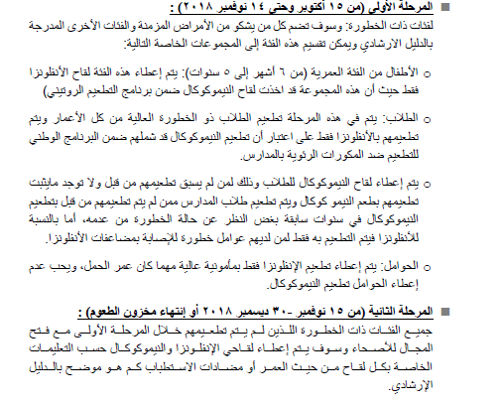

Slide 23
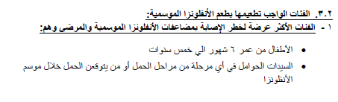
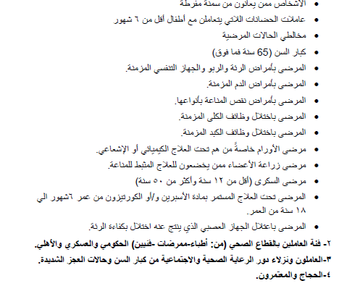

Slide 24
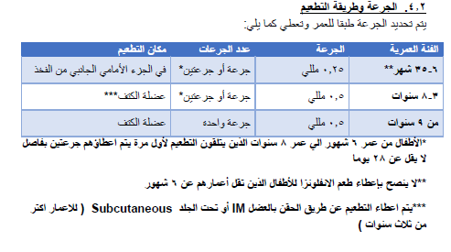

Slide 25
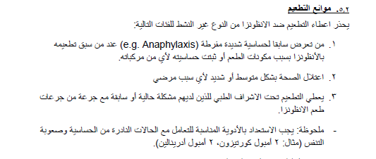

Slide 26
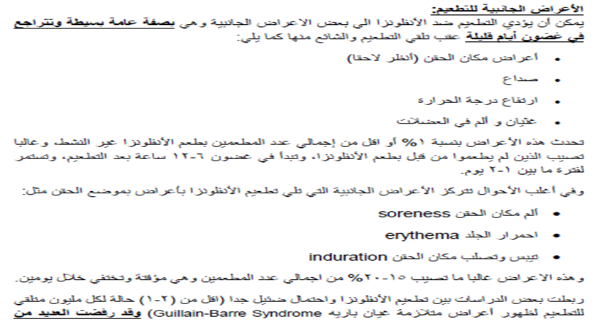

Slide 27
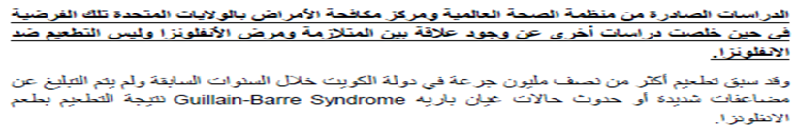

Slide 28
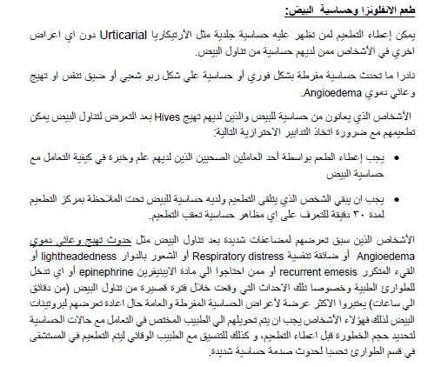

Slide 29
طعم النيموكوكال

Slide 30
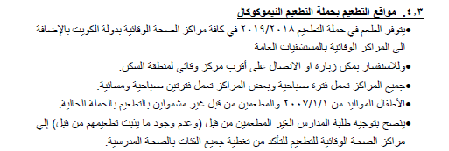

Slide 31
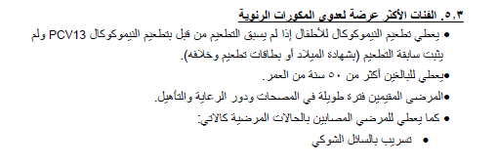

Slide 32
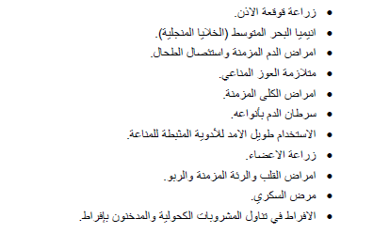

Slide 33
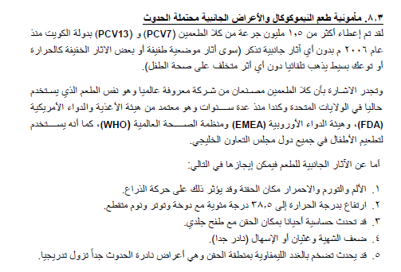

Slide 34
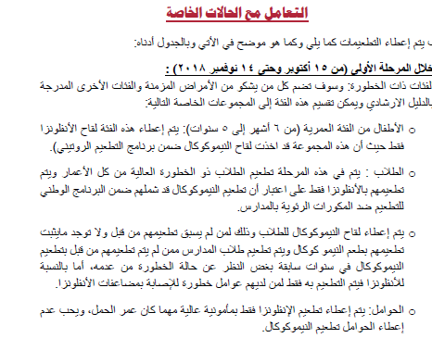

Slide 35
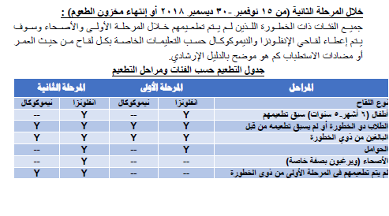

Slide 36
