Slide 1
Successful cover of exposed Tibia by liquid regenerative matrix – A new concept in tissue bridging
Case Report and Proof of concept
Dr. Mohan Rangaswamy
Consultant Plastic Surgeon
Dubai

Slide 2
Summary
This case report describes a simple way of performing in vivo tissue engineering using known, accepted techniques/materials to cover exposed bone defect
Likely to be useful in a variety of clinical situations
Adds another rung to the reconstructive ladder concept: skin graft, regenerative matrix, local flap, pedicle flap, free flap

Slide 3
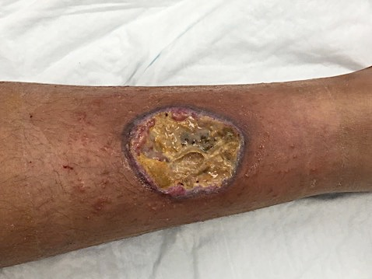
The problem
11 yr old boy, 4th degree iatrogenic burn Rt. Lower leg
Burn of anterior leg due to failed insulation of RF needle used to ablate osteoid osteoma in posterior cortex
debrided once, got infected
Later transferred to my care

Slide 4
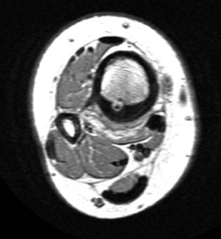
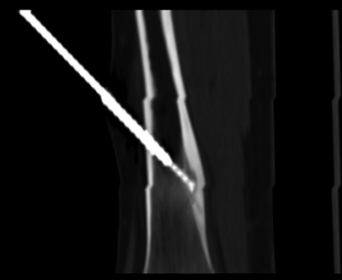
Background Details
Tumor was small
Surgery would involve scars and a lot of bone work
Ortho Sp. Decided to refer to interventionist
RF ablation done under image guide
Skin discoloration noticed after 2 days
Deteriorated next few days
Debridement done, NPWT applied
More pain, larger ulcer, infection

Slide 5
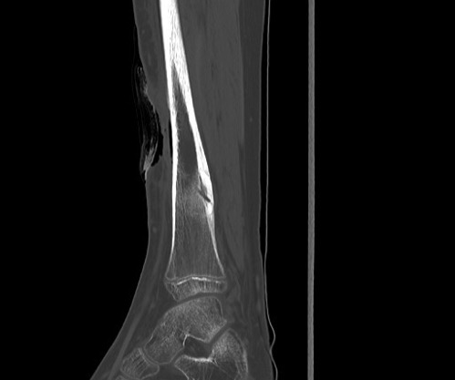
On initial presentation to the author
X-Ray after 1st debridement, Sept 2017
My assessment
The problem has been under estimated !
This is 4th degree burn, inside-out, bone likely to be burnt
Bone Scan ordered

Slide 6
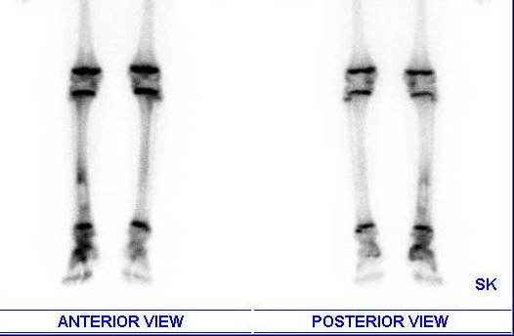
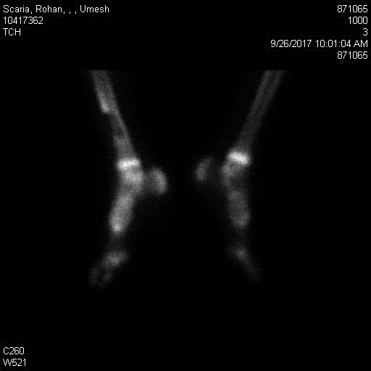
Bone Scan pictures
Photon deficient area in Tibial cortex and marrow
The bone and Marrow are burnt and all cells are probably dead
Confirms clinical impression

Slide 7
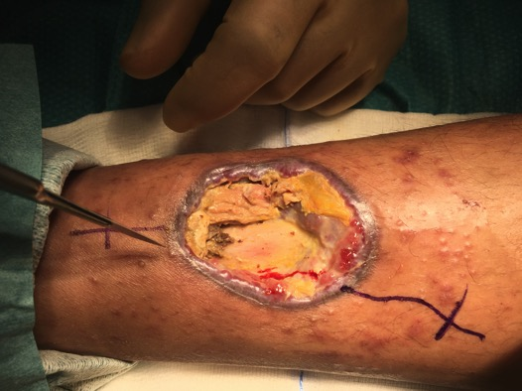
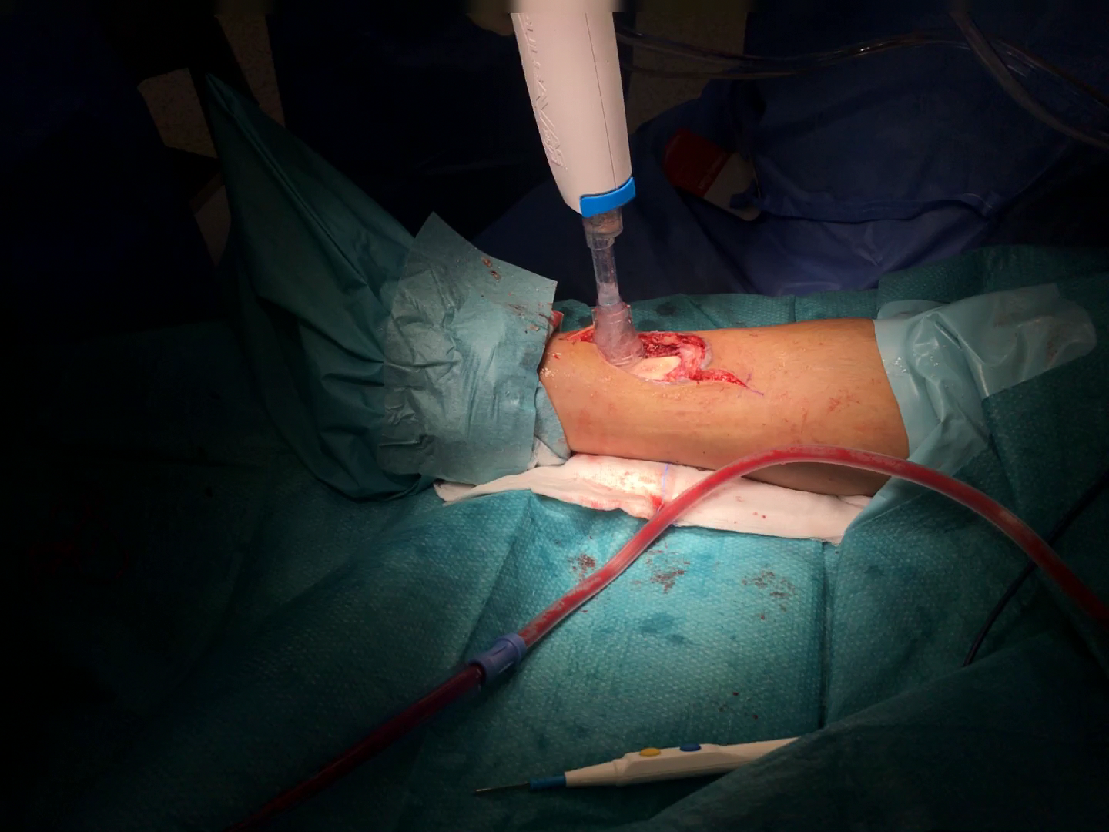
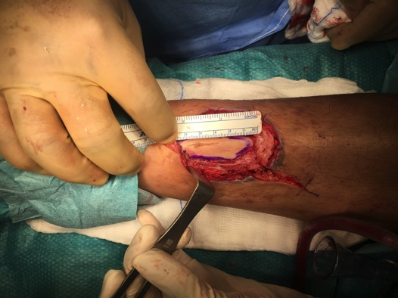
Second Debridement
Drill holes: No bleeding from cortex
Bone window: marrow was dead!

Slide 8
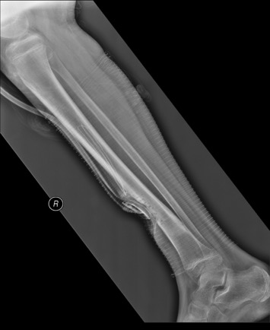
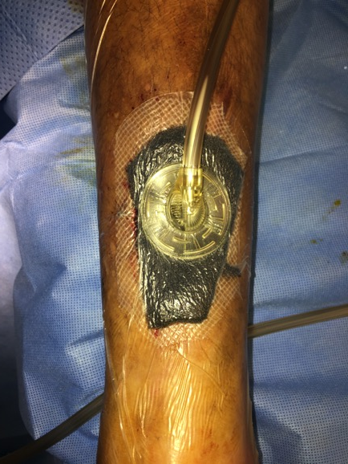
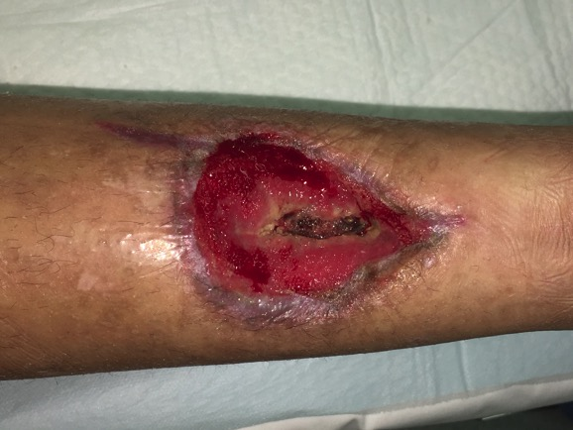
Progress 1 month post Debridement/NPWT/Abx
X-Ray after 2nd debridement
Culture appropriate antibiotics by PICC line

Slide 9
The area now needs soft tissue cover

Slide 10
What is the standard treatment in such case?
Debride soft tissue/bone
Control infection
NPWT
Local flap +/- bone graft & skin graft of donor defect

Slide 11
The Dilemma
This is an iatrogenic situation
Parents seriously worried about the limb and infection
Not happy to do more invasive surgery : flaps/grafts
Is there no other way ? They ask
Recent publications on treatment of leg ulcers with fat graft and NPWT *
Our own experience with fat grafting for radiation ulcers by peri-ulcer injections
I Proposed to try open fat grafting + PRP gel; this method appealed to parents
  *Stasch T¹, Hoehne J, Huynh T, De Baerdemaeker R, Grandel S, Herold C. Débridement and Autologous Lipotransfer for Chronic Ulceration of the Diabetic Foot and Lower Limb Improves Wound Healing. Plast Reconstr Surg. 2015 Dec;136(6):1357-66.

Slide 12
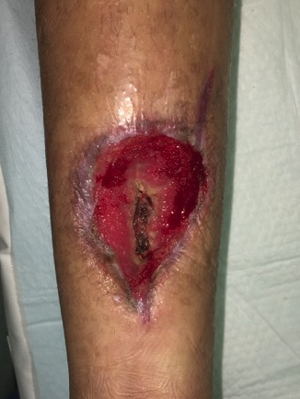
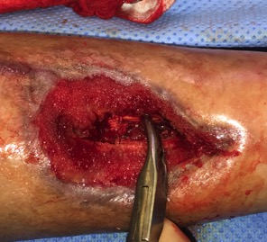
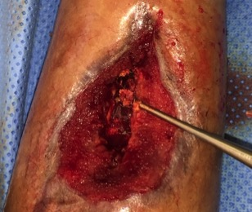
Second Surgery – Oct 2017
Soft tissue debridement
Bony debridement
Marrow curetted
Pulse lavage wash and preparation
3 items prepared
Fat harvested from abdomen by 1.5mm abrasive cannula
Fat dehydrated on sterile gauze
PRP prepared without anticoagulant
Allowed to clot on glass petri-dish ➔PRFM Gel
Equine Collagen [BIOPAD] soaked in PRP and fat

Slide 13
Second Surgery (contd.)
Regenerative Matrix Applied
Fat graft injected into wound edges
Wound covered by a matrix of:
PRP Gel [PRFM]
Layer of ‘dry’ fat graft
Collagen sheet (pre-soaked in PRP and seeded with fat particles)
3. Non adherent dressing applied

Slide 14
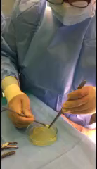
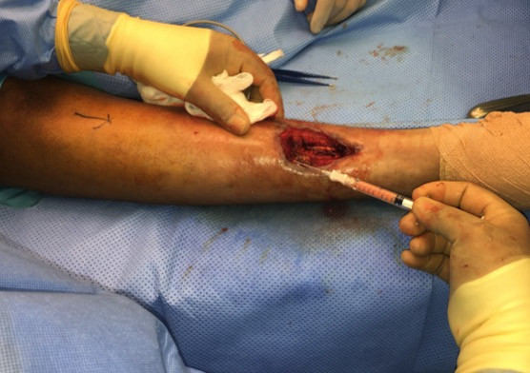
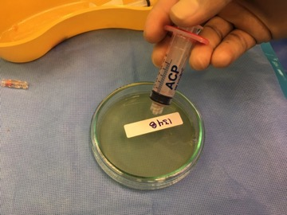
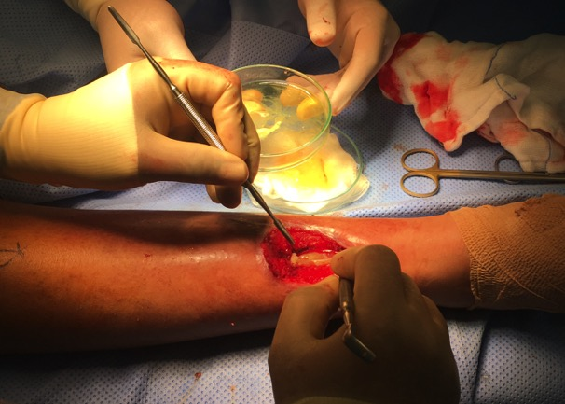
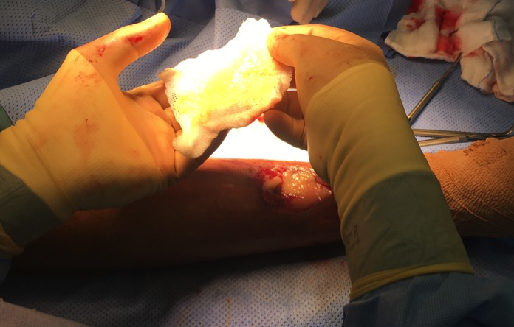
2
Collecting PRFM
3
1
PRP to glass dish
Injecting fat graft to borders
4
5
Bone covered with PRFM gel
layered with ‘dry’ fat

Slide 15
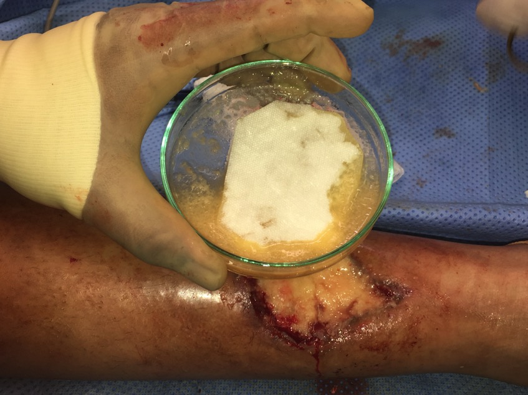
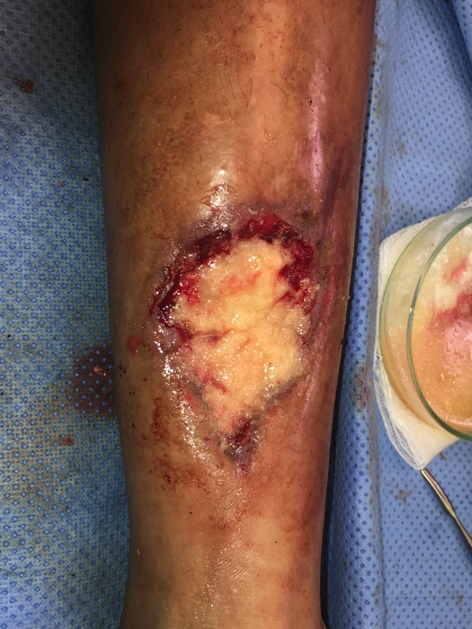
6
5
Collagen sheet soaked in PRP and impregnated with fat graft particles
Covered with ‘dry’ fat

Slide 16
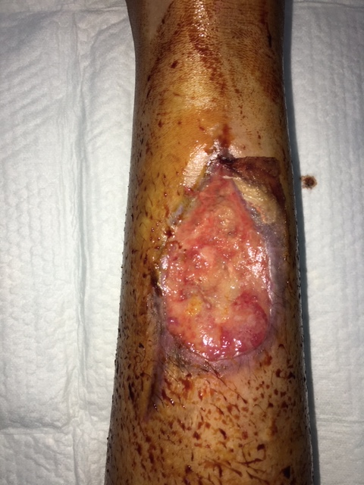
Appearance next day
Collagen sheet

Slide 17
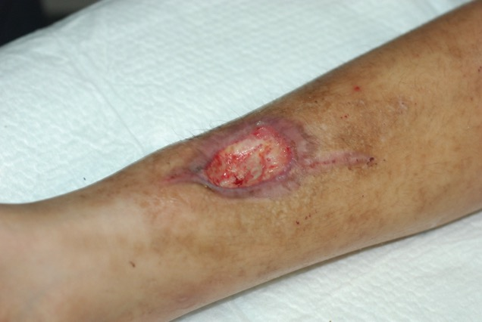
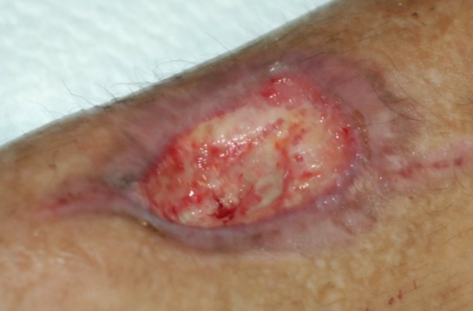
After 2 weeks
Bone covered
No infection or pain
Epithelization was slow
Hence decided for additional bio-stimulation
By platelet rich fibrin matrix (PRFM)

Slide 18
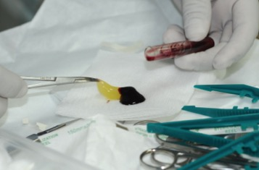
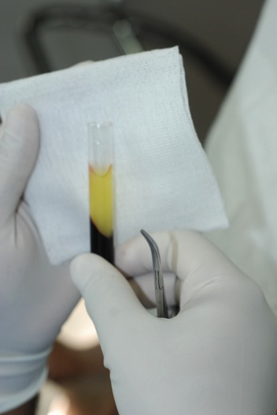
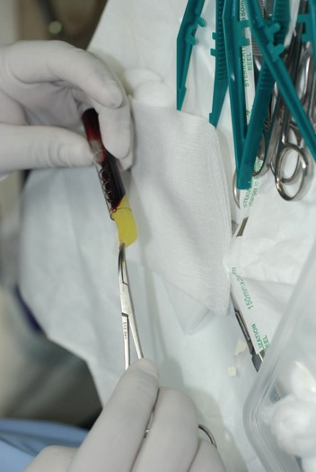
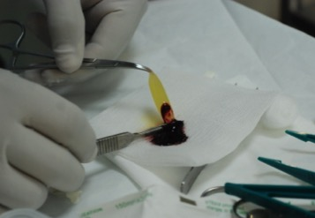
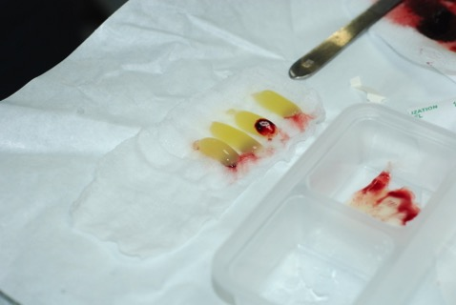
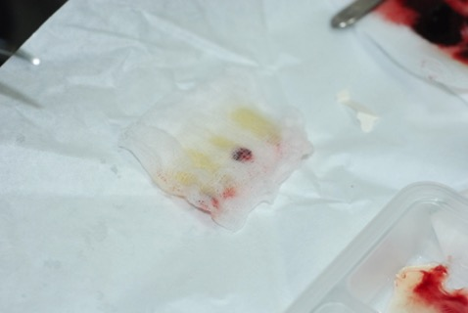
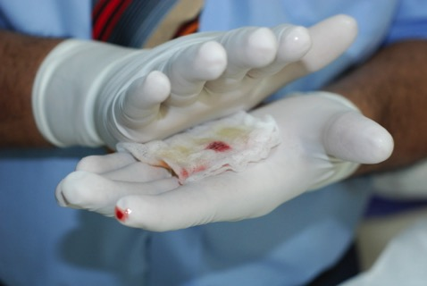
Preparation of PRFM
(Choukroun method)
Snip the red part
Spin
Ease out
Collect PRP gel
On wet gauze
Compress

Slide 19
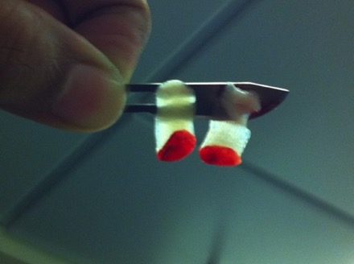
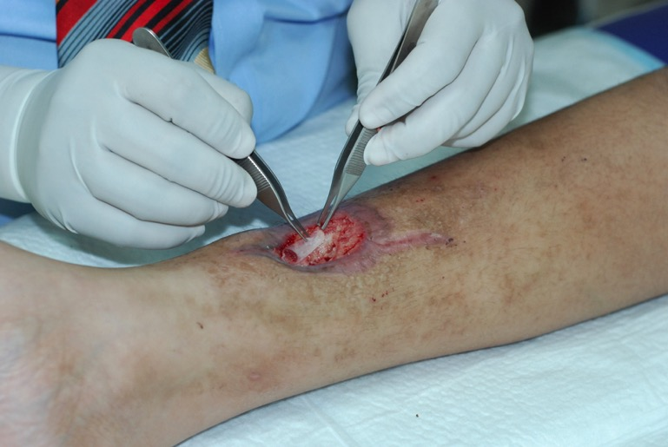
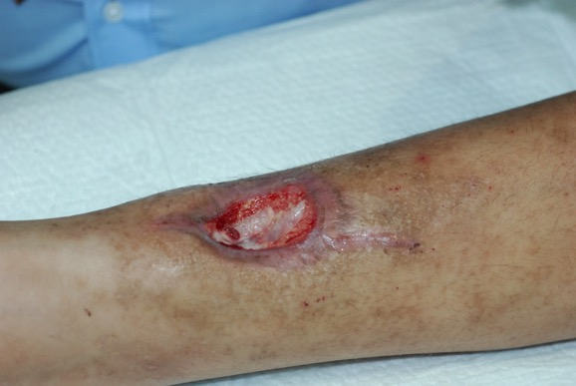
PRFM application for healing

Slide 20
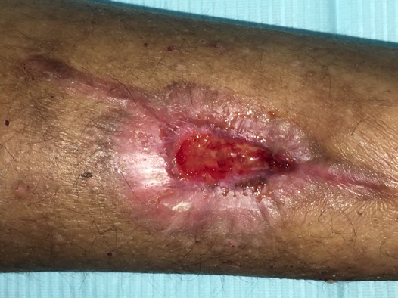
Faster Progress after PRFM

Slide 21
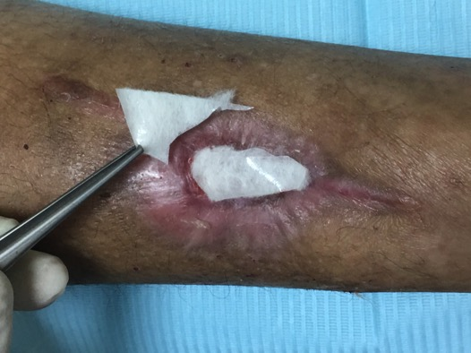
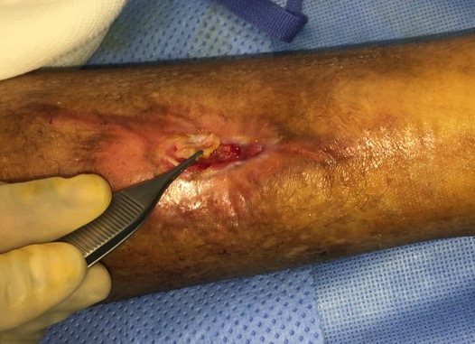
HA matrix dressing to speed up bridging
Hyalomatrix Dressing application
As a bridge of ECM to encourage epithelization

Slide 22
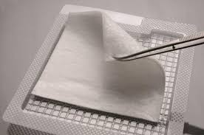
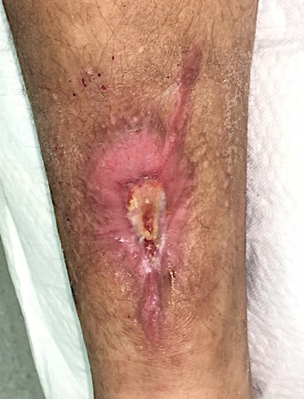
Hyalomatirx Dressing
Fibrous mat of HA fused to silicone membrane
Silicon provided moisture control, permits inspection and provides microbe barrier
HA acts as a tissue conductive bridge

Slide 23
He was basically healed in 40 days!

Slide 24
Skin grafting done later
Technically healed but not of good cosmetic quality
Also had contour depression
May not be stable in an active young boy
Decided to skin graft [overgrafting] after removing thin epithelium, parents agreed
(Epithelization proves that the bed can support a skin graft)

Slide 25
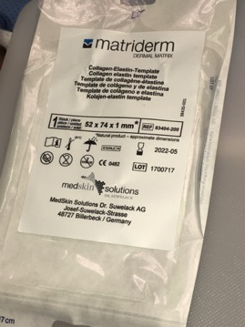
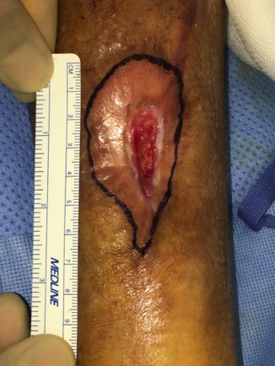
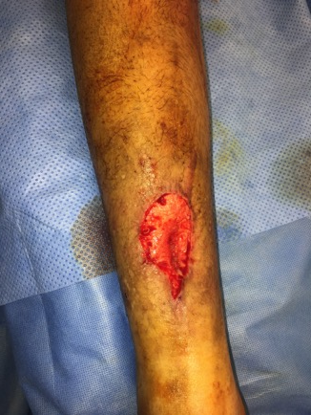
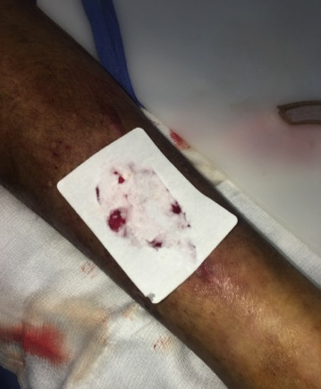
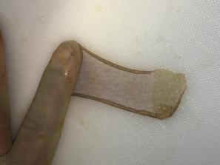
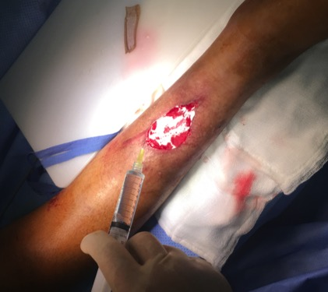
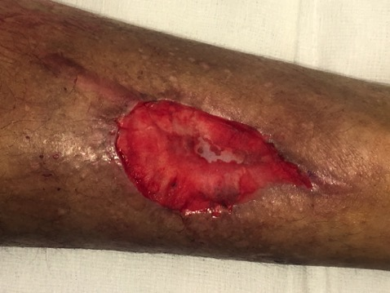
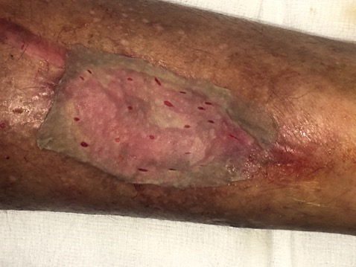
ADM + Skin grafting

Slide 26
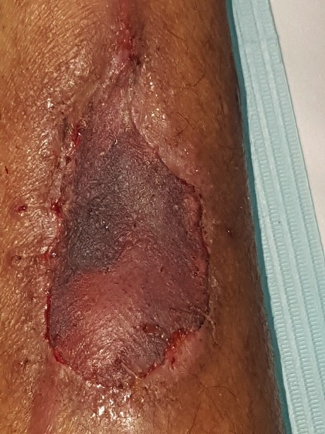
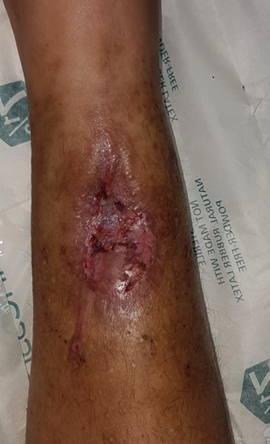

Day 5
10 months

Slide 27




Sequence
Sept 17
Oct 17
Nov 17
Infected, dead bone
Dec 17
Debridement + NPWT
Regentive Matrix
PRFM
Jan 18
ADM + SSG

Slide 28



Sequence
January 2018
November 2018
6x3 cm bone exp

Slide 29



X Rays

Slide 30
Result still stable after 14 months

Slide 31
Summary
A very bad wound with bone necrosis and infection was taken through stages of cleaning, NPWT, regenerative matrix and finally could be skin grafted with ADM reinforcement
Used: PRFM, Fat grafts, Collagen, HA dressing
A viable alternative to flap cover
No added scar

Slide 32
Discussion
Regenerative matrix-bridge applied between vascularized edges gets vascularized
NPWT speeds the process
This is in-vivo Tissue Engineering – soft tissue bridge on bone
Able to cover bone / tendons
Multiple possible mechanisms (hypotheses)
  Provision of ECM
  Angiogenesis
  Growth factors: cell multiplication
  In situ differentiation of ADSC

Slide 33


Regenerative Medicine
It is through myths that men are lifted above their captivity in the ordinary, attain powerful visions of the future, and realize such visions.
Peter Berger ('Pyramids of Sacrifice ')
Lower animals can regenerated parts/organs: planaria, axolotl, hydra, zebrafish, Xenopus, Drosophila, etc.,
Humans and mammals have lost whole organ regenerative capacity except Liver
Even tissue regeneration is limited
Lost parts are replaced by scar
Despite medical progress, regeneration in humans is considered ‘Can’t do it’
Now we think ‘may be’ to ‘certainly in future’
Hepar: after ἠπάομαι which means “to repair oneself”

Slide 34


Slide 35
Plast Reconstr Surg. 2015 Dec;136(6):1357-66.
Débridement and Autologous Lipotransfer for Chronic Ulceration of the Diabetic Foot and Lower Limb Improves Wound Healing.
Stasch T¹, Hoehne J, Huynh T, De Baerdemaeker R, Grandel S, Herold C.
Author information Abstract
BACKGROUND:
The application of autologous lipotransfer (fat grafting, lipofilling) in reconstructive surgery is steadily becoming more popular as evidence of the regenerative and reparative effects of fat becomes better known. The authors investigated the use of autologous lipotransfer for treatment of chronic diabetic and other foot and lower limb ulcers.
METHODS:
Twenty-six patients with nonhealing wounds were treated with surgical débridement and autologous lipotransfer (using the débridement and autologous lipotransfer method). The mean age of the wounds before intervention was 16.7 months. Wound size after débridement averaged 5.1 ± 2.6 cm2. On average, 7.1 ± 3.3 cc of lipoaspirate was transferred into the wound area.
RESULTS:
Twenty-two of 25 wounds (88 percent) healed completely within a mean of 68.0 ± 33.0 days. A reduction of wound size by 50 percent was achieved after an average of 4 weeks. In one patient with an ulcer within particularly scarred tissues on the lower limb, a repeated session of lipotransfer led to complete wound healing after another 4 weeks.
CONCLUSION:
The authors describe a simple and useful technique to improve wound healing in diabetic feet and chronic lower limb ulcers with a background of peripheral vascular disease, where other interventional options to achieve wound healing have failed.

Slide 36
J Wound Care. 2017 May 2;26(5):272-273. doi: 10.12968/jowc.2017.26.5.272.
Use of fat transfer to treat a chronic, non-healing, post-radiation ulcer: a case study.
Mohan A¹, Singh S².
Author information
Abstract
OBJECTIVE:
Problematic wound healing and ulceration in radiation-damaged tissue is a surgical challenge. Clinical studies have shown that grafting fat tissue in an irradiated area can improve the quality of the skin and has regenerative effects. This case study describes how fat transfer led to the healing of a chronic ulcer resistant to other forms of treatment.
CASE HISTORY:
A 67-year-old lady with a chronic, non-healing ulcer in her leg had a squamous cell carcinoma excised, followed by radiotherapy. Despite multiple excisions, the ulcer continued to cause symptoms. Following an initial procedure in which fat was infiltrated around and under the ulcer, the patient underwent a wide local excision and split-thickness skin grafting. Histology demonstrated a post-radiation dermatitis ulcer with no evidence of malignancy. After a period of management with dressings showing a reduction in ulcer size, more fat was infiltrated around the lesion. Two months later, the ulcer had fully healed and has not recurred.
CONCLUSION:
The use of adipose-derived stem cells to heal wounds in irradiated tissue has been the focus of research for some time. This case highlights the potential of adipose tissue to improve damaged skin. Its use could negate the need for complex surgical procedures.

Slide 37
PRF AND PRFM
[Platelet Rich Fibrin matrix]

Slide 38


What is PRFM?
Journal of Periodontology; Volume 81, Issue 4, Translational Periodontology
Three‐Dimensional Architecture and Cell Composition of a Choukroun's Platelet‐Rich Fibrin Clot and Membrane
David M. Dohan Ehrenfest, Marco Del Corso, Antoine Diss, Jaafar Mouhyi , Jean‐Baptiste Charrier
First published: 01 April 2010

Slide 39


Slide 40
Evidence in Dentistry
Choukroun et al.10 : PRF can be considered as healing biomaterial (Research).
Dohan et al.3 : Slow polymerization during PRF preparation seems to generate a fibrin network very similar to the natural one (in vitro).
Dohan et al.12 : PRF, unlike the other platelet concentrates, would be able to progressively release cytokines during fibrin matrix remodeling
(In vitro).
Dohan et al.14 : PRF could be an immune regulation node with inflammation retrocontrol abilities (in vitro)
Choukroun et al.33 : Sinus floor augmentation with FDBA and PRF leads to a reduction of healing time prior to implant placement.
(Comparative Study/ Controlled Clinical Trial)

Slide 41


Slide 42
Evidence in Ortho-Sports
Journal of Biomedical Materials Research Part A
Volume 95A, Issue 1
Platelet‐rich fibrin modulates the expression of extracellular signal‐regulated protein kinase and osteoprotegerin in human osteoblastsI‐Chang Chang, Chung‐Hung Tsai, Yu‐Chao Chang
First published: 19 August 2010
Taken together, PRF can stimulate osteoblasts proliferation. The activation of p‐ERK and OPG expression by PRF suggests a potential role for new bone formation. The application of PRF may provide the benefit for the bone regeneration.

Slide 43
PRP/PRFM + FAT

Slide 44
Int Wound J. 2018 Aug;15(4):519-526. doi: 10.1111/iwj.12892. Epub 2018 May 9.
Systematic review of the efficacy of fat grafting and platelet-rich plasma for wound healing.
Smith OJ¹, Kanapathy M^{1,2}, Khajuria A³, Prokopenko M¹, Hachach-Haram N¹, Mann H⁴, Mosahebi A^{1,2}.
Author information
Abstract
Adipose-derived stem cells found in fat grafts may have significant healing properties. When fat is combined with autologous platelet-rich plasma (PRP), there may be enhanced healing effects due to the pro-angiogenic and anti-inflammatory effects of PRP. This study aimed to evaluate the current evidence on fat grafting in combination with PRP for wound healing to establish the efficacy of this technique. A comprehensive search in the MEDLINE, EMBASE, CENTRAL, Science Citation Index, and Google Scholar databases (to March 2017) was conducted to identify studies on fat grafting and PRP for wound healing. Case series of less than 3 cases and studies only describing harvest technique were excluded. The database identified 571 articles, of which 3 articles that used a combination of fat and PRP for wound healing (1 RCT and 2 case series) were included in this review. A total of 69 wounds in 64 patients were treated with an average wound size of 36.32cm² . Of these, 67% of wounds achieved complete healing. When reported, the mean time to healing was 7.5 weeks for those who underwent a single treatment. There were no significant complications in any patients. The combination of fat grafting and PRP may achieve adequate wound healing with relatively quick wound healing time compared with standard wound management options. However, evidence is extremely limited, and further studies are required to evaluate its efficacy for wound healing

Slide 45
Collagen Matrix in wound healing

Slide 46
Collagen matrix
There is an overall consensus that to heal wounds, the substitution of connective tissue matrix (the main component of each wound), is necessary.
Collagen for dressing
Collagen for dermis substitution [ADM]
  Matriderm
  Integra

Slide 47
Hyaluronic Acid in wound healing

Slide 48
HA in wound healing
Proven in animal studies and clinical use
May work by
  Feedback loop promoting cell migration and proliferation in vascular/active tissues
  Facilitate hydration
  Tissue friendly Scaffold
Available as bi-layer

Slide 49
Present Case
The first case to use DEALT method to cover burnt bone with burnt marrow
Modifications: PRFM, Collagen cover
First pediatric case
Bone regeneration demonstrated

Slide 50
Regenerative Matrix Bridge

Slide 51
Regenerative Matrix Bridge
A new concept in reconstruction
Regenerative medicine
“Guided-Integrative-Regeneration-Process”
Hypothesis: Adipose cells and PRFM provide cells, ECM and GF + collagen acting as scaffold and space definer + Fat infiltration provides direct ADSC. Hypoxia induces release of GF+ Angiogenesis [PRFM, ADSC]

Slide 52
Advantages
Simple
Possible under LA in adults
Low cost
Low Tech [except for NPWT]
Repeatable
Universal
All other options still available

Slide 53
Limitations
Maximum extent of defect unknown, probably 4 cm across
Long term stability is to be studied
longer time to heal than flap methods but faster than conventional dressings

Slide 54
Precautions
Less than 10 cm² area
Distance to bridge less than 4 cm
Edges should bleed
No active infection
Short immobilization
Careful atrumatic dressing

Slide 55



Repair, Regenerate, Restore – moving towards the Prometheus story

Slide 56
Review of Literature
DE-A-LT method (Debridement and Lipotransfer)
  Stasch T¹, Hoehne J, Huynh T, De Baerdemaeker R, Grandel S, Herold C. Débridement and Autologous Lipotransfer for Chronic Ulceration of the Diabetic Foot and Lower Limb Improves Wound Healing. Plast Reconstr Surg. 2015 Dec;136(6):1357-66.
Fat + PRP
  Smith OJ¹, Kanapathy M^{1,2}, Khajuria A³, Prokopenko M¹, Hachach-Haram N¹, Mann H⁴, Mosahebi A^{1,2}. Systematic review of the efficacy of fat grafting and platelet-rich plasma for wound healing. Int Wound J. 2018 Aug;15(4):519-526.
Radiation ulcer
  Mohan A¹, Singh S² Use of fat transfer to treat a chronic, non-healing, post-radiation ulcer: a case study. J Wound Care. 2017 May 2;26(5):272-273.
Tissue engineered ADSC sheets
  Na J¹, Song SY², Kim JD¹, Han M¹, Heo JS³, Yang CE², Kim HO³, Lew DH⁴, Kim E⁵. Protein-Engineered Large Area Adipose-derived Stem Cell Sheets for Wound Healing. Sci Rep. 2018 Oct 26;8(1):15869.

Slide 57
Review of Literature
Collagen sheet promoting healing
  Ghanaati S¹, Kovács A², Barbeck M³, Lorenz J³, Teiler A³, Sadeghi N⁴, Kirkpatrick CJ³, Sader R³. Bilayered, non-cross-linked collagen matrix for regeneration of facial defects after skin cancer removal: a new perspective for biomaterial-based tissue reconstruction. J Cell Commun Signal. 2016 Mar;10(1):3-15.
Hyalomatrix Sheet
  HYALOMATRIX is a non-woven pad comprised of a wound contact layer made of a derivative of hyaluronic acid (HA) in fibrous form with an outer layer comprised of a semipermeable silicone membrane. The wound contact layer is biodegradable, and it acts as a 3D scaffold for cellular invasion and capillary growth. The silicone layer controls water vapor loss and provides protective coverage of the wound.
Matriderm (ADM)
  Lamy J¹, Gourari A, Atlan M, Zakine G. [Use of Matriderm® 1mm in reconstructive surgery. Series of 31 cases]. Ann Chir Plast Esthet. 2013 Jun;58(3):235-42. [Article in French]

