Slide 1

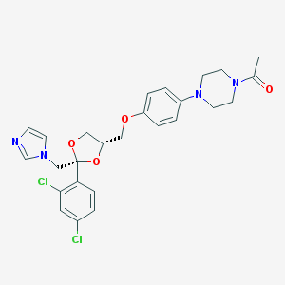
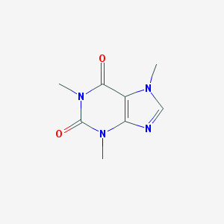
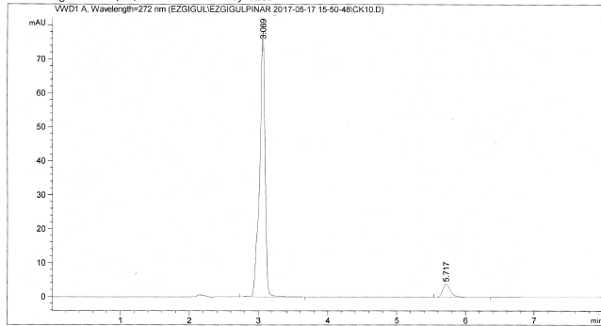
DEVELOPMENT AND VALIDATION OF AN HPLC METHOD FOR DETERMINATION OF KETOCONAZOLE AND CAFFEINE IN COSMETIC PRODUCTS
Hatice Ezgi Gülpınar ¹
Ezgi Gülpınar Pharmacy, Ankara, Turkey
Eda Şatana ²
Gazi University, Faculty of Pharmacy, Analytical Chemistry Dept.Ankara,Turkey
Figen Tırnaksız ³
Gazi University, Faculty of Pharmacy, Pharmaceutical Technology Dept. Ankara, Turkey
Introduction
Ketoconazole is an antifungal agent that can be used for topical and oral administration. Ketoconazole is a weak base with pKa values of 2.94 and 6.51. It is practically insoluable in water and soluable in different solvents. Caffeine is also used for topical and oral administration. It has potent antioxidant activity. The pKa value is 14.0 at 25 deg C and 10.4 at 40 deg C. It is soluable in water and different solvents.
The aim of this study is to develop and validate an easy, fast and accurate HPLC method for the quantitative determination of ketoconazole and caffeine contained cosmetic products for Franz Diffusion Tests.
fig1. ket structure (pubchem) fig2. caffeine structure (pubchem)
Materials:
*Ketoconazole *Caffeine *Distilled Water
*Acetonitrile *Phosphoric acid
*Phosphate buffer at pH 5.2 *Methanol
Methods:
Preparation of Stock Solutions
Standart solution:, ketoconazole was dissolved in acetonitrile priorly. Then diluted concentration of ketoconazole was obtained with phosphate buffer at pH 5.2.
Caffeine was dissolved in phosphate buffer at pH 5.2. Diluted concentrations were also obtained with phosphate buffer at pH 5.2 too.
Reagents and Solutions: the mobile phase prepared with Acetonitrile, distilled water and phosporic acid. The mobile phase purified by Millipore® system.
Chromatographic conditions; KET and CAF were determined with HPLC Agilent 1220 Infinity and the following parameters: 1ml/min flow, UV detector. The system was operated at room temperature.
Evaluation of seperation parameters:
After that, ACN, distilled water and phosphoric acid were used for appropriate seperation.
pH of Mobile Phase, Flow rate were evaluated.
Validation of method;
Linearity; KET stock solution ( mg/ml) was prepared in a 25 ml amber volumetric flask by dissolving KET in ACN and appropriate amounts of stock solution were diluated in phosphate buffer at pH 5.2 in order to obtain KET concentrations of 0.5, 1, 2.5, 5, 10, 20 μg/mL.
CAF standart solution was prepared in a 25 ml amber volumetric flask by dissolving CAF in phosphate buffer at pH 5.2 in order to obtain CAF concentrations of 0.5, 1, 2.5, 5, 10, 20 μg/mL.
Accuracy and recovery was determined by adding known amounts of KET and CAF standart solution to the sample at the beginning of the process (μg/mL). The obtained concentrations were 15,10,4 μg/mL respectively.
All studies were carried out in three paralell.
first of all, different known mobile phases were performed for seperation. Retention time of two compounts were detected. And intended resolution was achieved by using 37:63 ACN:wat(%0.05 H₃PO₄ ).
Table2. Effects of mobile phase pH on seperation
CAF and KET are weakly base and ionization required for optimum retention so the pH of mobile phase was determined. Varying ratio from 0.025% to 0.1% of H₃PO₄ was studied for resolution. And optimum resolution and retention occured at 0.5 % H₃PO_{4.}
Table3: Effects of flow rate on seperation
The flow rate was decreased to increase retention time of caffeine. The tailing occured and the width of the peaks increased at low flow rate. The optimum flow rate was determined as 1 ml/min.
Validation:
Fig3. caffeine linearity results fig4. Ket linearity results
Fig5: Final chromotagram of method
Mobile Phase |  |  | Flow Rate | Ret. Time |  | Peak Width |  | Wave lenght | Tailing
ACN | WAT | H₃PO₄ | ml/min | CAF | KET | CAF | KET | nm | CAF | KET
37 | 63 | %0.025 | 1 | 3,083 | 6,639 | 0,0819 | 0,1737 | 272 | - | -
37 | 63 | %0.05 | 1 | 3,1 | 5,8 | 0,0806 | 0,1203 | 272 | - | -
37 | 63 | %0.1 | 1 | 2,968 | 6,160 | 0,1012 | 0,1593 | 272 | - | -
Mobile Phase |  |  | Flow Rate | Ret. Time |  | Peak Width |  | Wave lenght | Tailing
ACN | WAT | H₃PO₄ | ml/min | CAF | KET | CAF | KET | nm | CAF | KET
37 | 63 | %0.05 | 1 | 3,1 | 5,8 | 0,0806 | 0,1203 | 272 | - | -
37 | 63 | %0.05 | 0,9 | 3,404 | 6,441 | 0,093 | 0,1498 | 272 | - | -
37 | 63 | %0.05 | 0,85 | 3,643 | 6,942 | 0,0935 | 0,1520 | 272 | + | -
37 | 63 | %0.05 | 0,8 | 3,853 | 8,027 | 0,0886 | 0,1695 | 272 | - | -
The curves were linear with a linear regression coeffients of 0,999;0,998 respectively.
Added % | Added amount µg/ml | Found amount µg/ml |  | Recovery %
 |  | caf | ket | caf | ket
150 | 15 | 14,85 | 14,68 | 99,00 | 97,86
100 | 10 | 10,10 | 9,91 | 101,00 | 99,10
40 | 4 | 4,02 | 4,04 | 100,5 | 101,00
table4:accuracy and recovery results |  |  | Mean | 100,166 | 99,32
 |  |  | %RSD | 0,1657 | 0,684
Recovery was calculated and %RSD was found as %0.1657 and %0.684 for caffeine and ketoconazole respectively.
Conclusion
The proposed HPLC method for KET and CAF determination in cosmetic products for Franz Diffusion tests showed linearity in the studied concentrations. The developed method is simple, fast and accurate. The preparation of samples is also easy, the excipients did not interfere in the method and it can be used in Franz Diffusion Tests.
Results and Discussion
Table1. Different chromatic conditions and results
Mobile Phase |  |  | Flow Rate | Ret. Time |  | Peak Width |  | Wave lenght | Tailing
ACN | WAT | H₃PO₄ | ml/min | CAF | KET | CAF | KET | nm | CAF | KET
50 | 50 | - | 1 | ? | ? | ? | ? | 272 | + | +
10 | 90 | %0.05 | 1 | >10 | >10 | ? | ? | 296 | ? | ?
21,8 | 68,2 | %0.05 | 1.1 | 2,919 | 8,350 | 0,0853 | 0,1824 | 272 | - | -
20 | 80 | %0.05 | 1 | 4,408 | >10 | 0,0836 | - | 296 | - | ?
35 | 65 | %0.1 | 1 | 3,331 | 6,445 | 0.1121 | 0.1437 | 272 | + | -
37 | 63 | %0.05 | 1 | 3,1 | 5,8 | 0,0806 | 0,1203 | 272 | - | -
References ;
1. determination of ketoconazole in shampoo by high performance liquid chromatography.an HPLC assay fort he determination of ketoconazole in common pharmaceutical preparations
Acknowledgement
The authors are thankful to Bilim Drug company for KET.
17th Edition of International Conference and Exhibition on Pharmaceutics & Novel Drug Delivery Systems
Notes:
Introduction
Ketoconazole is an antifungal agent that can be used for topical and oral administration. Ketoconazole is a weak base with pKa values of 2.94 and 6.51. It is practically insoluable in water and soluable in different solvents. Caffeine is also used for topical and oral administration. It has potent antioxidant activity. The pKa value is 14.0 at 25 deg C and 10.4 at 40 deg C. It is soluable in water and different solvents.
The aim of this study is to develop and validate an easy, fast and accurate HPLC method for the quantitative determination

