Slide 1

Accelerated PACK-CXL , New Era In Microbial Keratitis Therapy.
Dr. Ehabeldin Mohamed

Slide 2
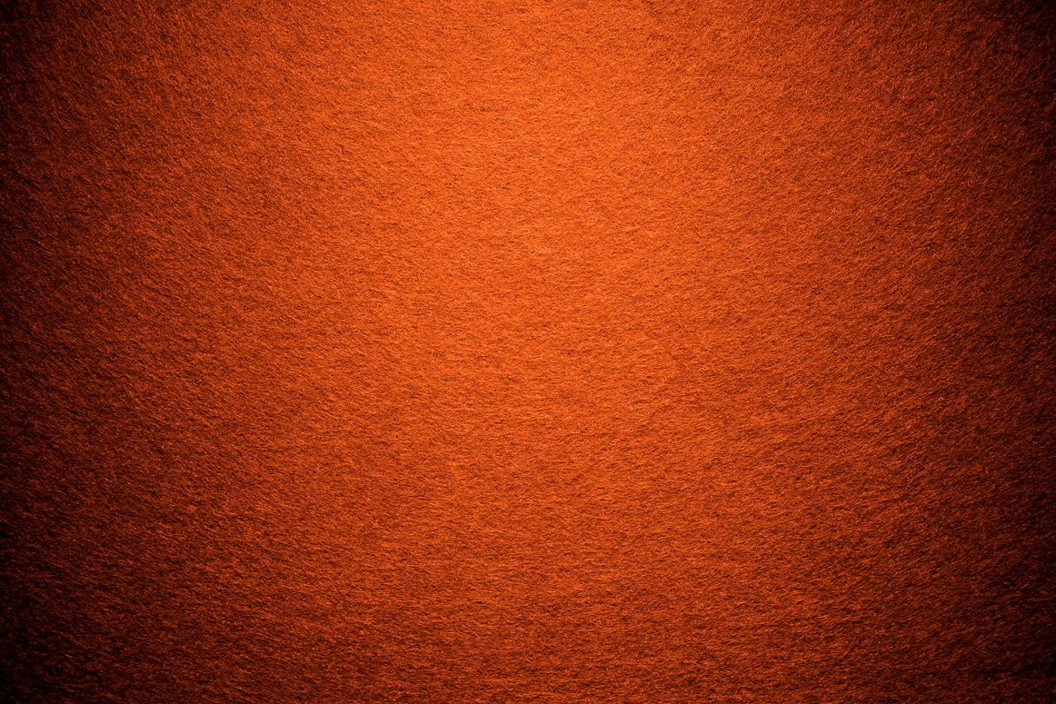
Case Presentation

Slide 3
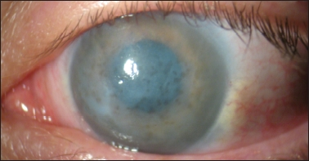
A 67 Y/O Male
Chronic Open Angle Glaucoma
On Cosopt & Xalatan
Underwent Cataract Surgery
He Had Corneal edema after one month Post surgery

Slide 4
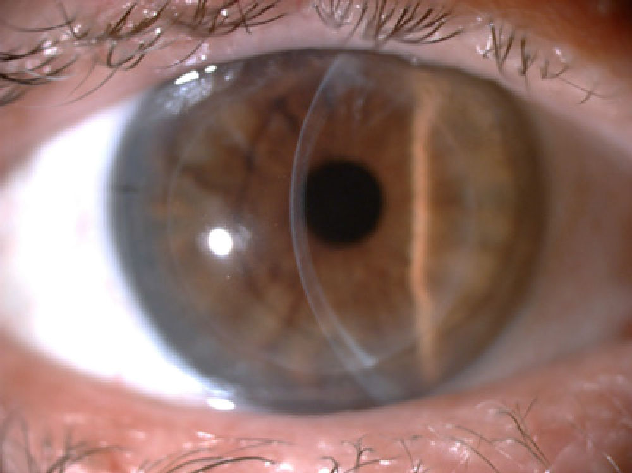
DSAEK

Slide 5
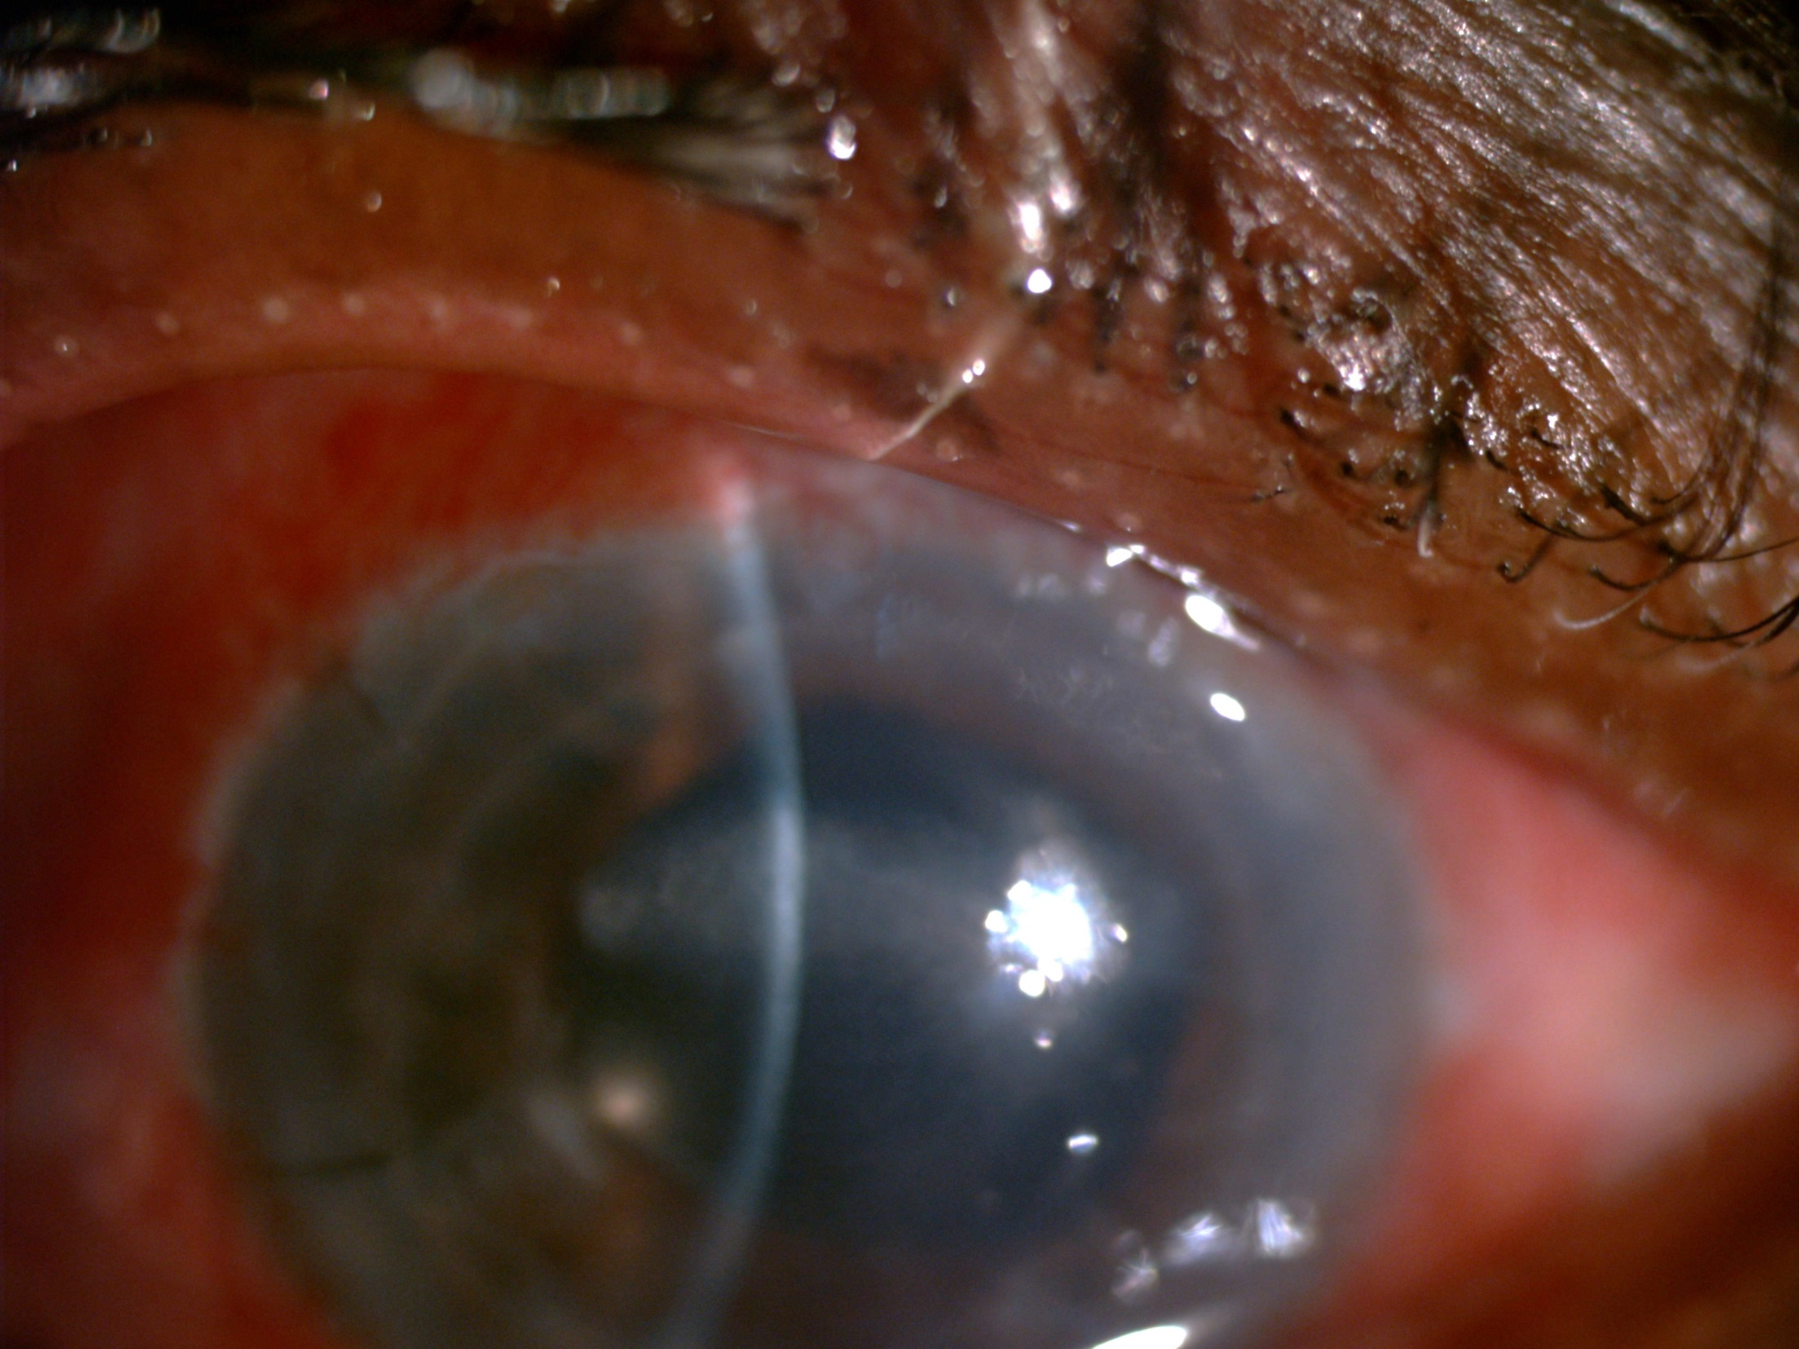

Slide 6
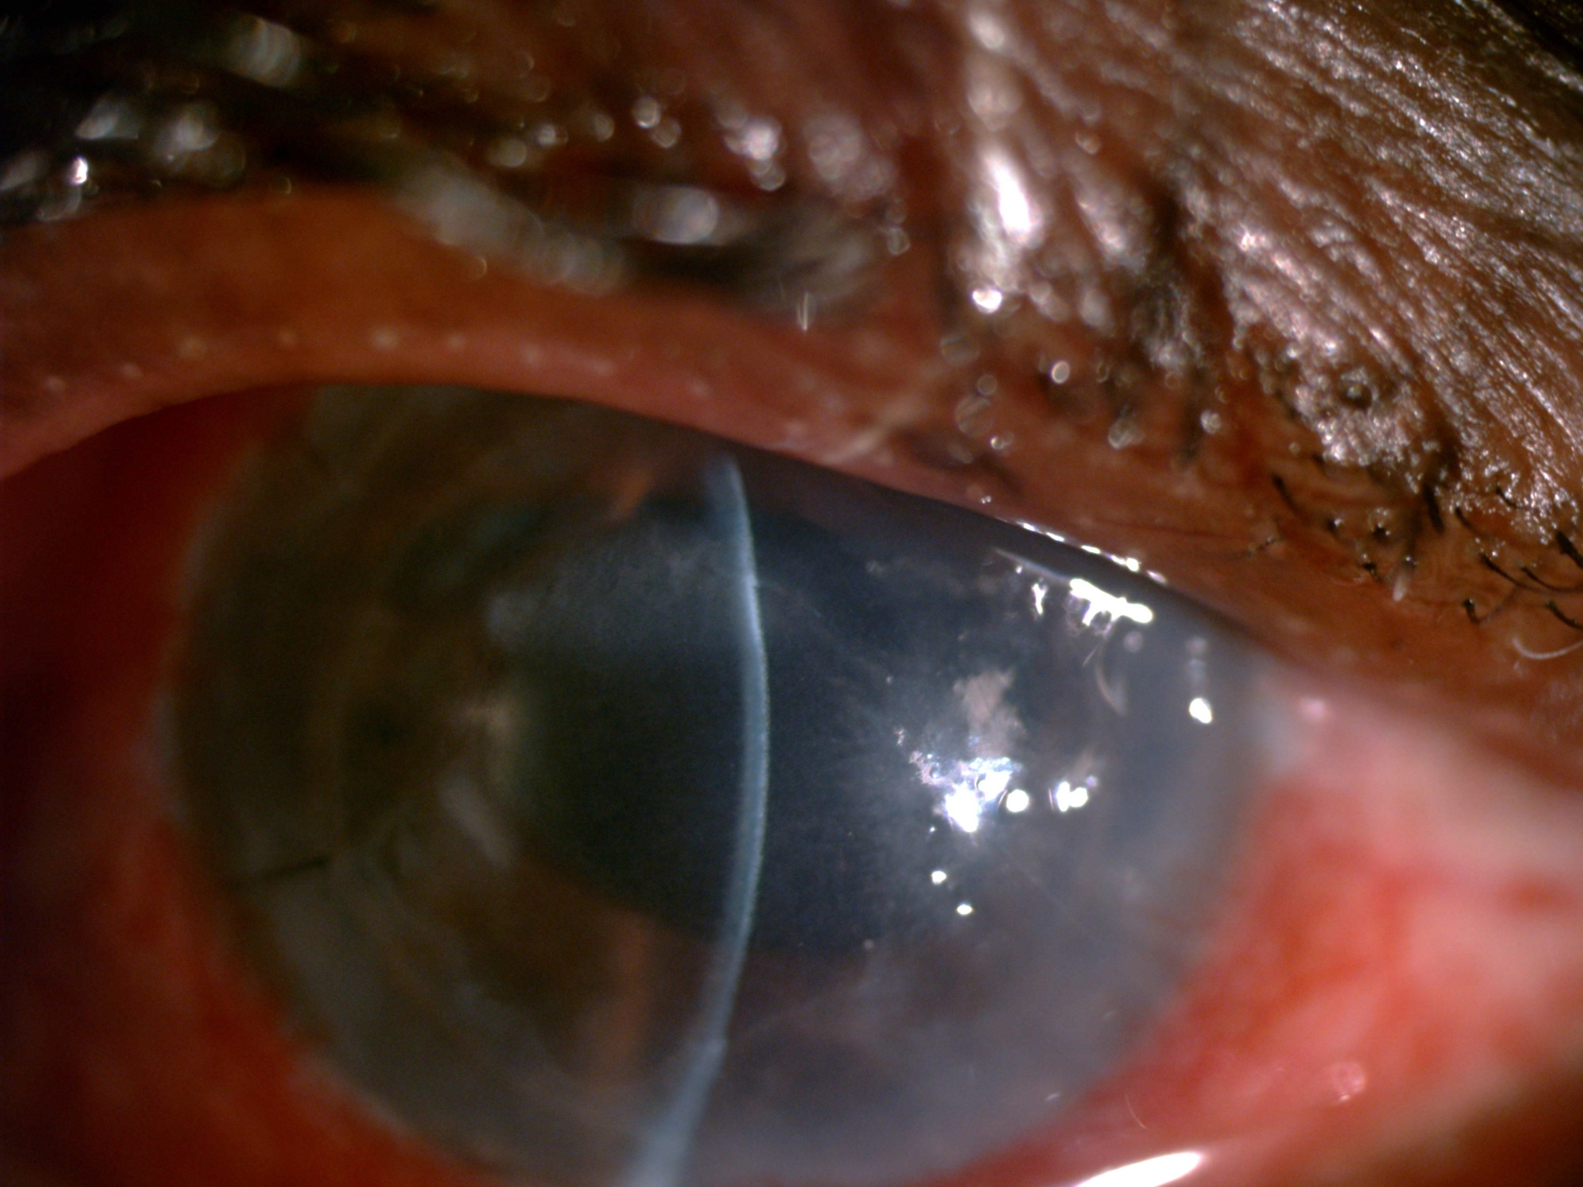

Slide 7
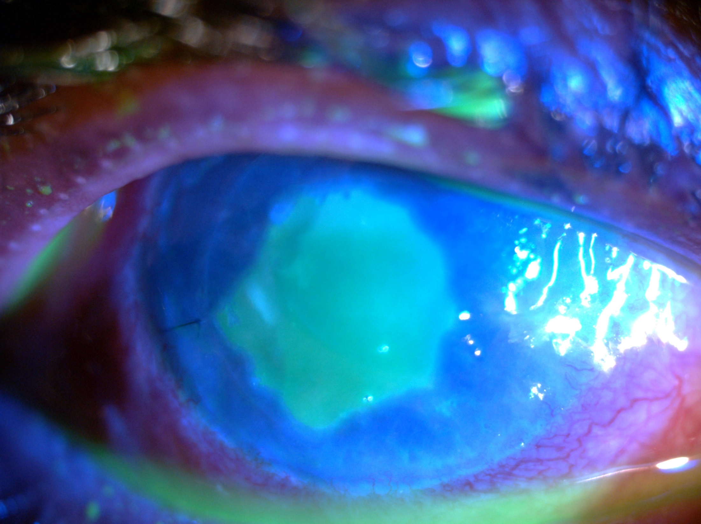

Slide 8
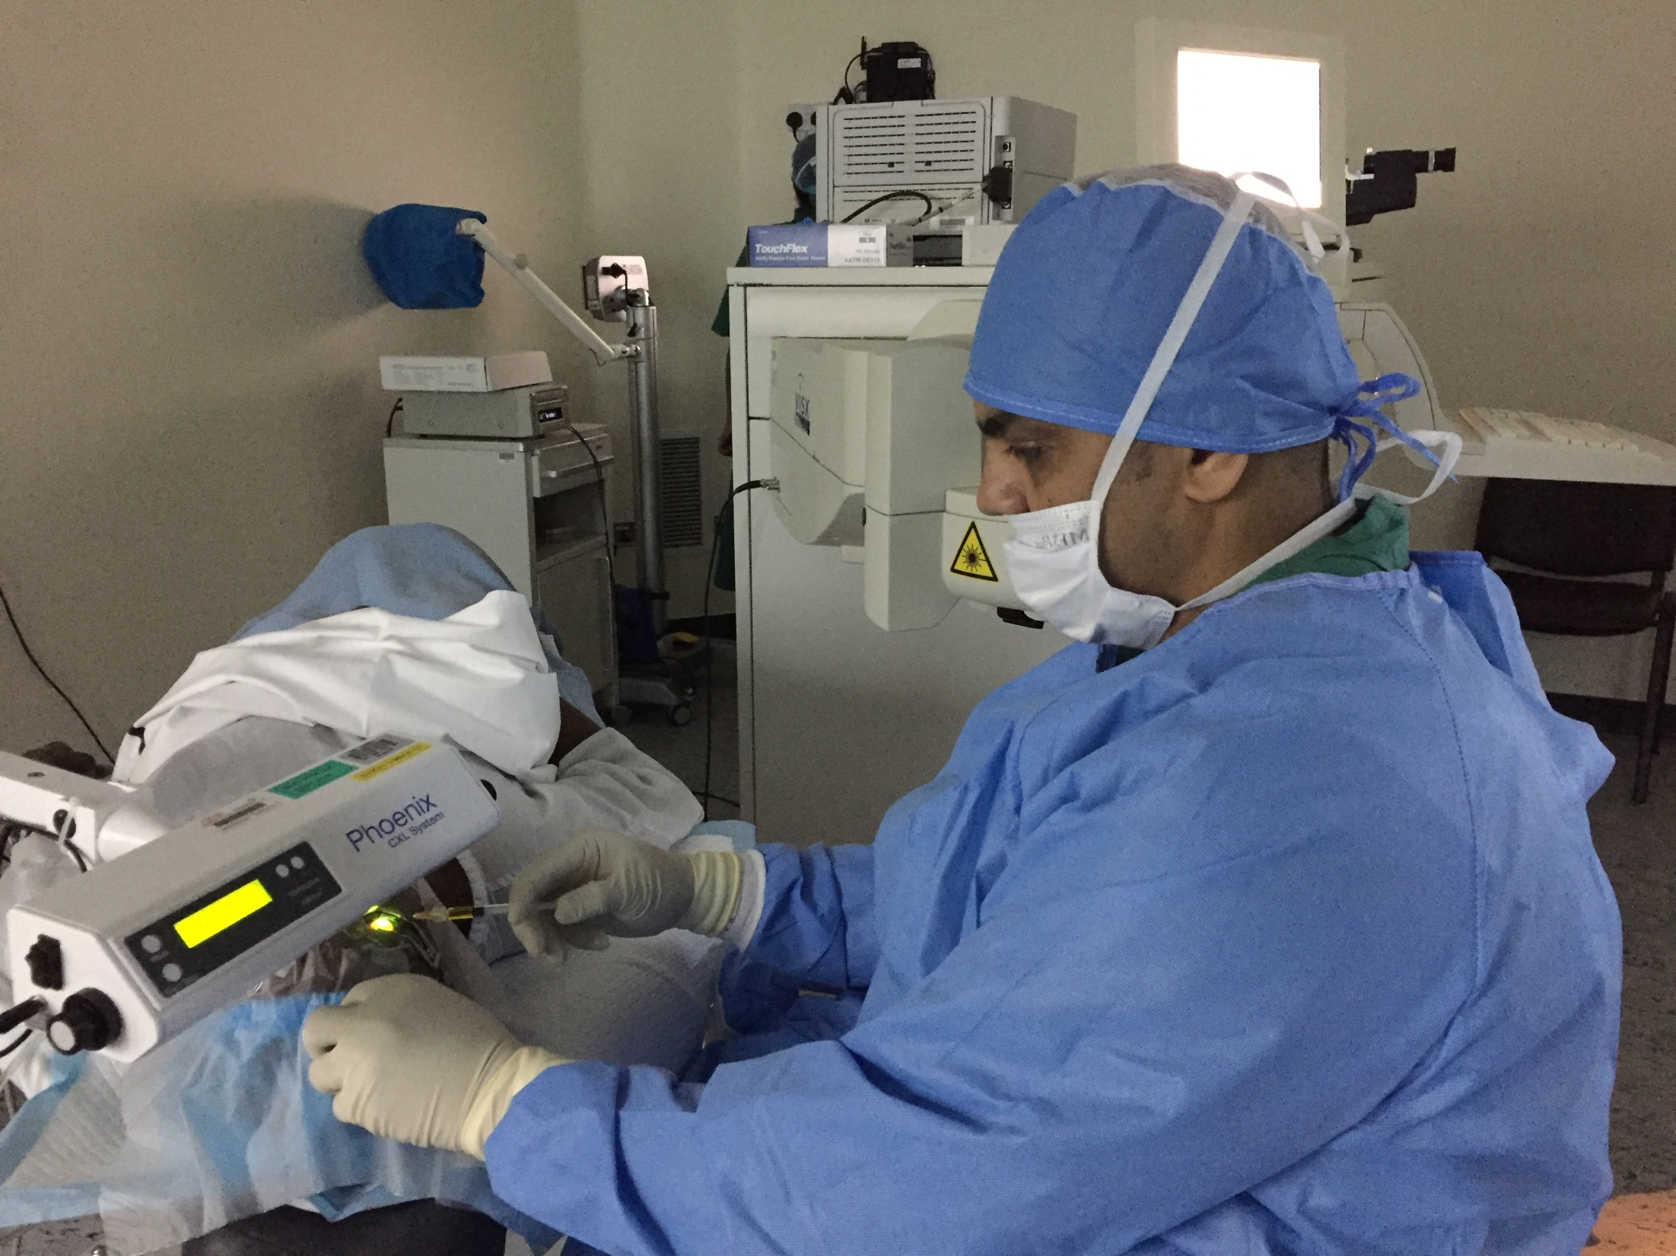
PACK CXL

Slide 9

RESULTS

Slide 10
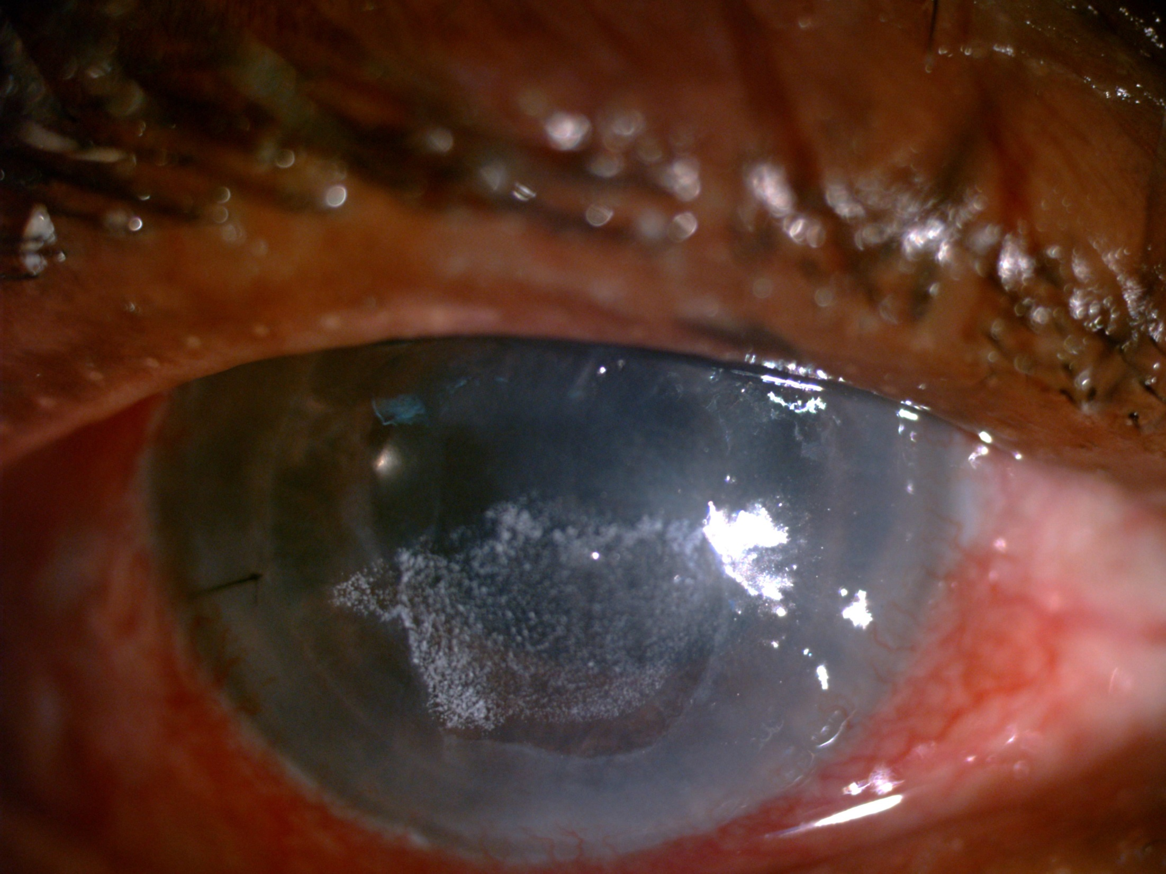

Slide 11
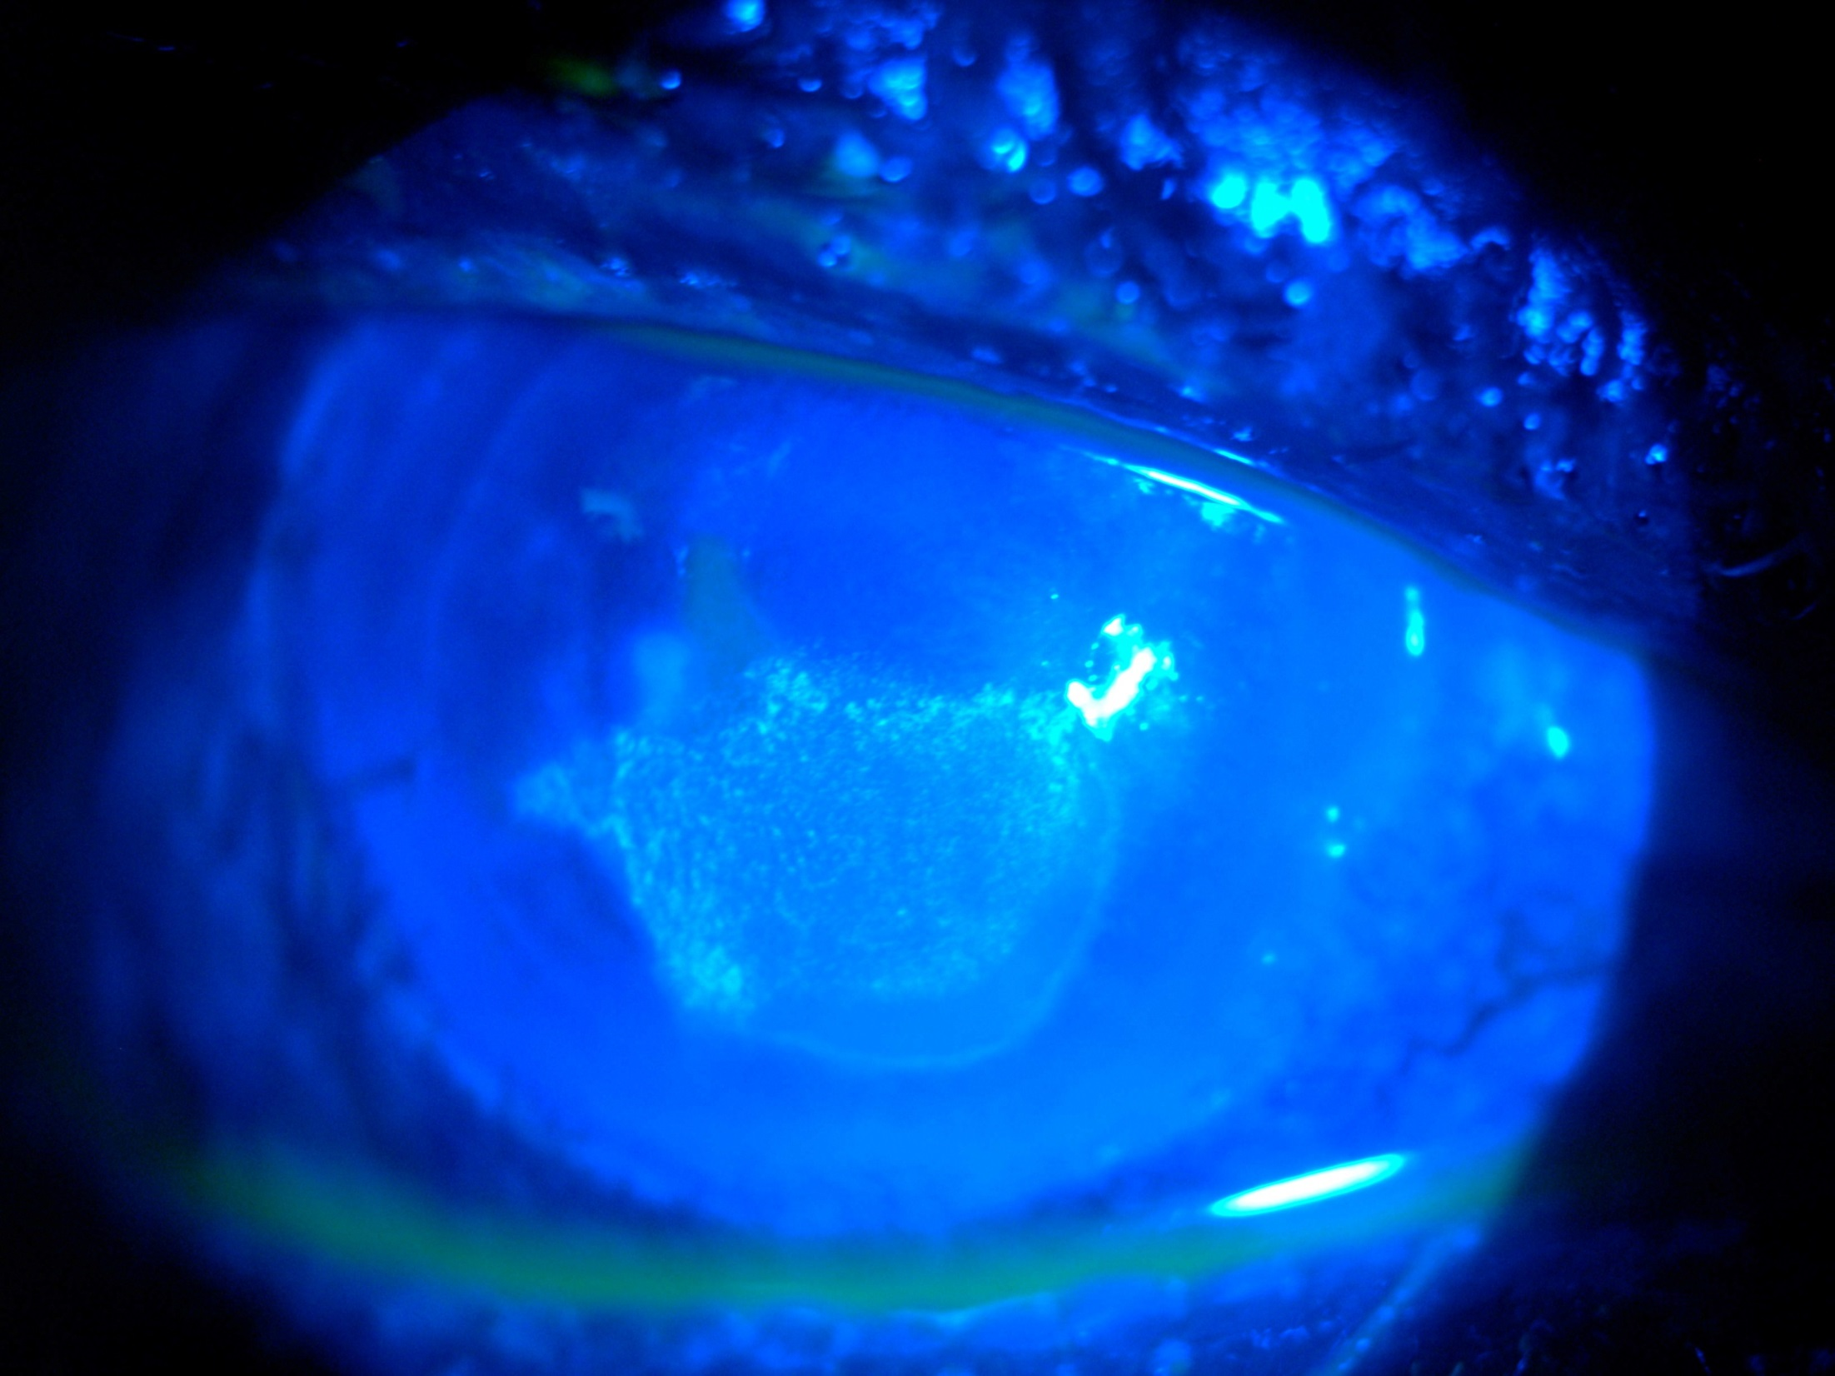

Slide 12
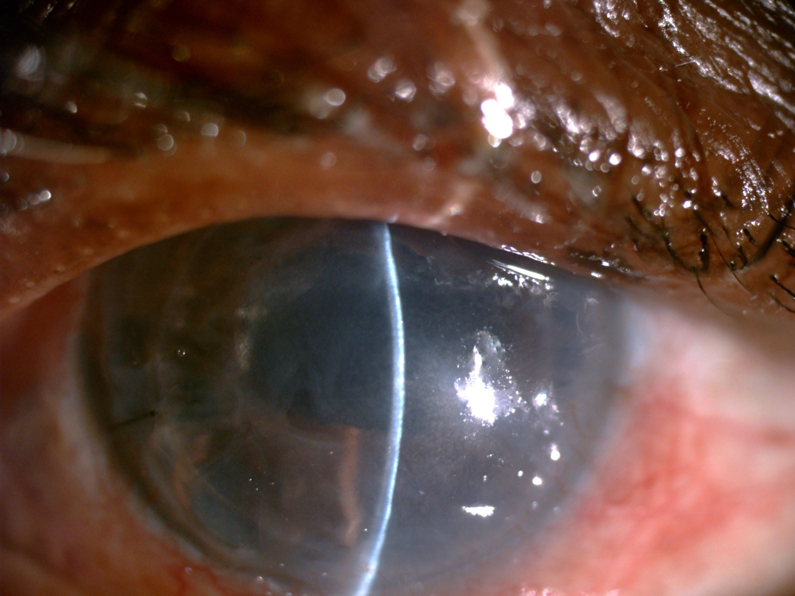

Slide 13
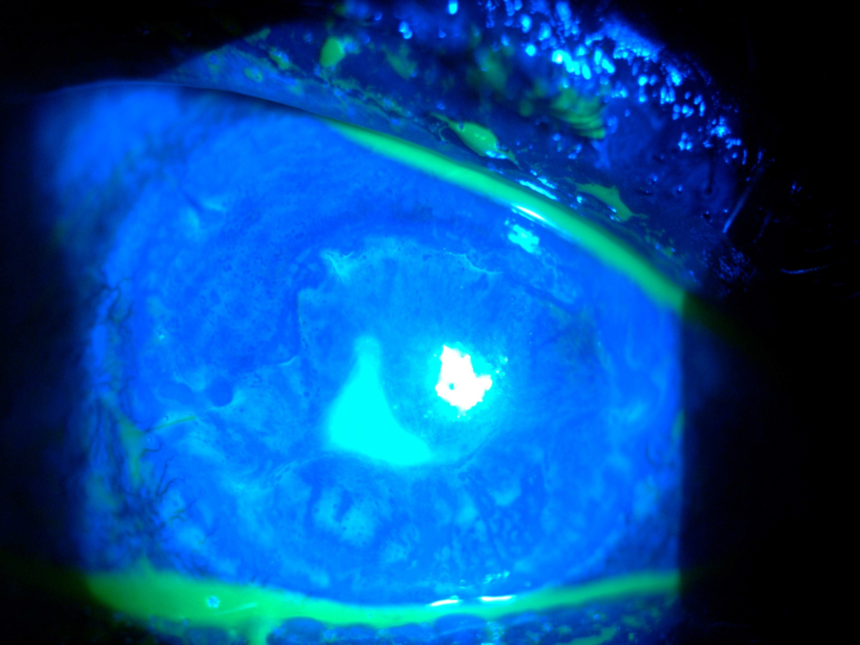

Slide 14
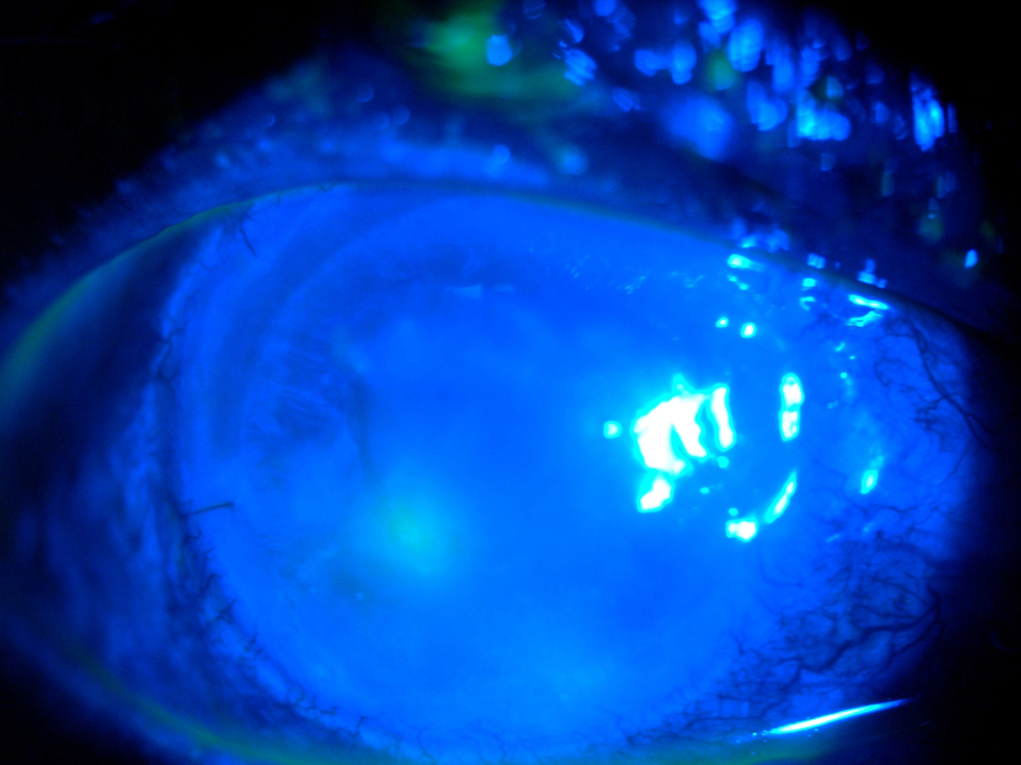

Slide 15
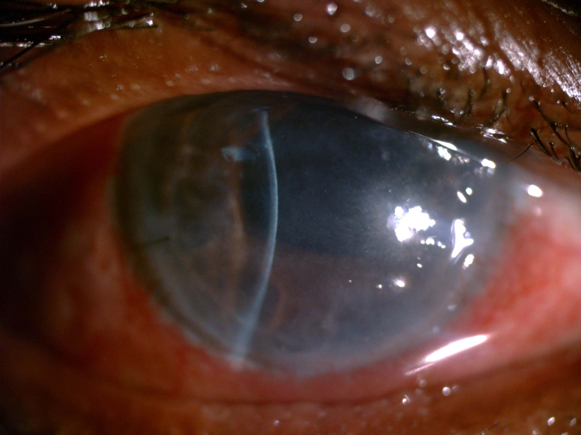

Slide 16
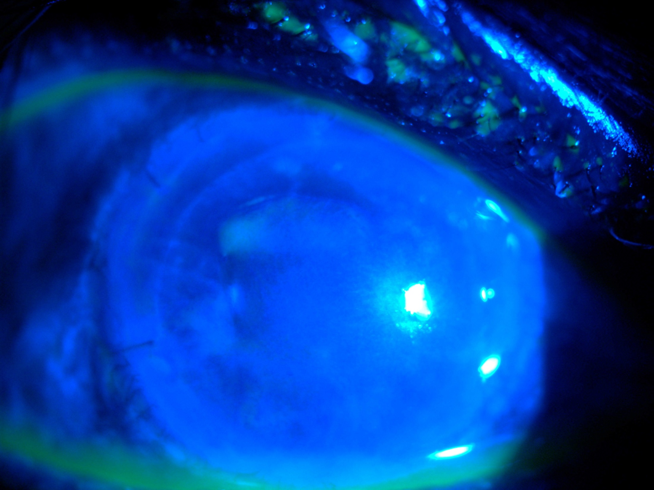

Slide 17
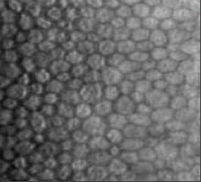

Does it affect endothelium..?
Pre-op
Post-op
Specular CD 2758 2674

Slide 18
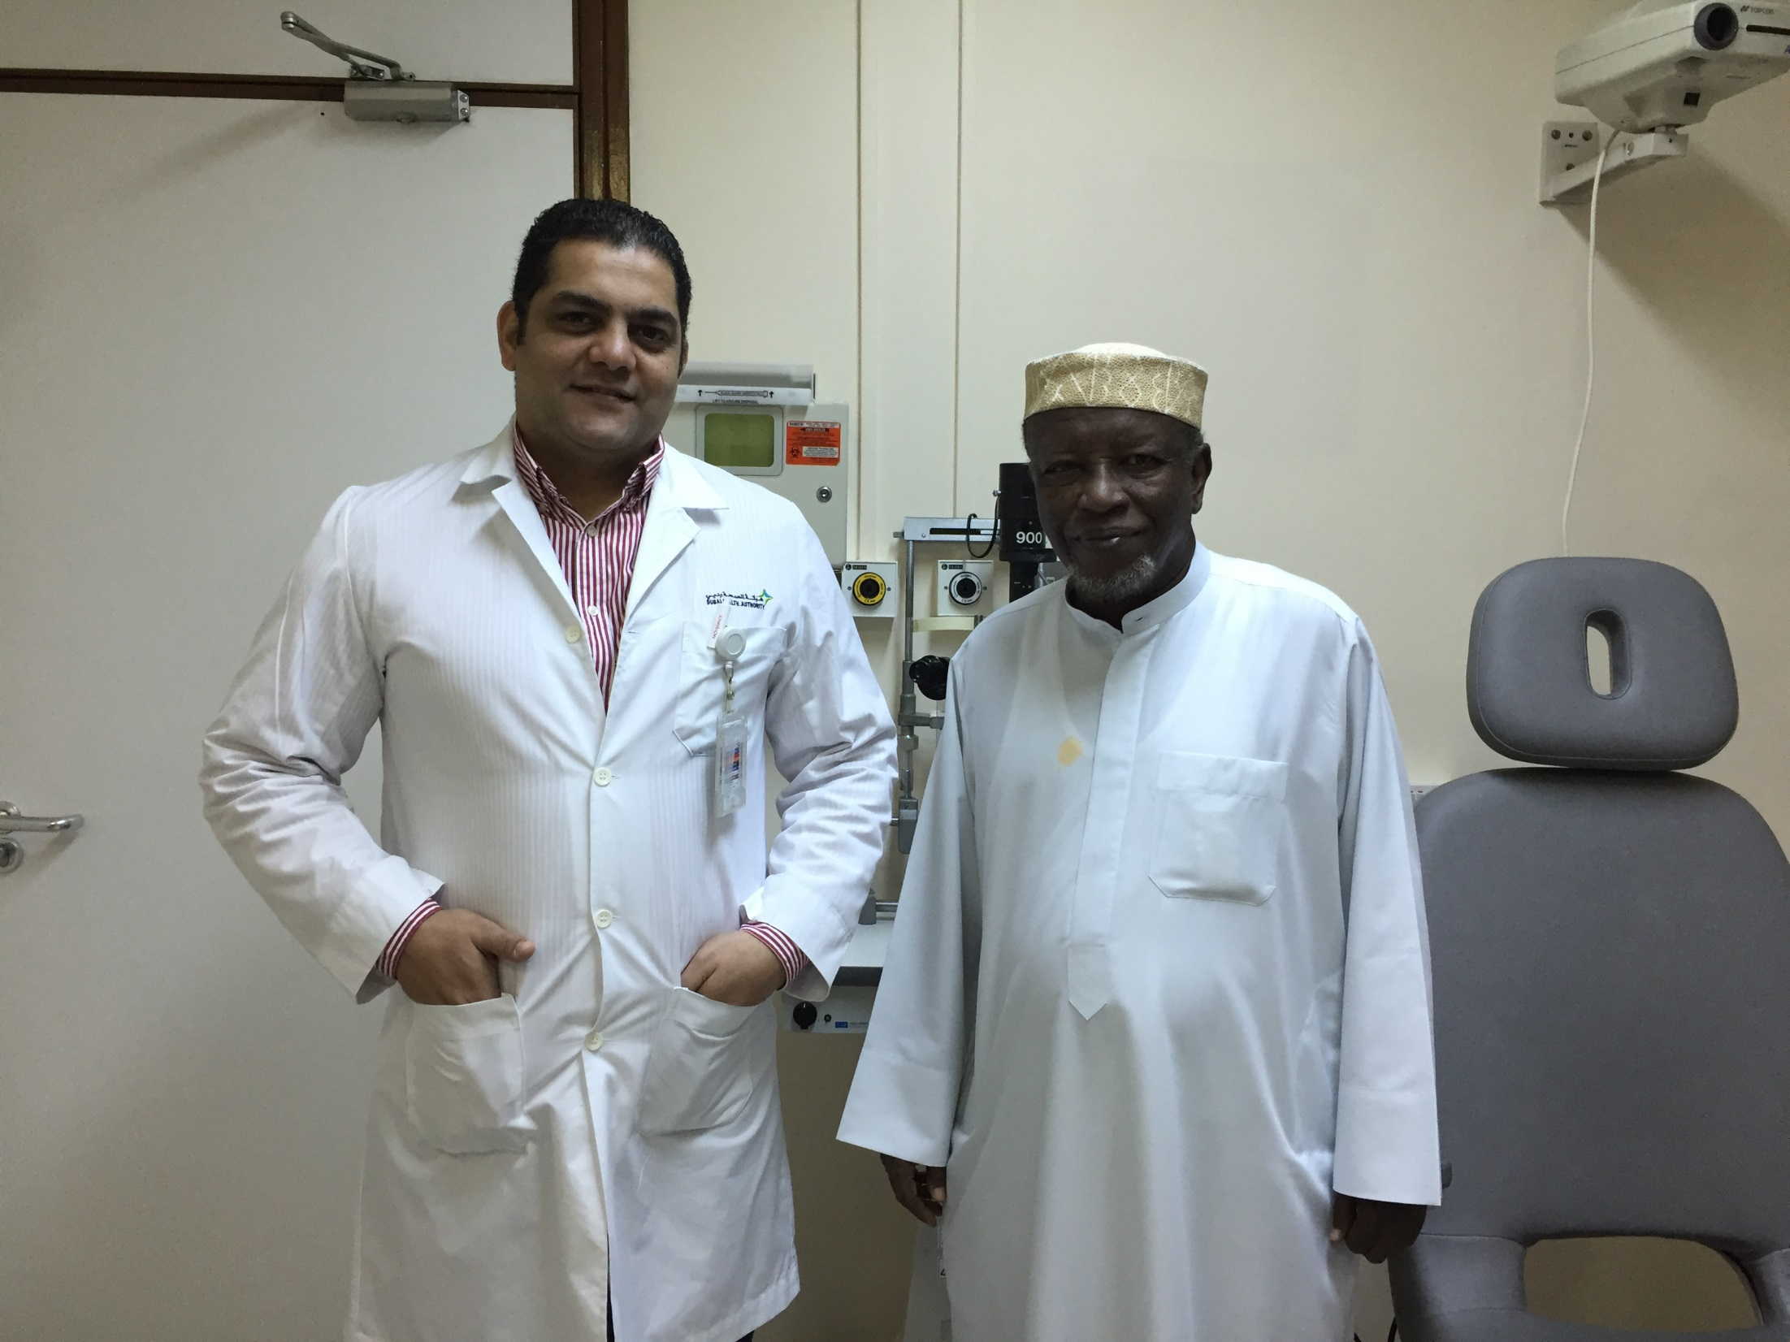

Slide 19
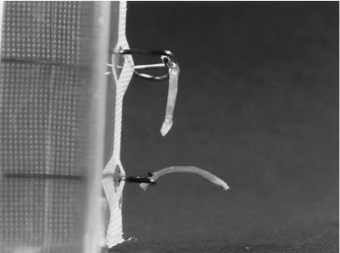
CXL
The aim of corneal crosslinking is to strengthen the cornea biomechanically by increasing the number of "anchors" that bond collagen fibers together.
Hence making it the only current treatment option that can arrest keratoconus progression
Corneal cross-linking (CXL) with riboflavin and UVA ,Originally introduced for the treatment of keratoconus by improving the biomechanical features of the cornea.
Wollensak G, Spoerl E, Seiler T. Riboflavin/ultraviolet-a-induced collagen crosslinking for the treatment of keratoconus. Am J Ophthalmol. 2003;135(5):620-627.

Slide 20

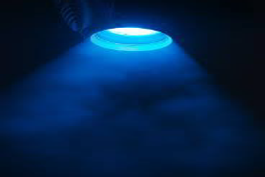


CXL
365 nm,
3mW/cm2
Photosensitizer
30 min

Slide 21
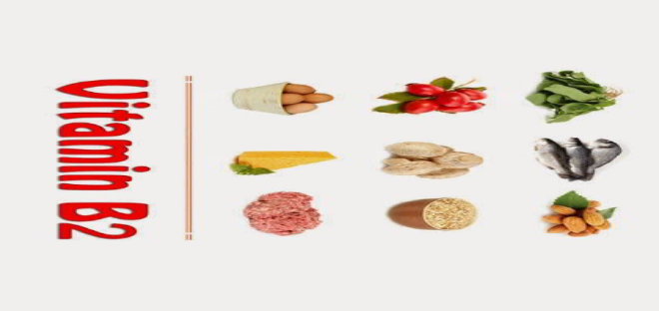

Riboflavin (Vitamin B2)
• Ribose (sugar – ribitol) Flavin (flavus = yellow)
• 1st isolated from whey (Lactoflavin) Blyth 1879
• Yellow colour, slight odour, bitter taste
• Slightly soluble in H20 and alcohol
• Heat stable decomposition at 2800C
• Destroyed by light, alkali
• Fluorescent in aqueous solution (λ-max 565nm)
• Rich dietary sources:
• Milk, cheese, oily fish, liver, kidney, eggs, green leafy vegetables,
whole grains, brewers yeast, almonds, sunflower seeds.
• Two active coenzymes
• Flavin mononucleotide (FMN)
• Flavin adenine dinucleotide (FAD)
• Multiple physiological functions:
• 150 Oxidation-reduction reactions
• Electron transport chain
• Citric Acid Cycle
• Catabolism of fatty acids
• Production of pyridoxic acid from pyridoxal (vit B6)
• Oxidation of pyruvate, α-ketoglutarate, amino acids
• Conversion of retinol (vitamin A) to retinoic acid
• Synthesis of an active form of folate
• Conversion of tryptophan to niacin (vitamin B3)

Slide 22
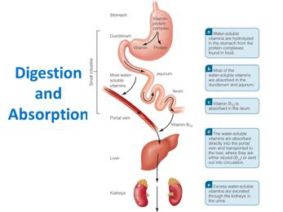

Riboflavin (Vitamin B2)
Cannot be synthesized in mammalian cells
• RDA 1.7mg males, 1.3mg females
• Increased in pregnancy/lactation
• Absorbed in the proximal intestine
• Zempleni AJClin Nutr 1996;63:54
• Maximal absorbed from single dose 27mg
• Regulated, active carrier, Na2+ dependant
• ?down regulation with excessive absorption
• Colonic absorption
• Bacterially synthesized riboflavin
• Conversion into FAD, FMN occurs mainly in the cells
of the small intestine, liver, heart, and kidney.
• Stored the liver, kidney and heart in the form of FAD
(70- 90%) or FMN or Riboflavin.
• Excreted in the kidneys (yellow discolouration)

Slide 23
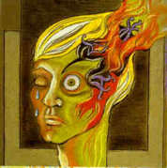
Riboflavin and the prophylaxis of Migraine Headache
Used for 3 decades in children and adults
• Oral dosage 100-400mg per day
• Systemic review Thompson J Clin Pharm Ther. 2017;42:394.
• 11 clinical trials reveal a mixed effect
• 5 showed consistent positive effect in adults
• 4 showed a mixed effect in paediatric &adolescent
• 2 did not shown benefit
• Adverse reactions generally been mild.
• Concluded that Riboflavin is well tolerated, inexpensive and demonstrated efficacy in the reduction of adult patient's migraine
headache frequency.
• Additional trials required.
• Riboflavin Has Neuroprotective Potential
• Marashly, Bohlega. Focus on Parkinson's Disease and Migraine.Front Neurol. 2017 Jul 20;8:333.

Slide 24
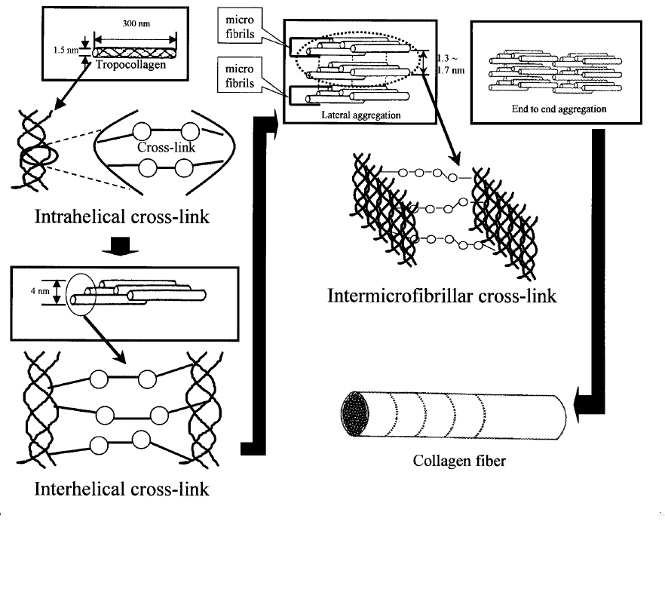



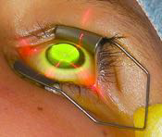
Photochemical Corneal Collagen Cross Linkage with Riboflavin and UVA
Riboflavin
• Vitamin B2
• Non-toxic
• Water soluble, Non-lipid soluble
• Good stromal penetration
• Absorbs UVA radiation
• Prevents UV damage to
deeper ocular structures
• Photosensitizer for production of
oxygen free radicals
• ?Responsible for Lysine cross links

Slide 25
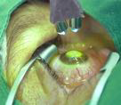
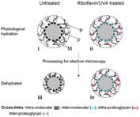

Epithelium off CXL: Dresden Protocol
Tetracaine 1%
• Pilocarpine 2%
• Remove 9mm central epithelium
• Riboflavin 0.1% every 2-3min for 30min
• Intra-operative pachymetry
• UVA exposure 3mW/cm2 for 30 min
• With Riboflavin 0.1% every 3-5 min
• Avoid limbal UV irradiation
• Antibiotics +/- BCL/pad
• Topical antibiotics and steroids
• Oral +/- topical anaesthetics
• 90 minute procedure
• NICE approved September 2013

Slide 26
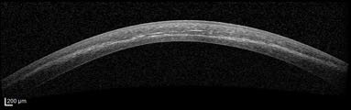
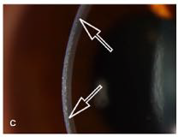
Treat thin corneas
• Initial decision: irradiation parameters for minimal thickness = 400 μm
Demarcation line
• visible in OCT at 1 month after treatment

Slide 27
Infectious keratitis
It is a well-known sight-threatening condition and leads to legal blindness in many cases, even when maximal conventional systemic and topical antibiotic therapies are available.
The disease may occur in all age groups, and treatment of bacterial keratitis is a costly and socioeconomic issue.
In the light of increasing AMR in ophthalmology, new treatment modalities are needed for the treatment of this commonly encountered disease.
The World Health Organization classifies infectious keratitis as a “silent epidemic Disease “
Whitcher JP, Srinivasan M. Corneal ulceration in the developing world–
a silent epidemic. Br J Ophthalmol. 1997;81:622–623.
5. World Health Organization (WHO), Geneva, Switzerland. Available at:
http://www.who.int/drugresistance/documents/surveillancereport/en/.
Accessed November 7, 2016.

Slide 28
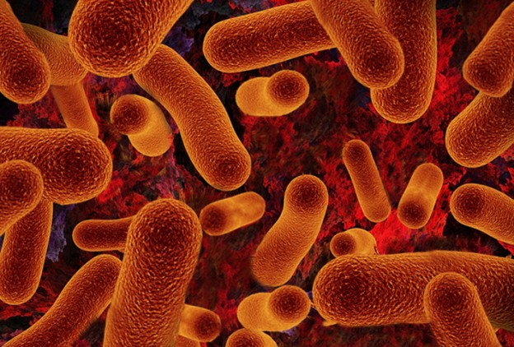
AMR
AMR is rising at an alarming speed, and the World Health Organization has published an urgent call to identify alternatives to antibiotics in its global report on AMR
World Health Organization (WHO), Geneva, Switzerland. Available at:
http://www.who.int/drugresistance/documents/surveillancereport/en/.
Accessed November 7, 2016.

Slide 29
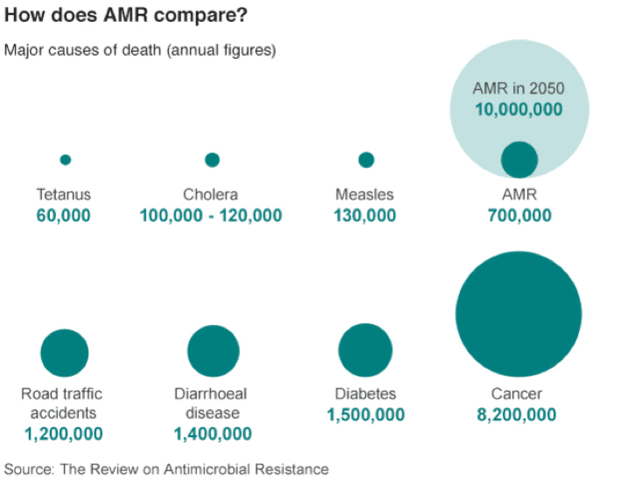
The graphic shows that by 2050, the WHO expects that more people will die due to antibiotic resistance than to cancer and diabetes combined.
For ophthalmology this will mean a distinct increase in antibiotic-resistant corneal infections.

Slide 30
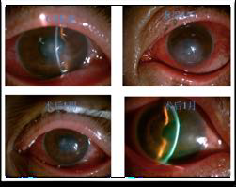
PACK-CXL
Photo activated chromophore for
keratitis-corneal collagen crosslinking
(PACK-CXL).
lseli first reported CXL for infectious
keratitis in 2008, thereafter many
studies revealed its efficacy in
bacterial and fungal keratitis.
Iseli HP, et al. Ultraviolet A/riboflavin corneal cross-linking for
infectious keratitis associated with corneal melts. Cornea.
2008;27:590–4.
Sun B, Mu GY. Evaluation of the in vitro antimicrobial
properties of ultraviand fusarium solani. Int J Ophthalmol 2014;
7(2):205-210.
Li Z, Mu G. Riboflavin/ultraviolet lightmediated crosslinking
for fungal keratitis. Br J Ophthalmol. 2013 Jan 26.

Slide 31
Mechanism of action
photodynamic inactivation of microorganisms arises from the generation of free radicals .
Free radicals rapidly oxidize biomolecules and induce damage in major cell components, mainly in the cell wall and DNA, which finally lead to killing of microorganisms.
Riboflavin
UV-light absorption
UV-Light Excitation of oxygen
Excitation of riboflavin Oxygen
oxidation of the
extracellular matrix

Slide 32

Pack CXL
Cytotoxic effect

Slide 33
PACK-CXL: published data
188 cases Standard “Dresden” protocol
Two cases were treated with accelerated PACK-CXL ²·³
173 cases: additional treatment
17 cases: solo-therapy¹·²
From 2008 until today, published studies cover a total of 190 eyes treated with CXL as an adjunct to antimicrobial treatment,
1.Makdoumi K. UVA-Riboflawin photochemical therapy of bacterial keratits: a pilot study. Graefs Arch Clin Exp Ophthalmol. 2012;250:95-102.
2. Tabibian D. Accelerated PACK-CXL as a First-line and Sole Treatment in Early Fungal Keratitis. J Refract Surg. 2014; 30:855-857
3. Chan TC. PACK-CXL for Bacterial Keratitis After Small Incision Lenticule Extraction (SMILE). J Refract Surg. 2017; 33:278-280

Slide 34

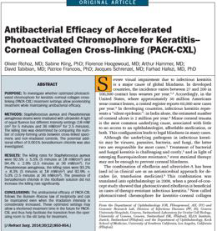
Can PACK-CXL be accelerated ?
Antibacterial Efficacy of Accelerated Photoactivated Chromophore for Keratitis–Corneal Collagen Cross-linking (PACK-CXL)
Olivier Richoz, MD; Sabine Kling, PhD; Florence Hoogewoud, MD; Arthur Hammer, MD; David Tabibian, MD; Patrice Francois, PhD; Jacques Schrenzel, MD; Farhad Hafezi, MD, PhD , 2014

Slide 35




Accelerated PACK-CXL
Abrasion of
epithelium.
(1mm around
the borders)
Rinsing and
patching
with Ab.
ointment
Corneal
scraping for
culture
Hypo-osmolaric
0.1%, riboflavin
(each 2 min for 20-30 min)
UV-Aradiation
(30mW/cm2
For 3 min)

Slide 36
Results
The killing rates for Staphylococcus aureus were 92.5% ± 5.5% (5 minutes at 18 mW/cm²) and 94.4% ± 2.9% (2.5 minutes at 36 mW/cm²).
For Pseudomonas aeruginosa, the killing rates were 93.2% ± 8.3% (5 minutes at 18 mW/cm²) and 92.9% ± 5.0% (2.5 minutes at 36 mW/cm²).
The antibacterial efficacy of PACK-CXL follows the Bunsen–Roscoe law of reciprocity and can be maintained even when the irradiation intensity is considerably increased.
These optimized settings may allow a shortened treatment time in the future for PACK-CXL and thus help facilitate the transition from the operating room to the slit lamp for treatment.

Slide 37

The C-Eye Device
Cross-Linking at the Slit Lamp

Slide 38
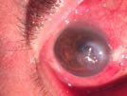


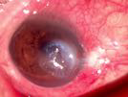


Gram (+)
Staphylococcus epidermidis.
Before PACK-CXL
S/P 5 Days
S/P 2 weeks

Slide 39



Gram (-)
Klebsiella pneumoniae, Pseudomonas Aeruginosa and Serratia Morganella
Before PACK-CXL
S/P 3 Days
S/P 2 weeks

Slide 40
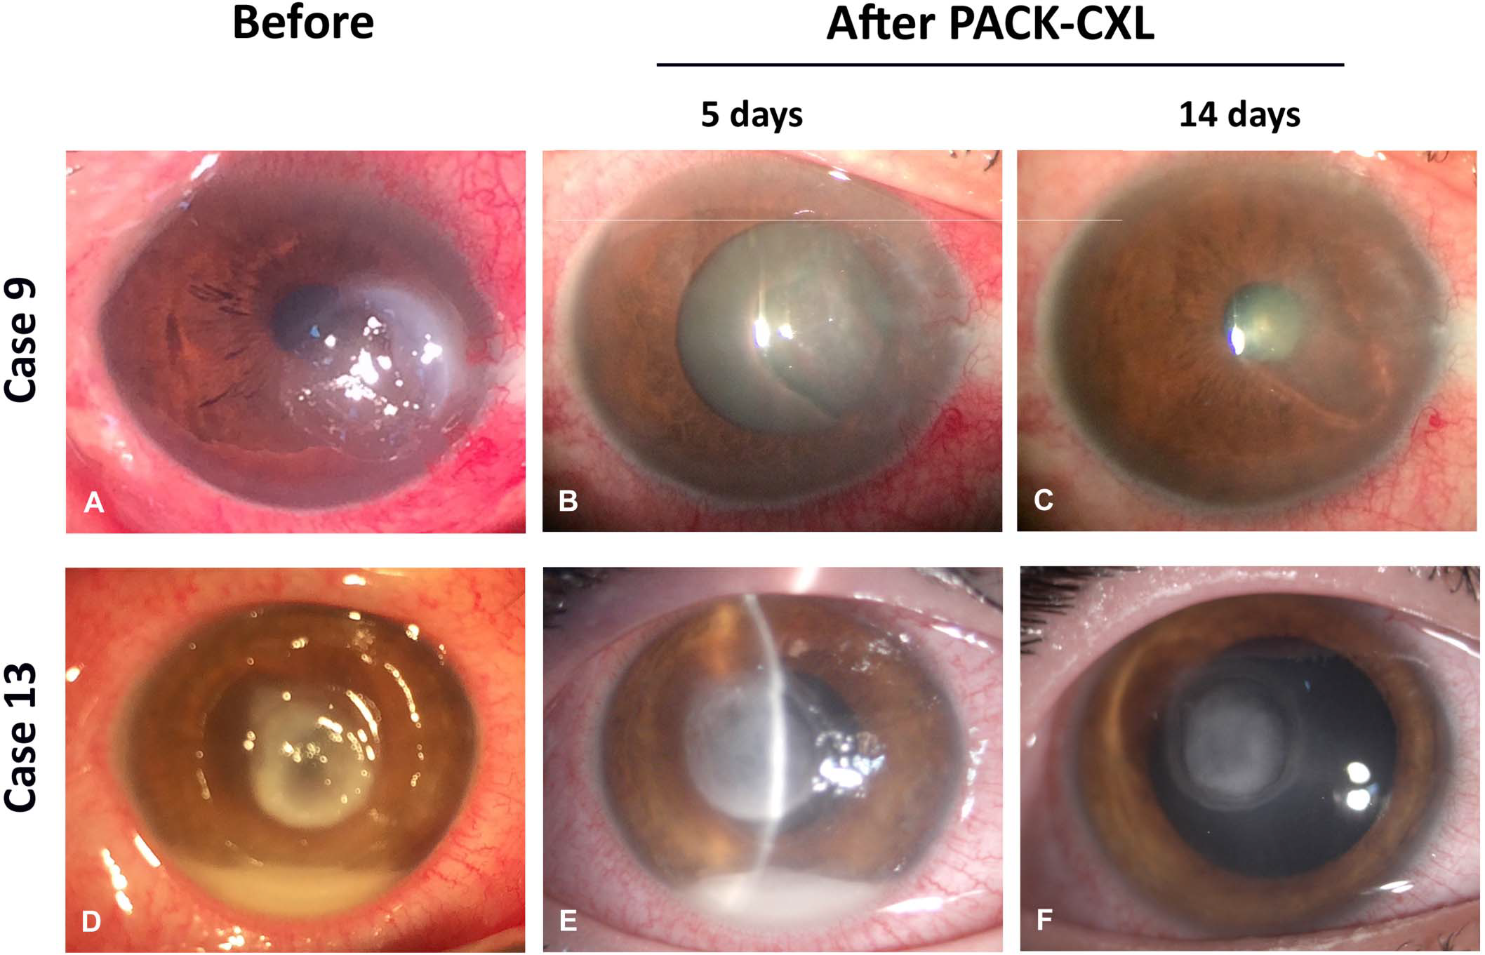

Slide 41
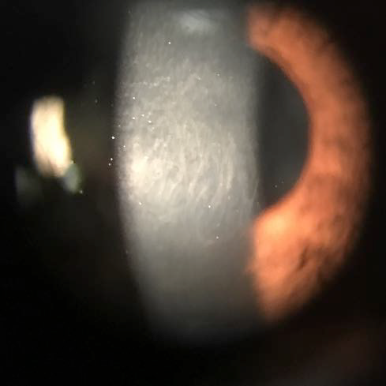
C O R N E A L H A Z E

Slide 42


Results: complete re-epithelialization

Slide 43
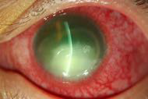
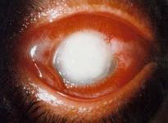
Fungal Keratitis
Fungal keratitis, first described by Leber in 1879.
Common corneal infection in developing countries, although not common in Western countries.
If not diagnosed and treated promptly and effectively, significant damage can occur.

Slide 44
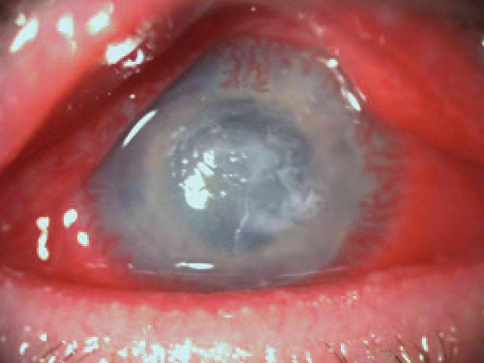
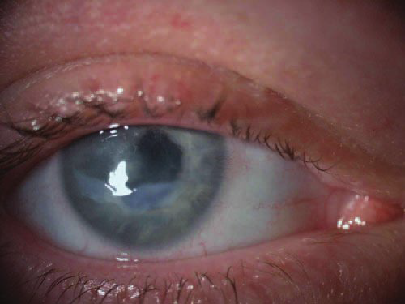
Slit-lamp image of eye with culture-proven Acanthamoeba keratitis treated after 3 months of medical therapy. CXL was performed
on the same day this image was taken
Slit-lamp image of the same eye 9 months after CXL. The infiltrate has resolved, but visual acuity remains at “counting fingers” due to corneal scarring with surface irregularity.

Slide 45
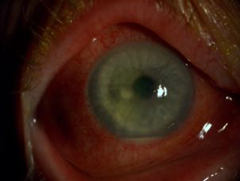
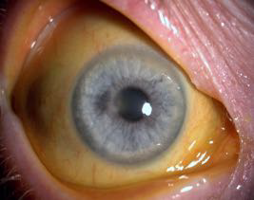
Limitations of PACK-CXL
• Better effect in bacterial vs fungal keratitis
• Limited effect in deep infiltrates - UVA 250 μm

Slide 46

CONCLUSION

Slide 47
Conclusion.
PACK-CXL kills bacteria irrespective of their antibiotic resistance.
Promising first results using accelerated PACK-CXL.
Accelerated PACK-CXL beneficial as an additional treatment In moderate-sized infectious keratitis.
The killing rate of PACK-CXL was significantly reduced in larger irradiated volumes (i.e. in deeper corneal ulcers).
Further research is needed to show the beneficial effect of This accelerated treatment for infective keratitis.

Slide 48

We Still Do Not See The Complete Picture

Slide 49


Slide 50



Slide 51


Slide 52

Thank you

