Slide 1

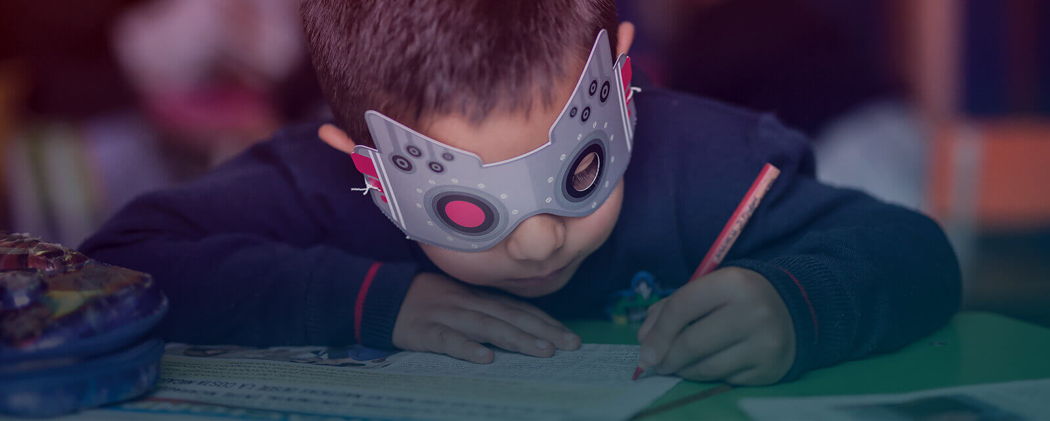
I RESCUE
WORLDWIDE AMBLYOPIA CAMPAING

Slide 2


MEDICAL OFTALMOLOGICAL FOUNDATION
FOR THE CHILD AND THE ADULT.
(FUNDACIÓN OFTALMOLÓGICA PARA EL NIÑO Y EL ADULTO)
It’s a non-profit institution that from 1987 leads the Wordwide Amblyopia and Visual Defects Campaign in Infancy.
The Foundation offers subsidized surgeries and treatments to low cost.
Thanks to the Campaings, today in Colombia, it’s a requirement that kids have a visual exam before they enter to school.
His director, Dr. Jaime Luis Vargas Ocampo, has been recognized with the Orden de la Democrecia (Order of Democracy) by the Colombian Congress, thaks to this work for kids and elders.
www.ambliopía.com
www.oftalmolima.pe

Slide 3
THE IDEA

Slide 4
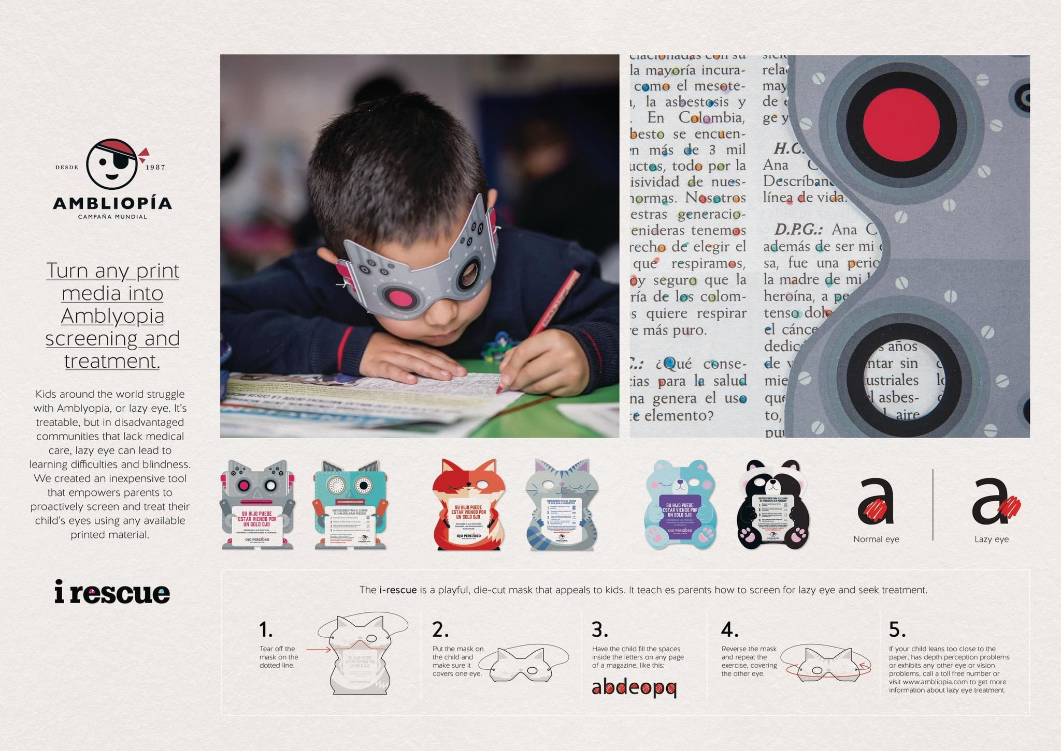
BACKGROUND
Kids around the world struggle with Amblyopia, or Lazy Eye. It’s treatable, but in disadvantaged communities that lack medical care, lazy eyes goes undiagnosed and un-corrected.
Without intervention, Amblyopia can lead to learning difficulties and blindness. Dr. Vargas Ocampo, who applied the treatment for Amblyopia which involves coloring in the counter spaces of letters, now runs the Worldwide Amplyopia Campaing. Dr. Vargas’s seeks to treat not only the children who come to his clinic, but also the ones he may never meet.

Slide 5
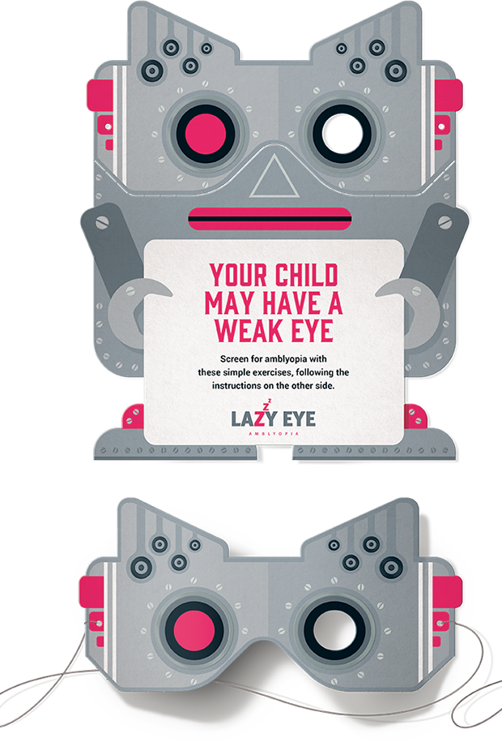
Treating Amblyopia isn’t hard, but diagnosing kids who lack access to medical care is a challenge. When the patients can’t go for treatment, treatment must come to the patients. We needed a tool that was inexpensive to produce, easy to distribute, and most importantly, fun to use. The I Rescue, is a playful, die-cut mask that catches attention in periodicals and waiting rooms, and empowers parents to proactively correct their child’s eyes for free.

Slide 6


PRESENTING
I Rescue
Turning any print media into Amblyopia screening and treatment
The I Rescue is an engaging tool that turns any printed material into a lazy Eye treatment. We distribute the tool through the periodicals people are already reading.
We needed a tool that was both inexpensive to produce and easy to distribute. The I Rescue is a playful, die-cut mask that commads attention in magazines, and teaches parents how to perform the lazy eye treatment.
It becomes an effective tool for screening, treatment and building awareness for the work of the Worldwide Amblyopia Campaing.
We desingned I Rescue to be sturdy and reversible so that it’s equally charming and effective no matter which eye is being worked. Wearing the I Rescue becomes a fun diversion from the tedium of the eye exercises required for treatment.
Masks on cardboard

Slide 7
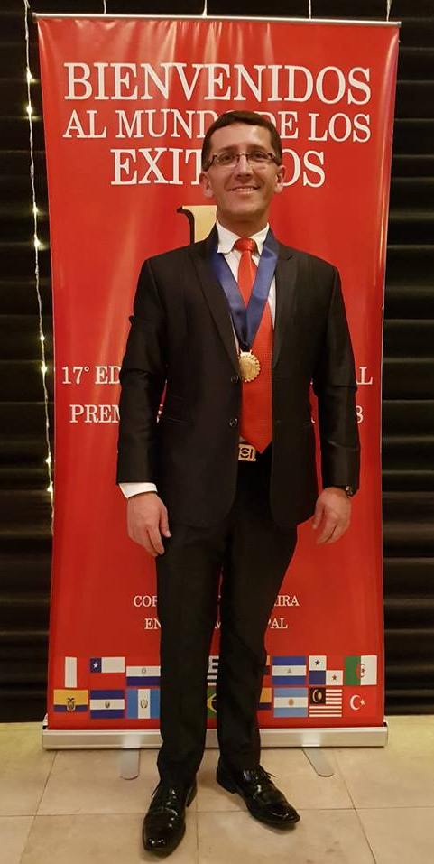
Dr. Mauricio Miranda Vargas Fano
Surgeon Ophthalmologist
Medical Director for the Global Campaign of Amblyopia in Peru and Oftalmolima Eye Clinic
Representative of Dr. Jaime Luis Vargas Ocampo, Founder and Director of the Global Amblyopia Campaign.
2018

Slide 8



RECOGNITIONS RECEIVED IN:
2018
Health & Wellness Lions:
Non-profit /Foundation-led
Education & Awareness
BRONZE
2018
Health & Wellness
GRAPHITE PENCIL
2018
El Ojo Gráfica
GR15- Formatos impresos
No convencionales
SILVER
WWW.AMBLIOPIA.COM
WWW.OFTALMOLIMA.PE

Slide 9
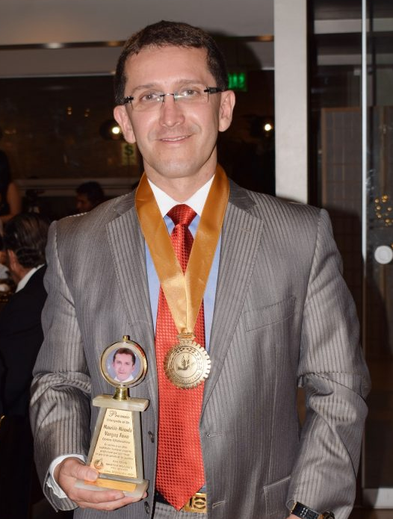
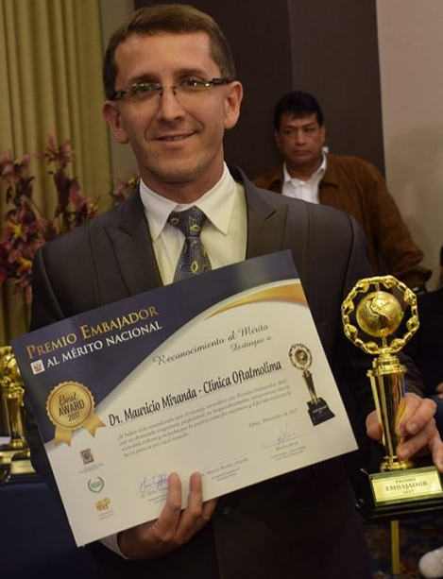
Recognitions Received :
Fijet-América Gold Award 2017 as best entrepreneur.
Ambassador to National Merit Award 2017
The Sparrow of Peace 2017.
Golden Star Awards 2017 – Panama City – Panama.
Circle of Journalists of Radio and Television Awards Gold Medal to National Merit and Honor Title as Outstanding Person of Peru year 2018.
Professional Excellence Award of Medicine of Peru 2018 granted by Altamira Foundation and Municipal Point.
Thanks

