Slide 1
Does lid hygiene with Blephex® treat Demodex Blepharitis better than lid hygiene alone
Henry D. Perry MD, Ilan Epstein MD, Michael Choi MD, Eric D. Donnenfeld MD, Ross Stuber BA

Slide 2
Research objectives
To evaluate the efficacy of lid hygiene and microblepharoexfoliation (MBE) in the treatment of blepharitis caused by eyelash infestation of the Demodex mite
To correlate Demodex eyelash infestation with Meibomian gland dysfunction (MGD) and dry eye disease using ocular surface parameters

Slide 3
Blepharitis
Blepharitis is a term used to describe highly common eyelid inflammation that is often chronic¹.
Blepharitis may be anterior (eyelid skin, base of the eyelashes, and lash follicles) with signs of scaling/crusting/erythema at the eyelid margins with collarette formation at the base of the eyelash.
Up to 30% of patients with blepharitis have been found to be positive for Demodex folliculorum²⁻³.
But, more commonly, blepharitis is posterior (meibomian glands and their orifices) with signs of gland inspissation, and plugging.¹
Notes:
Blepharitis is a term used to describe highly common eyelid inflammation, often chronic in nature, which represents a significant challenge to the clinician due to its often-inadequate treatment and considerable overlap with other ocular surface disease¹.
Up to 30% of patients with blepharitis have been found to be positive for Demodex folliculorum, which can infest in the eyelash follicle and base/shaft as well as within meibomian glands, although a similar prevalence has also been reported in patients without blepharitis⁸⁻⁹.
Current treatments include home lid scrubs and warm compresses, topical lubrication, topical and oral antibiotics, topical anti-inflammatory agents, oral fish oil supplementation, and oral tetracyclines²⁻⁷.

Slide 4
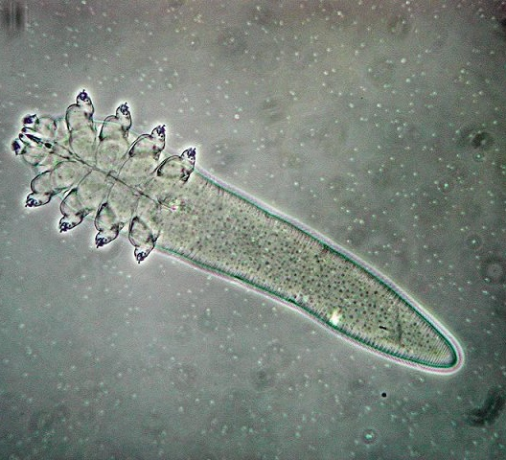
Demodex
Demodex folliculorum usually infest the eyelashes and hair as well as other parts of the face and body.⁴
Demodex infestation increases with age.⁴
Demodex folliculorum can infest the eyelash follicle, its base and shaft as well as within meibomian glands.⁵

Slide 5
Demodex Effects on Eyelids and Lashes
Causes inflammation, damage and distention of the eyelash follicle
Loss of eyelashes⁶
Disease of the eyelash
Produces a cuff of material called cylindrical dandruff⁵
Linked to meibomian gland dysfunction and in chalazion formation and meibomian gland dysfunction⁵

Slide 6
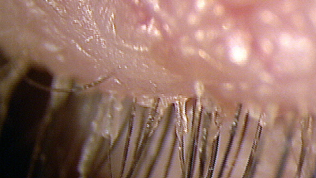
Diagnosing Demodex
Patient complains of eyelid itching
Slit lamp examination demonstrates “cylindrical dandruff” around base of eyelashes (note on imaged lashes)
  Eyelash disease
  Corneal and conjunctival inflammation may be present(15)
Demodex folliculorum is identified by microscopic evaluation of the epilated eyelash

Slide 7
Current Treatments
Home lid scrubs and warm compresses
Topical lubrication
Topical and oral antibiotics
Topical anti-inflammatory agents
Oral fish oil supplementation
Oral tetracyclines⁷⁻¹²

Slide 8
Hypothesis
The investigators believe the addition of BlephEx® to lid hygiene will be effective in reducing the Demodex infestation of the eyelashes in patients with blepharitis as well as improve dry eye disease and meibomian gland dysfunction parameters, compared to lid hygiene alone.

Slide 9
Study Design
This study is a prospective, randomized, single center trial.
Evaluates the effect of lid hygiene when combined with microblepharoexfoliation treatment using BlephEx® for the treatment of Demodex positive blepharitis.
Goal is to reduce the eyelash infestation with the Demodex mite.
It will also monitor blepharitis, dry eye disease and meibomian gland dysfunction (MGD) severity via testing parameters to investigate a possible correlation with Demodex eyelash infestation levels.

Slide 10
Study Groups
50 total patient subjects with confirmed Demodex positive blepharitis on light microscopy
Randomized into two groups
One group will receive an in-office BlephEx® MBE treatment during Visit 1 and the other group will not
All subjects will be instructed to perform lid hygiene with warm salt-water soaks twice daily until the next study visit approximately one month later.
At Visit 2, all subjects will be re-evaluated and receive a BlephEx® treatment, and the study will conclude.

Slide 11
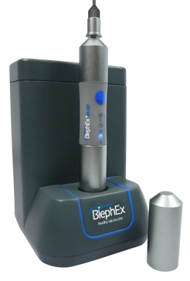
BlephEx®
System for exfoliating of the eyelid margin (microblepharoexfoliation) to remove biofilm accumulation, scurf/debris, and Demodex mites.
A disposable brush with a micro-sponge tip is soaked in LidHygenix® Foam [LidHygenix, Inc, Atlanta, GA]
The brush is attached to an electric rotary hand-piece that is brushed along the eyelid margin back and forth for about 1-2 minutes.
The BlephEx system is marketed and sold to ophthalmic practices to be given as an in-office treatment for blepharitis

Slide 12
Testing Parameters
OSDI questionnaire score
Non-contact tear break-up time
Tear lipid thickness
Tear osmolarity
MMP-9 level
Schirmer 1 testing
Meibography
Lissamine green staining of the ocular surface

Slide 13
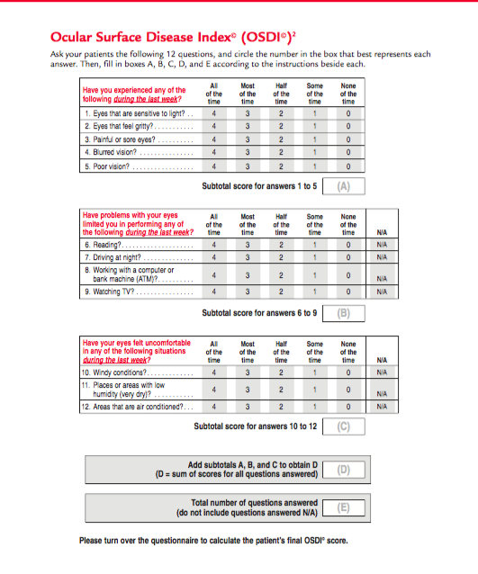

Slide 15
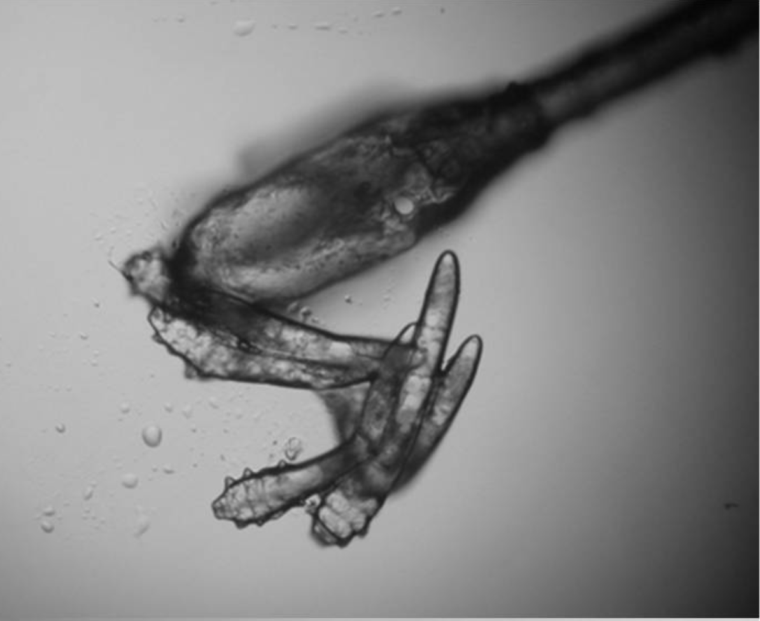
Light Microscopy
Epilation of eyelashes to be examined under a light microscope for inspection and quantification of Demodex mites in the field

Slide 16
Tear osmolarity testing
TearLab® Osmolarity System [TearLab Corporation, San Diego, CA]
Normal <312 mosm/L
Borderline 312-323mosm/L
Moderate or severe dry eye >323mosm/L

Slide 17
Schirmer 1 Testing
Quantifies both basal and reflex aqueous tear production
  Normal aqueous tear level: >/= 15mm wetting
  Mild aqueous tear deficiency: 9-14mm wetting
  Moderate aqueous tear deficiency: 4-8mm wetting
  Severe aqueous tear deficiency: <4mm wetting

Slide 18
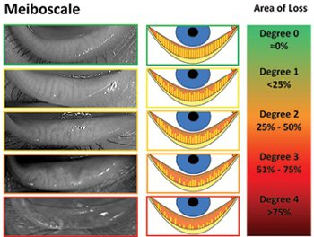
Meibomian Gland Grading
Physician grades meibomian gland appearance and drop-out

Slide 19
Slit Lamp Examination
Presence of foam on the eyelid margin indicates detergent like tear film
Lissamine green staining of the ocular surface:
  Vital dye applied to ocular surface will stain degenerated and dead cells, as well as mucous fibrils
  Gradation of staining of the cornea and conjunctiva according to the Modified Oxford Score 0-5

Slide 20
MMP-9 Tear Level Testing
Inflammadry® [RPS Diagnostics, Sarasota, FL] system
It is used to detect elevated levels of inflammatory marker MMP-9 in tears
Elevated levels of MMP-9 are consistently seen in the tears of patients with dry eye disease

Slide 21
References
1. McCulley JP, Dougherty JM, Deneau DG. Classification of chronic blepharitis. Ophthalmology 1982;89:1173-80.
2. Kemal M, Sumer Z, Toker MI, et al. The prevalence of Demodex folliculorum in blepharitis patients and the normal population. Ophthalmic Epidemiol 2005;12:287- 90.
8. Lindsley K, Matsumura S, Hatef E, Akpek EK. Interventions for chronic blepharitis. Cochrane Database of Syst Revs 2012, Issue 5. Art. No.: CD005556. DOI: 10.1002/14651858.CD005556.pub2.
9. Torkildsen GL, Cockrum P, Meier E, et al. Evaluation of clinical efficacy and safety of tobramycin/dexamethasone ophthalmic suspension 0.3%/0.05% compared to azithromycin ophthalmic solution 1% in the treatment of moderate to severe acute blepharitis/blepharoconjunctivitis. Curr Med Res Opin 2011;27:171-8.
10. Dougherty JM, McCulley JP, Silvany RE, Meyer DR. The role of tetracycline in chronic blepharitis. Inhibition of lipase production in staphylococci. Invest Ophthalmol Vis Sci 1991;32:2970-5.
11. Perry HD, Doshi-Carnevale S, Donnenfeld ED, et al. Efficacy of commercially available topical cyclosporine A 0.05% in the treatment of meibomian gland dysfunction. Cornea 2006;25:171-5.
12. Macsai MS. The role of omega-3 dietary supplementation in blepharitis and meibomian gland dysfunction (an AOS thesis). Trans Am Ophthalmol Soc 2008;106:336-56.
3. Gao Y-Y, Di Pascuale MA, Li W, et al. High prevalence of Demodex in eyelashes with cylindrical dandruff. Invest Ophthalmol Vis Sci 2005;46:3089-94.
7. Key JE. A comparative study of eyelid cleaning regimens in chronic blepharitis. CLAO J 1996;22:209-12.
4. Roth AM. Demodex folliculorum in hair follicles of eyelid skin. Ann Ophthalmol 1979; 11:37-40.
5. Tighe S, Gao YY, Tseng SC. Terpinen-4-ol is the Most Active Ingredient of Tea Tree Oil to Kill. Transl Vis Sci Technol. 2013;2:2.
6. English FP; Demodex folliculorum and oedema of the eyelash. Br J Ophthalmol 1971: 55(11): 742-746

