Slide 1

Medications errors and Patient safety
BY/ Hesham Almekawy
PCICU Nurse

Slide 2
Out lines
Definition
Factors That May Influence Medication Errors
Safety Principles
Causes of Medication Errors
Prevention Strategies
Conclusions
references

Slide 3
Medication Error
A Medication Error is defined by The National Coordinating Council For Medication Error Reporting And Prevention (NCC MERP) as “any preventable event that may cause or lead to inappropriate medication use or pt harm while the medication is in the control of the health care professional, pt, or consumer.”

Slide 4
Factors That May Influence Medication Errors
Human related
System related
Medication related

Slide 5
Human Related Factors
Health Care providers
  Over worked
  Under trained
  Inadequate drug knowledge
  Competence
  Distracted
  Illness
  stressed
Patients
  Educational and health literacy level
  language barriers
  poor quality of life and patient experience
  Complexity of clinical case, including multiple health conditions, polypharmacy and high-risk medications

Slide 6
The system Related Factors
Lack of communication
Poor work flow
Disorganized work place
Insufficient resources
Lack of supervision

Slide 7
Medication Related Factors
Look alike/ sound alike medication
Multiple dosage forms and strengths

Slide 8
Safety Principles
Cognitive psychologists report that the human brain is creative and is wired to make errors
patient safety as a primary precept of the profession
the way to approach error prevention is a systems approach. This method would avoid the "blame game" .

Slide 9
Safety Principles
The 10 rights are goals, not procedures.^{[3]}
  Right Patient Right Route
  Right Medication Right Time
  Right Dose Right Documentation
  Right evaluation Right to refuse medication
  Right assessment Right education

Slide 10
Causes Of Medication Errors AND Prevention Strategies
  Failed communication.
  Dose miscalculations.
  Incorrect drug administration.
  Poor drug distribution practices.
  Lack of patient education.

Slide 11
Causes of Medication Errors AND Prevention Strategies
Failed Communication:
  Poorly handwritten or verbal orders
    Handwriting is a major source of error
      write legibly.
      Always specify the drug strength, even if only one strength exists.
      Express dosages in metric weights or volumes (e.g., mg or ml)
      differentiates the drug names by using (capitals) letters
    Telephone and verbal orders are likewise prone to misinterpretation.
      Keep phone or verbal orders to a minimum
      Repeat back orders taken over the telephone

Slide 12
Causes of Medication Errors AND Prevention Strategies
  Drugs with similar-sounding or similar-looking names
    Highlight distinguishing syllables (ex.: acetoHEXAMIDE versus acetaZOLAMIDE or buPROPrion versus busPIRone).
    The ISMP has developed an extensive list of confused drug names (see www.jointcommission. org). See individual monographs for DO NOT CONFUSE information.

Slide 13
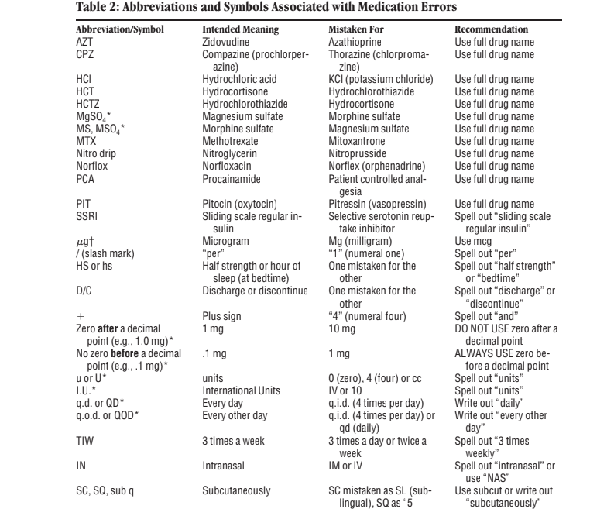
Avoid abbreviations :

Slide 14
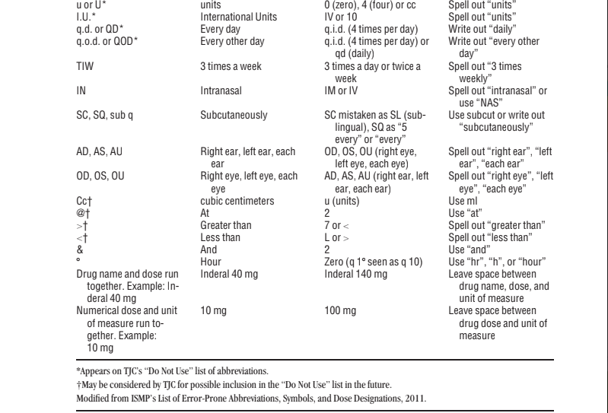
Avoid abbreviations :

Slide 15
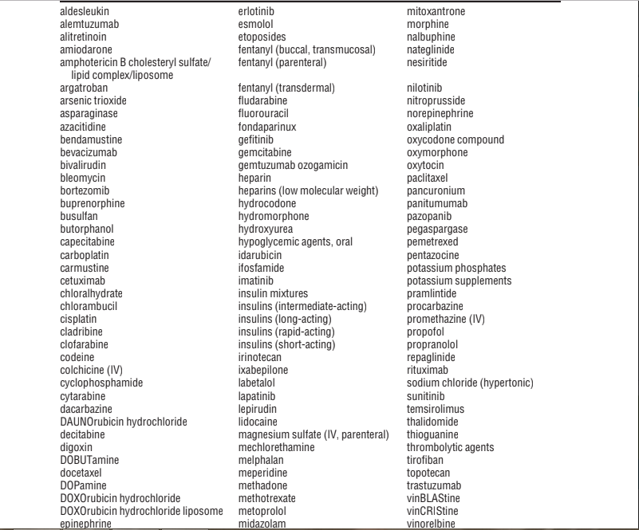
High Alert Medications

Slide 16
Causes of Medication Errors AND Prevention Strategies
  Misuse of zeroes in decimal numbers.
    Over dosage or Under-dosing also may occur so prevent a desired, perhaps life-saving effect.
    Using a leading zero (.2 mg instead of 0.2 mg)
    Not adding an unnecessary trailing zero (2.0 mg instead of 2 mg)
  Use of package units (amps, vials, tablets) instead of metric measures (grams, milligrams, mill equivalents)
    can result in overdose or under dose when the medications ordered come in various strengths. (e.g., calcium chloride, 1 ampule or epinephrine, 1 Bristojet).

Slide 17
Causes of Medication Errors AND Prevention Strategies
Ambiguous or incomplete orders:
  Examples include situations when the route of administration, dose, or dosage form has not been specified.
  Do not use" / “may be read as the number one (1).
  When reviewing an unusual order, verify the order with the person writing the order .
  Encourage that the drug’s indication for use be provided on medication orders.
  Provide complete medication orders: do not use “resume preop” or “continue previous meds.” .
  Provide the age , the height and the weight of the pt.

Slide 18
Causes of Medication Errors AND Prevention Strategies
Dose Miscalculations:
  a prime source of medication error.
  dosing formulas provide many opportunities to introduce error.
  vulnerable populations, such as premature infants, children, the elderly, and those with serious underlying illnesses are at greatest risk SO Many medications need to be dose-adjusted related to age, height and weight, and body composition.

Slide 19
Causes of Medication Errors AND Prevention Strategies
Medication reconciliation:
  Medication reconciliation programs are a process of identifying the most accurate list of all medications a pt is taking and using this list to provide correct medications anywhere within the health care system

Slide 20
Causes of Medication Errors AND Prevention Strategies
Incorrect Drug Administration:
  Misidentification of a patient, incorrect route of administration, missed doses, or improper drug preparation are types of errors that occur during the administration phase.
Poor Distribution Practices:
  error-prone storing practices such as keeping similar-looking products next to each other.

Slide 21
Causes of Medication Errors AND Prevention Strategies
Technology
  Electronic prescribing systems
    incorporate medication safety alerts (e.g., maximum dose alerts, allergy screening)
    should be integrated or interfaced with pharmacy and laboratory systems to provide drug–drug and drug–disease interactions alerts and include clinical order screening capability.
    Ex
      Pharmacy order entry system
      computer physician order entry (CPOE)
  Bar codes
    These systems are designed to use bar-code scanning devices to validate identity of pts , verify medications administered, document administration, and provide safety alerts.

Slide 22
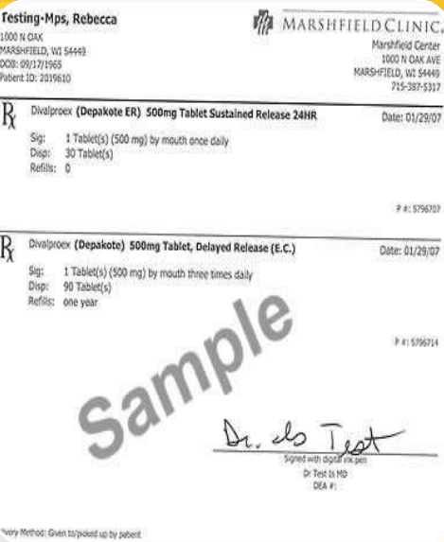
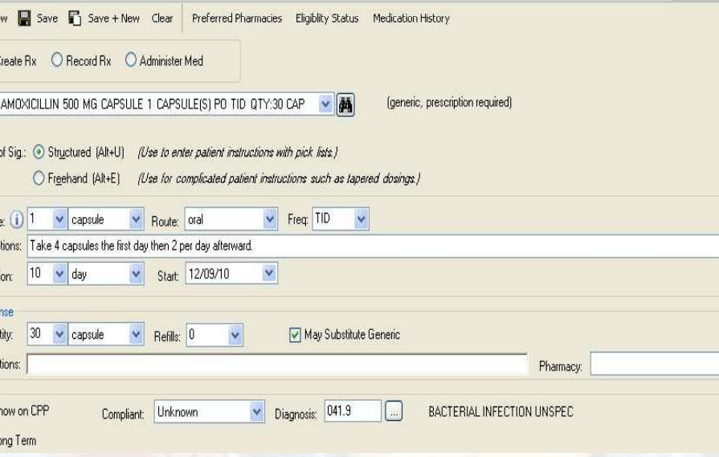
Electronic prescription & Computerized physician order

Slide 23
Causes of Medication Errors AND Prevention Strategies
“Smart” infusion pumps
  Allow users to enter drug infusion protocols into a drug library along with predefined dosage limits. If a dosage is outside the limits established, an alarm is sounded and drug delivery is halted, informing the clinician that the dose is outside the recommended range.

Slide 24
Causes of Medication Errors AND Prevention Strategies
Lack of Patient Education:
  The knowledgeable patient can recognize when something has changed in his or her medication regimen and can question the health care provider.
  Patient education also enhances adherence.
  Educate patients about the medications they take. Provide verbal and written instructions and ask the patient to restate important points

Slide 25
conclusion
  Check to see that other healthcare providers have not made any errors in any part of the medication order chain.
  They must ensure that they themselves do not make an error.^{[3]}
  Provide sufficient identification before administering medications have another health care provider
  Look for duplicate therapies and interactions:
  Provide standard concentrations and infusion rate tables.
  Be sure to fully understand any drug administration device before using it. This includes infusion pumps, inhalers, and transdermal patches.

Slide 26
conclusion
Supply pharmacy and patient care areas with current reference material
Cultivate a culture that does not assign blame when medication errors occur but looks for root causes instead.
Encourage staff to participate in the error reporting program TO Promote a non punitive approach to reducing medication errors

Slide 27
REFERENCE
Davis’s drug guide for nurses / April Hazard Vallerand, Cynthia A. Sanoski, Judith Hopfer Deglin. — Fourteenth edition. p. ; cm ISBN 978-0-8036-3976-8 (US) ISBN 978-0-8036-3977-5 (Canadian). Copyright © 2015 by F. A. Davis Company.
SAUNDERS NURSING DRUG HANDBOOK 2016 ISBN: 978-0-323-35379-3 ISSN: 1098-8661 Copyright © 2016
Patient safety research: introductory course (on-line). Geneva: World Health Organization; 2016 (http://www.who.int/patientsafety/research/online_course/ en/, accessed 19 September 2016).
Patient safety toolkit. London: Royal College of General Practitioners; (http:// www.rcgp.org.uk/clinical-and-research/toolkits/patient-safety.aspx, accessed 19 September 2016).

Slide 28


