Slide 1
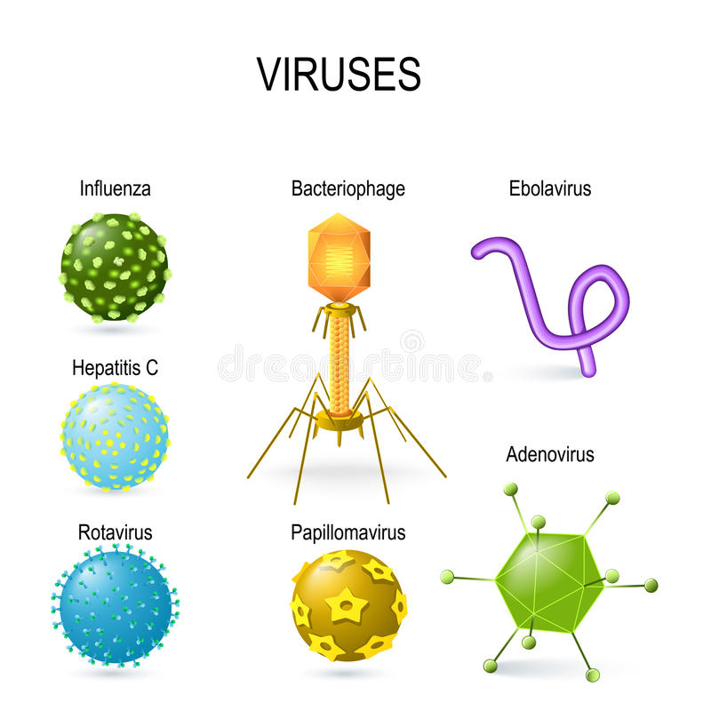
Multivalent Viral Nanorobotics and The Future of Gene Therapy
In the future, we seek new approaches to old methods in order to meet our needs, This is even true in Bio-Nanorobotics. I want you to consider humans once used a Stone hatchet instead of a screwdriver.
We constantly innovate to make a better product, why should we not take the same set of thoughts about our products, should they innovate to suit our needs.

Slide 2
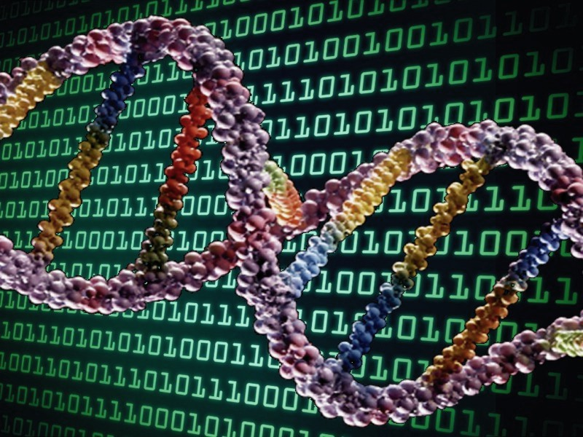
Synthetic Hybridization
We can construct Synthetic Vectors using Oligonucleotide synthesis, we no longer need to do anything but splice genes together and DNA fragments together. We can construct the genome directly from data, we no longer need to keep Genes in any form but computer information, which speeds up the process and customization ability of Vectors allowing Biotechnological and Nanotechnological direct construction of Organisms from data stored in electronic media from Electronic Machines like a 3-D DNA Printer.

Slide 3
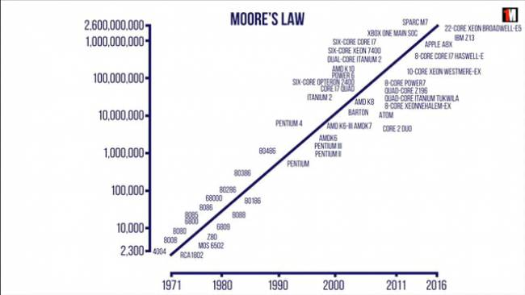
Moore’s Law of Biotechnology
Just as in computers we will see DNA synthesis Machines improving with exponential complexity with more and more column’s of DNA synthesis to the point that all of DNA Synthesis will be on Digital code into chemical code as fast as we need it within seconds as a DNA Printer.

Slide 4
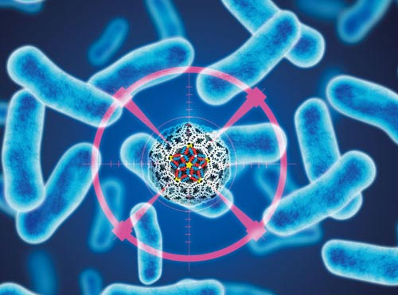
Construction of Gene Delivery Methods
As DNA synthesis increases in speed we will need to begin to find methods of increasing complexity to send DNA directly where we need it such as into a specific cell type, we should be able to choose the exact location that the Bio machinery begins and Ends its journey in the body for better control of our Viral Machines as if they were machines and not organic organisms always going to where needed.

Slide 5
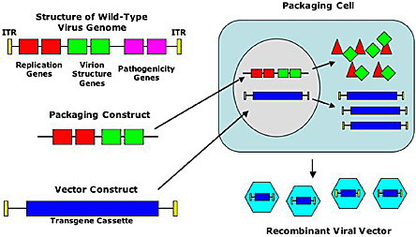
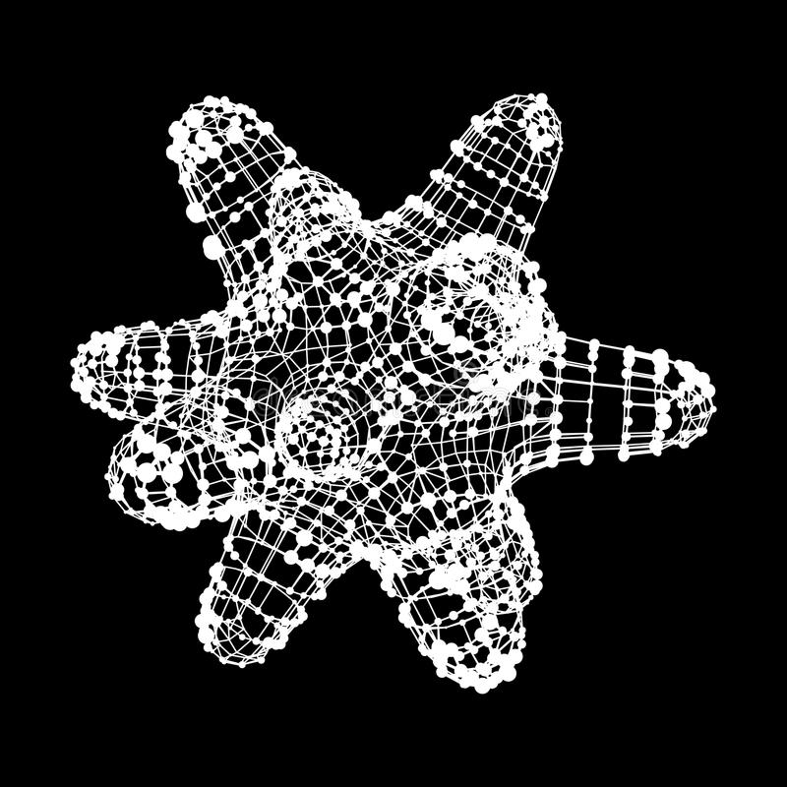
Multivalent Viral Vectors
Multivalent Viral Vectors that Target only select Cells Types, we can directly Manipulate the Vector’s Structure to target specific cells types selecting the Glycoproteins we want without unwanted genes using Synthetic DNA synthesis. We can select our vector to only transfect what we design it to.

Slide 6
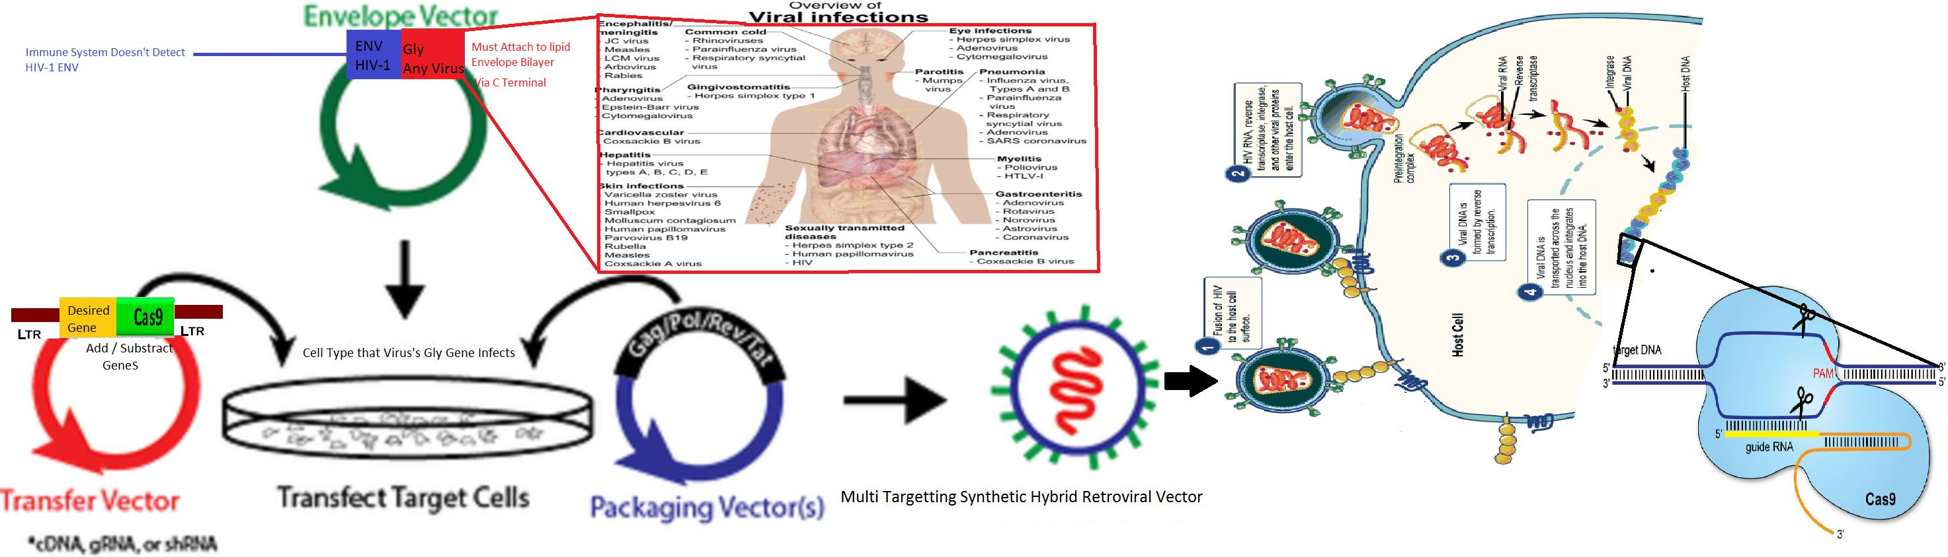
Cut and Paste Genes for easy access on Viral Machinery

Slide 7
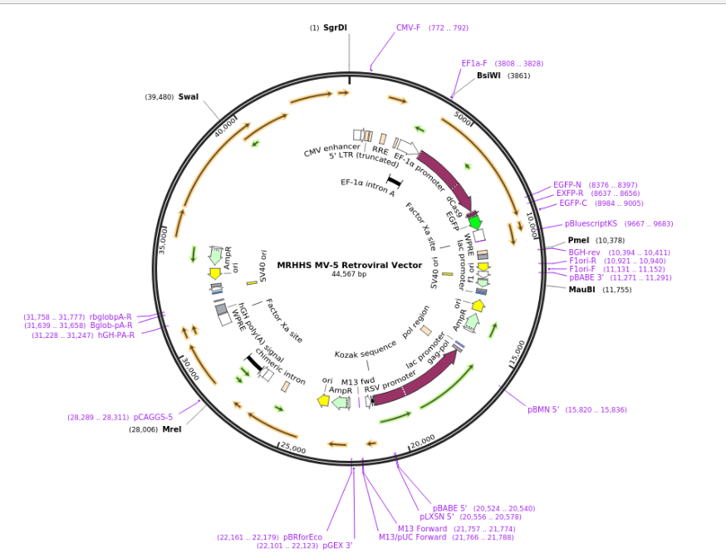
CRISPRs in Delivery Vectors for a “Subtract” and “Add” Command
Basically, the previous slide shown a fully functional Multivalent Bio machine to add to the evolution of the Vector to a better tool we can add CRISPRs and selective targeting proteins which allow the Vector to easily target cell types such as exclusively Skin cells and Heart Muscle cells or any variant we would like along with CRISPR allows us to erase data from the cell at any point while we add it using the Delivery Vector. In the figure this is a Multivalent Viral Vector MV-5 meaning has five host cell types it infects.

Slide 8
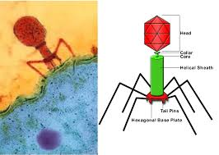
Multivalent Phages – Target Multiple Bacteria Types
We can also apply the evolutionary advantage for being a vector of Multivalence to Bacteriophages getting multiple types of Bacteriophage merging them and using them to kill antibiotic resistant bacteria types by constructing them custom for the Bacteria type making a Viral Soap being able to kill 99.99% of bacteria and not just a single type of bacteria or strain by manipulation and Hybridization of Vectors using Gene-tailoring in vectors.

Slide 9
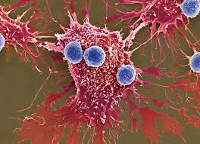
2030s The Nano-revolution
In the future, they say we will have nanotechnology and Nanorobotics, I say today we have Nanotechnology, Why wait….
We can deliver any gene into the cell and change the very structure of Virus to the point that they barely similar with their previous form. We can manipulate cell by cell the cell with our technology and edit their very makeup directly, Viral Nanorobotics is changing the very fabric of the medical field everyday with new cures, by the 2030s I believe instead we will have cured all disease using Viruses and Viral Vectors whether Genetic or Pathogenic that should be the new goal for 2030. Diseases such as cancer will have one last decade then be gone due to Nanotechnology.

