Slide 1



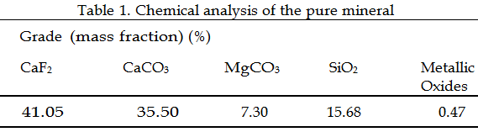
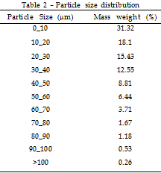
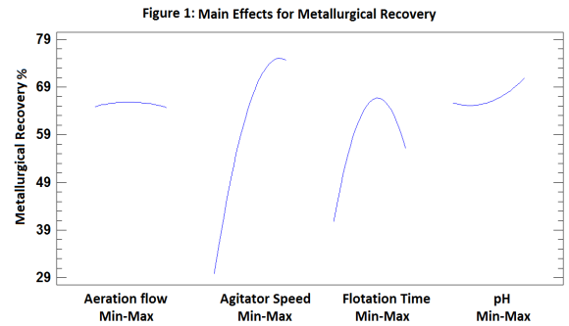

Influence of mechanical variables and pH on flotation of ultrafine fluorspar particles
J. R. Corpas-Martínez ^{a, b}, A. Pérez-Muñoz ª, R. Navarro-Domínguez ^{b}, C. Amor-Castillo ^{b}, M.A. Martín-Lara ª, M. Caleroª
ª Department of Chemical engineering, University of Granada, 18071 Granada, Spain
^{b} Minera de Órgiva S.L., Mina Carriles, Órgiva, 18400 Granada, Spain
Introduction
The formation of slime particles in the processes of crushing and grinding of minerals is a factor that limits froth flotation. Minera de Órgiva S.L. (Spain) produces slime sludge containing 41.05 CaF₂ from the benefice of a fluorite ore (table 1). The particle size distribution of the material is shown in table 2.
Tables
Results & Discussion
Figure 1 shows how each of the variables studied influenced metallurgical recovery under the tested range. As can be seen, the variable that most influenced the metallurgical recovery was the agitator speed, achieving the maximum fluorite recovery at the top level. Accordingly, as the objective is to carry out a roughing of the starting mineral, the flotation with the upper value of agitator speed must be carried out in order to leave the resulting sterile with the minimum fluorite content possible. Otherwise time of flotation reaches a maximum near the central point because an excess of time leads to a calcite flotation due to their similar surface properties with fluorite, and therefore similar interactions with oleic acid. On the other hand, aeration flow and pH do not show any significant effect on metallurgical recovery under the tested range.
Aim of this research
To make this byproduct markeable, this research studies the influence of physical variables and pH on fluorspar metallurgical recovery.
Materials & Methods
Four mechanical variables were studied: Aeration flow (from 0,3 to 0,8 m³/h), flotation time (from 1 to 7 minutes), agitator speed (from 800 to 1600 rpm) and pH (from 8 to 11). Results were adjusted to a polynomial mathematical model based in the relation between the variables and the metallurgical recovery.
Where X_{i} represents operational variables; Y_{i} output response (metallurgical recovery) and a_{i} are constants.
Graphs
Conclusion
The mathematical model fits the obtained data satisfactorily with a R² of 96%. The mathematical model optimization led to obtain a marketable product, in a single flotation stage, with 76% of fluorite. It can be made without sacrificing the recovery with a value of 70%.

