Slide 1
Numerical flow analysis on winglets in subsonic conditions
By
Surya.G
17n31d7606

Slide 2
Abstract
Aircraft winglet is a device placed at set of angle on the tail of aircraft wing. This device plays a very important role in improving aircraft performance. The economic raise of the aircraft flight make the aircraft designer and the airline management to find a new technology to reduce the cost. Winglet design will reduce the fuel consuming by reducing the aircraft drag and make the aircraft more stable during flight, also it will give the aircraft engine longer life by reducing the load on the engine thrust. The aim of this paper is to design and simulate a model of winglet for aircraft. Study about winglet contribution on aircraft performance in term of less fuel consumption and the stability of aircraft. Study how winglet can reduce aircraft induced drag. Analyses about winglet effect on reducing wingtip vortex. The model of winglet is designed using One of the Cad tool(Pro-E) analysis is by ANSYS.

Slide 3
Properties
Reduce wingtip vortices
Cut back on drag up to 20%*
Higher cruise speed
Increased fuel economy
Possibly double wings lift to drag ratio
Good when wing extension is not possible

Slide 4
Geometry Requirements
  Airfoil
  Chord distribution
  Height
  Twist
  Sweep

Slide 5
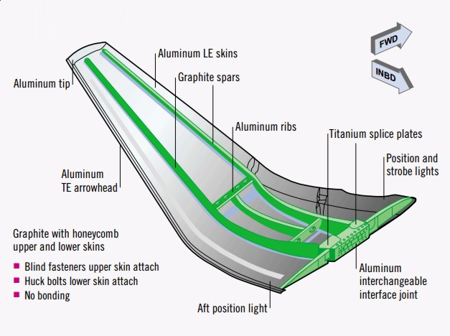
Winglet parts

Slide 6
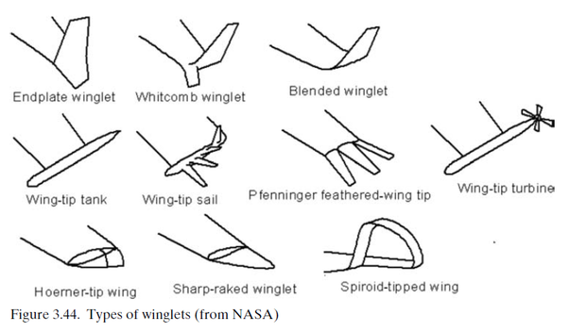
Few types of Winglets

Slide 7
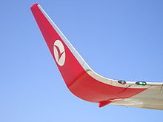
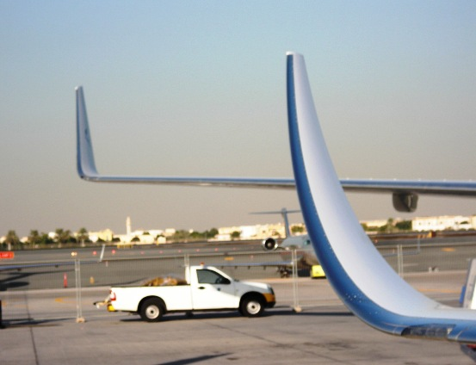
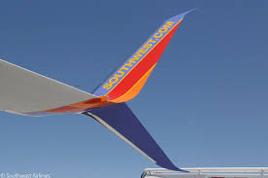
Winglets

