Slide 1

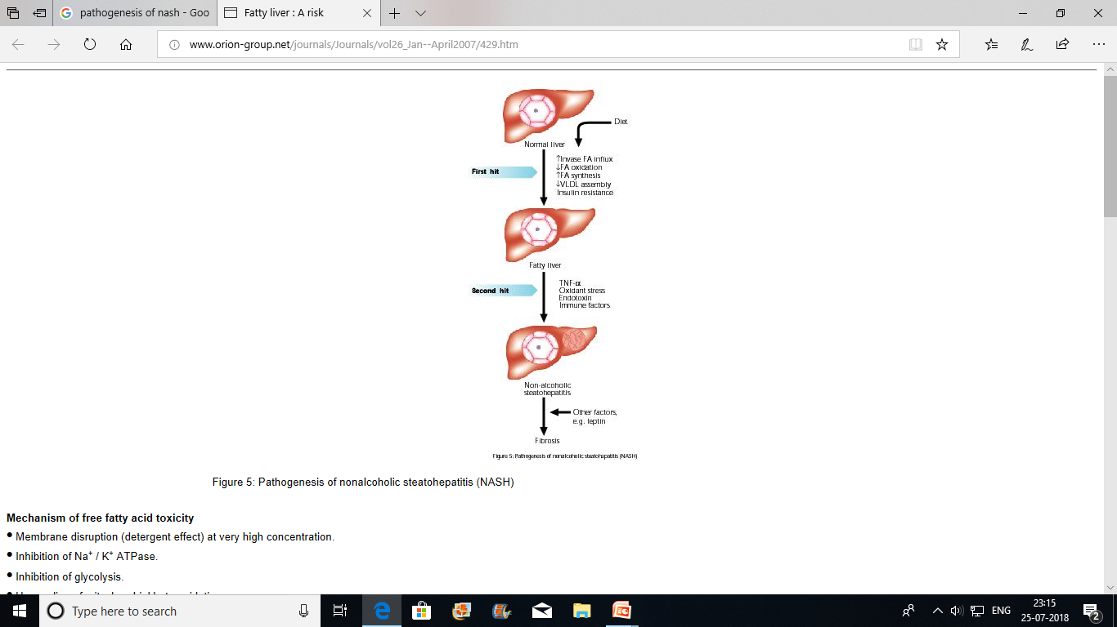
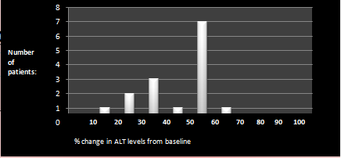
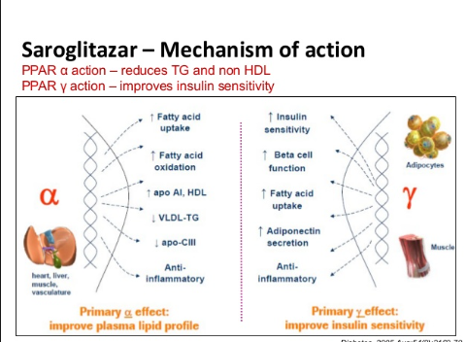
Efficacy of Saroglitazar in Non Alcoholic Steato-hepatitis – a preliminary study Preeti Dalal,Atul Sachdev ,Deepak Bansal ,Mandeep Singla,Poornima Aggarwal Department of General Medicine, GMCH Chandigarh
BACKGROUND: Non-alcoholic fatty liver disease (NAFLD) is a common condition that affect millions of patients worldwide. It progresses to non alcoholic steato-hepatitis (NASH) and liver cirrhosis. NASH is commonly associated with Increased liver related and all cause mortality. The pharmacological treatment of patients with NAFLD is still evolving. No single therapy for NAFLD has been clearly proven to be effective. In this study, the efficacy of saroglitazar, a dual PPARα/γ agonist, was assessed in the patients of NASH. AIMS AND OBJECTIVES: To study efficacy of saroglitazar in the patients of non alcoholic steatohepatitis. | METHODS : An interventional study conducted at the department of medicine at Government Medical College and Hospital Chandigarh. All patients to receive Saroglitazar for 6 months. Saroglitazar to be given as an add on therapy to the drugs that were previously being given for other medical conditions and patients were advised to continue all the previous medications alongwith Saroglitazar. Inclusion criteria: Males or females who are 18 to 75 years of age, who gave the consent and fulfilled the following criteria were enrolled : Had documented diagnosis of non alcoholic fatty liver disease established either by imaging (ultrasound, CT scan or MRI) or liver biopsy showing NASH or simple steatosis, ALT level of ≥ 1.5 × Upper limit of normal. No improvement in ALT levels after following dietary and weight loss recommendations for 3 months . Exclusion criteria: Consumption of > 3 units of alcohol per day if male and > 2 units of alcohol per day if female. Presence of alternative causes of fatty liver, including: History of other chronic liver disease (chronic HCV infection or active HBV infection, or autoimmune hepatitis, cholestatic and metabolic liver diseases) or hemochromatosis Patient has known cirrhosis. Score on Fibroscan more than 7kPa. 3. TPN, starvation or protein-calorie malnutrition within the 90 days preceding Visit 1. Use of drugs associated with NAFLD for more than 12 consecutive weeks in the 1 year before 1st visit.
OUTCOMES & RESULTS: The primary outcome of the main study was percentage change in baseline serum ALT levels after 1,3 and 6 months of receiving Saroglitazar 4 mg once daily after breakfast. The study is still going on and this is a preliminary data where we studied the outcomes at the end of 1 and 3 months. A total of 20 patients received the drug,5 out of them were diabetics. 10 patients have received the drug for 3 months and rest 10 patients for 1 month so far. It was seen that despite of non-significant weight reduction, the ALT levels reduced tremendously. 95%(19 out of 20) patients showed reduction in ALT levels at the end of 1 month. One patient was non compliant to the medication because of the cost of drug. The mean reduction was 41%. In 5 patients(25%) there was absolute reduction i.e normalisation of ALT levels at the end of 1 month. There was no reported incidence of any adverse effect. 10 patients who have received the drug for 3 months till now showed normalization of ALT levels along with either ultrasonographic regression (from grade 2 to 1)or complete resolution of their fattly liver findings. The lipid profile improved in 5 patients at the end of 3 months.(10 out of 20 had deranged lipid profile in the beginning.) There was not much change seen on fibroscan and in HbA1c levels(diabetics).
CONCLUSIONS: Based on the findings of the study it seems possible that Saroglitazar, a dual PPARα/γ agonist may improve serum ALT levels and can prevent adverse outcomes of other conditions associated with non alcoholic steato-hepatitis. References: Pai V, Paneerselvam A, Mukhopadhyay S, Bhansali A, Kamath D, Gambhire D et al. A multicenter, prospective, randomized, double-blind study to evaluate the safety and efﬁcacy of Saroglitazar 2 and 4 mg compared to Pioglitazone 45 mg in diabetic dyslipidemia. J Diabetes Sci Technol 2014;8:132–41. Jani RH, Pai V, Jha P, Jariwala G, Mukhopadhyay S, Bhansali A et al. A multicenter, prospective, randomized, double-blind study to evaluate the safety and efﬁcacy of Saroglitazar 2 and 4 mg compared with placebo in type 2 diabetes mellitus patients having hypertriglyceridemia not controlled with atorvastatin therapy (PRESS VI). Diabetes Technol Ther 2014;16:63–71

