Slide 1
LIVER CIRRHOSIS

Slide 2
DESCRIPTION
The LIVER is the largest glandular organ of the body.
It’s weight about 3lb(1.36kg).
It is reddish brown in colour and is divided into four lobes of unequal size and shape.
The LIVER lies on the right side of the abdominal cavity beneath the diaphragm.
Blood is carried to the LIVER via two large vessels called the HEPATIC ARTERY and the PORTAL VEIN.

Slide 3
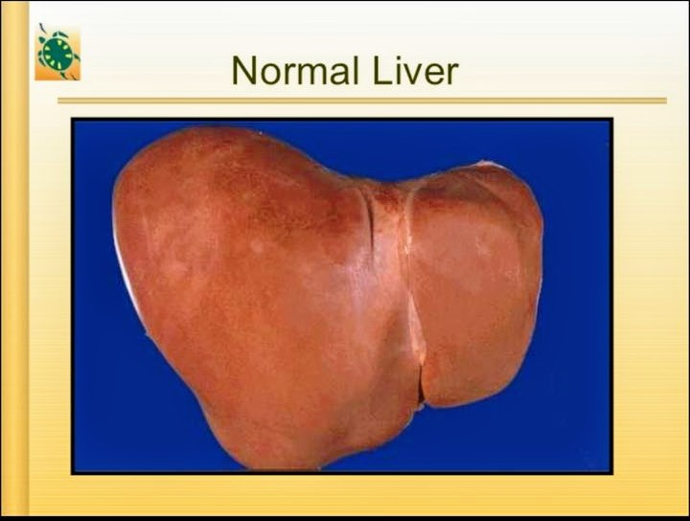

Slide 4
WHAT is CIRRHOSIS?
CIRRHOSIS is a condition in which the LIVER slowly deteriorates and malfunction due to CHRONIC INJURY.
SCAR TISSUE replaces HEALTHY LIVER TISSUE,partially blocking the flow of blood through the LIVER.
SCARRING also impairs the LIVER‘s ability to:-
Control infections
Removes bacteria and toxins from the blood.
Process nutrients,hormone, and drugs
Make proteins that regulate blood clotting
Produce bile to help absorb fats-including cholesterol and fat-soluble vitamins

Slide 5
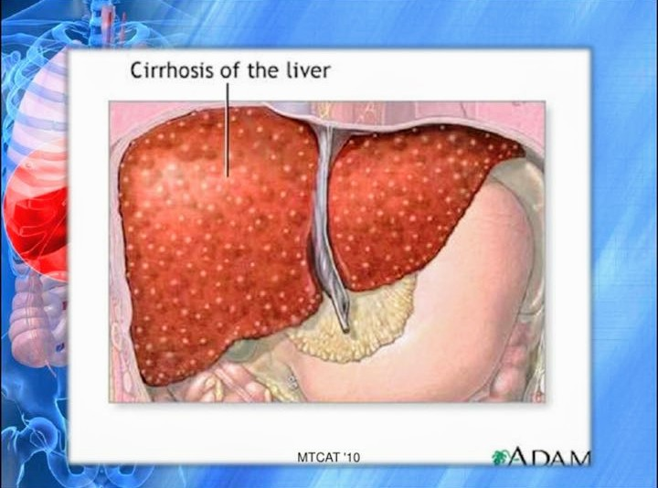

Slide 6
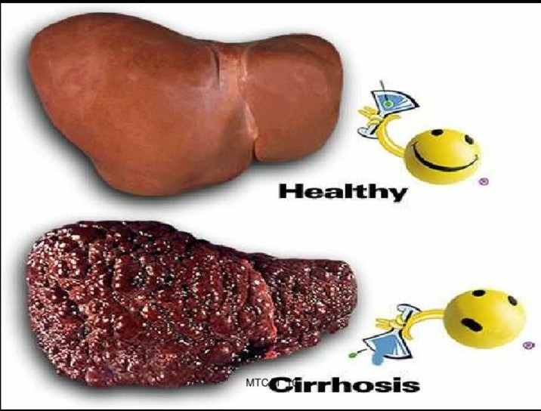

Slide 7
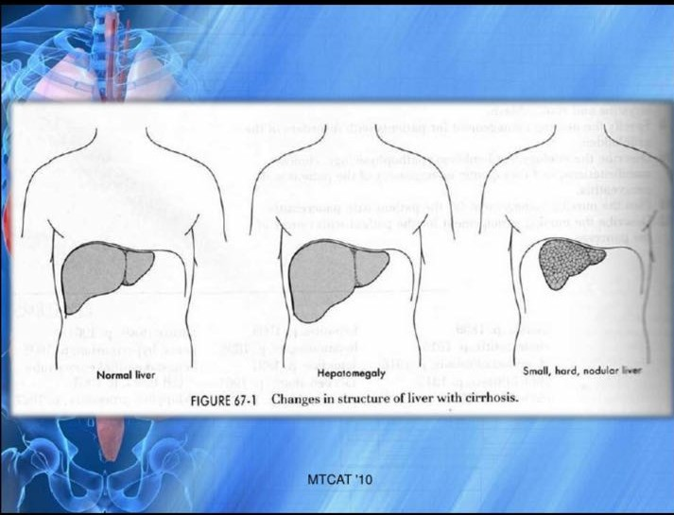

Slide 8
What cause CIRRHOSIS?
CIRRHOSIS has various causes:-
Heavy alcohol consumption
Chronic hepatitis C
Obesity
CIRRHOSIS is not caused by trauma to the LIVER or other acute , or short term, cause of damage.
Usually years of chronic injury are required to cause CIRRHOSIS

Slide 9
Types:
ALCOHOLIC CIRRHOSIS (LAENNEC’S CIRRHOSIS)
Most common types of liver cirrhosis
Caused by chronic alcoholism
B. POSTNECROTIC CIRRHOSIS
Late result of a previous bout of acute viral hepatitis

Slide 10
C. BILIARY CIRRHOSIS
Resulted from chronic BILIARY obstruction and infection
Least common type

Slide 11
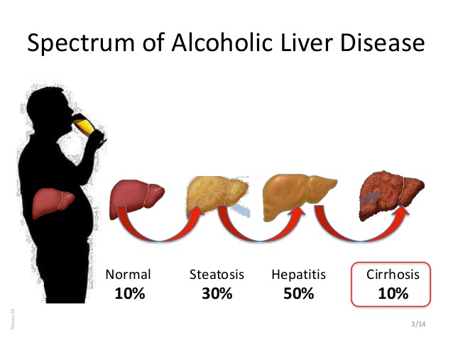

Slide 12
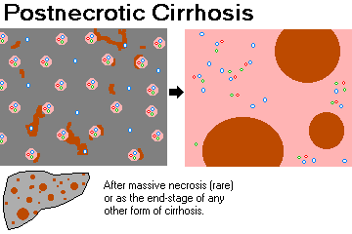

Slide 13
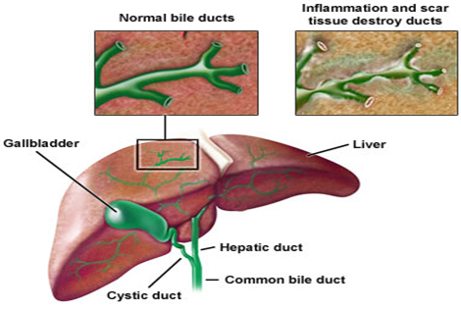

Slide 14
Pathophysiology:
Liver cell damage result in inflammation and hepatomegaly
Attempts at regeneration eventually result to fibrosis and a small nodular liver
Hepatic function is slowly impaired
Obstruction of venous channels block flow and cause portal hypertension

Slide 15
Pathogenesis:
Hepatocytes injury leading to necrosis.
Alcohol, virus, drugs, toxins, genetic etc..
Chronic inflammation-(hepatitis).
Bridging fibrosis
Regeneration of remaining hepatocytes proliferates as round nodules.
Loss of vascular arrangement results in regeneration hepatocytes ineffective.

Slide 16
What are the symptoms?
Many people with CIRRHOSIS have no symptoms in the early stages of the disease. Howe,as the disease progresses ,a Pearson may experience the following symptoms:-
Weaknesses.
Fatigue
Loss of appetite
Nausea
Vomiting

Slide 17
Abdominal pain
Itching
Spider like blood vessels on the skin

Slide 18
WHAT are the risks and complication?
As liver functions deteriorates,on or more complications may develop.In some people,complications may be the first signs of the disease.
EDEMA and ASCITES.
When liver damage progresses to advanced stage,fluid collects in the legs,called EDEMA and in the abdomen,called ASCITES.
ASCITES can lead to bacterial peritonitis,a serious infection.

Slide 19
Diagnosis
BLOOD TEST :-Can measure LIVER function and the amount of liver damage
A Blood test may be used to measure the levels of the LIVER enzymes- alanine transaminase (ALT) and aspartate transferase (AST)
SCANS
Ultrasound scan, computerized topography scan or a magnetic resonance imaging (MRI)

Slide 20
LIVER BIOPSY:
A liver biopsy is where a fine needle is inserted into the body,usually between ribs,to remove a small sample of liver cells.
The sample is sent to a laboratory so it can be examined under a microscope
ENDOSCOPY
An endoscopy is where a thin ,long , flexible tube with a light and video camera at the end called an endoscopy is passed down throat and into the stomach.
Images of oesophagus,the tube from throat to stomach and stomach transmitted to an external screen,where any swollen vessels,which are a sign of CIRRHOSIS,can be seen.

