Slide 1
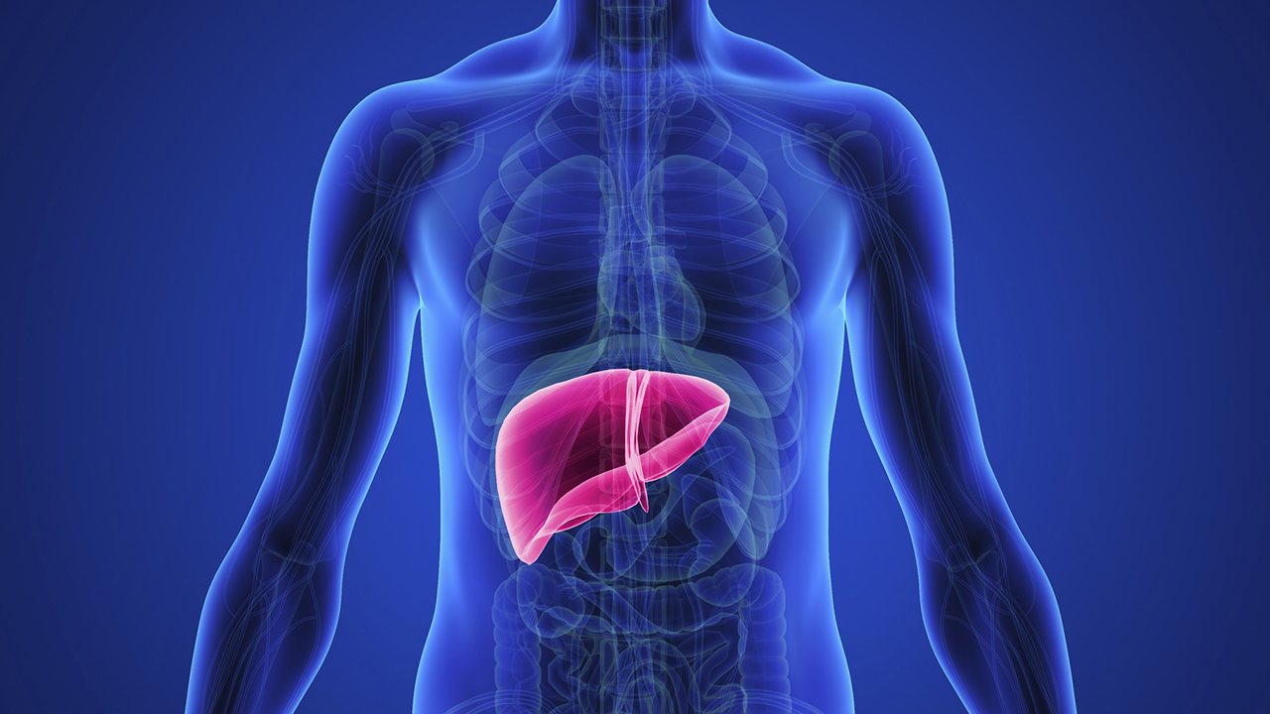
Pharmacotherapeutics -III
Presentation
On
Liver disorder
PRESENTED BY :-
PARGAT MANGAT

Slide 2
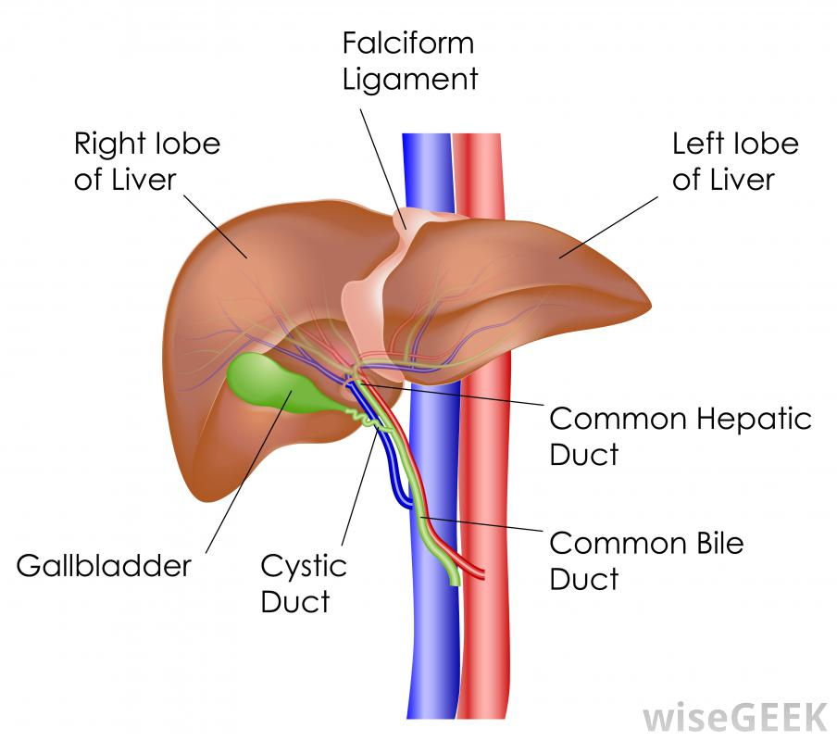
LIVER
The largest solid organ in the body, situated in the upper part of the abdomen on the right side.
A human liver normally weighs approximately 1.5 kg (3.3 lb), and has a width of about 15 cm (6 in).
It is both the heaviest internal organ and the largest gland in the human body.
Liver is divided into two lobes : left lobe and right lobe.
Right lobe is largest lobe and left lobe is smallest lobe.

Slide 3
F U N C T I O N S O F L I V E R : -
Storage-
1.1 Glucose.
1.2 Vitamins like B12, D and K.
1.3 Copper.
1.4 Iron.
Degradation-
2.1 Insulin.
2.2 Bilirubin.
2.3 Ammonia.
2.4 Drugs.
Metabolism-
3.1 Carbohydrates: Glucogenesis, Gluconeogenesis, Glycogenolysis.
3.2 Lipid: Cholesterol synthesis, Lipogenesis.
Synthesis-
4.1 Serum albumin.
4.2 Coagulation factors.
4.3 C-reactive proteins.
4.4 Carrier proteins (ceruloplasmin, albumin, haptoglobin).
4.5 Hormones (thrombopoietin, IGF-1).
4.6 Pro-hormones (angiotensin). 4.7 Apolipoproteins.
4.8 Complement proteins. 4.9 Non-essential amino acids.

Slide 4
DISEASES OF LIVER
(Discussed here)
J A U N D I C E
H E P A T I T I S
A L C O H O L I C L I V E R D I S E A S E

Slide 5
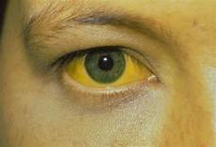
J A U N D I C E
It is the yellowish discoloration of the tissue due to deposition of bilirubin, which occurs in presence of hyperbilirubinemia.
Normal bilirubin level – 0.3 to 1.0 mg/dl.
Sites to examine jaundice are - base of tongue , palm and soles , general skin surface, mucous membrane of palate (specially soft palate) , upper bulbar conjuctiva.
Types of jaundice -
1. Prehepatic /hemolytic jaundice.
2. Hepatic jaundice.
3. Post hepatic / obstructive / surgical jaundice.

Slide 6
1. P R E – H E P A T I C J A U N D I C E :
Excess bilirubin production due excess breakdown of heamoglobulin and indirect bilirubin.
2. H E P A T I C J A U N D I C E :
Liver ability to conjugate or excrete bilirubin is affected and increase in the levels of conjugated and unconjugated bilirubin.
3. P O S T J A U N D I C E :
Bilirubin forms at normal rate and conjugation is normal i.e., equal to direct bilirubin. Any intrahepatic or extrahepatic condition leads to the obstruction in bile flow.

Slide 7
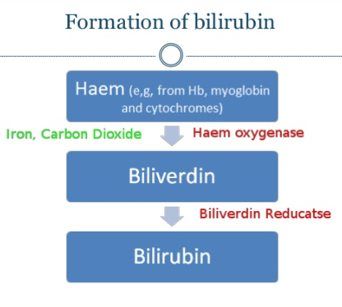

Slide 8
SIGN AND SYMPTOMS :-
Early features-
Yellowish discolouration of skin, sclera, etc.
Pale/clay coloured stool.
Dark urine.
Pruritis.
Late features-
Xanthelasma (yellowish plaque) and Xanthomas.
Malabsorption:- weight loss, steatorrhoea (oily stool), increased bleeding tendency.
Fever, Rigor, Pain.

Slide 9
D I A G N O S I S : -
Liver function tests.
Bilirubin levels.
Detoxification function test:
Urine : bilirubin and urobilinogen
Stool.
Enzymatic test:
ALP , ASP , AST , prothrombin time and alpha glutamyl transpeptidase.
Radiography investigation :
CT – scan , MRI , Biopsy and ultrasound.

Slide 10
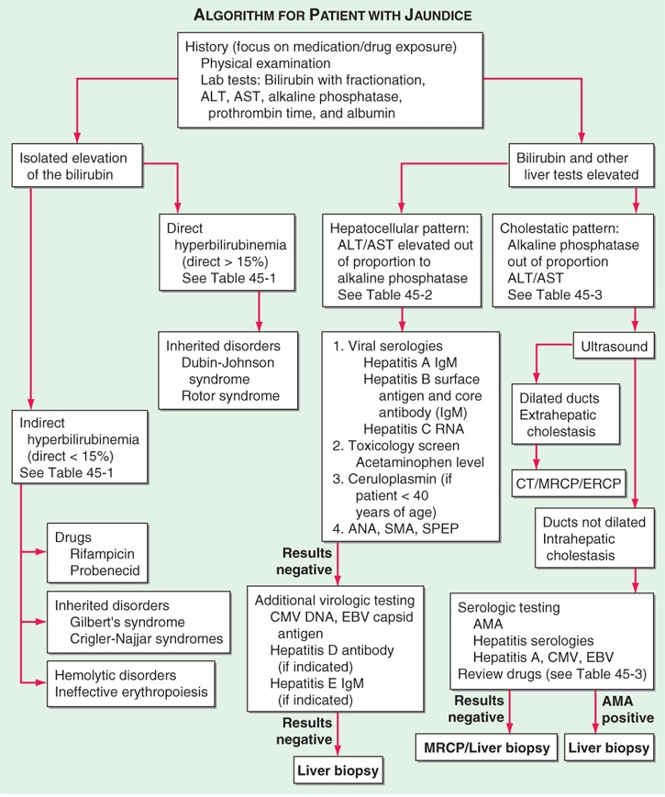

Slide 11
H E P A T I T I S
( Inflammation of the LIVER )
The term viral hepatitis is used to describe the infection of liver caused by hepatotropic viruses such as hepatitis A , B , C , D and E.
Hepatitis A virus.
Hepatitis B virus.
Hepatitis C virus.
Hepatitis delta virus.
Hepatitis E virus.
Hepatitis G virus.
All these human hepatitis viruses are RNA viruses except HBV which is DNA virus.
The development of jaundice is characteristic feature of liver disease.
A correct diagnosis can only be made by patient’s sera for the presence of specific anti - viral antibodies.

Slide 12
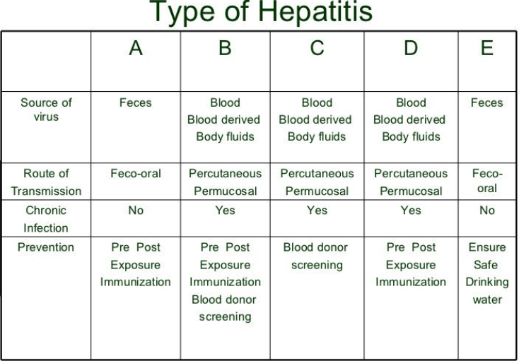

Slide 13
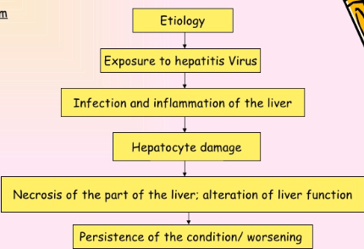
P A T H O P H Y S I O L O G Y

Slide 14
H E P A T I T I S A V I R U S
Causative organism : Hepatitis A an enveloped positive stranded RNA virus .
Transmission :
Via faecal oral route and acquired by ingestion of faeces contaminated water.
High concentration of virus are sheded off during 3-10 days prior to onset of illness, 1-2 weeks after the onset of jaundice.
Pathogenesis :
Incubation or perclinical period: it is ranging is 10- 15 days during which the patient remains asymptomatic despite replication of the virus.
Prodromal or preicteric phase: it last for several days to weeks. During this phase symptoms like: nausea, vomiting , loss of appetite , dark urine may appear.
Icteric phase : total bilirubin level exceeds 20-40mg/dl and jaundice develop in patient. This phase begins within 10 days of initial symptoms.
Convalescent period: In this phase resolution of disease is slow but patient`s recovery is uneventful and complete.

Slide 15
D i a g n o s i s :
Serologic tests , ELISA , RIA.
P R E V E N T I O N :-
Recommendations for Hepatitis A Vaccination :
All childrens at the age of 1 year.
Person travelling to or working in countries that have high or intermediate endemicity of infection.
Man who had sex with men.
Illegal-drug users.
Persons who have occupational risks of infection.
Persons having clotting-factor disorders.
Persons having Chronic Liver Disease.

Slide 16
H E P A T I T I S B V I R U S
Caustive organism : Hepatitis B virus is 42 nm an enveloped virus containing a partially double stranded circular DNA genome and classified within the family of hepadnavirus.
Pathogenesis :
During the incubation period of the disease ( 6- 24 weeks) patient feel unwell with possible nausea , vomiting, anorexia and headache. Patient may become jaundiced, although a low grade fever and loss of appetite may improve.
Sign and symptoms :
Vomiting and seizures.
Hepatic encephalopathy.
Asterixis (flapping hand tremor).
Diagnosis :
Presence of hepatitis B surface antigen for at least 6 months.
Liver biopsies.
Hepatitis B virus DNA greater than 105 copies/mol.

Slide 17
PREVENTION :-
Recommendations for Hepatitis B Virus Vaccination :
Infants.
Adolescents.
All unvaccinated adults.
Men and women with history of other STD and person with history of multiple sex partners.
Man who had sex with men.
Injection-drug users.
Sex partner having HBV.
International travellers.
Recipients of clotting-factor concentrates.
STD clinic patients.
HIV patient/HIV testing patient.
Drug abuse treatment.
Chronic dialysis/ESRD patients.

Slide 18
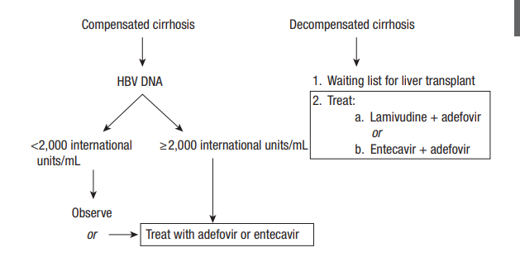
A L O G R I T H M O F H B V :

Slide 19
H E P A T I T I S C V I R U S
Causative organism : Hepatitis C Virus.
Transmission : It spreads by having sex within an infected person.
Two types :
Acute hepatitis :
it last for 6 months and patient is asymptomatic .incubation period is 50 days.
Chronic hepatitis: it takes 10-14 years to evidence chronic hepatitis.
Symptoms :
Fatigue , malaise , diarrheal and joint pain. • No HCV vaccine is currently available.
Prevention :
No HCV vaccine is currently available.

Slide 20
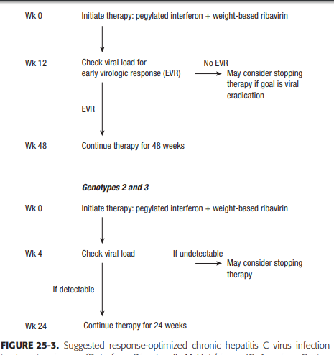

Slide 21
H E P A T I T I S D V I R U S :
It is defective single stranded RNA virus.
Transmission :
Blood borne disease and vertical transmission ( mother to infant ) is rare.
Pathogenesis:
HDV can either infect the person simultaneously with HBV ( co –infection ) or super infect a person already infected with HBV (superinfection).
H E P A T I T I S E and G V I R U S :
Hepatitis E:
It is single stranded positive sense RNA genome.
Hepatitis G:
Single stranded RNA virus.it is identified with PCR amplification technique.

Slide 22
A L C O H O L I C L I V E R DISEASE
Alcoholic liver disease is a term that encompasses the liver manifestations of alcohol overconsumption including : fatty liver, alcoholic hepatitis, and chronic hepatitis with liver fibrosis or cirrhosis.
Sign and symptoms :
The most common sign of alcoholic hepatitis is yellowing of the skin and whites of the eyes (jaundice).
Loss of appetite , Nausea and vomiting ,Abdominal tenderness, Fever, often low grade , Fatigue and weakness , Malnutrition is common in people with alcoholic hepatitis.
Additional signs and symptoms that occur with severe alcoholic
hepatitis include: Fluid accumulation in abdomen (ascites).
Confusion and behavior changes due to a buildup of toxins normally broken down and eliminated by the liver Kidney and liver failure.

Slide 23
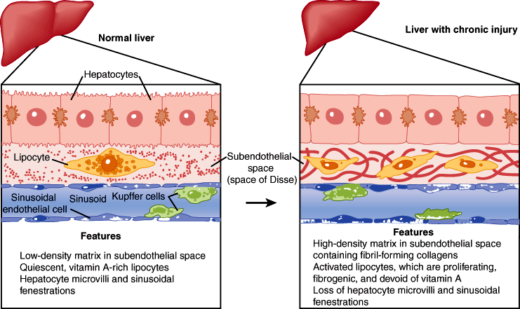

Slide 24
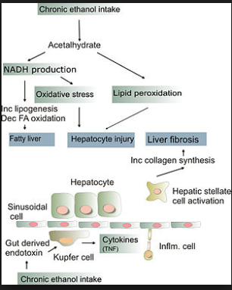
P A T H O G E N E S I S

Slide 25
D I A G N O S I S :
Imaging studies : used to assess hepatic parenchymal changes.
CT – scan , MRI and ultrasound.
Hepatic phosphorus 31 magnetic resonance spectroscopy :
it is used to calculated hepatic energy metabolism and phospholipid membrane metabolism.
Liver Biopsy.
Screening for Alcohol abuse:
AUDIT ( alcohol use disorder identification test).
MAST ( Michigan alcoholism screening test).

Slide 26
T R E A T M E N T :
1. Abstinence (alcohol prevention).
2. Nutrition .
3. Medication therapy:
Corticosteroids - Prednisolone, given at dose of 40mg daily for 4 weeks followed by rapid 4 weeks taper.
Pentoxifylline : TNF synthesis inhibitor. ( 400mg thrice a day).
Propylthiouracil : used to reverse hypermetabolism response.
Colchicine : inhibition of collagen production.
Silmyrin : used to enhance liver regeneration and protect hepatocytes from toxicity.
4. Liver transplantation.

Slide 27
THANK YOU

