Slide 1

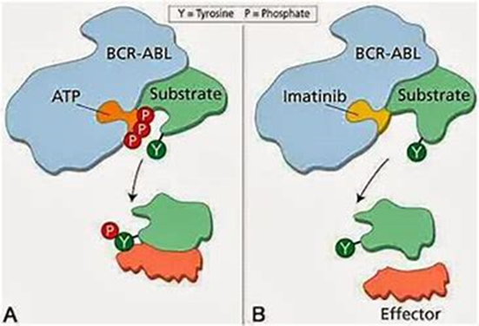
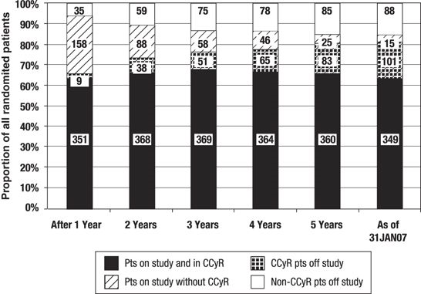
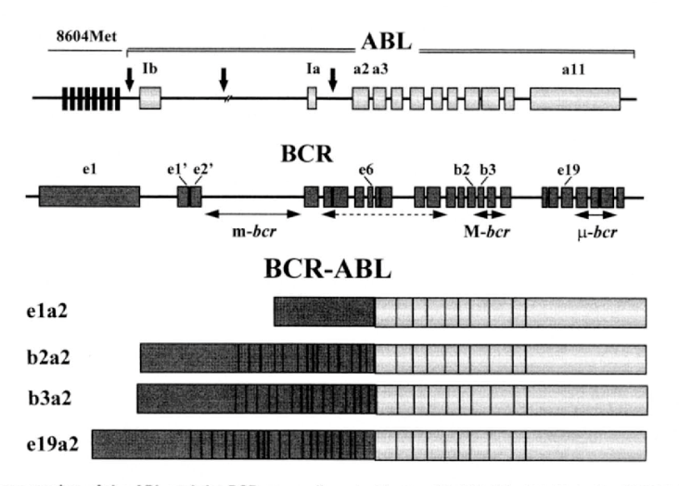
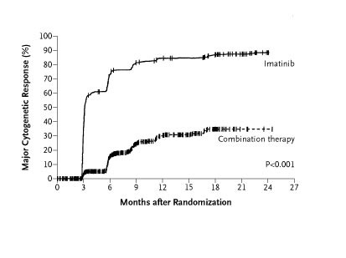
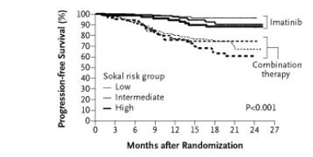
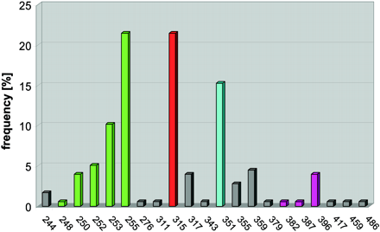
Imatinib the First targeted treatment and its Role in Chronic Myeloid Leukaemia (CML). Dominic Worku CT1 DOCTOR,, THE ROYAL MARSDEN, CHELSEA, LONDON. dominicworku@Hotmail.co.uk
INTRODUCTION
Chronic Myeloid Leukaemia (CML) is a haematopoietic stem cell disorder characterised in >90% of cases by the presence of a reciprocal translocation between chromosomes 9 and 22 affecting the bcr and abl genes. This is termed the Philadelphia chromosome. This disorder represents 15% of adult leukaemia's. ⁽¹⁾This was the first condition which showed proof that cancer is as the result of DNA changes and confirmed Boveris hypothesis that cancer originates from chromosomal changes ⁽²⁾ . The two genes involved in this translocation have physiological roles (Figure 2). The ABL gene product is a nonreceptor tyrosine kinase which is thought to be involved in the cell cycle and cell signalling. BCR protein encodes a serine threonine kinase at its N-terminus with GTPase activity at the C-terminus.
The nature of the fusion protein produced by this translocation is dependent on the location of there respective breaks and can lead to different clinical phenotypes. The breakpoints within the ABL gene can occur over a large area. While BCR occurs in 3 main areas termed the major, minor and molecular break cluster regions. The p210 molecular weight BCR-ABL fusion protein is associated with CML although fusion proteins ranging from p210-250 have been described. ⁽³⁾ (Figure 1)
Figure 4: 6 year follow up of Imatinib arm of IRIS trial. This demonstrated 66% patient still on study treatment and of these 63% still had a complete cytogenetic response (CCyR) with 88% overall survival. ⁽⁹⁾
Figure 2: Mechanism of Action of Imatinib
EVIDENCE FOR IMTAINIB
Phase 1 Trial (1998)
Chronic Phase patients (n=54) response seen at ≥140mg/day. Complete haematological response (CHR) seen at 300mg with 13% achieving Complete Cytogenetic Response (CCyR)n Blast crisis patients less likely to respond and show durable responses
Phase 2 Trial (1999)
3 main patient groups (1) IFNa Resistant CP (2) Accelerated Phase (3) Blast Crisis For patients who received imatinib in the chronic phase 41% CCyR and 60% Major Cytogenetic Response (MCR) versus 7% and 16% respectively in blast crisis. Progression Free Survival 89.2% at 18 months ⁽⁶⁾⁽⁷⁾
Phase 3: IRIS STUDY (INTENRTIONAL RANDOMIZED STUDY OF INTERFERON AND STI571) (2003)
Prospective, multicentre, open label RCT involving 16 countries and 177 hospitals.
utilised 1106 patients with CP CML diagnosed 6 months previously split between imatinib (400mg) and interferon and cytarbine.
End points included both progression and rates of haematological and molecular response as well safety and tolerability. Intention to treat analysis was performed.⁽⁸⁾
RESISTANCE AND SUBOPTIMAL RESPONSE
While imatinib has been shown to produce significant haematological and cytogenetic responses, primary drug resistance has been observed with up to ~25% of patients not achieving a CCyR with a much smaller number unable to achieve CHR while on therapy. Indeed within these patients it is mutations in the ABL kinase domain that provides the greatest risk of this by not allowing BCR-ABL to adopt an inactive conformation which is necessary for imatinib binding. Indeed the frequency of mutations appears to correlate with the phase of the disease. ⁽¹⁰⁻¹¹⁾
Secondary resistance however implies loss of response in those who previously showed and occurs within 25% of patients.⁽¹²⁾ Mechanisms underpinning this include amplification of BCR-ABL transcripts , overexpression of drug efflux mechanisms such as P-glycoprotein and BCR-ABL independent methods of haemopoietic stem cell transformation. ⁽¹³⁾ In those who relapse a particular point mutation T315I which affects imatinib binding has been most commonly found. T315I makes up part of the P-loop which lies between the two catalytic domains (N-lobe and C-lobe) and adjacent to the A-loop of the C-lobe involved in activation of the ABL kinase. The P-loop is important for phosphate binding and internalisation of imatinib. Mutations in this area lead to decreased sensitivity to imatinib of between 70-100 times (Figure 5) ^{(12,13)}
Figure 1 : The various morphologies of the BCR-ABL fusion protein. Underlying this is the changes in breakpoints at different points within the ABL and BCR protein ⁽³⁾
EVOLUTION OF TREATMENTS
1800’s-Arsenicals
1960s- Busulfan, Hydroxyurea
1980s- Interferon alpha
2001-Imatinib
1990s-Radiotherapy
1980s Allogenic Stem Cell Transplantation
Figure 5 : Mutation frequency within the kinase domain of BCR-ABL by amino acid location in in vitro kinase assays in CML patients. ⁽¹¹⁾
It was because of the identification of the Philadelphia chromosome that Imatinib was created through rational drug design. Imatinib works by binding to the inactive conformation of the BCR-ABL protein close to the ATP binding site thereby inactivating downstream signalling pathways which include the RAS-MAPK, PI3K kinase, and mTOR pathways. (Figure 2) it however also has a roles in inhibiting several other proteins and does so in a highly selective manner and thus stops the leukaemia progression while leading to translocation of BCR-ABL from the cytoplasm into the nucleus thereby affecting its ability to participate in signalling pathways.⁽⁴⁾
Figure 3: Results of IRIS Study demonstrated that rate of major cytogenetic response at 18 months 87.1% v 34.7% in the combination group (p<0.001) which mirrored progression free survival at 12 months (96.6% v 79.9%). Importantly when this was analysed according to SOKAL group (a pre-treatment prognostic tool factoring age, platelet count, % myeloblasts and spleen size) imatinib was better than combination treatment
CONCLUSION
Imatinib was the first targeted treatment for a cancer and paved the way for future drug development. It can lead to high rates of CHR and transition to CCyR depending on the phase of the disease it is started and lead to durable responses with discontinuation a possibility. However imatinib resistance remains a real issue for cml patients.
Notes:
References
1. Tidu C. Chronic Myeloid Leukaemia.Patient Uk.2016:https://patient.info/doctor/chronic-myeloid-leukaemia-pro
2. Nowell PC. Discovery of the Philadelphia chromosome: a personal perspective. J Clin Invest2007;117(8):2033-2035.
3. Melo JV. The Diversity of BCR-ABL fusion proteins and their relationship to leukaemia phenotype. The Journal of the American Society of Haematology.1996;8(7):2375-2384
4. . Iqbal N, Iqbal N. Imatinib: A breakthrough of targeted therapy in cancer. Chemotherapy Research and Practice.2014:http://dx.org/10.1155/2014/357027.
5. Mughal TI, Schreiber A. Principal long-term adverse effects of imatinib in patients with chronic myeloid leukaemia in chronic phase.Bilogics:Target&Therapy.2010;4:315-323.
6. Sacha T. Imaitnib in Chronic Myeloid Leukaemia: an overview. Mediterranean Journal of Haematology and Infectious Diseases.2014;6(1).
7. Deininger M, Buchdunger E, Druker BJ. The development of imatinib as a therapeutic agent for chronic myeloid leukaemia. Blood.2005;105(7):2640-2653.
8. O’Brien SG et al. Imatinib compared with interferon and low dose cytarbine for newly diagnosed chronic-phase chronic myeloid leukaemia. The New England Journal of Medicine.2003;348:994-1004.
9. Hochhaus A et al. Six-year follow-up of patients receiving imatinib for the first line treatment of chronic myeloid leukaemia. Leukaemia.2009;23:1054-1061.
10.Comert M, Baran Y, Saydam G. Changes in molecular biology of chronic myeloid leukaemia in tyrosine kinase inhibitor era. Am J Blood Res.2013;393):191-200.
11. Druker BJ. Translation of the philadelphia chromsome into therapy for CML. Blood.2008;112:4808-4817.
12. Milojkovic D, Apperley J. Mechanisms of resistance to imatinib and second-generation tyrosine kinase inhibitors in chronic myeloid leukaemia. American Association for Cancer Research.2009;15(24):7519-7527.
13. Reddy EP, Aggarwal AK. The Ins and Outs of BCR-ABL inhibition. Genes Cancer.2012;3(5):447-454.

