Slide 1
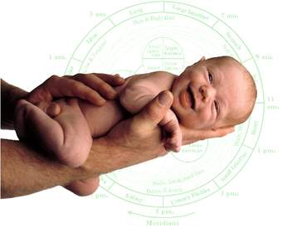
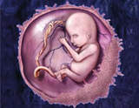

بسم الله الرحمن الرحيم

Slide 2
Ethical issue
A problem or situation that requires a person or organization to
choose between alternatives that must be evaluated as right (ethical)
or wrong (unethical).
The importance of ethics in the practice of medicine was manifested at least
2,500 years ago in the Hippocratic tradition, which emphasized the virtues
that were expected to characterize and guide the behavior of physicians.

Slide 3

Bioethics" has been used in the last twenty years to describe the investigation and a study of ways in which decisions in medicine and science touch upon our health and lives and upon our society and environment.
Bioethics is concerned with questions about basic human values such as the rights to life and health, and the rightness or wrongness of certain developments in healthcare institutions, life technology, medicine, the health professions and about society's responsibility for the life and health of its members.

Slide 4
Bioethics involves issues relating to the beginning and end of human life, all the way from issues relating to in-vitro fertilisation and abortion to euthanasia and palliative care.
Bioethics has an impact on every level of human community from the local nursing home to the huge international conferences on issues like the Human Genome.
Bioethics is a branch of "applied ethics" and requires the expertise of people working in a wide range disciplines including: law, philosophy, theology, medicine, the life sciences, nursing and social science.

Slide 5
Bioethics is full of difficult ethical questions for everybody: families, hospitals, governments and civilisation.
Fundamental values are at stake: human life, the dignity of the frail and elderly, just healthcare, bodily integrity and the ability to make reasonable decisions.
Developments in reproductive biology have enabled infertility treatment by means of assisted reproductive techniques (ART) and/or introduction of up-to-date methods for reproductive function restoration.

Slide 6
The term “assisted reproduction" is associated with certain treatments which give hope to many — patients, clinical personnel, researchers — but which also open numerous ethical, legal, religious and social questions .
Reproductive ethics is concerned with the ethics surrounding human reproduction and beginning-of-life issues such as contraception, assisted reproductive technologies (e.g., in vitro fertilization, zygote intrafallopian transfer (ZIFT), intracytoplasmic sperm injection (ISCI), etc.), surrogacy, and preimplantation genetic diagnosis.

Slide 7

Ethical issues specific to this field include among other concerns the introduction of technology into the reproductive process, distinctions between reproduction and procreation,
the potential for abortifacient effects through the use of certain contraceptives, embryo & oocyte cryopreservation, embryo adoption & donation, uterus transplants,
mitochondrial replacement/donation interventions; synthetic gametes, the exploitation and commodification of women for reproductive services (i.e., egg donation and surrogacy), and sex selection of embryos or fetuses.

Slide 8
Reproductive medicine is a new important field in all the countries.
The possibilities are tremendous, therefore we have to decide if limits are necessary or should we consider that everything that have been initiated (as clone, gene transfer….) can be apply in humans.
That will be the challenge of a global ethical approach in each country with their culture, morality, guidelines or laws.
Our modern society is changing quickly, so we, physicians, religious, and politics have to adjust our care for our patients. All this knowledge has to be controlled by the moral, the ethics and the laws to avoid any drift.

Slide 9
The medical progress in the field of reproduction has only been possible because of parallel scientific discoveries.
Development in genetics, medical imagery, hormonology, and animal reproduction applied to reproductive medicine allowed this progress.
In addition, this is a new trend in our modern society which encourages infertile couples to obtain children.
Ineluctable is no more. Everything should be possible or almost. The wish to have children is now realizable for couple who were until now with no hope.
Better understanding of ovulation, spermatogenesis, news drugs contribute to ameliorate ovulation induction, and so IVF procedures.

Slide 10
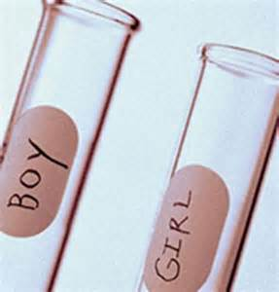
The first researches about animal reproduction started almost one century. But, we had to wait until the biologist Robert Edwards, after thirteen years of persistence and intractability, to obtain the birth of Louise Brown ( first human to have been born after conception by in vitro fertilisation, or IVF) ,
This event introduced in the all world news therapeutic possibilities in infertility treatment.

Slide 11
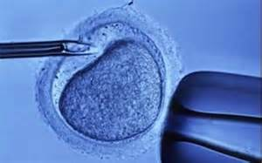
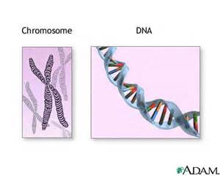
In 1990, for the first time a spermatozoa has been deposed under the zona pellucida, followed later by the first intracytoplamsic sperm injection opened the treatment to the male infertility.
Next step was preimplantation genetic diagnosis (PGD), allowing to select an embryo without any genetic disease.
Last progress has been in vitro maturation (IVM) consisting to collect oocytes without ovarian hyperstimulation, and to make them finish their maturation.

Slide 12
We are only at the beginning of new discoveries about human embryo development and its anomaly.
Over the past 50 years, medical technology expanded exponentially, so that obstetrician–gynecologists have had to face complex ethical questions regarding assisted reproductive technologies, prenatal diagnosis and selective abortion, medical care at the beginning and end of life, the use of genetic information, and the like.
Medical knowledge alone is not sufficient to solve these problems. Instead, responsible decisions in these areas depend on a thoughtful consideration of the values, interests, goals, rights, and obligations of those involved.
All of these are the concern of medical ethics. The formal discipline of biomedical ethics and structured ethical analysis can help physicians resolve ethical dilemmas.

Slide 13
Very few medical specialities have such a large a wealth and interferences between its medical practice and ethical or philosophical questions. These questions had to be posed because of the evolution of our modern society.
There are many ethical concerns surrounding the subject of reproductive research and infertility treatment (Multiple Gestation ,
Financial Aspect for IVF Treatment , Preimplantation Genetic Testing , fertility preservation, gamete donation , Embryo donation , surrogacy and gestational carriers etc).
Some of these issues are described below:

Slide 14
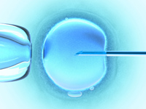
Reproductive Technology
Assisted reproductive technology (ART) is a medical intervention developed to improve an ‘infertile’ couple’s chance of pregnancy
The means of ART involves separating procreation from sexual intercourse - the importance of this association is addressed in bioethics.
Issues addressed in bioethics are the appropriate use of these technologies and the techniques employed to carry out procedures for quality and ethical reviews.
Assisted reproductive technology and its use directly impact the foundational unit of society – the family.
ART enables children to be conceived who have no genetic or social relationship to one or both of their parents.

Slide 15
One important bioethical issues include the appropriate use of pre-implantation genetic diagnostic screening, use, storage and destruction of excess IVF embryos, and research involving embryos. ART research requires human participants, donors and donated embryos, oocytes and sperm.
Ethical issues that arise in ART research surround the creation and destruction of embryos. One approach in bioethics involves preserving justice, beneficence, non-maleficence and the autonomous interests of all involved.
Bioethicists contribute to ethical guidelines and moral evaluations of new technologies and techniques in ART as well as to public discourse that leads to development of national regulations and restrictions of unacceptable practices.

Slide 16

Human Embryos and Gametes
Human gametes have a unique status compared to other human body cells. This is because it is only the gametes that have the reproductive capacity to form a new human life, and in doing so carry an individual’s heritage to the next generation.
Gametes therefore need to be treated in accord with this status and so there are particular ethical considerations that pertain to their use in reproductive technology programmes as well as in research applications.

Slide 17
Once conception and early embryonic development became possible outside of the human body, embryos could be screened for genetic conditions, discarded, frozen and stored, used for training purposes, or research with or without their destruction.
The moral status of human embryos is the central question in determining what should or should not be done to them, and it is a question that has been considered by philosophers for millennia.

Slide 18

contraceptives
the deliberate interference with the natural process of fertility in order to prevent conception is widespread across the global community.
However, the effects of widespread contraceptive usage are perhaps not as clear as they first seem. Hormonal contraceptives come with their own health risks – some of which will remain unknown.

Slide 19
They also raise a host questions whether or not contraceptives have an abortifacient effect (a drug which allows conception to occur yet renders the woman’s womb hostile to implantation – effectively, working as an early abortion).
This is particularly problematic for Judeo-Christian or Islamic tradition where life begins at conception. Yet, the ethical questions arising from contraception are by no means confined to questions of health.
The increased usage of contraception has contributed to a new understanding of the role of sexual intercourse, the family and the notion of responsible parenthood – all of which bear intimately on the functioning of society as a whole.

Slide 20
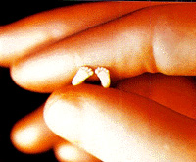
ABORTION
The matter of abortion, the essential bioethics topic, raises intensely personal issues for many people. It is a polarising and divisive issue that raises discussions about morals, science, medicine, sexuality, autonomy, religion, and politics.
What is the moral status of the unborn children – how much do they matter, and what are our obligations towards them?
The matter of 'personhood' arises, as a philosophical and legal discussion about what rights to grant them.

Slide 21
The ethical aspect of abortion is related but distinct from the legal.
Whether or not it is moral, should abortion be legal? Generally prohibited but with some exceptions? Should it be regulated? Publicly funded?
Should doctors and nurses be able to object according to their conscience?

Slide 22


Surrogacy
It is often a devastating and life changing experience for a woman to discover that for one reason or another she cannot become pregnant and have children of her own.
In some women, with repeated unsuccessful attempts of (ART) or having a non-functional uterus, the remaining option (besides that of adoption) is surrogacy.
However, a major concern with surrogacy is the potential harm that may be inflicted upon the surrogate mother and the child.
There are numbers of ethical issues relevant to this topic. The ideals and values we hold concerning liberty and autonomy, have to be weighed against other values such as informed consent, welfare and exploitation.

Slide 23
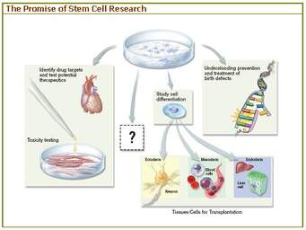
Stem Cells
The promise of new therapeutic avenues for the treatment of a range of conditions has led researchers to consider the use of stem cells. It has even been suggested that one day stem cells may be able to form whole organs and hence contribute to organ transplantation therapies.
Embryonic stem cells are located in the human embryo at the blastocyst stage (5 to 6 days of age). Embryos at this age are often unwanted in reproductive technology treatment, and some parents have donated them for research.

Slide 24
Cord blood stem cells are derived from the umbilical cord which is often still routinely discarded at birth.
The key ethical issues concern the destruction of human embryos for stem cell derivation. On the grounds that the human embryo is a human life with moral value justifying its protection, the extraction of embryonic stem cells is unethical.
One limitation to the possible use of embryonic stem cells in therapy is that they will likely be rejected by the recipient. In an attempt to overcome this, researchers are attempting to produce cloned human embryos to derive genetically near-identical stem cells for possible treatment.

Slide 25
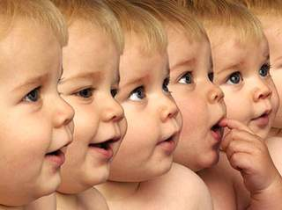

Cloning
Any discussion about cloning needs to begin with careful definitions. Cloning can occur at the level of DNA, at the level of the single cell, or at the level of the whole organism. Typically, ethical attention is focused upon cloning in the context of the genetic copying of a whole organism.
Cloned human embryos have been produced, but there are no reliable reports that any have been implanted in a woman’s uterus, let alone developed to birth.
Cloning to birth has come to be called ‘reproductive cloning’, whereas cloning embryos so that their stem cells may be extracted for possible research or therapeutic use has come to be called ‘therapeutic cloning’. .

Slide 26
The key ethical issue with therapeutic cloning is the moral status of the cloned embryo, which is created solely for destruction.
The ethical issues with reproductive cloning include genetic damage to the clone, health risks to the mother, very low success rate meaning loss of large numbers of embryos and fetuses, psychological harm to the clone, complex altered familial relationships, and commodification of human life.

Slide 27
CONCLUSION

Slide 28

Physicians vary widely in their familiarity with ethical theories and methods and their sensitivity toward ethical issues.
It is important for physicians to improve their skills in addressing ethical questions through formal undergraduate and graduate medical education, organized continuing education, or personal experience and reading as well as discussion with others.
In addition to their ethical responsibilities in direct patient care, obstetrician–gynecologists have ethical responsibilities related to their involvement in the organization, administration, and evaluation of health care.

Slide 29
Obstetricians and gynecologists should offer their support for institutions, policies, and practices that ensure quality of and more equitable access to health care, particularly, but not exclusively, for women and children.
Obstetrician–gynecologists who are familiar with the concepts of medical ethics will be better able to approach complex ethical situations in a clear and structured way.
By considering the ethical frameworks involving principles, virtues, care and feminist perspectives, concern for community, and case precedents, they can enhance their ability to make ethically justifiable clinical decisions.
They also need to attend to the kinds of ethical issues and problems that arise particularly or with special features in obstetrics and gynecology.

Slide 30

Finally, obstetricians and gynecologists can enhance their decision-making process by considering when it would be useful to seek a formal or informal ethics consult as well as which guidelines would be most helpful to them as they move from case to case and decision to decision.
Guidelines, consisting of several logical steps, are offered to aid the practitioners in analyzing and resolving ethical problems.
The virtues of truthfulness, fidelity, trustworthiness, and integrity must guide physicians in their roles as expert witnesses, as consultants to public officials, as educators of the lay public, and as health advocates.

Slide 31


Slide 32


Slide 33
THANK YOU

