Slide 1
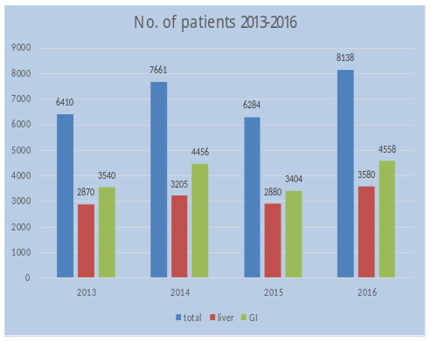
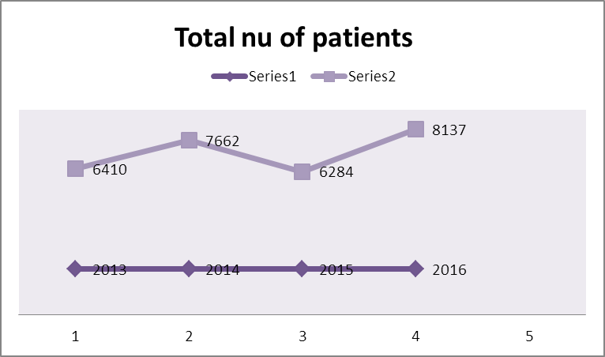
SPECTRUM OF GASTEROENTEROLOGY AND LIVER DISEASE AT THE AGA KHAN UNIVERSITY HOSPITAL; RESULTS FROM THE GODD REGISTRY
Farheen Lubna, Shahab Abid, Saeed Hamid, Wasim Jaffri, Faisal Wasim, Amna Subhan, Om Parkash, Rustam Khan, Faraz Siddiqui
Section of Gastroenterology , Department of Medicine, Aga Khan University, Karachi
Background:
The prevalence of GI and liver disease in the Pakistani population has increased remarkably over the recent years, reflecting an elevated burden on healthcare systems. Optimized health management and effective resource utilization in Health care facilities is based on timely documentation and reporting of disease patterns.
Aims :
To present data from the GODD (gastroenterology outpatient discharge diagnosis) registry, comparing annual trends of GI & liver disease incidence among patients presenting to the Aga Khan University Hospital.
Methods:
A review of electronic records was performed for all patients presenting to the Gastroenterology clinic, AKUH between 2013 and 2016. Collected information included patient characteristics and outpatient discharge diagnosis (primary and associated), based on a list of 72 approved diagnosis categories related to gastrointestinal and Liver diseases. Annual variation in this data is presented in this paper. A single visit is counted for specific year for each patient.
Total Number of Patients (Liver Disease)
Result:
A total of 28,493 new patients were seen in gastroenterology clinic (table 1). The mean age of the patients was 44.6+15.8 years with an overall higher representation of males (58%). The number of patients was seen to gradually increase during study period from 6410 in 2013 to 8138 in 2016. Overall, 15,956 (56%) patients presented with GI disease which comprised APD(78.4%), FGID (14.98%) and others(6.62%), while patients with liver diseases were 12,535 (44%) and included HCV(50.3%), HBV(20.3%),HDV(7%),Hepatitis A(0.79%), Hepatitis E(0.59), NBNC(4.22%), NASH(5%), Hepatoma (1.80%), Others(10%).
Conclusion:
This report highlights annual trends in outpatient data from a major tertiary care center in Karachi, Pakistan. The analysis suggests a higher frequency of GI disorders, majority of which are comprise of APD, GERD, gastritis. Among liver disorder, HCV, HBV were highest in our setting. Further efforts should focus on prioritization and effective management of these most commonly observed ailments.

