Slide 1


Corneal Alternations Induced by Topical Application of
Benzalkonium Chloride in Rabbit
Wensheng Chen MD.PhD
Zhiyuan Li MD.PhD
the Eye Institute of Xiamen University.China
The Affliated Hospital of Southern Medical University at Chenzhou.China

Slide 2
Statements
We have no financial interests with any corporations.

Slide 3
Background
Benzalkonium chloride (BAC) is the most common preservative in ophthalmic preparations;
in vivo toxic effect of BAC on the barrier function of corneal endothelium remains unclear;
the long-time using of eye drop with BAC do harmful to the ocular surface but there is less evidence about the short-time exposure.
Notes:
zonula occludens (ZO)-1;The corneal endothelium, similar to
the epithelium, exhibits a thick band of actin cytoskeleton at the
apical junctional complex (AJC), which has been referred to as the
peri-junctional actomyosin ring (PAMR).

Slide 4
Method
twice daily for four days to rabbits eye
PBS
0.01%BAC
0.05%BAC
0.10%BAC
SLIT LAMP
Sherimer’s
IVCM
Fluorescent penetration experiment
whole mount
slice
IF:ZO-1,PARM
HE
IF:MUC5AC

Slide 5
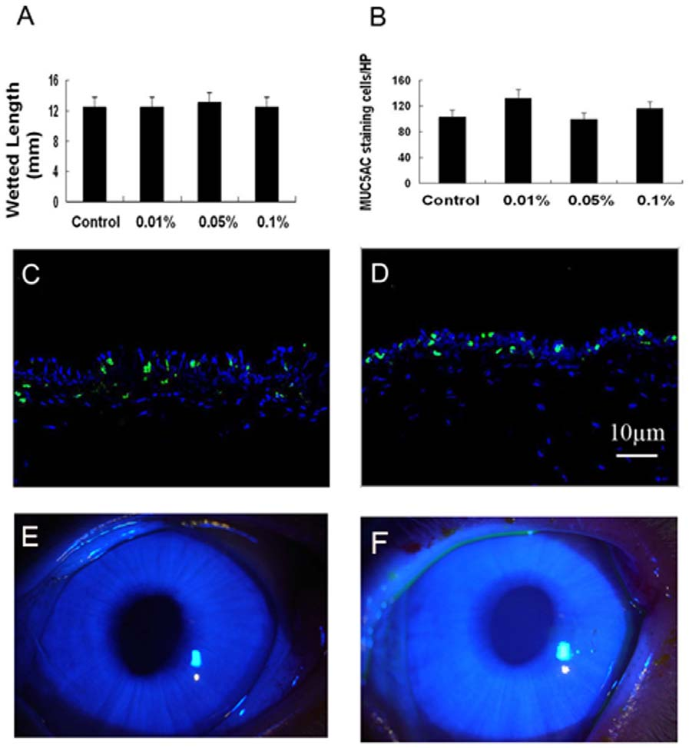
the Ocular Surface remains “healthy”

Slide 6
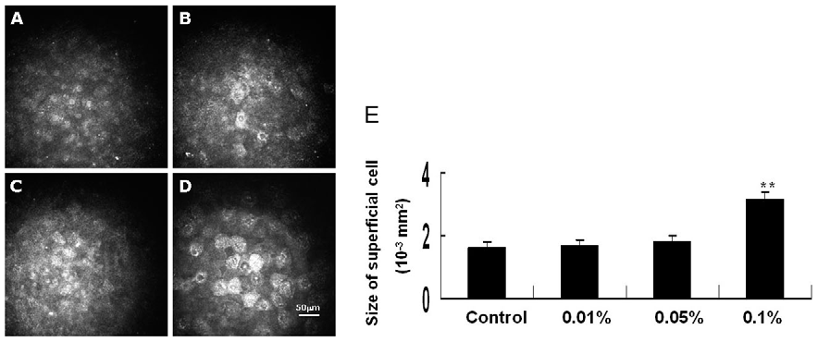
the Superfical cells Morphology

Slide 7
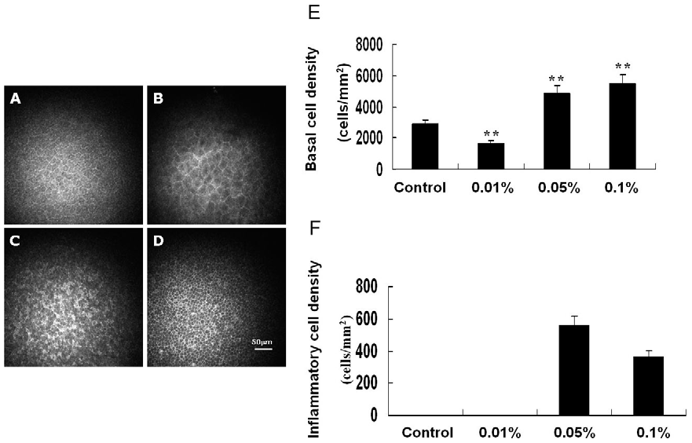
the Basal Layer of Epithelial

Slide 8
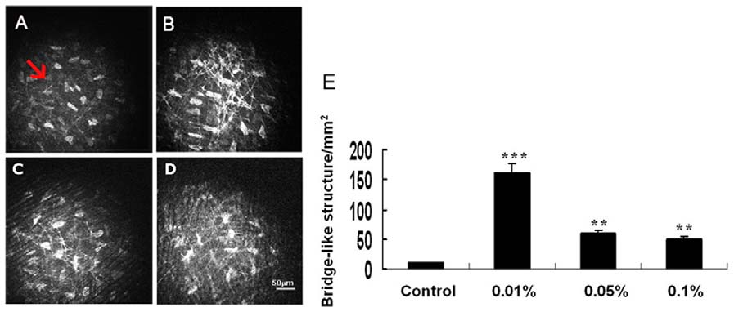
the Inner Community

Slide 9
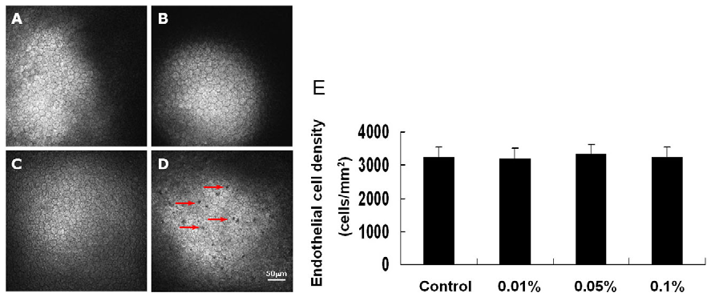
the Endothelial Surface Accumulation

Slide 10
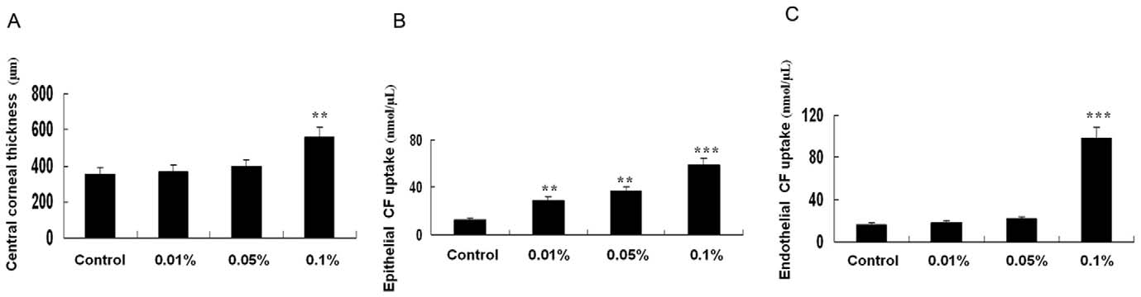
Corneal Fluorescence Absorption & Function

Slide 11
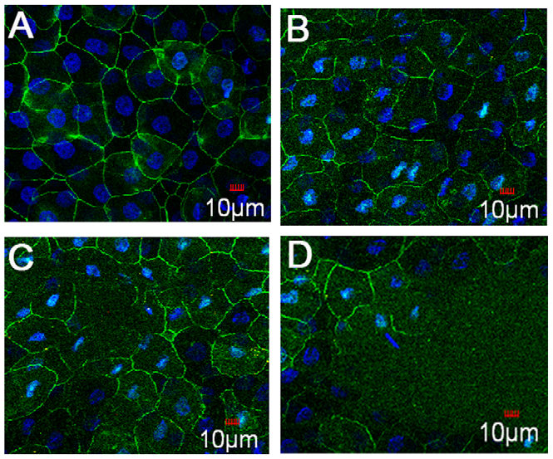
Cell-cell Tight Connect--Zone Occlusion-1

Slide 12
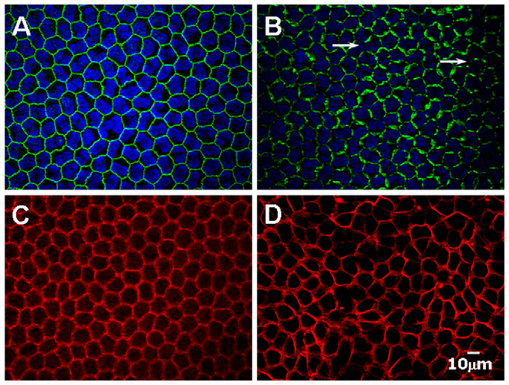
PAMR and ZO-1 in the Corneal Endothelium.

Slide 13
Conclusion
Our study demonstrated that topical application of BAC can quickly impair the whole cornea without occurrence of dry eye.
BAC at high concentration induces disruption of the barrier integrity at the corneal endothelium.

Slide 14

Thanks for attending!!!

