Slide 1

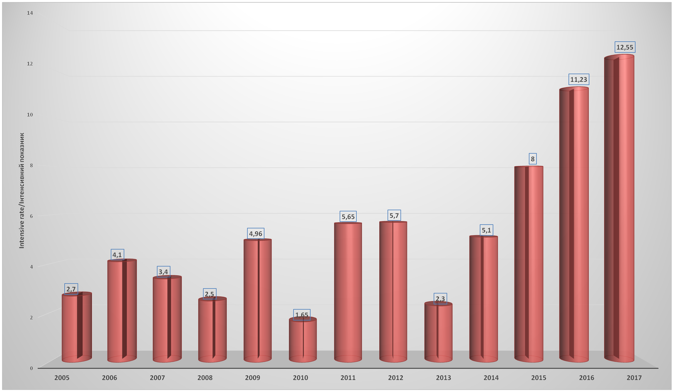
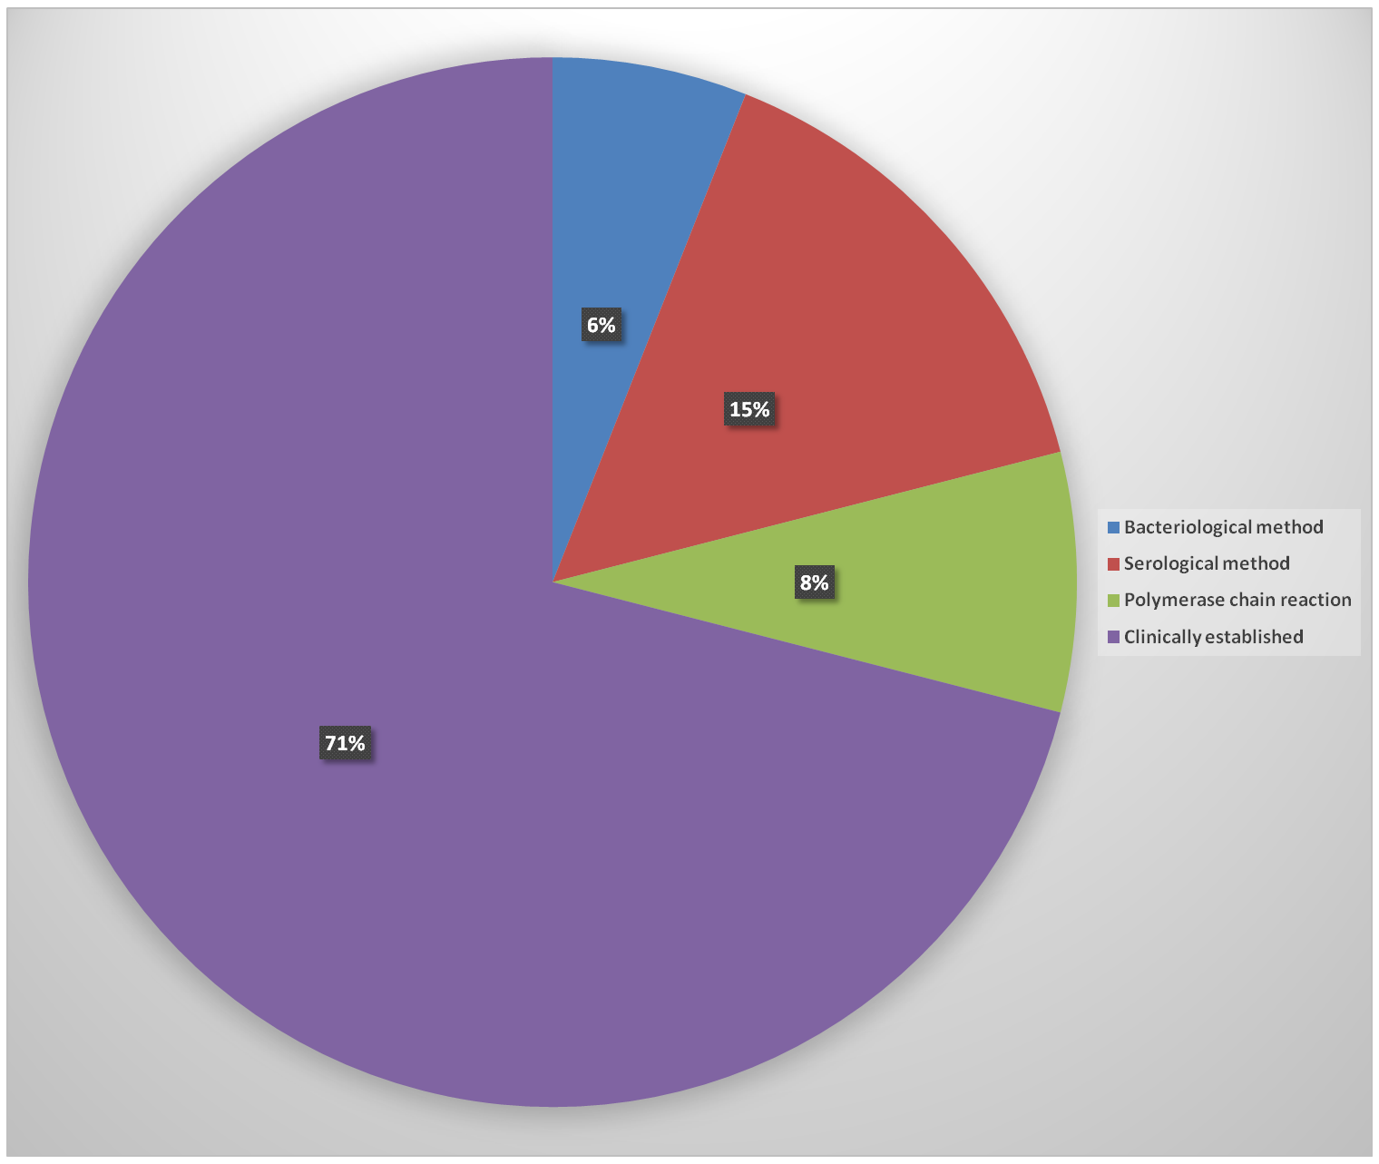
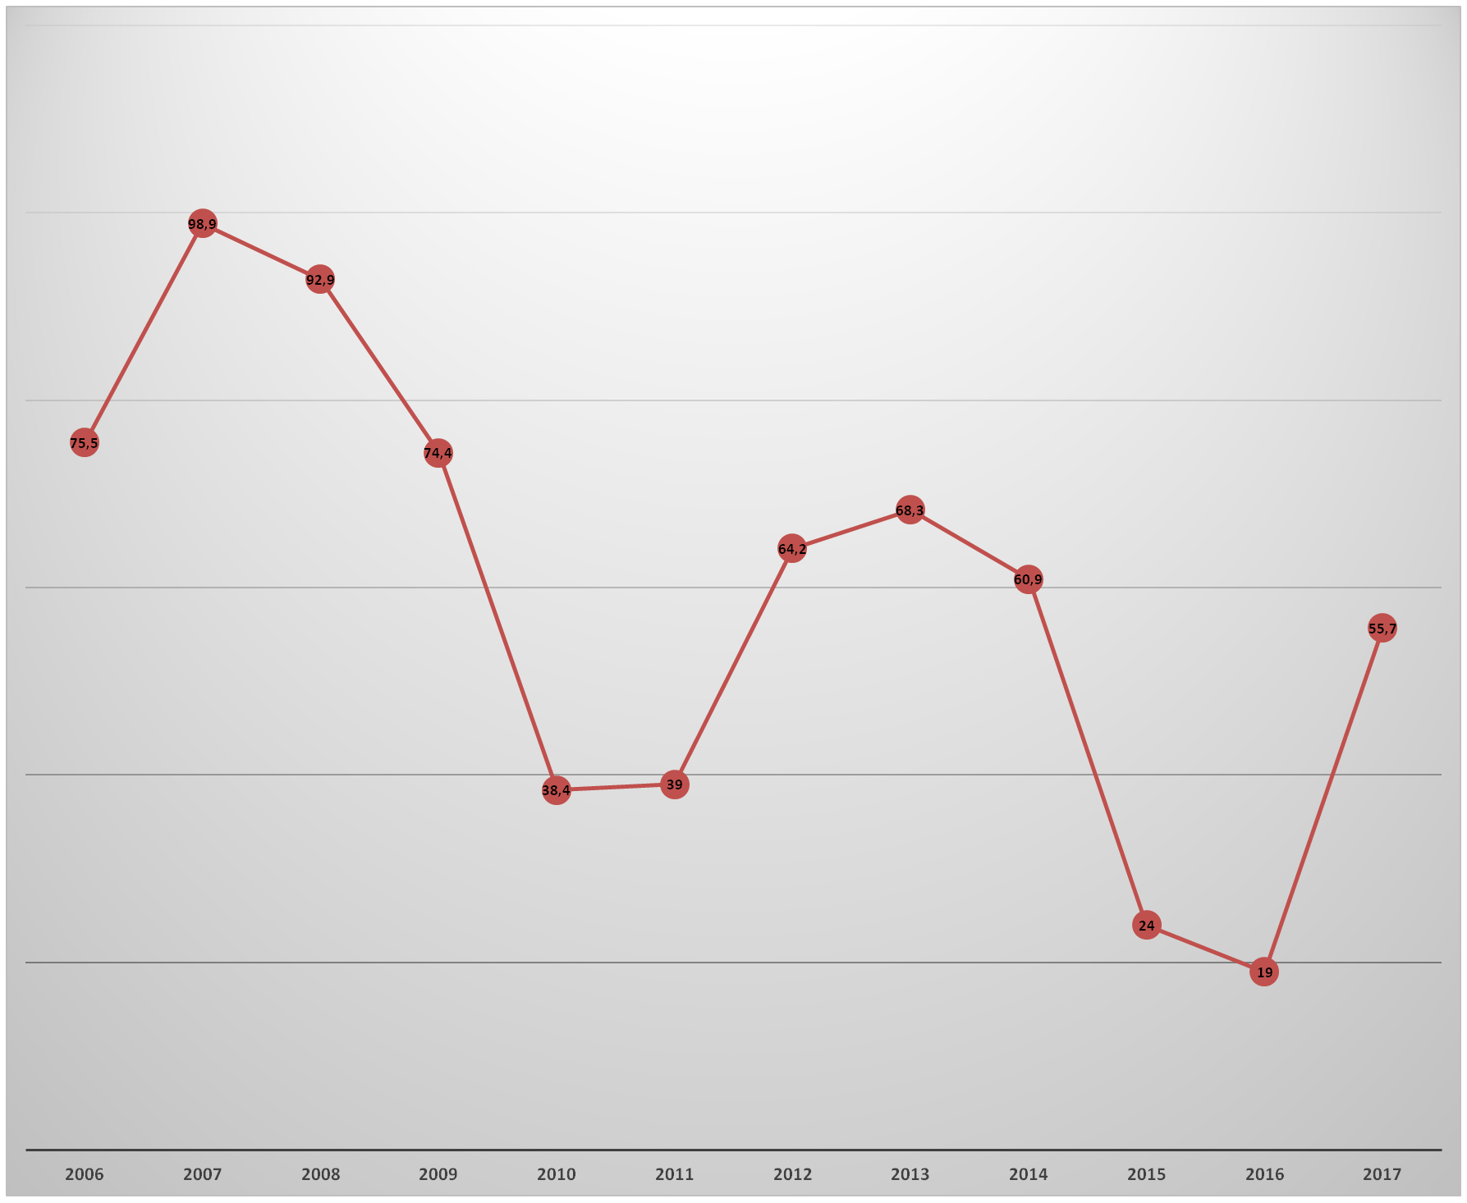
Retrospective epidemiological analysis of pertussis morbidity in Lviv Oblast in 2005-2017
Ivanchenko N.
Danylo Halytsky Lviv National Medical University, Lviv, Pecarska str., 69b, +3 (067) 162-45-84; timknat@ukr.net
RESEARCH QUESTION
Fig. 1. The dynamics of the morbidity of the pertussis
Fig. 2. The share of laboratory confirmed diagnoses
Fig. 3. % coverage by vaccination of pertussis
Pertussis is a vaccine-preventable infectious disease which remains a challenging issue for the Ukrainian healthcare system, despite the introduction of vaccination since 1956.
INTRO / BACKGROUND/
To date, pertussis outbreaks are registered in Poland, Spain, China, Australia and other countries. In 2000, European Regional Bureau of the WHO adopted the Health XXI document, which suggested reducing the incidence up to less than 1.0 cases per 100,000 population. However, current morbidity rates of pertussis in Ukraine and in Lviv Oblast far exceed the recommended level.
RESULTS/
CONCLUSIONS AND FUTURE DIRECTIONS
In Lviv Oblast, fluctuations of the incidence of pertussis were observed in 2005-2013, with interepidemic periods of 1-3 years, and thereafter there was a steady trend to the increase in the number of cases of pertussis. 72 cases of the illness with an intensive rate of 2.7 per 100 thousand population was registered in 2005; 107 cases (4.1) in 2006; 87 (3.4) in 2007; 70 (2,5) in 2008; 126 (4.96) in 2009; and only 42 cases with an intense index of 1.65 in 2010. However, in 2011, the incidence increased up to 143 cases (5.65); and in 2012 it reached 145 cases (5.7). In 2013, there was a 2.5-fold decrease to 49 cases (2.3); and in 2014 the incidence rose up to 129 cases (5.1). In 2015, 196 cases (8.0) were registered. There were 283 cases (11.23) in 2016 and 317 cases (12.55) in 2017 (Fig. 1). The distribution by age is as follows: 49% accounts for children up to 1 year, 31% for those aged 1-4 years, 11% for 5-9 years, 8% for 10-14 years, 1% for 15-17 years, 1% for 18 and over. Severe course of pertussis was observed in children under the age of 1 and in over-60s. There were 4 fatal cases in children. Bacteriological confirmation of the diagnosis for the period of 2005-2017 was noted only in 6% of cases, 15% were confirmed by serological methods, 8% by polymerase chain reaction, 71% of diagnoses were clinically established (Fig. 2). The probable difference in the number of patients depending on sex is absent. Results of the monitoring of pertussis preventive vaccination coverage in children under the age of 1 showed that 75.5% of children were vaccinated in 2006, 98.9% in 2007, 92.9% in 2008, 74.4% in 2009, 38,4% in 2010, 39.0% in 2011, 64.2% in 2012, 68.3% in 2013, 60.9% in 2014, only 24.0% in 2015, 19.4% in 2016, 55.7% in 2017 (Fig. 3).
Decrease in the coverage of pertussis prophylactic vaccination in the population of Lviv Oblast contributes to the increase in the incidence of pertussis. Wide introduction of modern diagnostic methods – polymerase chain reaction and enzyme immunoassay – will ensure timely detection and treatment of patients with pertussis.
METHODS
A retrospective epidemiological analysis of the state statistical reports, inpatient medical records of those diagnosed with pertussis who underwent medical treatment at the Lviv Oblast Clinical Hospital for the Infectious Diseases was conducted.
ACKNOWLEDGEMENTS
Thanks colleagues from Lviv Oblast Infection Diseases Hospital, doctors from Lviv Oblast laboratory center for help in treatment patients and prepearing this poster.
Notes:
Printed on A4 paper (or other sized single sheets) and mounted to board in separate panels

