Slide 1


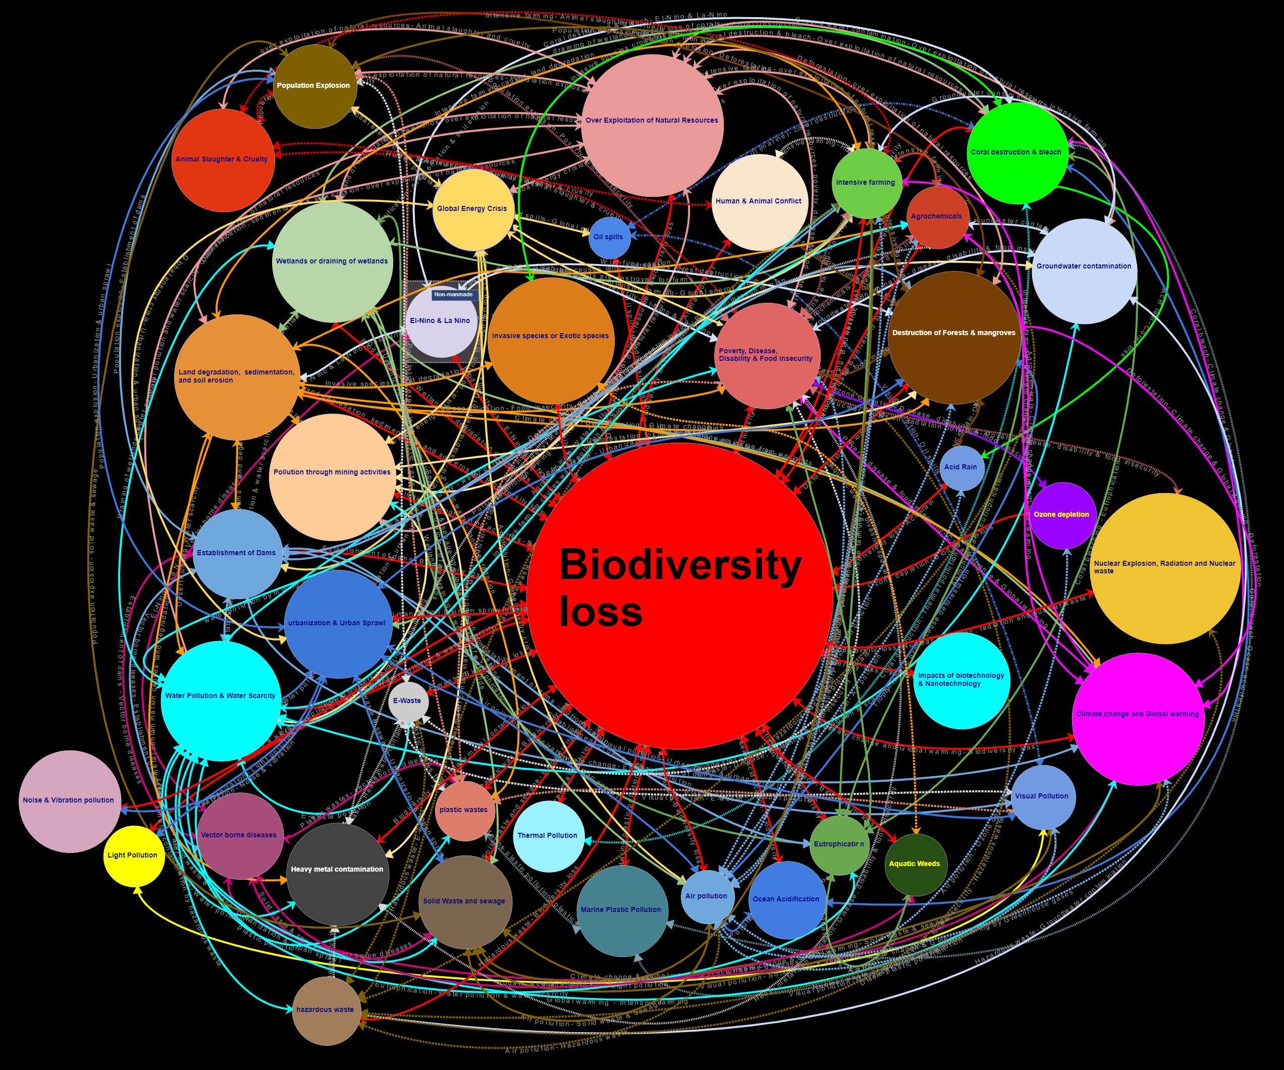
EuroSciCon Conference on Climate change
Examine the interconnected nature of the man-made environmental problems in a global prospective
Sivakumaran Sivaramanan¹ Sarath Kotagama²
1. Environmental Officer, Central Environmental Authority, “Parisarapiyasa”, 104, Denzil Kobbekaduwamawatha, Battaramulla, Sri Lanka.
2. ‘VidyaJothi’, Emeritus Professor, Department of Zoology, University of Colombo, Sri Lanka.
Abstract
Introduction
Discussion
In recent Katowice Climate Change Conference COPE 24 the United Nations secretary general António Guterres urged governments to finalize the implementation guidelines of Paris climate change agreement. Climate change is a global environmental problem with complicated outcomes. Manmade climate change is believed to be caused primarily as a result of deforestation, draining of wetlands, intensive farming and air pollution (greenhouse gas emission). Each of these problem such as air pollution is caused by intensive farming, burning of fossil fuels (due to global energy crisis), urbanization, methane emission from solid waste dumps, etc. Furthermore, the deforestation is mainly caused by increasing human population, poverty, over exploitation of natural resources, urbanization, mining minerals, intensive farming, establishment of dams, wild fires during El Niño, acid rain and global warming (cyclic as cause and effect). Furthermore, each of these manmade environmental problem such as air pollution and deforestation may cause various other environmental problems. For instance, air pollution causes ocean acidification, ozone depletion, acid rain, disease, visual pollution (smog), etc. Similarly, deforestation causes issues such as biodiversity loss, land degradation, human animal conflict, etc. Thus, it is clear that all major manmade environmental problems are interconnected (as cause and effect), and the sustainable solutions often consider breaking of key links (mitigation through eliminating the primary causes) of the problems such as, in order to mitigate eutrophication, it is possible to find temporary solution via application of coagulant chemicals, and sustainable solutions are banning agrochemicals and intensive farming techniques (removing source problems/ links). In reality, however, human adaptability factors (economic, social, behavioral, health and political) act as the barriers for finding sustainable solution in this way. Thus, application of regenerative solutions such as floating wetlands, act as a shortcut and facilitate achieving permanent solution to the problem by overcoming human adaptability factors without altering the source problem (link). Thus, regenerative solutions (shortcuts) are to be created, where sustainable solutions (removing links or mitigating causative problems) are not feasible. This phenomenon also prevents crisis of human adaptability factors such as ‘yellow vest’ movement in the future.
In order to establish permanent solutions, it is important to identify the links between man-made environmental problems (as cause and effect). Study provides means to prove such links from real world events occurred in various parts of the world. In addition, designing both sustainable solutions (link cutters) and regenerative solutions (establishing shortcuts) for the identified environmental problems are examined. However, unlike regenerative solutions sustainable solutions are vulnerable to human adaptability factors (economic, social& political).
Based on the mental map shown in fig. 1. It is possible for us to identify links and key links. Analysis were done according to following proved hypothesizes.
Hypothesis 1: Both causes and impacts of manmade environmental problems are also manmade environmental problems. Links between manmade environmental problems depict its complex nature, but it also helps us to track and establish link cutters and/or shortcuts in order to find sustainable and/or regenerative solutions, respectively.
E.g. Eutrophication caused by intensive farming / agrochemicals. Impacts of eutrophication are biodiversity loss, water pollution, loss of wetlands, neurodegenerative disease, etc. Banning agrochemicals and switching to organic farming is a sustainable solution, while establishing floating wetlands is a regenerative solution.
Hypothesis 2: There are keystone manmade environmental issues, solving keystone issues would result in the permanent solution of many linked manmade environmental problems (N.B. when environmental problems caused by more than one manmade environmental problems, their causative environmental problems cannot be considered as the keystone link).
E.g. 1. Air pollution causes global warming, ocean acidification, acid rain, ozone depletion, respiratory diseases, etc. Mitigating air pollution would stop all the resulted environmental issues. Thus, air pollution is a keystone environmental issue.
E.g. 2. Deforestation caused by intensive farming, energy crisis (oil palm) and urbanization. Mitigating or stopping intensive farming alone is not going to end the deforestation. Thus, intensive farming is not a keystone link.
Methods and Materials
This research aims to demonstrate the links between the manmade environmental problems through evidencing the links by real world examples based on theoretical sampling method, data are collected from previously published literature such as books, peer reviewed journal articles and reliable internet based sources, and implementation of both sustainable and regenerative solutions were analyzed.
Results
About 204 links (as cause and effect) between 40 manmade environmental problems (funneled based on severity) are proved with the real world examples from scientific literature (not given here). Fig. 1 depicts the world’s first mental map on interconnections between manmade environmental problems based on cause and effect relationship (please zoom to see).
Conclusions
All manmade environmental problems are linked as causes and effects. Establishing sustainable solutions (link cutters) often affected by human adaptability factors (economic, political& social). This can be overcome by regenerative solutions (creating shortcuts to the linked manmade environmental issues).
Future Directions
Future environmental problems can be discovered such as micro plastics in sea food, crisis of nuclear waste, etc. However, regenerative solutions can also create new problems. E.g. mosquitos from floating wetlands (wetlands are regenerative solution to eutrophication).
Contact Information
Figure 1.
Acknowledgements
S. Sivaramanan
Central Environmental Authority
Email: sivaramanansr@gmail.com; sivaramanansr@Hotmail.com
Website: www.envo.yolasite.com
Phone: +94 768930300
References
Thanks to Dr. Daniel Christian Wahl, my Asst. Director (SEA) Mrs. M.R. Namalie, Director (EIA) Mrs. Nilmini Attanayake, Deputy Director General (EM&A) Mrs. Kanthi de Silva, Director General of CEA Mr. P.B Hemantha Jayasinghe and all CEA staff for their support and facilitation.
This poster is an abbreviated form of an extended study. The original theses has the elaborated study with references.

