Slide 1

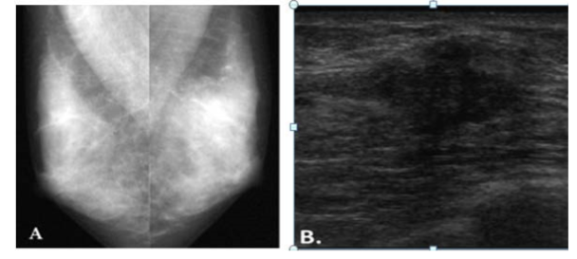
To determine the role of ultrasound as a diagnostic tool for screening of breast cancer in younger women (25-38) in Guyana.
￼
RESULTS/DISCUSSION
A total of 80 charts were reviewed, with a 95% confidence level and a CI of 9.42. The average age at which women were being screened is 33. Ultrasound showed sensitivity was 97% and the specificity 98%.
Discussion: It was noted that ultrasound was more sensitive than mammogram. Afro-Guyanese were the major ethnicity screened. Most patients had ultrasound done and both malignant and benign diseases were discovered with this modality.
BACKGROUND
Ultrasound as a diagnostic tool for the detection of breast cancer in younger women is becoming more evident. Ultrasound is used in many ways, not only as an initial diagnosis tool be for confirmation as to a pathology by performing core biopsies from the breast and staging of breast cancer. It is also combined with mammography, a procedure called sono-mammography to aid in better detection of breast cancer.
Many younger women believe that is not possible for them to have breast cancer. It was proven that this specific type of cancer is prevalent in women over 40, but it was noticed that is the past five (5) years more women between the ages 25-38 have developed breast cancer, some a bit too late. However through awareness this can be eliminated and a regular screening programme can be developed.
METHODS
The research was a qualitative retrospective study which focused on charts from the Cancer Institute of Guyana that was acquired during the period of January 2010 to December 2016. Data extracted is reflected on a data collection sheet.
AIM
To compare patient breast cancer screening methods and show the importance of ultrasound
IMAGE ANALYSIS
Mammography and ultrasound image of person with palpable left beast dense mass. mammography and ultrasound
OBJECTIVES:
How effective is the use of ultrasound in the detection of breast cancer
Create awareness about the importance of early screening in younger women
DETAILS | AMOUNT
TARGET POPULATION | 22, 184
STUDY POPULATION | 5,546
SAMPLE POPULATION | 100
CONFIDENCE LEVEL | 95 %
CONFIDENCE INTERVAL | 9.42
LITERATURE REVIEW
The physical density of breast and the patient age potentially affect the accuracy of mammography. Our results showed that age and the physical density of breast potentially affect mammogram images of women with 41 years or younger with sensitivity 66% and specificity 68%. Sensitivity improved with mammography in women older than 41 years. As a result, the diagnosis by using ultrasound alongside the mammogram are preferable imaging combination in such cases of women and considered that mammography and ultrasound the new gold standard in breast screening⁹
Using ultrasound as a first line diagnostic tool was studied by S.R.C. Benson et al. There were 796 patients with confirmed breast cancer in this study. The specificity in this case was not significant as positives on ultrasound was 710 (89%) and on mammography 706 (89%). There was 537 symptomatic patients, ultrasound positives were 497 (93%) and mammography 465 (87%)²⁸. They determined that ultrasound is significantly better than mammography for detecting invasive breast cancer (92% patients). There was a 9% increase of detection with the combination.
Image A-Mediolateral mammogram
Image does not show the mass. The breast appears white.
Image B- Ultrasound shows solid mass.
Mass has irregular shape, indistinct and angular margins.
  Histopathology revealed invasive ductal carcinoma.
CONCLUSION
Ultrasound is effective and sensitive in the diagnosis of breast cancer. It is also effective in diagnosing benign breast diseases in younger women with dense breast tissue. Ultrasound is cheaper and safer than other imaging modalities for screening and diagnosis.
The researcher is actively promoting the use of ultrasound in screening for breast diseases in younger women to increase awareness and advocacy among health care professionals on the importance and availability of ultrasound so that this tool can be more actively utilized especially among younger patients.
For additional information please contact:
[Name] Felicia Nandan
[Department] Medical Imaging
[Institution or organization] University Of Guyana
Notes:
The study showed that out of the 30 diagnosed malignancies two lesions were missed on mammography and four lesions were missed on ultrasonography. One of them was missed on both. For malignancies specificity of mammography is 93.3% and that of ultrasonography is 86.67%. Combining both the modalities specificity is near 97%. Out of total 92 abnormal breasts 12 were missed on USG and 20 were missed on mammography. Combining both the modalities only 2 lesions were missed and were diagnosed on histopathology alone, Overall specificity for USG in breast masses is 86.9% and for mammography it is 78.6%. Combining both the modalities the specificity is 97.6%. The “p” value is obtained which is highly significant for combination of ultrasonography and mammography in comparison with any individual modality (p = 0.0059 & p = 0.0001 respectively)²⁷.

