Slide 1
Automated Registration & Lineage – lib (AURELl)
Vineet Mishra | IDS

Slide 2
Agenda
Summary
Functional Description
Architecture
Use cases

Slide 3
AURELl – Summary
Asset discovery has always been a tough task
Asset, lineages and associated linkages are important part to a system and help to maintain data ecosystem
Maintain Asset life expectancy/availability
AURELl is a library extension which provides capability to fuse required possible data sources across different system

Slide 4
Functional Description
A Lightweight component which can be imported to implement the postHook hierarchy
An event is pushed for each Asset Creation/Deletion
For each event an actions schema is defined which finally rest in Kafka

Slide 5
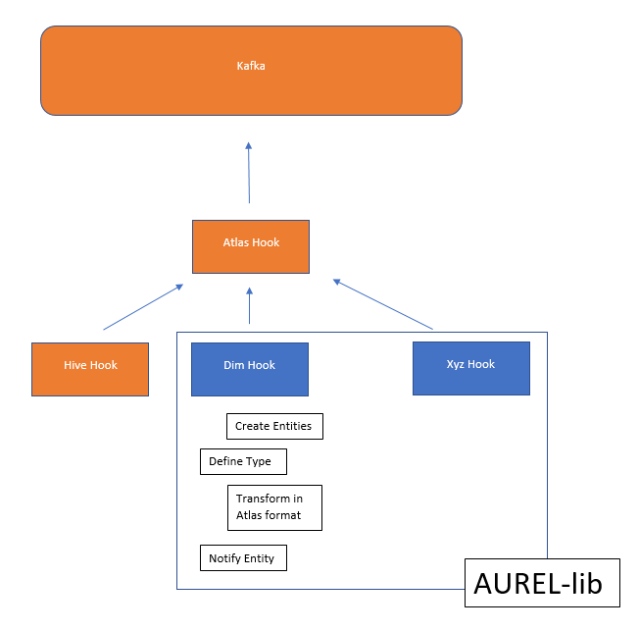
Architecture

Slide 6
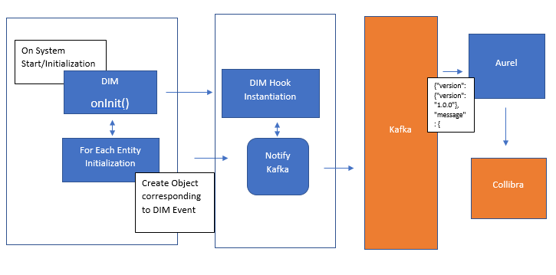
Complete Flow

Slide 7
Use Case
OCF
DIM
A few more to come. . .

