Slide 1

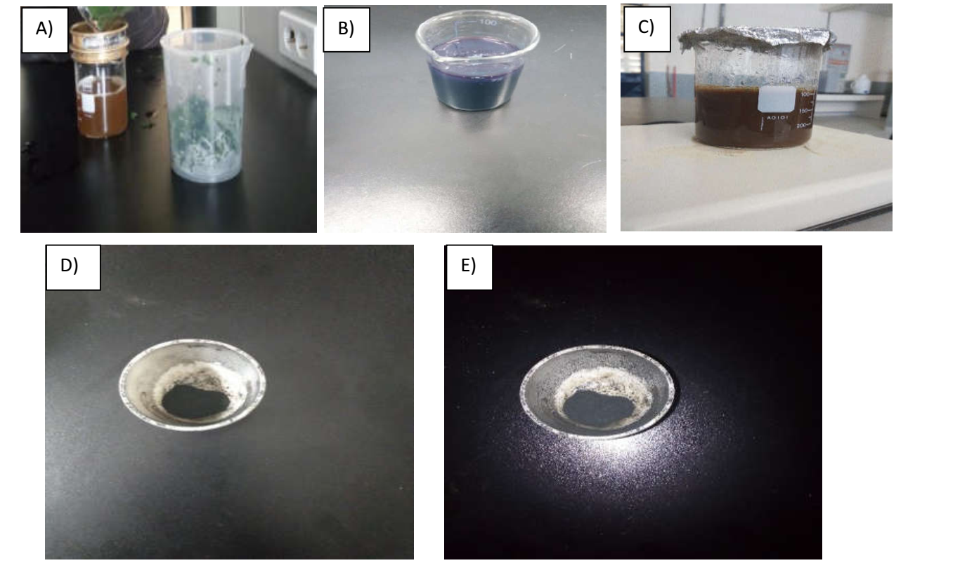
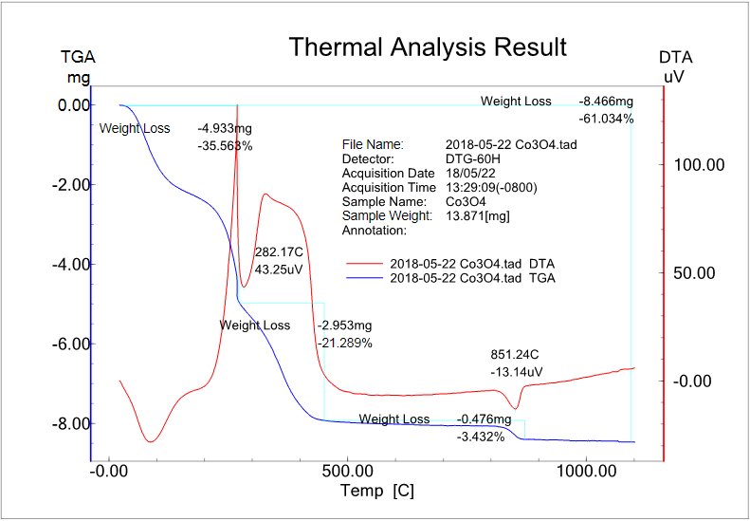

Green Synthesis and Characterization of Cobalt Oxide Nanoparticles Using Moringa Oleifera Plant Leaf Extracts
Bawoke Gete, Daniel Fikremariam, Lamesgin Liyew, Liya Mebrahtu, Setegn Geta, Yeselamfire Hailu, Yaschalew Bitew, Osman Ahmed Zelekew*
School of Mechanical, Chemical, and Materials Engineering, Department of Materials Science and Engineering, Adama Science and Technology University, Adama, Ethiopia
bawokematerial@gmail.com, Phone: +251-93892079
Abstract
Cobalt oxide nanoparticles (Co₃O₄ NPs) using Moringa oleifera leaves extract was synthesized. The resulting Co₃O₄ was characterized by TGA thermal analysis, and X-ray diffraction (XRD). The thermal decomposition temperature of the sample was determined and it was found at 450 ºC. Moreover, the crystallite sizes of the resulting cobalt oxide were also calculated by using Scherer formula. The sizes were about 23.76, 11.62, and 18.93 nm at 25, 50, and 100 ml of plant extracts, respectively. Therefore, it is possible to synthesis a cobalt oxide with cost effective and environmental friendly way by using moringa leaf extract as stabilizing agent.
Objectives of the project
Results and Discussion
    General Objective
Green synthesis and characterization of Co₃O₄ nanoparticles using aqueous Moringa Oleifera leaves extract.
Specific Objectives
To synthesize Co₃O₄ nanoparticles using aqueous Moringa Oleifera leave extracts
To characterize the synthesized Co₃O₄ nanoparticles using TGA- DTA, XRD
To study the effect of extracted concentration on the Co₃O₄ crystallite size.
Experimental Methods
Figure 1. A) Plant extract, B) Plant extract + precursor, C) Precursor without plant extract, D) Powders formed with annealing, E) Powder formed without annealing.
Chemicals and instruments
Cobalt nitrate [Co(NO₃)₂·6H₂O], sodium hydroxide (NaOH), Distilled water, Ethanol, Moringa Oliefera plant extract, XRD, Oven, Magnetic stirrer, furnace, funnel, filter paper, 150, Spoon, Differential Thermal Gravitometry (DTG), Bickers, Ceramic crucible.
Experimental procedure
Plant leaves were collected and washed with distilled water.
The plant leaf was boiled with hot plate under continuous
stirring until a green color was appeared.
Cobalt nitrate was added to each bicker containing boiled plant
extract having 25 , 50 and 100 ml of plant extract under
continuous stirring.
Then, 1M NaOH (5 droplets) were added to form precipitate
The resulting precipitates were filtered, washed , and dried at
100 ºC for 13 hr in the oven.
Characterizations
Thermal Gravimetric Analysis (TGA) characterization was
performed under the temperature range of room temperature to
1100 ⁰C .
The samples were annealed at 450 ºC .
XRD analysis was performed to identify the phases and
structure of the materials
Figure 2. TGA analysis result of the powder.
Conclusions
Figure 3. XRD patterns of as prepared sample, 25-Co₃O₄, 50-Co₃O₄, and 50-Co₃O₄.
Cobalt oxide (Co₃O₄) nanoparticles were successfully synthesized by using a green synthetic method form Moringa Oleifera extracts. For the resulting cobalt oxide, the smaller crystallite size was found at 50ml (volume of extract). However, the larger crystallite sizes of the Co₃O₄ were obtained at 25 and 100 ml of plant extracts. Therefore, a more preferable size at 50 ml of extract is recommended for different applications such as better antibacterial application, catalytic activity, and thin film solar cell absorber.
Acknowledgments
We acknowledged our advisor, Dr. Osman Ahmed for all of his help and guidance, critical reading, commitment, encouragement, suggestions and constructive criticisms in the project work. We would like to thank Mr. Demeke for helping us in operating the XRD and TG analysis. Finally, we would like to acknowledge Adama Science and Technology University, Department of Material Science and Engineering for providing materials and chemicals for our project.

