Slide 1

Dr. Moataz MAHRAN
B.D.S, M.S.C ENDODONTICS AIH SHAMS UNIVERSITY CAIRO, EGYPT.
HEAD OF DEPARTMENT OF ENDODONTICS MAGRABI DENTAL CENTER,JEDDAH, SAUDIARABIA.
MEMBER OF THE BRITISH ENDODONTIC SOCIETY.
MEMBER OF THE EUROPEAN ENDODONTIC SOCIETY.
IRISH DENTAL COUNCIL REGISTERED.

Slide 2
TEMPERATURE CHANGE ON THE External ROOT SURFACE DURING ULTRASONIC REMOVAL OF BROKEN INSTRUMENT.

Slide 3
Success of endodontic treatment depends on different phases:
Access Cavity preparation
Cleaning and Shaping
Obturation
Coronal restoration

Slide 4
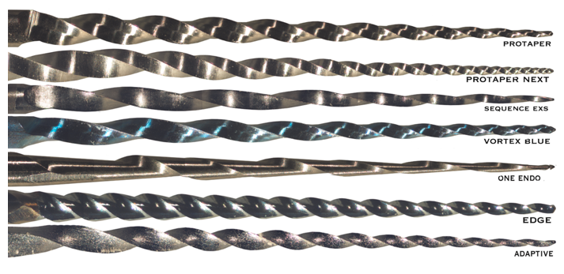
Cleaning and shaping can be performed by different intracanal rotary and hand instruments.

Slide 5
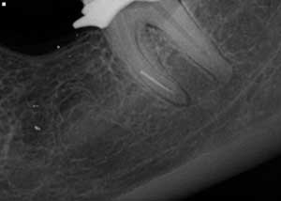
Intra-canal instrument separation, a common mishap owing to the limited flexibility and strength of instruments, a mishap that can jeopardize the whole treatment procedure and affect the prognosis immensely.

Slide 6
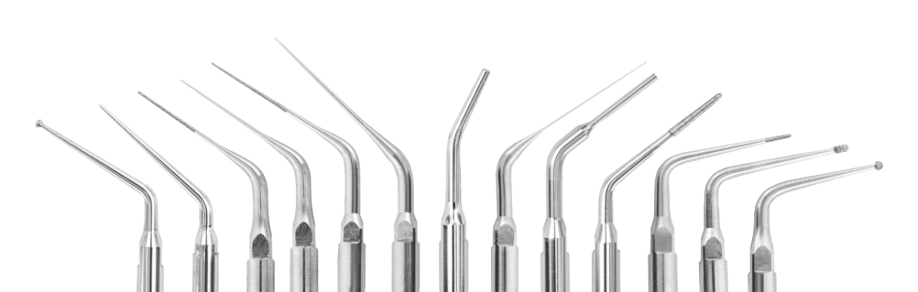
Ultrasonic tips are one of the most successful approaches used nowadays to retrieve the separated instruments

Slide 7
Many studies were carried out to detect the amount of heat generated on the external root surface during post removal.
Few studies were performed to detect the amount of heat generated during broken instrument removal.

Slide 8
The aim of this study was to:
Measure the amount of heat generated on the external root surface during broken instrument removal using different types of ultrasonic tips with different power and time settings.
Investigate the relation between the heat generated on the external root surface and the remaining dentin thickness.

Slide 9
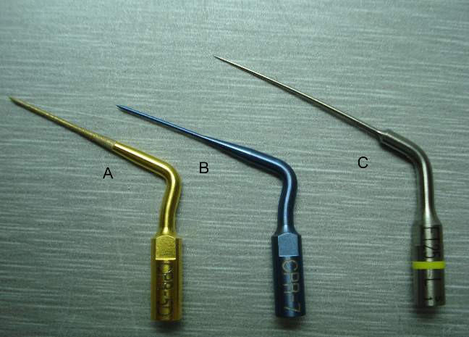
A-CPR5 B-CPR 7 C-ET 25

Slide 10
Classification of samples:
The sixty samples used in this study were classified into three equal groups according to the type of tips used.
Group I :20 samples where CPR5 ultrasonic tips were used.
Group II :20 samples where CPR7 ultrasonic tips were used.
Group III :20 samples where ET25 ultrasonic tips were used.

Slide 11
Every group was further subdivided into two equal subgroups according to the power settings
Subgroup A: power setting 1
Subgroup B: power setting 5

Slide 12
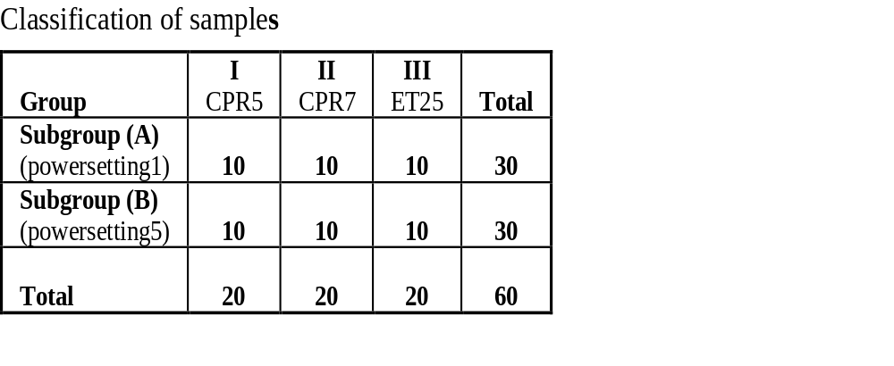

Slide 13
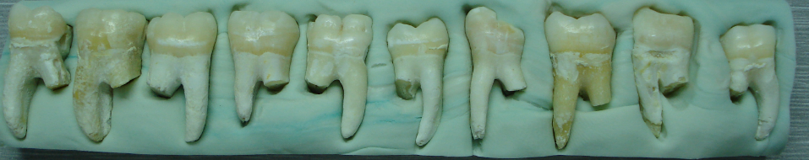
Rubber base indices of the teeth fixed to a flat tray

Slide 14
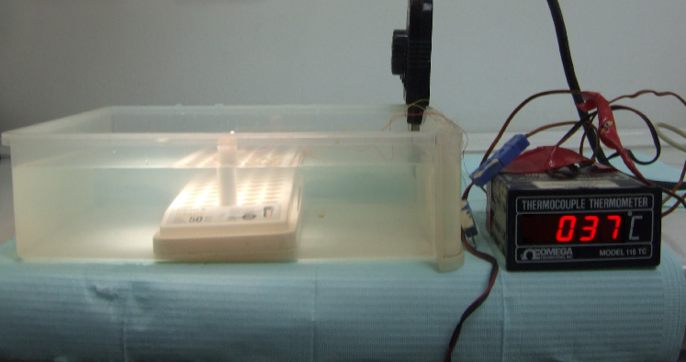
Thermocouple device connected to the prepared sample embedded in eppendorf tube placed in a water bath.

Slide 15
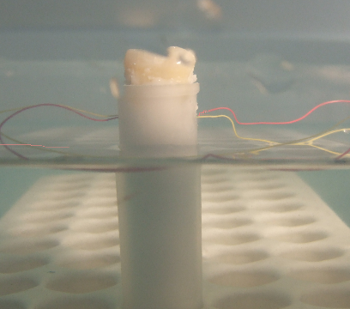

Slide 16
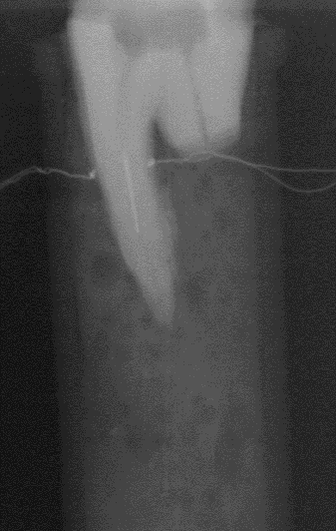
Digital radiograph showing two thermocouples connected to the external root surface opposite to the Coronal end of the separated

Slide 17
Methods of evaluation:
1-Evaluation of the amount of heat generated on the external root surface during broken instrument removal:
Every tip in each of the three groups was evaluated for the amount of heat it produced on the external root surface during broken instrument removal at power1 and power 5 every 30 seconds for a total of 5 minutes using mobile phone stopwatch
2- Evaluation of the root canal remaining dentin thickness:
Teeth were scanned by a computed tomography scanner (before and after the heat measurement on the external root surface).The distances from canal wall to the root surface at the most coronal section of the fractured file were measured at the mesial, distal, dentin sides of each root by CT-analyzer. The average thicknesses of the cut-planes were calculated for each side separately.

Slide 18
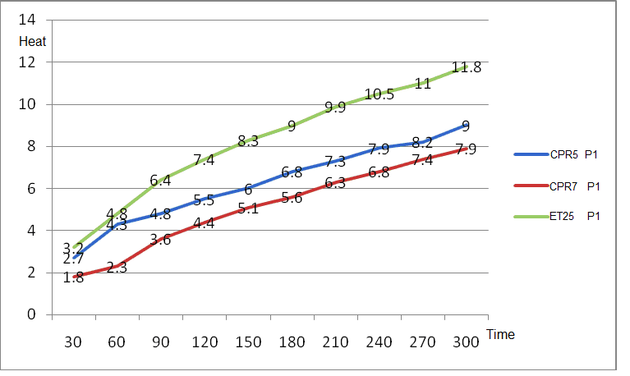
Linear correlation between time and heat generation of CPR5, CPR7 and ET25, at power 1 showing temperature rise at 30 seconds for a total time of 5 minutes.

Slide 19
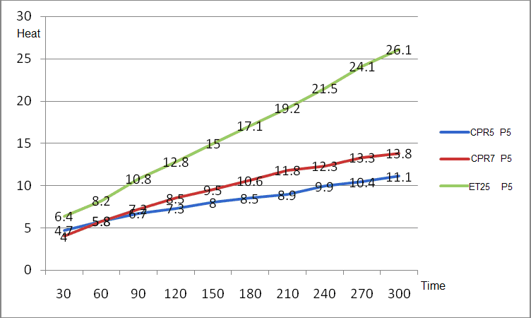
linear correlation between time and heat generation of CPR5, CPR7 and ET25, at power 5 showing temperature rise at 30 seconds for a total time of 5 minutes.

Slide 20
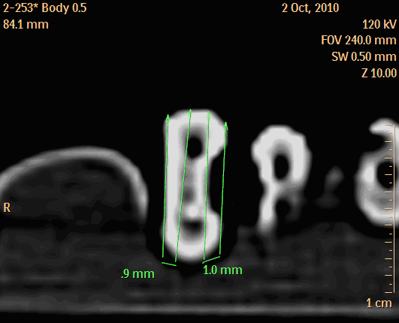
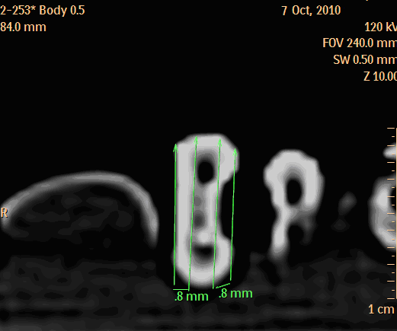
preoperative dentin thickness. postoperative dentin thickness.

Slide 21
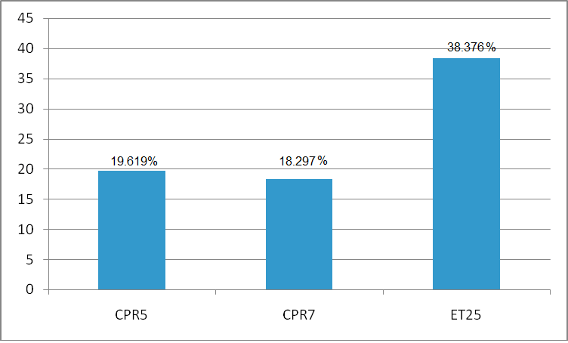
Histogram showing the percentages of lost mesial dentin caused by CPR5, CPR7 and ET25 at power 1.

Slide 22
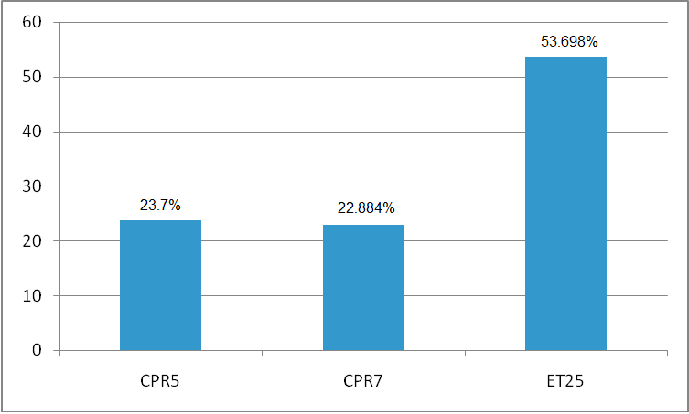
Histogram showing the percentages of lost mesial dentin caused by CPR5, CPR7 and ET25 at power 5.

Slide 23
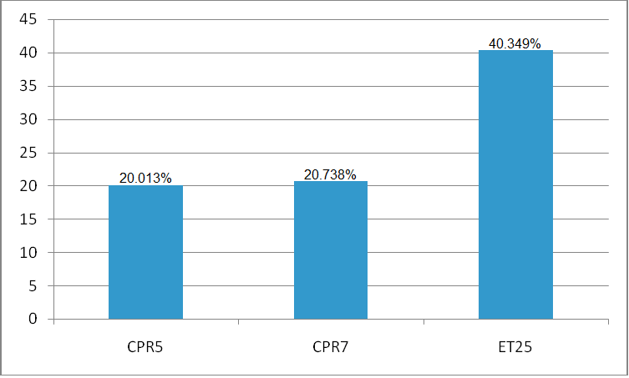
Histogram showing the percentages of lost distal dentin caused by CPR5, CPR7 and ET25 at power 1.

Slide 24
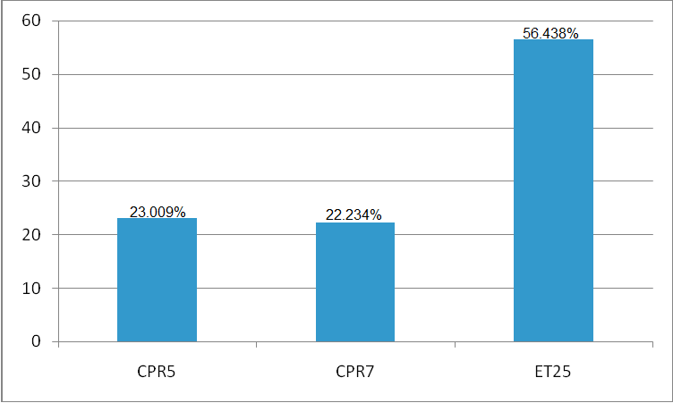
Histogram showing the percentages of lost distal dentin caused by CPR5, CPR7 and ET25 at power 5.

Slide 25
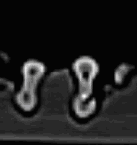
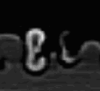
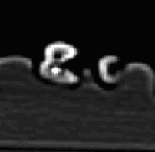
3 samples of group 3 (ET25) with perforations in distal wall.

Slide 26
Conclusions
1-The assembly used in the study proved to be efficient in measuring the external root surface temperature in situation simulating clinical conditions.
2-The material of the tips, the time of application and the power intensity affected both the amount of heat generated and the amount of removed dentin.
3-The size of the ultrasonic tips may be an influencing factor that affects the amount of the remaining mesial and distal dentin thickness.
4-There is a potential risk of root perforation during the use of the ultrasonic tips

Slide 27
Clinical recommendations
CPR5 ultrasonic tips at power 1 can be used safety up to 300 seconds of continues vibration.
CPR5 ultrasonic tips at power 5 can be used safely up to 240 seconds of continues vibration
CPR7 ultrasonic tips at power 1 can be used safety up to 300 seconds of continues vibration.
CPR7 ultrasonic tips at power 5 can be used safety up to 150 seconds of continues vibration.
ET25 ultrasonic tips at power 1 can be used safety up to 210 seconds of continues vibration
ET25 ultrasonic tips at power 5 can be used safety up to 60 seconds of continues vibration.

Slide 28
THANK YOU

