Slide 1




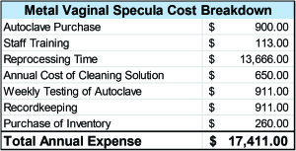
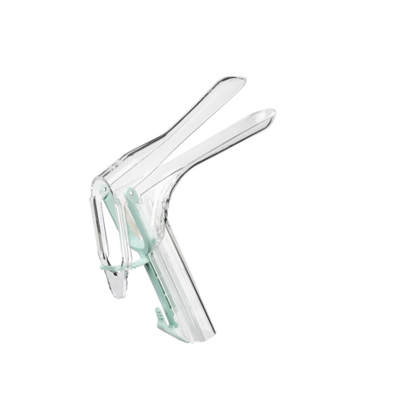
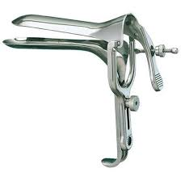
Metal vs Plastic Speculums in Teaching the Pelvic Exam
REPLACE THIS BOX WITH YOUR ORGANIZATION’S
HIGH RESOLUTION LOGO
REPLACE THIS BOX WITH YOUR ORGANATION’S
HIGH RESOLUTION LOGO
Mary Showstark, M.S., PA-C
Introduction
Methods and Materials
Results
Discussion
There are many studies that look at positioning of the patient but none address patient comfort between utilizing a metal and plastic speculum¹; and furthermore, there are no studies that address whether or not when teaching physician assistant students the pelvic exam is it easier to perform with metal vs plastic speculums. There are studies that suggest using a sheathed plastic speculum may help visualization.² There are also studies that state do not utilize foot rests for the exam due to patient discomfort, but whether or not that comfort is due to the foot positioning or the insertion of the speculum is unclear.^{3,4} There is also the question to whether or not being able to visualize the cervix is due to the light source being held at a 45 degree angle or a torch not aimed directly at the cervix.³
Many women feel anxious and powerless with pelvic examination¹, so training students to be able to perform the pelvic exam quickly and efficiently is key. With this study, we utilized Gynecological Training Associates (GTAs).
Would teaching students to be able to use plastic vs metal make a difference and if there was a preference for ease of use, would that make the exam less uncomfortable for future patient encounter? This immediate study aims to examine whether or not students found metal vs plastic speculums easier to use on (GTAs).
Forty-one students with Yale University Online PA Program trained on Gynecological Training Associates (GTAs) using metal and plastic speculums.
The GTAs brought their own metal speculums and each was trained on how to use and had previously had experience instructing with metal speculums.
The GTAs were supplied plastic speculums and each was trained on how to use and had previously had experience instructing with plastic speculums.
The students gave feedback of one vs the other and ease of use.
The GTAs are paid and do not have a conflict of interest with the study.
Welch Allyn supplied the plastic speculums in small and medium for the GTAs preference.
Formalized IRB was implemented and Office of Collaborative Projects at Yale was notified between the joint venture with Welch Allyn
Welch Allyn model number 59000-LED( S) and 59001-LED (M) were used
The study participant breakdown was as follows: 65% Female, 34% male
Plastic Speculum Ease of Use: 29% strongly agreed, 27% agree, 7% somewhat agree, 5% neither agree or disagree, 22% somewhat disagree, 7% disagree, 2% strongly disagree. Total Agree 64%; Total Disagree 31%
Metal Speculums Ease of Use: 27% strongly agree, 32% agree, 17% somewhat agree, 7% neither agree or disagree, 7% somewhat disagree, 5% disagree, 5% strongly disagree; Total Agree 76%; Total Disagree 17%
I have used metal speculums before 1/41 students (2.4%)s
I have used plastic speculums before 5/41 students: 12%
I have performed a pelvic exam before this immersion 5/41 students: 12%
I have performed how many pelvic exams excluding this training experience on average less than 5 with one student performing 20
I have used metal speculums in the past_times 1/41 (2.4%) students with one student using 18 times
I have used plastic speculums in the past_times 5/41 students (12%) on average 5 or less
Many students commented on the fact that they thought the plastic speculums were harmful to the environment.
Reprocessing a metal speculum actually requires the use of strong detergents and solvents that are environmentally unfriendly. Ethylene oxide, a potentially mutagenic chemical known by the International Agency for Research on Cancer, as a proven carcinogen or sporicidal disinfectants are used during the sterilization process. Facilities that reuse devices like vaginal specula often release persistent bioaccumulative toxins during the incineration of medical chemical waste. Bleach, for example, can contain mercury, which is harmful to both wildlife and humans.⁵
Reusable devices also require repackaging. This produces more plastic waste than single-use products, because the secondary wrapping is heavier than packaging for a disposable device. For a practice that does approximately 75 pelvic exams a week, the cost for single-use vaginal specula with built-in light source is just over $10,000 dollars each year.⁵
There are no set industry standards for speculae size, and manufacturers vary in their categorization. As a general principle, the wider the speculum, the greater the potential for patient discomfort in speculum insertion and opening, whereas the narrower the speculum, the more limited the visualization.¹
Many of the students found the plastic difficult to use not fully grasping the “locking mechanisms”; however, they liked the light source. Students commented that they thought the metal was easier to use but “barbaric and cold” and possibly more uncomfortable for the patient making “metal noises,” and had “many screws.”
Plastic | Metal
The light and ease of locking/unlocking made this very easy to use. It needs to align better. | thought this was the easiest type of speculum to use
Easier to use, but I wish they were not so hard on the environment. | I preferred them to the plastic. They seemed sturdier and like they were less likely to malfunction and accidentally close on the patients cervix.
I thought it was the easiest to use. | Much more control and consistency locating the cervix compared to lighter models.
Although I think plastic speculums were easier to use, the whole experience with the teaching assistant was not good | It was more sturdy so I thought it was easier to use
The plastic speculums were easy to insert and open/lock, but provided a smaller visual field. | I liked the variable positioning with the metal speculum, whereas with the plastic there were set distances it could be opened.
Super easy to get the cervix in view. Quicker to expand speculum.
Was easy but harder than metal
Much easier to use and loved the light that was built in
Plastic | Metal
They were difficult to close before removing the speculum. | Cumbersome and more difficult to insert and view cervix
adjustments were awkward | The locking mechanism and lack of light made this much harder to use.
Difficult to click into place and difficult to remove | It felt as if I was pinching the patient with these.
There were so many clips and things to adjust, took a lot more effort and practice than the metal one | I did not like the process necessary for opening and closing it.
Was more difficult. More room for user error | It seemed more uncomfortable for the patient
 | Difficult to screw the pieces into place
 | The metal speculums were hard to keep shut when inserting, and difficult to "lock" once in place. However, they provided a wider visual field.
About The Yale PA Online Program
The Yale online learning experience includes lectures that are studio recorded for high quality, weekly live class sessions in a virtual classroom, as well as opportunities to collaborate with peers and connect with instructors.
The blended learning experience combines online coursework, live online small group sessions, in-person clinical experiences, and on-campus immersions.
The curriculum focuses on problem-based learning.
The clinical mentoring experience can take place in the student’s own community.
The students return to Yale University for two scheduled immersions.
The second immersion in December is one week. Here is where students learn technical skills and are practicing practical skills for their clinical rotations. We chose to work with Gynecological Training Associates. These training associates were asked to train the students with both metal and Welch Allyn plastic speculums.
Ease of Use as reported by trainees
Conclusions
We did not evaluate comfort between metal vs plastic for GTAs. We wished to analyze which was easier to use for the students. If we can teach students to perform the exam seamlessly, with a speculum of choice, then hopefully, they will identify their patient’s cervix and their patients’ exams will be quicker and less uncomfortable. If a student is able to use a plastic speculum to visualize the cervix quicker and easier then we recommend that be the choice for them going forward in practice if they are able to request such in their clinic.
Other factors, such as student fear practicing on GTAs first and not a mannequin may exist as well as demonstrated in Pugh’s 2009 study.⁶ Further research needs to be done with training students and with a larger ‘N.’
Figure 3. Ease of Use Comparison Histogram
Figure1. Plastic Speculum Example
Figure 2.Metal Speculum Example
Table 1: Ease to Operate/Durability
Table 2: Common difficulties with each Type
Table 3: Cost Breakdown: Metal Speculums
Contact
References
Mary Showstark
Yale University Online Physician Assistant Program
Email: mary.showstark@yale.edu
Website: https://paonline.yale.edu
Bates, C.K., Carroll, N. & Potter. The Challenging Pelvic Exam. J. J GEN INTERN MED (2011) 26: 651. https://doi.org/10.1007/s11606-010-1610-8.
Hill DA, Hill DA, Cacciatore ML, Lamvu G. Sheathed versus standard speculum for visualization of the cervix. International journal of gynecology and obstetrics. 2014;125(2):116-120. doi: 10.1016/j.ijgo.2013.10.025.
Panayotidis C. Vaginal examination, have we forgotten the basics? European Clinics in Obstetrics and Gynaecology. 11/01/2007;3(2):103-110. doi: 10.1007/s11296-007-0071-z.
Seehusen DA, Johnson DR, Earwood JS, et al. Improving women's experience during speculum examinations at routine gynaecological visits: randomised clinical trial. BMJ. 2006;333(7560):171.
https://obpmedical.com/vaginal-speculum-single-use-vs-reusable/
Pugh, C. Fear of Causing Harm: Use of Mannequin-Based Simulation to Decrease Student Anxiety Prior to Interacting With Female Teaching Associates Teaching and Learning in Medicine, 4/15/2009, ISSN: 1040-1334, Volume 21, Issue 2, p. 116.

